Slide 1
PowerPointLabs Test Cases
General instructions:
DO NOT SAVE these slides after testing. Keep this file in its original form.
If your result is different from the expected output, please submit a bug report (attach slides/screenshots as necessary).

Slide 2
Zoom To Area
Additional instructions:
Select the BLUE color shape.
Click “Zoom To Area” button in the ribbon.
Compare the result with the expected output.

Slide 3
Zoom to Area:: Single Shape

Slide 4
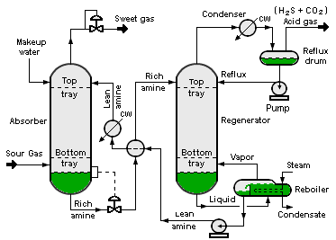

Slide 5
Zoom Shape 1

Slide 6
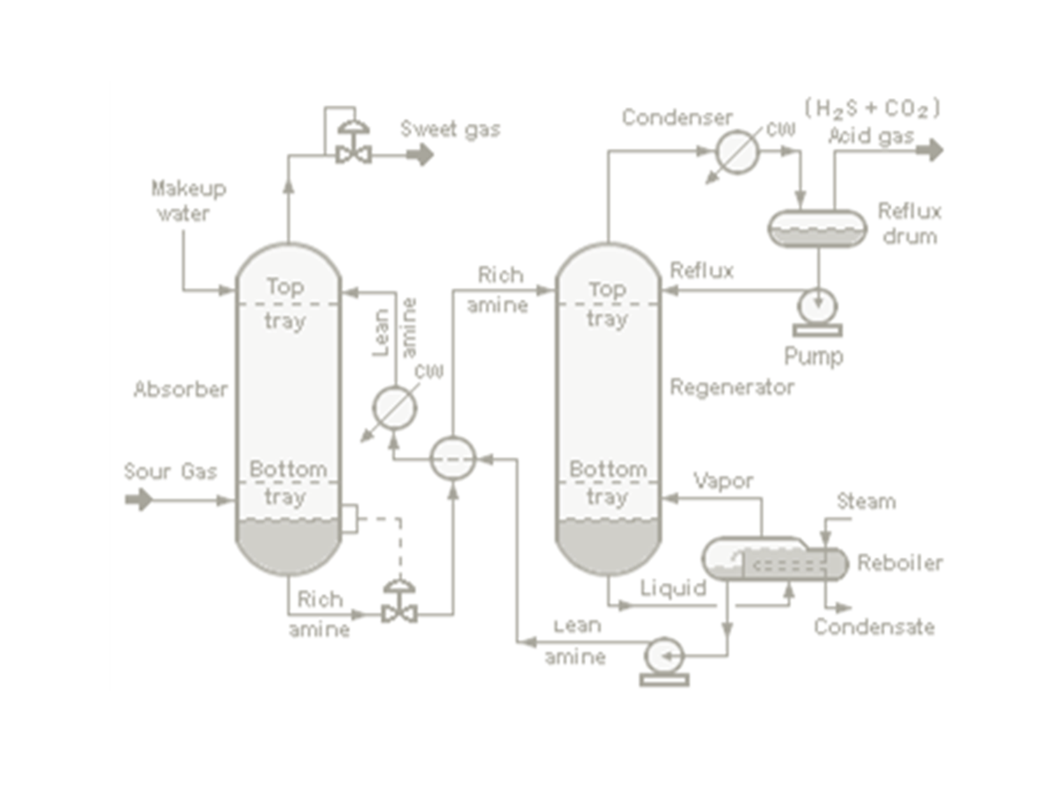


Slide 9
Zoom to Area:: Multiple Shapes
Select all blue rectangles sequentially.

Slide 10

2
1
TEXT IN SLIDE
3
4

Slide 11
Zoom Shape 1
Zoom Shape 2
2
Zoom Shape 3
1
TEXT IN SLIDE
3
Zoom Shape 4
4

Slide 12
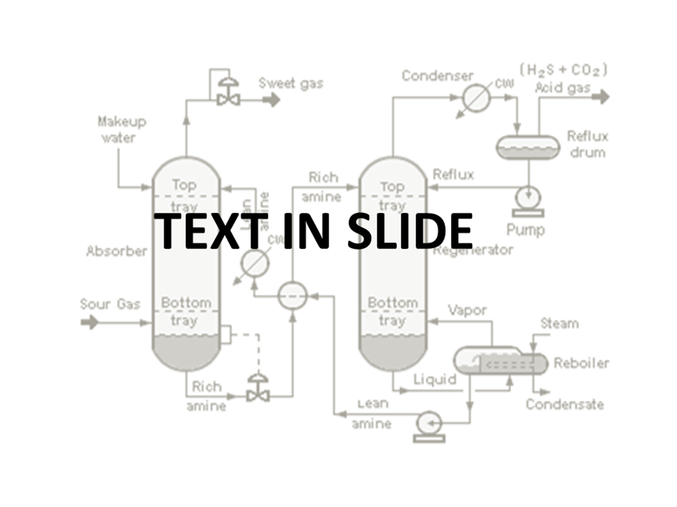
TEXT IN SLIDE

Slide 20
TEXT IN SLIDE

Slide 21
