Slide 1
PowerPointLabs Test Cases
General instructions:
DO NOT SAVE these slides after testing. Keep this file in its original form.
If your result is different from the expected output, please submit a bug report (attach slides/screenshots as necessary).

Slide 2
Rotate Slightly
Additional instructions:
Select the Shape/Shapes.
Click PositionsLab Ribbon button.
Apply Rotate Clockwise, Rotate Anti-Clockwise to the Shape/Shapes
Compare the result with the expected output.

Slide 3

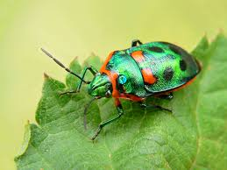

Slide 4
Rotate Slightly:: Clockwise

Slide 6
Rotate Slightly:: Anti-Clockwise

Slide 8
