Slide 1
PowerPointLabs Test Cases
General instructions:
DO NOT SAVE these slides after testing. Keep this file in its original form.
If your result is different from the expected output, please submit a bug report (attach slides/screenshots as necessary).

Slide 2
Auto Zoom
Additional instructions:
Select the BLUE color Rectangle shape(s).
Click “Drill Down” or “Step Back” button in the ribbon.
Compare the result with the expected output.
Also try tweaking these:
Include Slide Background
Put All Zoom Effects on Separate Slides

Slide 3
Auto Zoom:: Simple Zoom In (Drill Down)
Enable slide background in AutoZoom settings

Slide 4
Drill Down

Slide 5
Blah blah
Blah blah
Blah blah

Slide 6
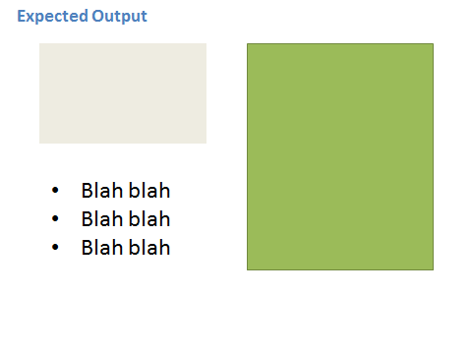

Slide 7
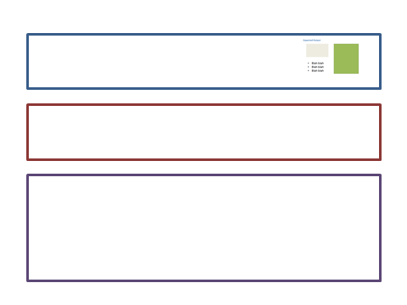


Slide 8
Expected Output
Blah blah
Blah blah
Blah blah

Slide 9
Auto Zoom:: Simple Zoom In (Drill Down)
Disable slide background in AutoZoom settings

Slide 10
Drill Down

Slide 11
Blah blah
Blah blah
Blah blah

Slide 12


Slide 13

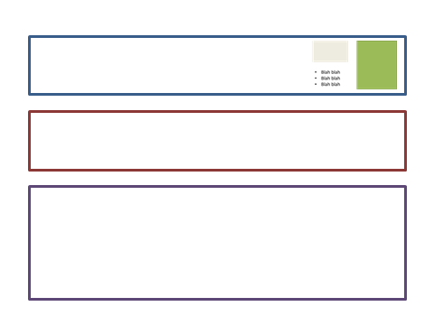

Slide 14
Blah blah
Blah blah
Blah blah

Slide 15
Auto Zoom:: Simple Zoom Out (Step Back)
Enable slide background in AutoZoom settings

Slide 16
Blah blah
Blah blah
Blah blah

Slide 17
Step Back

Slide 18
Blah blah
Blah blah
Blah blah

Slide 19

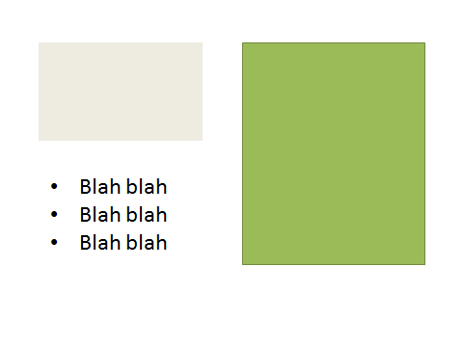

Slide 21
Auto Zoom:: Simple Zoom Out (Step Back)
Disable slide background in AutoZoom settings

Slide 22
Blah blah
Blah blah
Blah blah

Slide 23
Step Back

Slide 24
Blah blah
Blah blah
Blah blah

Slide 25


Slide 27
Auto Zoom:: Errrors
1) Move slide 16 to the end of the presentation. Attempt to Drill down. This should cause an error.
2) Move the slide to the start of the presentation. Attempt to Step back. This should also cause an error.

Slide 28
Zoom Shape

Slide 29
