Slide 1
PowerPointLabs Test Cases
General instructions:
DO NOT SAVE these slides after testing. Keep this file in its original form.
If your result is different from the expected output, please submit a bug report (attach slides/screenshots as necessary).

Slide 2
Auto Zoom
Additional instructions:
Select the BLUE color Rectangle shape(s).
Click “Drill Down” or “Step Back” button in the ribbon.
Compare the result with the expected output.
Also try tweaking these:
Include Slide Background
Put All Zoom Effects on Separate Slides

Slide 3
Auto Zoom:: Simple Zoom In (Drill Down)

Slide 4
Drill Down

Slide 5
Blah blah
Blah blah
Blah blah

Slide 6
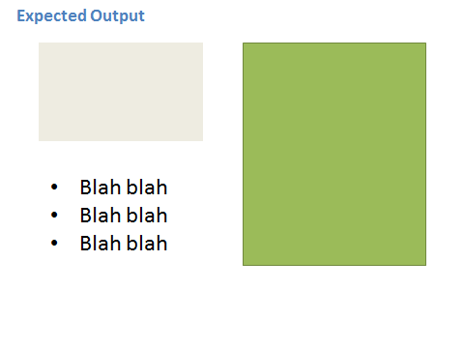

Slide 7
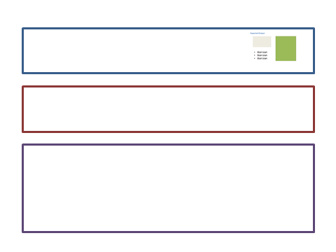


Slide 8
Expected Output
Blah blah
Blah blah
Blah blah

Slide 9
Auto Zoom:: Simple Zoom Out (Step Back)

Slide 10
Blah blah
Blah blah
Blah blah

Slide 11
Step Back

Slide 12
Blah blah
Blah blah
Blah blah

Slide 13

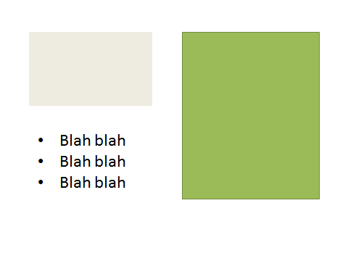

Slide 15
Auto Zoom:: Errrors
1) Move slide 16 to the end of the presentation. Attempt to Drill down. This should cause an error.
2) Move the slide to the start of the presentation. Attempt to Step back. This should also cause an error.

Slide 16
Zoom Shape

Slide 17
