Slide 1
PowerPointLabs Test Cases
General instructions:
DO NOT SAVE these slides after testing. Keep this file in its original form.
If your result is different from the expected output, please submit a bug report (attach slides/screenshots as necessary).

Slide 2
Auto Zoom
Additional instructions:
Select the BLUE color Rectangle shape(s).
Click “Drill Down” or “Step Back” button in the ribbon.
Compare the result with the expected output.
Also try tweaking these:
Include Slide Background
Put All Zoom Effects on Separate Slides

Slide 3
Auto Zoom:: Simple Zoom In (Drill Down)

Slide 4
Drill Down

Slide 5
Blah blah
Blah blah
Blah blah

Slide 6
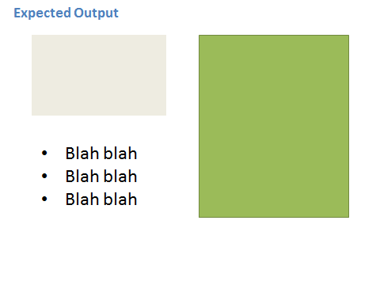

Slide 7
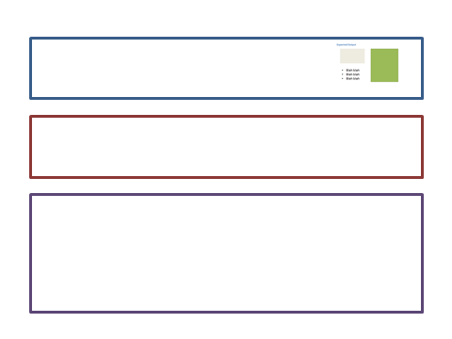


Slide 8
Expected Output
Blah blah
Blah blah
Blah blah

Slide 9
Auto Zoom:: Simple Zoom Out (Step Back)

Slide 10
Blah blah
Blah blah
Blah blah

Slide 11
Step Back

Slide 12
Blah blah
Blah blah
Blah blah

Slide 13

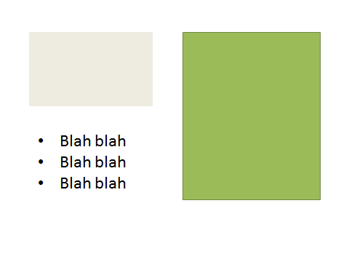

Slide 15
