Slide 1
PowerPointLabs Test Cases
General instructions:
DO NOT SAVE these slides after testing. Keep this file in its original form.
If your result is different from the expected output, please submit a bug report (attach slides/screenshots as necessary).

Slide 2
Zoom To Area
Additional instructions:
Select the BLUE color shape.
Click “Zoom To Area” button in the ribbon.
Compare the result with the expected output.

Slide 3
Zoom to Area:: normal case

Slide 4
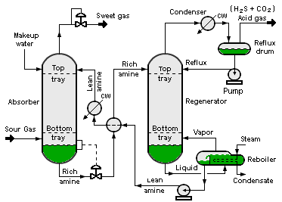

Slide 5
Zoom Shape 1
Expected output

Slide 6
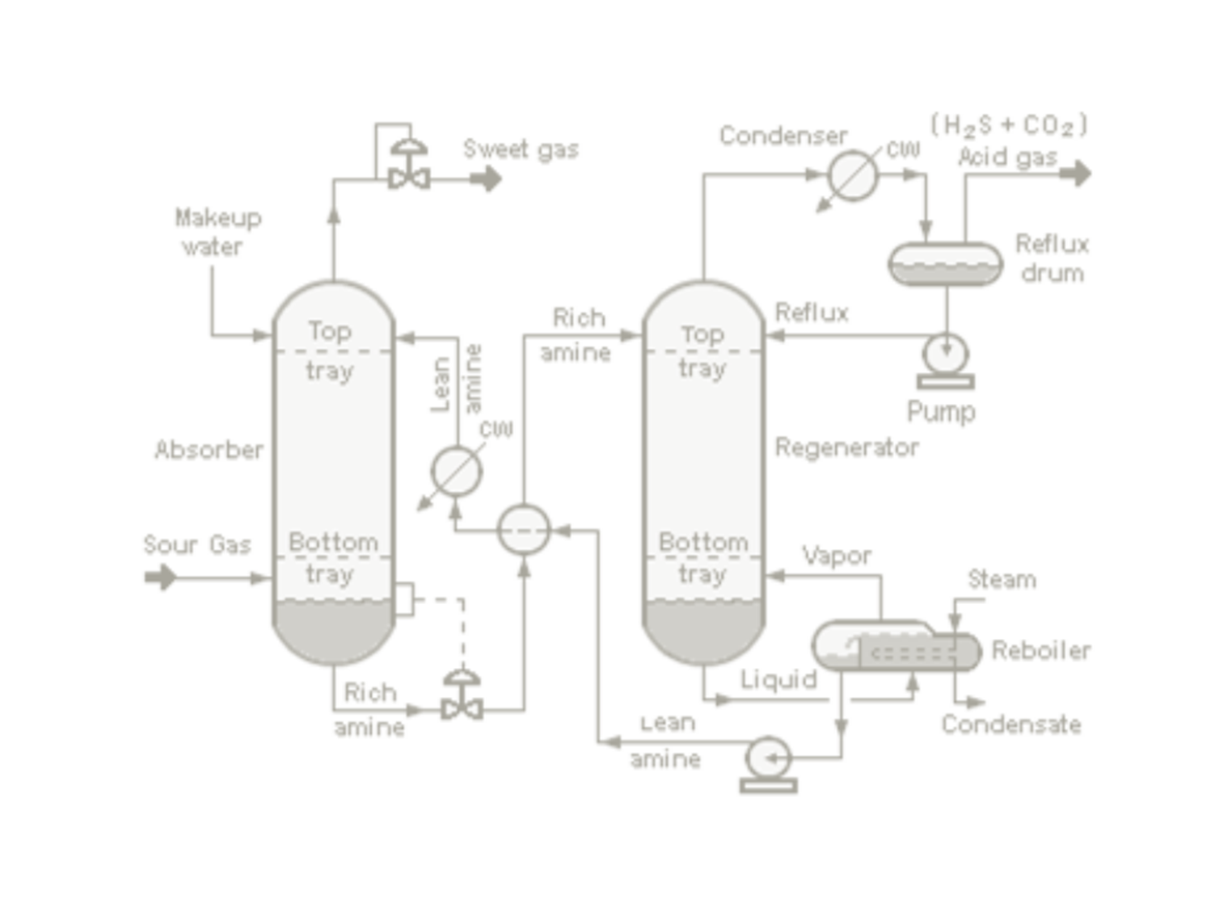


Expected output

Slide 7
Zoom to Area:: zoom and pan, shapes with same name
Select all blue rectangles sequentially.

Slide 8
1
2
3

Slide 9
Zoom Shape 1
Zoom Shape 2
Zoom Shape 3
Expected output

Slide 10
Expected output

Slide 11
