Slide 1
Expansion Tank
V-001
MLK_PMT_10102_-_V-002_1
FLUID | COMPONENT | DESIGN CODE | MATERIAL |  |  | INSULATED (Y/N) | OP. PARAMETER |  | CURRENT RISK RATING | Corrosion Group : Damage Mechanism Susceptible: Internal Shell General Corrosion External ATMOSPHERIC CORROSION
 |  |  | TYPE | SPEC | GR |  | T (֯C) | P (Mpa)
DMSD | Shell Plate | - | Stainless Steel | SA 240 M | 316L | - | 100 C | 1.0 BarG | LOW
DMSD | Dish Head | - | Stainless Steel | SA 240 M | 316L | - | 100 C | 1.0 BarG
DMSD | Pipe (Nozzle 3A) | - | Stainless Steel | SA 312 M TP | 316L | - | 100 C | 1.0 BarG
DMSD | Pipe (Nozzle 3B) | - | Stainless Steel | SA 312 M TP | 316L | - | 100 C | 1.0 BarG
DMSD | Pipe (Nozzle 3C) | - | Stainless Steel | SA 312 M TP | 316L | - | 100 C | 1.0 BarG
INSPECTION METHOD | INSPECTION COVERAGE | DAMAGE MECHANISM
UTTM (Correction Factor) | 100% of TML Location – Refer TML as per Attachment | General Corrosion
VISUAL INSPECTION | External Visual Inspection (100% Coverage) With follow up by UT, RT, or pit gauge as required. | Atmospheric Corrosion

Slide 2
Expansion Tank
V-001
MLK_PMT_10102_-_V-002_1
FLUID | COMPONENT | DESIGN CODE | MATERIAL |  |  | INSULATED (Y/N) | OP. PARAMETER |  | CURRENT RISK RATING | Corrosion Group : Damage Mechanism Susceptible: Internal Shell General Corrosion External ATMOSPHERIC CORROSION
 |  |  | TYPE | SPEC | GR |  | T (֯C) | P (Mpa)
DMSD | Flange (Nozzle 4A) | - | Stainless Steel | SA 182 M | F316L | - | 100 C | 1.0 BarG | LOW
DMSD | Flange (Nozzle 4B) | - | Stainless Steel | SA 182 M | F316L | - | 100 C | 1.0 BarG
DMSD | Flange (Nozzle 4C) | - | Stainless Steel | SA 182 M | F316L | - | 100 C | 1.0 BarG
DMSD | Doubler Plate | - | Stainless Steel | SA 240 M | 304 | - | 100 C | 1.0 BarG
- | - | - | - | - | - | - | - | - | - | -
INSPECTION METHOD | INSPECTION COVERAGE | DAMAGE MECHANISM
UTTM (Correction Factor) | 100% of TML Location – Refer TML as per Attachment | General Corrosion
VISUAL INSPECTION | External Visual Inspection (100% Coverage) With follow up by UT, RT, or pit gauge as required. | Atmospheric Corrosion

Slide 3
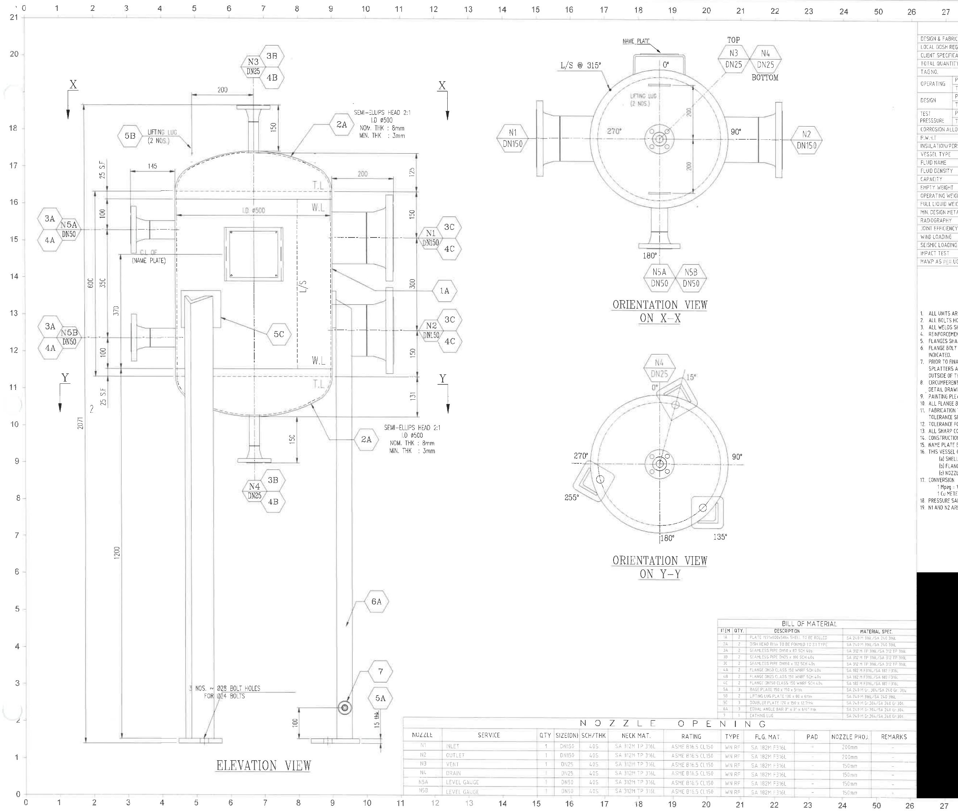

Slide 4
Expansion Tank
V-002
MLK_PMT_10103_-_V-003
FLUID | COMPONENT | DESIGN CODE | MATERIAL |  |  | INSULATED (Y/N) | OP. PARAMETER |  | CURRENT RISK RATING | Corrosion Group : Damage Mechanism Susceptible: Internal Shell General Corrosion External ATMOSPHERIC CORROSION
 |  |  | TYPE | SPEC | GR |  | T (֯C) | P (Mpa)
Condensate | Shell & Dished End | - | Carbon Steel | SA-516 | 70 | - | 185 C | 1,000 kPaG | LOW
Condensate | Flange, Manhole Flange and Cover | - | Not Found | A-105 | Not Found | - | 185 C | 1,000 kPaG
Condensate | Pipe | - | Carbon Steel | SA-106 | B | - | 185 C | 1,000 kPaG
Condensate | Socket | - | Not Found | A-105 | Not Found | - | 185 C | 1,000 kPaG
Condensate | Reinforced Plate | - | Carbon Steel | SA-516 | 70 | - | 185 C | 1,000 kPaG
INSPECTION METHOD | INSPECTION COVERAGE | DAMAGE MECHANISM
UTTM (Correction Factor) | 100% of TML Location – Refer TML as per Attachment | General Corrosion
VISUAL INSPECTION | External Visual Inspection (100% Coverage) With follow up by UT, RT, or pit gauge as required. | Atmospheric Corrosion

Slide 5
Expansion Tank
V-002
MLK_PMT_10103_-_V-003
FLUID | COMPONENT | DESIGN CODE | MATERIAL |  |  | INSULATED (Y/N) | OP. PARAMETER |  | CURRENT RISK RATING | Corrosion Group : Damage Mechanism Susceptible: Internal Shell General Corrosion External ATMOSPHERIC CORROSION
 |  |  | TYPE | SPEC | GR |  | T (֯C) | P (Mpa)
Condensate | Pressure Retaining Bolts & Nuts | - | Stainless Steel Bolting | SA-193 / SA-194 | B7 / 2H | - | 185 C | 1,000 kPaG | LOW
- | - | - | - | - | - | - | - | - | - | -
- | - | - | - | - | - | - | - | - | - | -
- | - | - | - | - | - | - | - | - | - | -
- | - | - | - | - | - | - | - | - | - | -
INSPECTION METHOD | INSPECTION COVERAGE | DAMAGE MECHANISM
UTTM (Correction Factor) | 100% of TML Location – Refer TML as per Attachment | General Corrosion
VISUAL INSPECTION | External Visual Inspection (100% Coverage) With follow up by UT, RT, or pit gauge as required. | Atmospheric Corrosion

Slide 6
