Slide 1

JHIPSTER july 2018 Nico Klasens

Slide 2
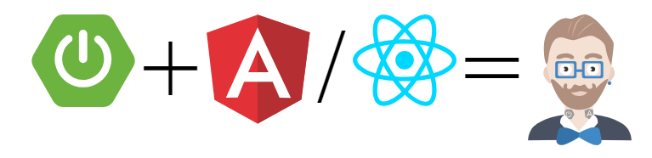
Agenda
Introduction
What is Jhipster
My opinion
Workshop

Slide 3
Who am I
Work for Amis for almost 1 year in the UI practice
We develop in Angular, React, Oracle-JET, ADF
Full stack ?
Use Java for 21 years and started with version 1.0
Written production applications in C++, ECMAscript, Erlang, Groovy, PHP, Python, Ruby, Scala
Used / Supported several data stores: Relational DB with replication, Sharded MongoDB, Riak, ElasticSearch, Redis, Memcached.
Test Automation tools for Android, iOS, Web client and Server apps
Deployments with ansible, chef, puppet, docker
Used LXC (linux containers) before docker to utilize the hardware
Used BGP (Border Gateway Protocol) to handle DDoS attacks

Slide 4
WHAT IS JHIPSTER
JHipster is a development platform to generate, develop and deploy Spring Boot + Angular/React Web applications and Spring microservices.
Goal
Our goal is to generate for you a complete and modern Web app or microservice architecture, unifying:
A high-performance and robust Java stack on the server side with Spring Boot
A sleek, modern, mobile-first front-end with Angular, React and Bootstrap
A robust microservice architecture with the JHipster Registry, Netflix OSS, the ELK stack and Docker
A powerful workflow to build your application with Yeoman, Webpack and Maven/Gradle

Slide 5
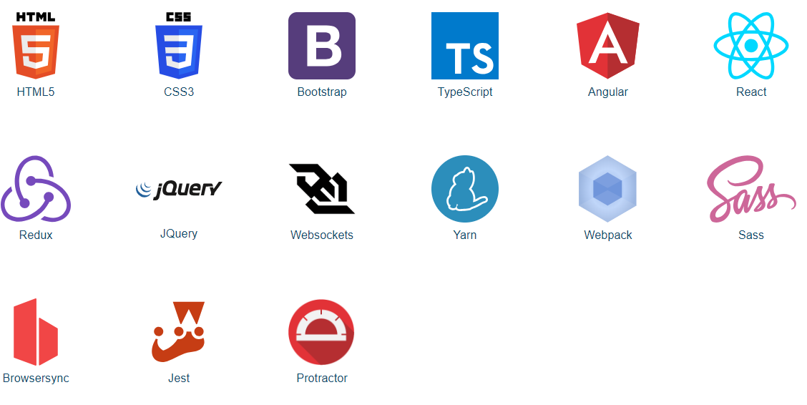
CLIENT OPTIONS

Slide 6
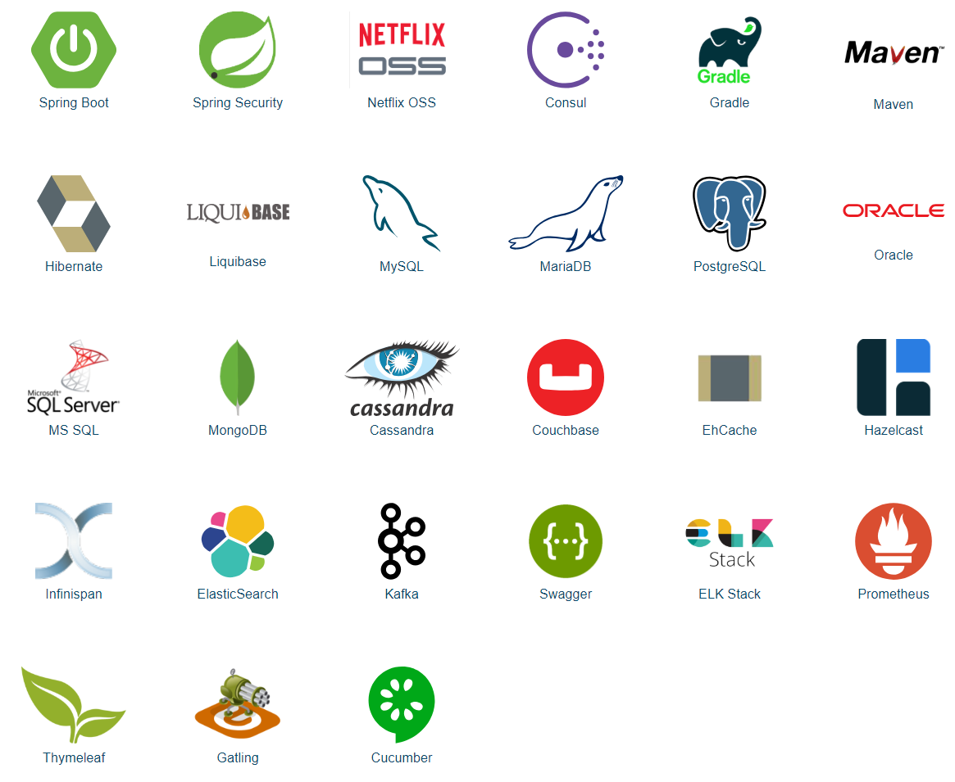
SERVER SIDE OPTIONS

Slide 7
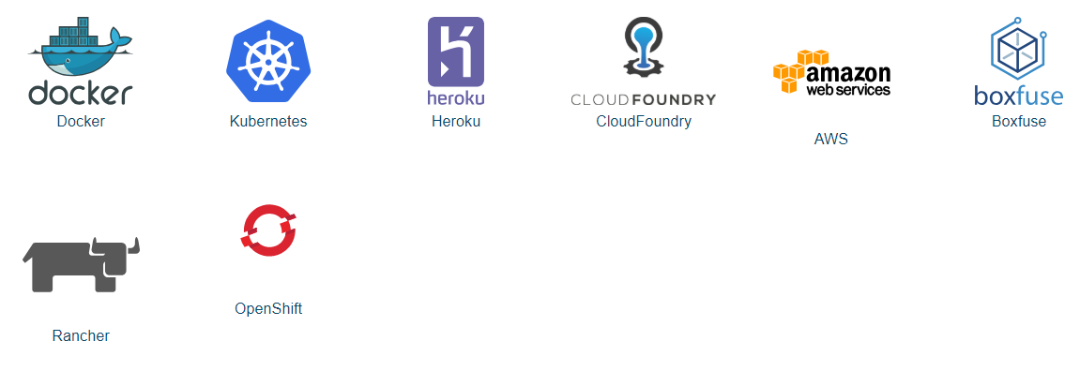
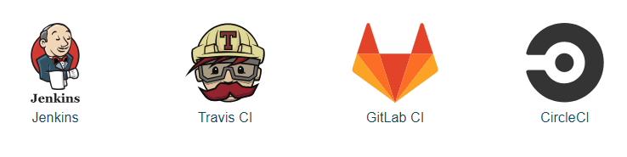
DEPLOYMENT Ci/CD OPTIONS

Slide 8

You need to be somewhere
You ask a hipster to make something to get you there
He starts to ask you some questions and you answer
He goes away
After a while he returns
“Here you go. ENJOY the flight. Oh btw you have to fly it yourself! If you want to bring someone you have to add chairs in the back. I can help you with that”

Slide 9
The system looks solid and well crafted
Each component designed by an experienced engineer
The components are assembled in an optimal way and an experienced developer can find things blind-folded
The blueprints can be combined to get a different result which also works

Slide 10
Developer/Team/Operation Experience
Focus on excellent experience for all (java) developers.
No operating system preference (shell and git ignore/attributes)
No Editor/IDE preference
Multiple ways to install
Automation of tasks
Reload of application, OS Notifications for builds ready
Generation of common feature for applications
Security, Monitoring, Logging, i18n
Easy to switch between JHipster projects
Not much knowledge required to play with complex technologies
Generated code has 75% test coverage which shows how to write tests
Generated code is inspiration how to use the frameworks
A lot of good practises are put in place

Slide 11
Things you need to know
JHipster generates a professional production application
It is a starting point
It will help you with new features only when you do not break the structure of the application and mind when you extend/change the sources
It generates a lot of duplications which you would have implement differently yourself
CRUD screens WILL be refactored to another UX-flow
Administration probably moves to a seperate ops frontend
There are decisions made in the architecture which you need to agree with
Experienced spring-boot/angular/react developers will be very productive
Inexperienced spring-boot/angular/react developers will break the application in ways which are hard to debug
JHipster is a full-stack generation. Only use it for that. Spring-boot, Angular and React have their own generation tools.

Slide 12
Installation types
JHipster Online is a simple way to generate an application without installing JHipster in the first place. (require java, node and yarn to run)
“Local installation with Yarn” is the classical way of working with JHipster. Everything is installed on your machine, which can be a little complex to set up, but that’s how most people usually work.
“Installation with a package manager” is only available for Mac OS X and Windows. This is a very simple installation method, if you use a package manager. (require brew or chocolatey)
The Vagrant-based “development box”, with all tools already set up in a Ubuntu-based virtual machine. (require Virtualbox and Vagrant)
The “Docker” container, which brings you a lightweight container with JHipster installed.

Slide 13
Let’s generate a space craft
https://github.com/AMIS-Services/SIG-JHipster
Thanks

