Slide 1
API / Javascript / Node.js Talent Launch

Slide 2
INTRODUCTION
Day 1
What are API’s and how are they used
Basics of Javascript
Day 2
More Advanced Javascript
Node.js to run an API server

Slide 3
WORKSHOP FILES
https://repo.virtualsciences.nl/Talent-Launch/javascript-node-api
AMIS-TalentLaunch-API_JSON_NODE.docx
Workshop walkthrough
ATL-javascript.pptx
Basic Javascript
ATL-API_NODE.pptx
Advanced javascript and Node.js

Slide 4
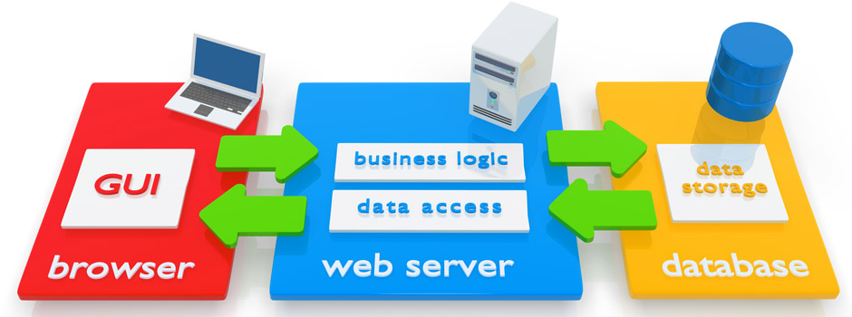
WEB APPLICATION

Slide 5
LABS
1. Programmatic access to Public Data
2. Public APIs
3. Getting around JSON
4. Introduction to JavaScript

