Slide 1

Vagrant – Infrastructure as Code: geautomatiseerde provisioning van op maat ontworpen Virtual Machines
Code Café Online
18 mei 2020
Marc Lameriks

Slide 2
Agenda
What is Vagrant?
Why Vagrant?
For Developers
Vagrant Boxes
Getting Started
vagrant init
Vagrantfile
vagrant version
vagrant up
vagrant ssh
vagrant destroy
Example Vagrantfile
Making re-usable box my_ubuntu_k3s (vagrant package)
vagrant box list

Slide 3
What is Vagrant?
Vagrant is a tool for building and managing virtual machine environments in a single workflow. With an easy-to-use workflow and focus on automation, Vagrant lowers development environment setup time, increases production parity, and makes the "works on my machine" excuse a relic of the past.
Notes:
the state or condition of being equal

Slide 4
Why Vagrant?
Vagrant provides easy to configure, reproducible, and portable work environments built on top of industry-standard technology and controlled by a single consistent workflow to help maximize the productivity and flexibility of you and your team.
To achieve its magic, Vagrant stands on the shoulders of giants. Machines are provisioned on top of VirtualBox, VMware, AWS, or any other provider. Then, industry-standard provisioning tools such as shell scripts, Chef, or Puppet, can automatically install and configure software on the virtual machine.
Vagrantfile
Vagrant.configure("2") do |config|
config.vm.box = "ubuntu/bionic64"
config.vm.define "ubuntu_k3s" do |ubuntu_k3s|
config.vm.network "forwarded_port",
guest: 8001,
host: 8001,
auto_correct: true
config.vm.provider "virtualbox" do |vb|
vb.name = "Ubuntu k3s"
vb.memory = "8192"
vb.cpus = "1"
args = []
config.vm.provision "k3s shell script", type: "shell",
path: "scripts/k3s.sh",
args: args
end
end
end

Slide 5
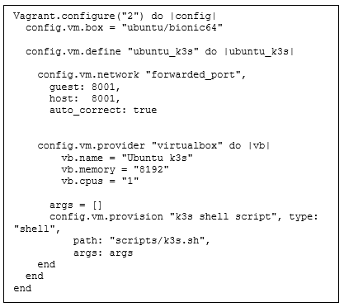




For Developers
Once you or someone else creates a single Vagrantfile, you just need to vagrant up and everything is installed and configured for you to work.
All your team members are running code in the same environment, against the same dependencies, all configured the same way. Say goodbye to "works on my machine" bugs.
Vagrantfile

Slide 6
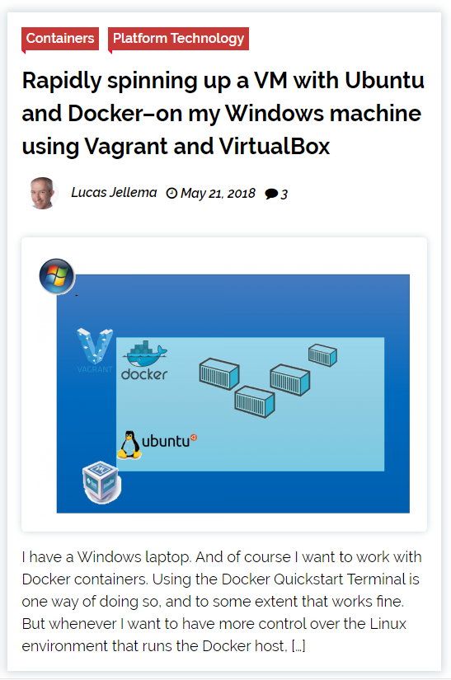
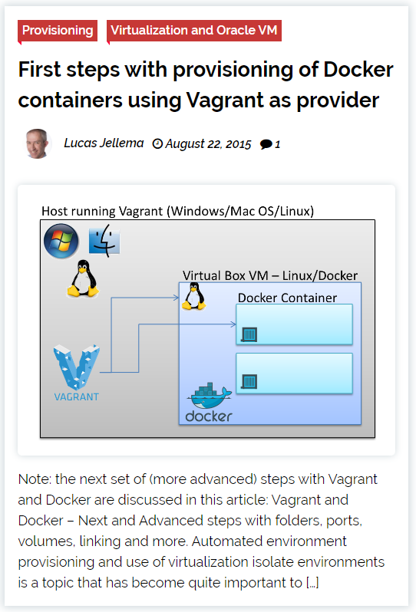
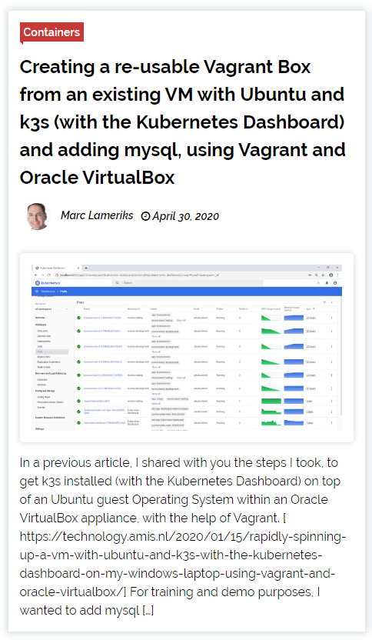
AMIS Technology Blog
2018
2015
2020

Slide 7
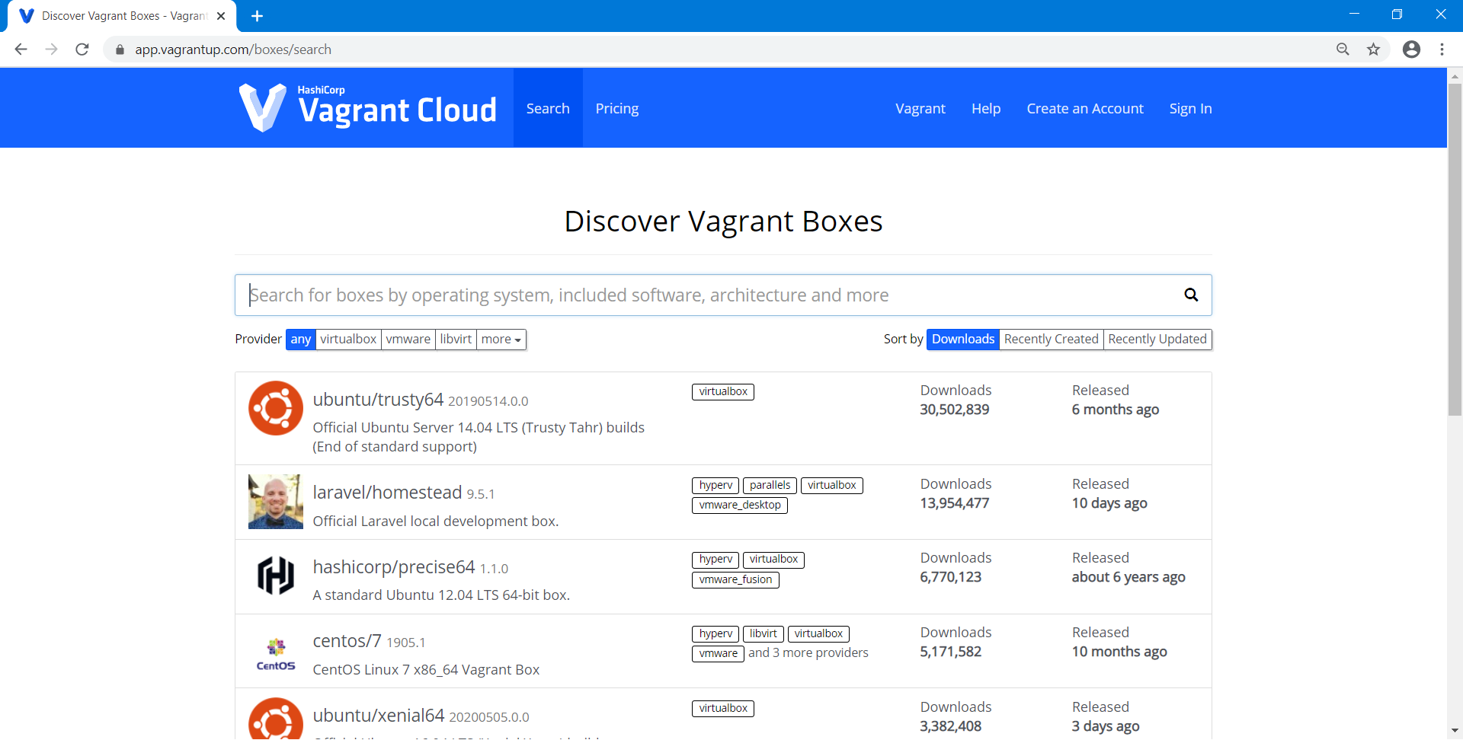
Vagrant Boxes
Instead of building a virtual machine from scratch, which would be a slow and tedious process, Vagrant uses a base image to quickly clone a virtual machine. These base images are known as "boxes" in Vagrant, and specifying the box to use for your Vagrant environment is always the first step after creating a new Vagrantfile.
https://app.vagrantup.com/boxes/search

Slide 8
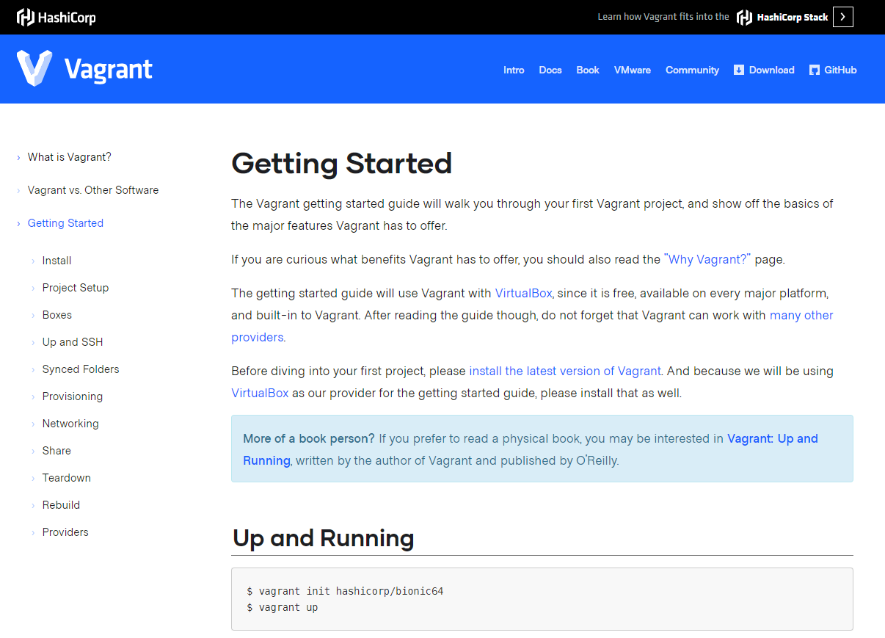
Getting Started
https://www.vagrantup.com/intro/getting-started/index.html
Notes:
the state or condition of being equal

Slide 9

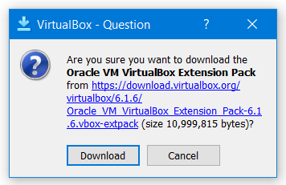
Getting Started, installation
https://www.vagrantup.com/intro/getting-started/index.html
The getting started guide will use Vagrant with VirtualBox, since it is free, available on every major platform, and built-in to Vagrant.
Install Vagrant (https://www.vagrantup.com/downloads.html)
Install VirtualBox (https://www.virtualbox.org/wiki/Downloads)
Versie 2.2.9:
vagrant_2.2.9_x86_64.msi
VirtualBox-6.1.6-137129-Win.exe
Oracle_VM_VirtualBox_Extension_Pack-6.1.6.vbox-extpack
Versie 2.2.6 (t.b.v. Conclusion/AMIS laptop):
vagrant_2.2.6_x86_64.msi
VirtualBox-6.0.20-137117-Win.exe
Oracle_VM_VirtualBox_Extension_Pack-6.0.20.vbox-extpack
Notes:
the state or condition of being equal

Slide 10
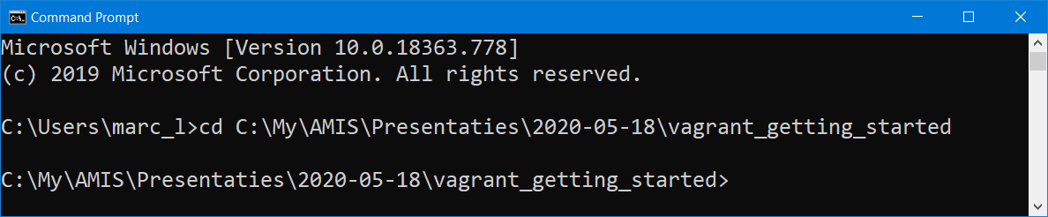
Getting Started
$ mkdir vagrant_getting_started (in Windows: New Folder)
$ cd vagrant_getting_started
Notes:
the state or condition of being equal

Slide 11
vagrant init hashicorp/bionic64
C:\My\AMIS\Presentaties\2020-05-18\vagrant_getting_started>vagrant init hashicorp/bionic64
==> vagrant: A new version of Vagrant is available: 2.2.9 (installed version: 2.2.6)!
==> vagrant: To upgrade visit: https://www.vagrantup.com/downloads.html
A `Vagrantfile` has been placed in this directory. You are now
ready to `vagrant up` your first virtual environment! Please read
the comments in the Vagrantfile as well as documentation on
`vagrantup.com` for more information on using Vagrant.
C:\My\AMIS\Presentaties\2020-05-18\vagrant_getting_started>
Notes:
the state or condition of being equal

Slide 12
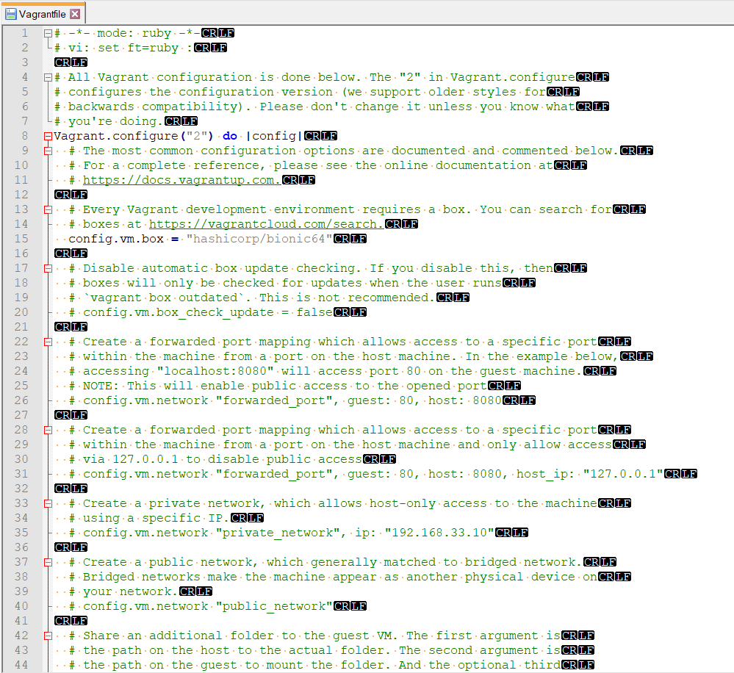
Vagrantfile
Notes:
the state or condition of being equal

Slide 13
vagrant version
C:\My\AMIS\Presentaties\2020-05-18\vagrant_getting_started>vagrant version
Installed Version: 2.2.6
Latest Version: 2.2.9
Notes:
the state or condition of being equal

Slide 14
vagrant up
Vagrantfile
Vagrant.configure("2") do |config|
config.vm.box = "ubuntu/bionic64"
end
C:\My\AMIS\Presentaties\2020-05-18\vagrant_getting_started>vagrant up
Bringing machine 'default' up with 'virtualbox' provider...
==> default: Box 'hashicorp/bionic64' could not be found. Attempting to find and install...
default: Box Provider: virtualbox
default: Box Version: >= 0
==> default: Loading metadata for box 'hashicorp/bionic64'
default: URL: https://vagrantcloud.com/hashicorp/bionic64
==> default: Adding box 'hashicorp/bionic64' (v1.0.282) for provider: virtualbox
default: Downloading: https://vagrantcloud.com/hashicorp/boxes/bionic64/versions/1.0.282/providers/virtualbox.box
default: Download redirected to host: vagrantcloud-files-production.s3.amazonaws.com
Notes:
the state or condition of being equal

Slide 15

vagrant up
==> default: Successfully added box 'hashicorp/bionic64' (v1.0.282) for 'virtualbox'!
Notes:
the state or condition of being equal

Slide 16

vagrant up
==> default: Setting the name of the VM: vagrant_getting_started_default_1589619875737_78158
The name defaults to the format <DIRECTORY>_default_<TIMESTAMP>
Notes:
the state or condition of being equal

Slide 17
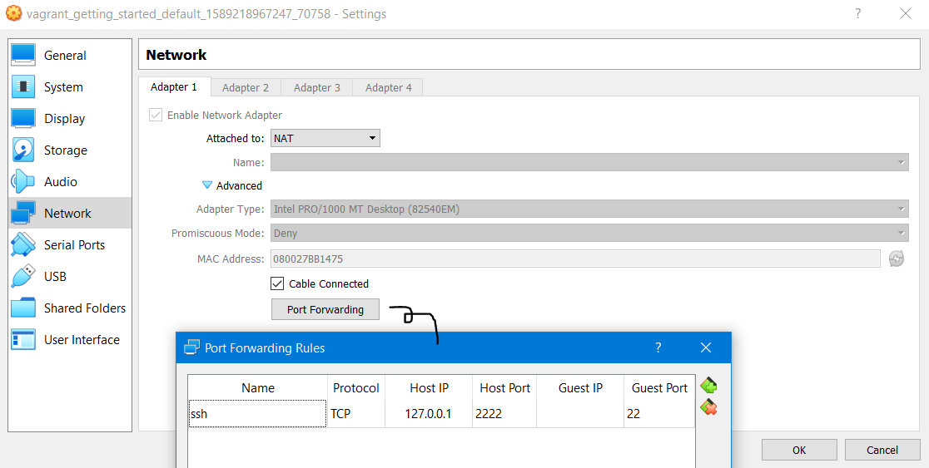
vagrant up
==> default: Forwarding ports...
default: 22 (guest) => 2222 (host) (adapter 1)
Notes:
the state or condition of being equal

Slide 18
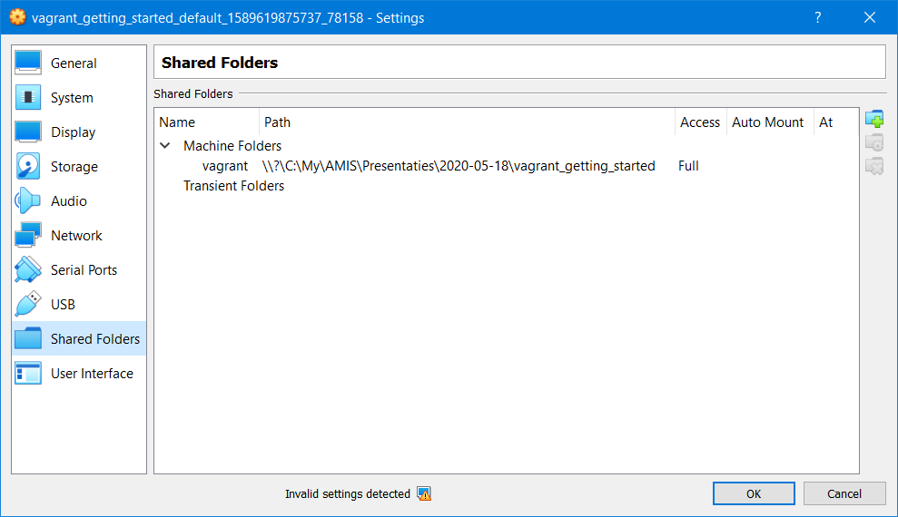
vagrant up
==> default: Mounting shared folders...
default: /vagrant => C:/My/AMIS/Presentaties/2020-05-18/vagrant_getting_started
Notes:
the state or condition of being equal

Slide 19
vagrant ssh
C:\My\AMIS\Presentaties\2020-05-18\vagrant_getting_started>vagrant ssh
Welcome to Ubuntu 18.04.3 LTS (GNU/Linux 4.15.0-58-generic x86_64)Welcome to Ubuntu 18.04.3 LTS (GNU/Linux 4.15.0-58-generic x86_64)
…
147 packages can be updated.
93 updates are security updates.
vagrant@vagrant:~$
vagrant@vagrant:~$
Notes:
the state or condition of being equal

Slide 20
vagrant ssh
vagrant@vagrant:~$ ls -latr
total 40
drwxr-xr-x 3 root 4096 Aug 15 2019 ..
-rw-r--r-- 1 vagrant 807 Aug 15 2019 .profile
-rw-r--r-- 1 vagrant 3771 Aug 15 2019 .bashrc
-rw-r--r-- 1 vagrant vagrant 220 Aug 15 2019 .bash_logout
drwx------ 3 vagrant vagrant 4096 Aug 15 2019 .gnupg
drwx------ 2 vagrant vagrant 4096 Aug 15 2019 .cache
-rw-r--r-- 1 vagrant vagrant 6 Aug 15 2019 .vbox_version
-rw-r--r-- 1 vagrant vagrant 0 Aug 15 2019 .sudo_as_admin_successful
-rw-r--r-- 1 root root 180 Aug 15 2019 .wget-hsts
drwxr-xr-x 5 vagrant vagrant 4096 Aug 15 2019 .
drwx------ 2 vagrant root 4096 May 11 18:16 .ssh
vagrant@vagrant:~$ exit
logout
Connection to 127.0.0.1 closed.
Notes:
the state or condition of being equal

Slide 21
vagrant destroy
C:\My\AMIS\Presentaties\2020-05-18\vagrant_getting_started>vagrant destroy
default: Are you sure you want to destroy the 'default' VM? [y/N] y
==> default: Forcing shutdown of VM...
==> default: Destroying VM and associated drives...
Notes:
the state or condition of being equal

Slide 22
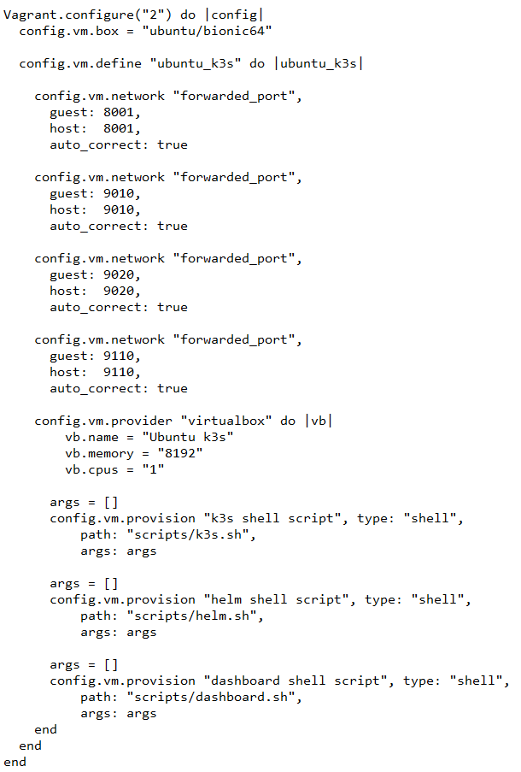
Voorbeeld Vagrantfile
If you explicitly define a VM, the name used replaces the token 'default'. This is the name vagrant outputs on the console.
ubuntu_k3s
The name defaults to the format <DIRECTORY>_default_<TIMESTAMP>
Notes:
the state or condition of being equal

Slide 23
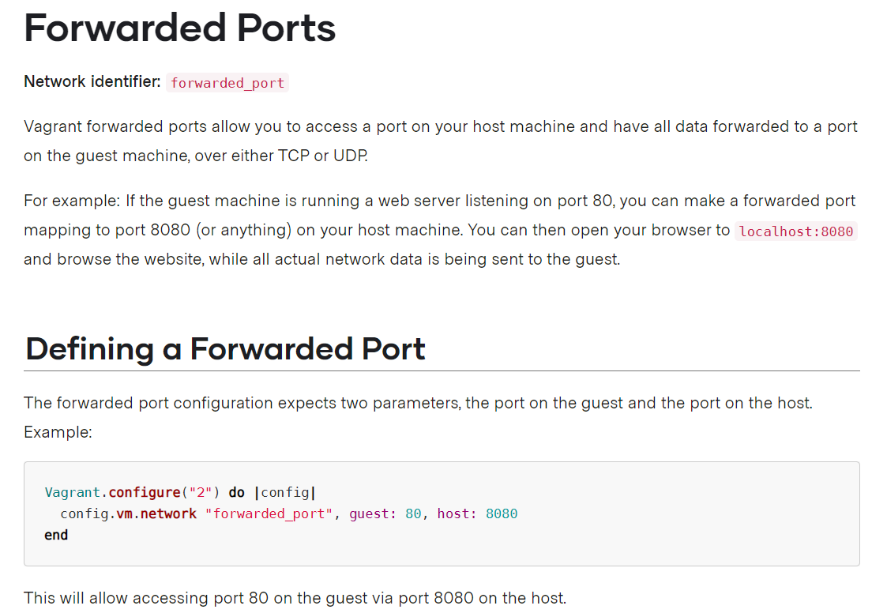
Voorbeeld Vagrantfile
Notes:
the state or condition of being equal

Slide 24
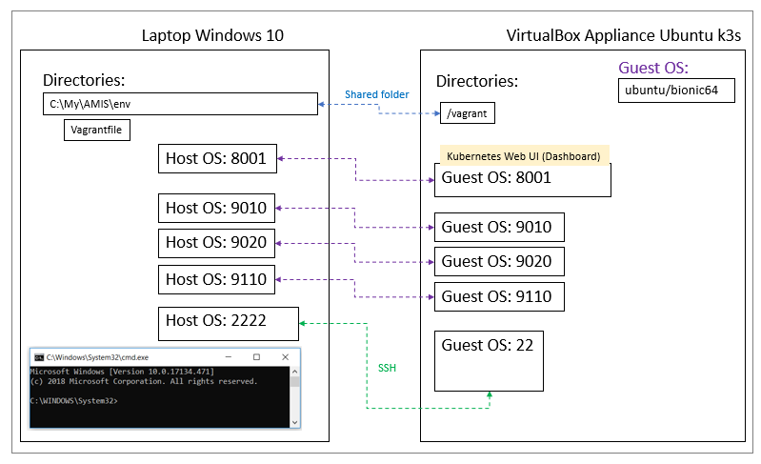
Voorbeeld Vagrantfile
Notes:
the state or condition of being equal

Slide 25
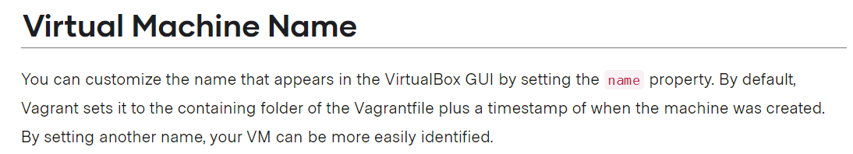

Voorbeeld Vagrantfile
Notes:
the state or condition of being equal

Slide 26
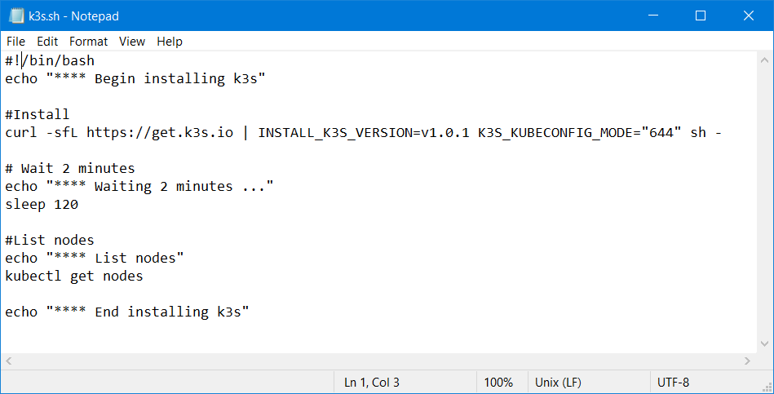
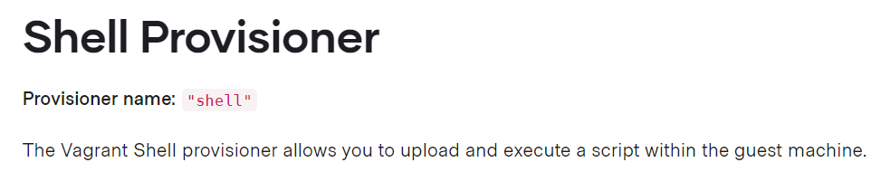
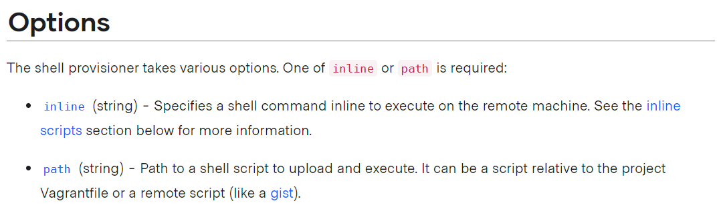
Example Vagrantfile
Notes:
the state or condition of being equal

Slide 27
Making re-usable box my_ubuntu_k3s
C:\My\AMIS\Presentaties\2020-05-18\vagrant_getting_started>vagrant package --output my_ubuntu_k3s.box
This command packages a currently running VirtualBox or Hyper-V environment into a re-usable box.
--output NAME - The resulting package will be saved as NAME. By default, it will be saved as package.box.
[https://www.vagrantup.com/docs/cli/package.html]
==> ubuntu_k3s: Attempting graceful shutdown of VM...
==> ubuntu_k3s: Forcing shutdown of VM...
==> ubuntu_k3s: Clearing any previously set forwarded ports...
==> ubuntu_k3s: Exporting VM...
==> ubuntu_k3s: Compressing package to: C:/My/AMIS/env/my_ubuntu_k3s.box
Notes:
the state or condition of being equal

Slide 28
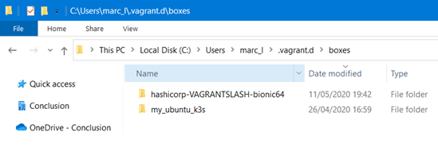
Using a re-usable box my_ubuntu_k3s, Vagrantfile
Vagrant.configure("2") do |config|
config.vm.box = "my_ubuntu_k3s"
config.vm.define "ubuntu_k3s_mysql" do |ubuntu_k3s_mysql|
..
config.vm.provider "virtualbox" do |vb|
vb.name = "Ubuntu k3s mysql"
vb.memory = "8192"
vb.cpus = "1"
end
end
end
Notes:
the state or condition of being equal

Slide 29
vagrant box list
C:\My\AMIS\Presentaties\2020-05-18\vagrant_getting_started>vagrant box list
hashicorp/bionic64 (virtualbox, 1.0.282)
my_ubuntu_k3s (virtualbox, 0)
ol7-latest (virtualbox, 0)
ubuntu/bionic64 (virtualbox, 20191218.0.0)
ubuntu/bionic64 (virtualbox, 20200107.0.0)
ubuntu/bionic64 (virtualbox, 20200124.0.0)
ubuntu/bionic64 (virtualbox, 20200402.0.0)
ubuntu/bionic64 (virtualbox, 20200407.0.0)
ubuntu/bionic64 (virtualbox, 20200416.0.0)
ubuntu/bionic64 (virtualbox, 20200425.0.0)
ubuntu/xenial64 (virtualbox, 20190109.0.0)
ubuntu/xenial64 (virtualbox, 20190115.0.0)
ubuntu/xenial64 (virtualbox, 20190118.0.0)
ubuntu/xenial64 (virtualbox, 20190123.0.0)
ubuntu/xenial64 (virtualbox, 20190123.0.1)
Notes:
the state or condition of being equal

