Slide 1

Clustering

Slide 2
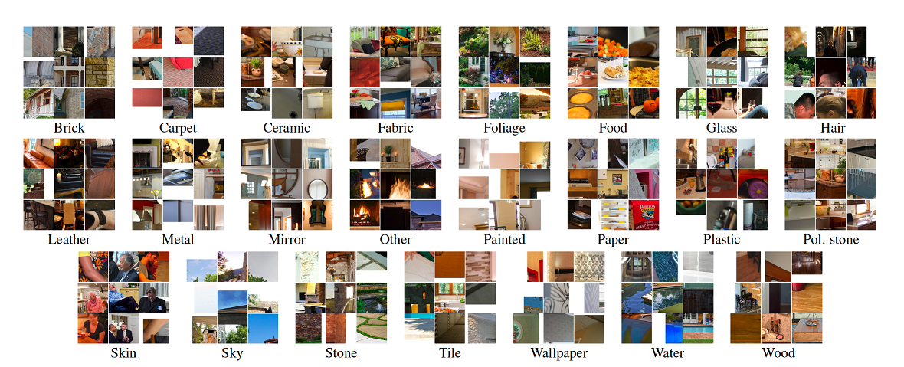
Labeled dataset

Slide 3
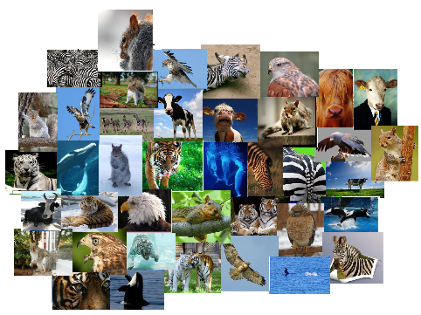
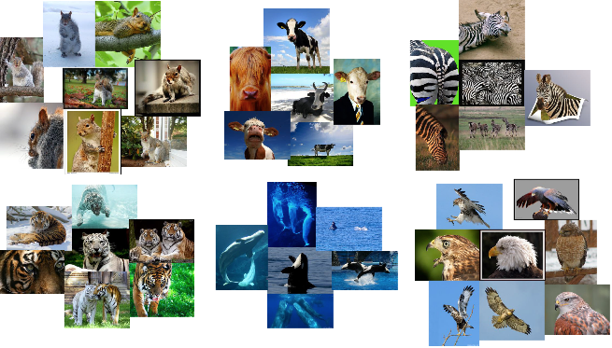

Group similar things

Slide 4
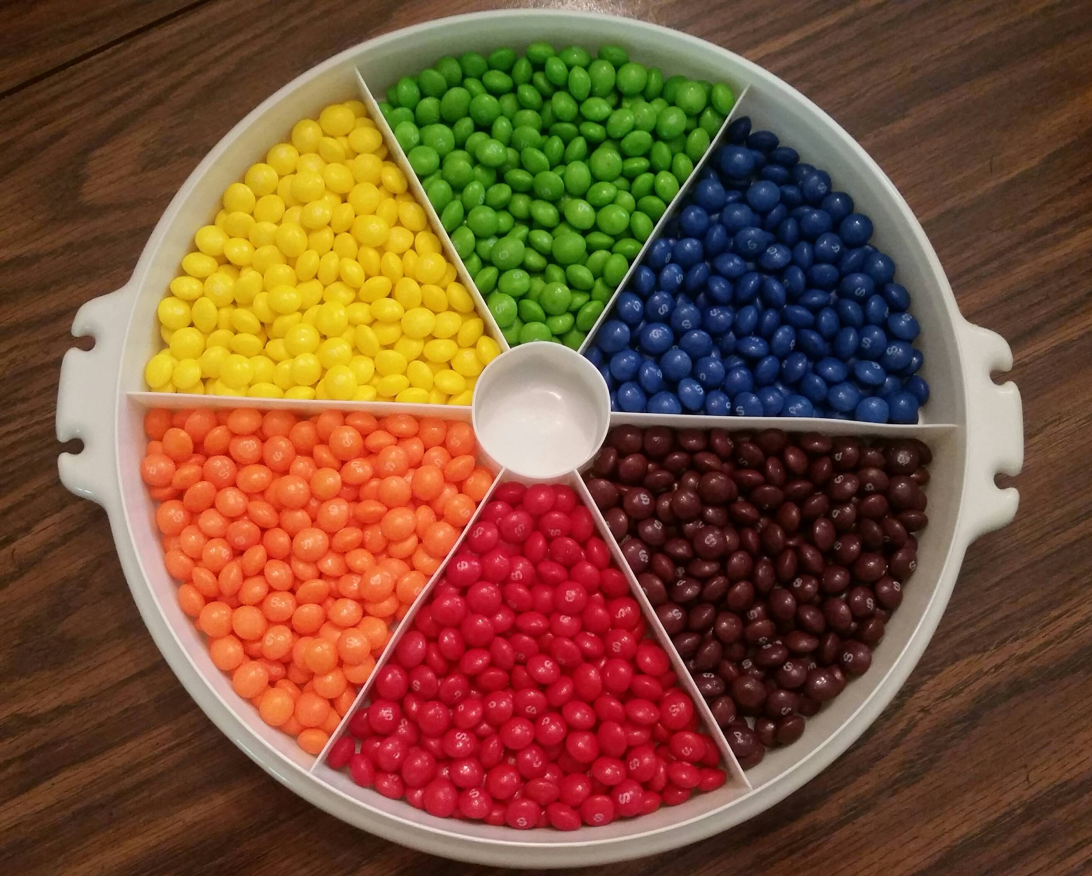
Definition of Clustering
Process of grouping a set of documents into clusters of similar documents
Documents within a cluster should be similar
Documents from different clusters should be dissimilar
Unsupervised learning

Slide 5
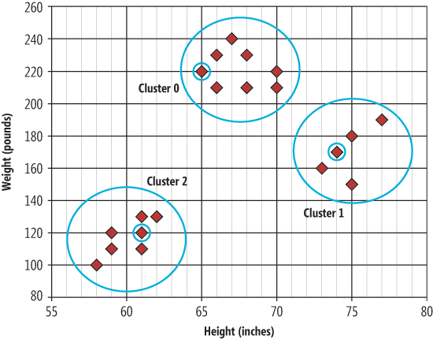
Clear cluster structure

Slide 6
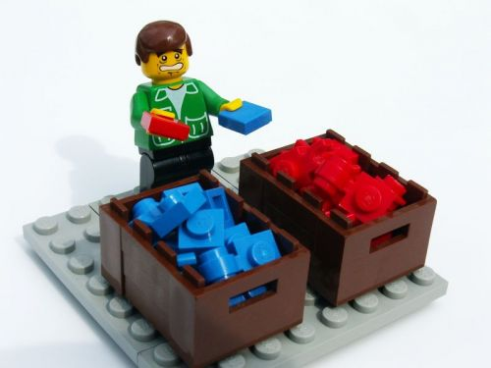
Classification vs Clustering
Classification: supervised
Clustering: unsupervised
Classification: Classes are human-defined and part of the input to the learning algorithm.
Clustering: Clusters are inferred from the data without human input.
However, there are many ways of influencing the outcome of clustering: number of clusters, similarity measure, representation..

Slide 7

Applications
Behaviour clustering
Customer segmentation
Sensors
Group images
Detecting anomalies
Help by labeling of a large dataset
Clustering of documents on same topic

Slide 8
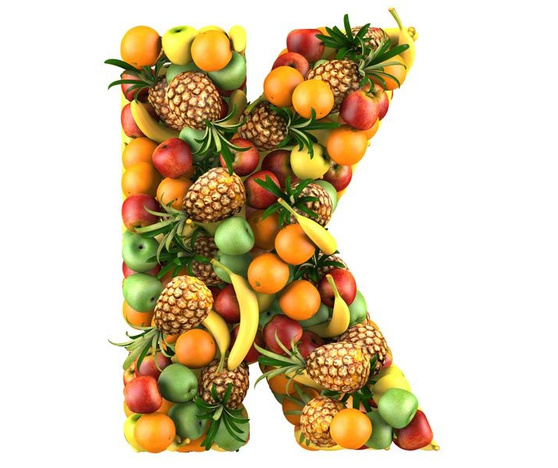
k-Means clustering
A well known clustering algorithm
Simple
A cluster is defined by a centroid
Minimize the average squared error difference from the centroid
Find the minimum by iterating two steps:
Reassignment
Recomputation
Result: k clusters, with data points assigned to a single cluster
Important: only data fields with numeric values can be used

Slide 9

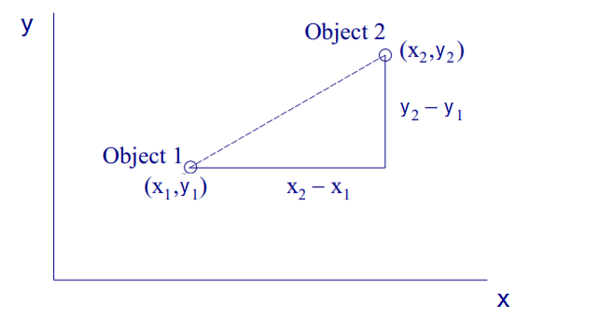
Distance measures
Dashed line: Euclidean distance
Solid line: Manhattan distance

Slide 10
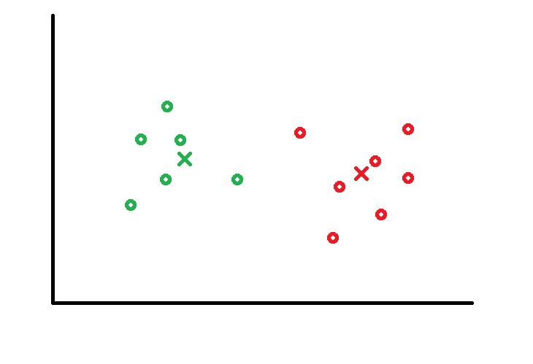
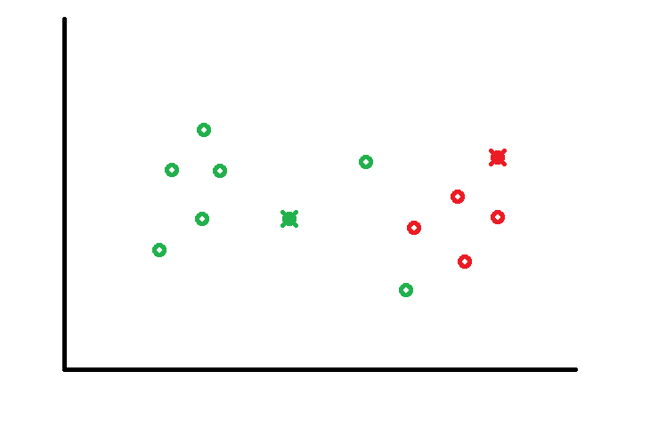
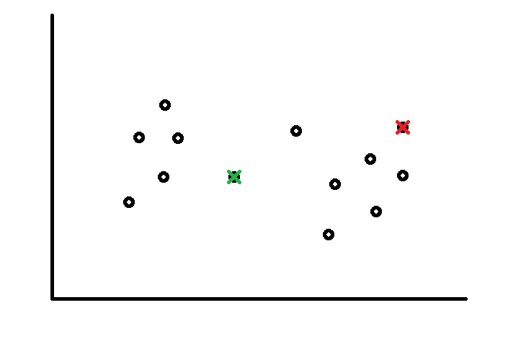
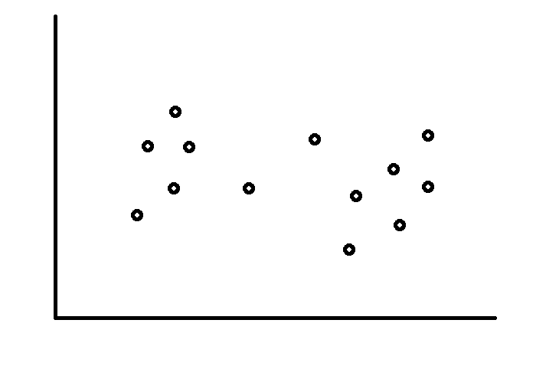
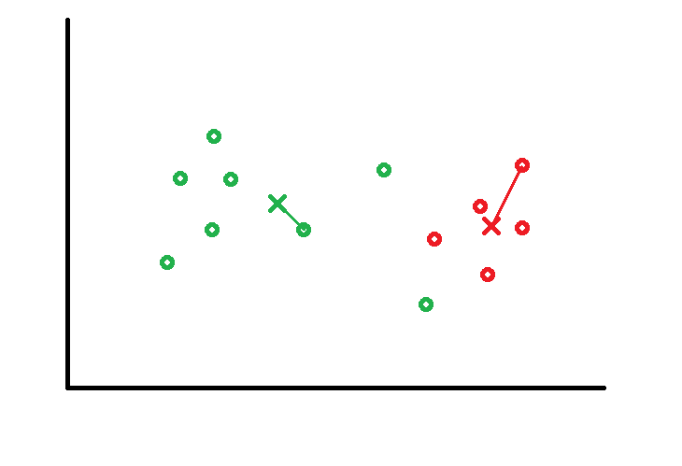
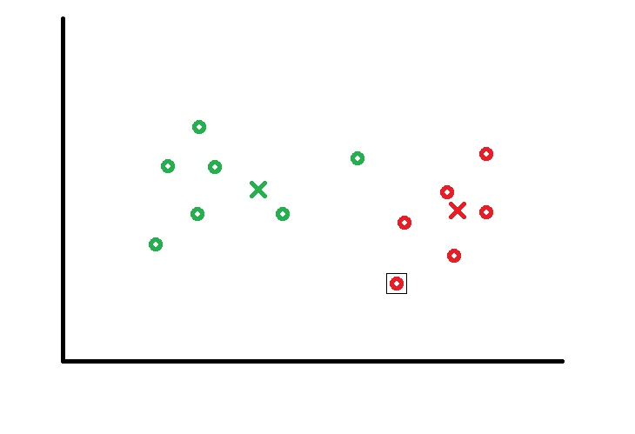
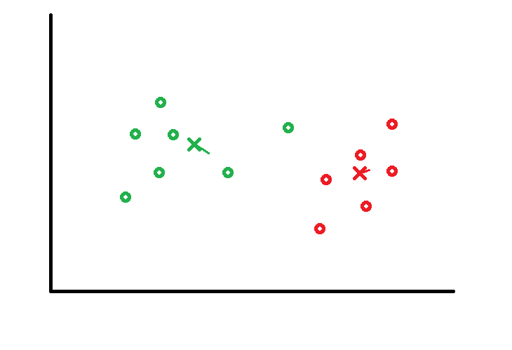
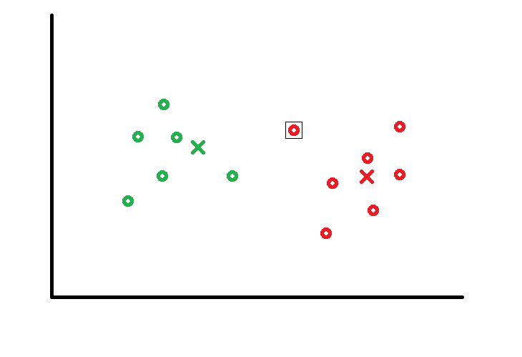
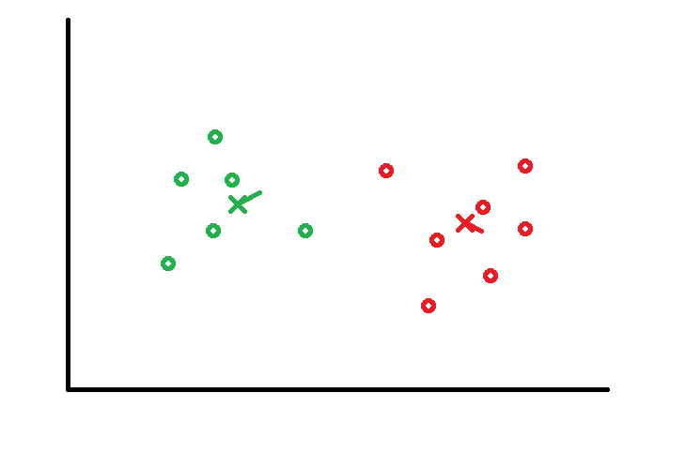
Algorithm
Initialization:
Choose k random points as centroids
Assignment step:
Assign all points to their closest centroid, they form a cluster (Euclidean/Manhattan distance)
Computation step:
Take the mean of all data points in a cluster as the new centroid
Repeat step 1 and 2 until a stop criteria is met:
Centroids are not shifted between iterations
Sum of distances is minimized
Max number of iterations is reached

Slide 11
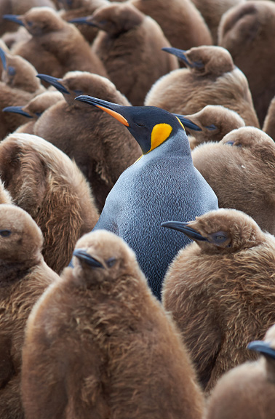
k?
Choose to few k → large error
Choose to many k → overfitting
No general method to find the exact k
Run the algorithm a number of times with different k
Look at the dataset yourself to determine k

Slide 12
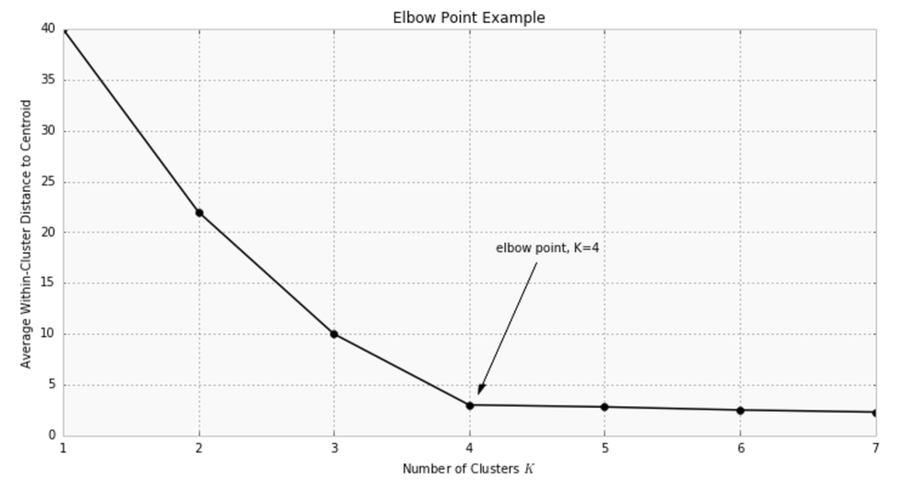
Elbow point
Metric: Distance between data point and it’s cluster centroid
Increasing k will always decrease metric
Find point where increase of k is diminishing

Slide 13
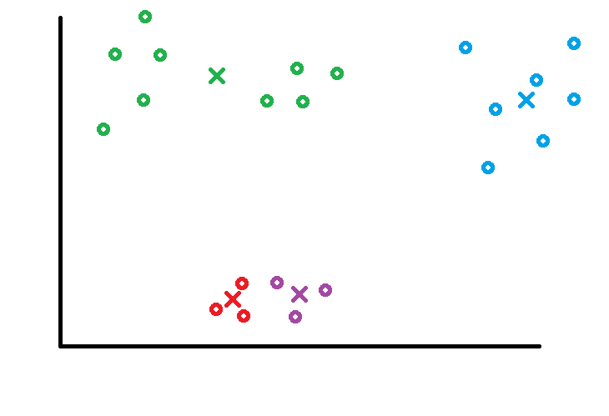
Unlucky Initialization
Randomly selecting points as centroids might give different results.
It might even result in unwanted clusters
Solutions:
Ensure distribution over the data set (filter outliers, use heuristics)
Try different sets of centroids

Slide 14
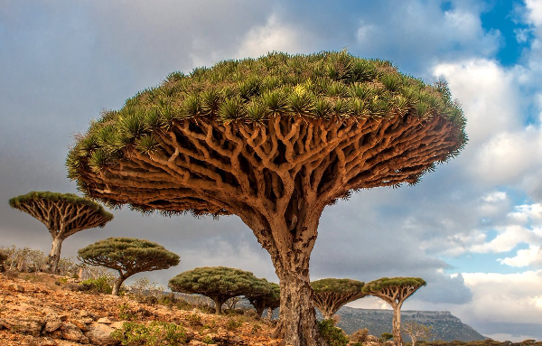
Hierarchical Clustering
A different approach
Clusters are created in a predetermined ordering -> hierarchy
No pre-knowledge of the dataset is required
Clustering results in a nice tree-based representation, a dendogram

Slide 15
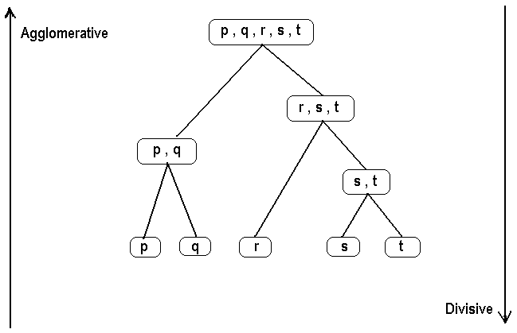
Hierarchical Clustering Algorithms
Agglomerative clustering:
Bottom up
Good at identifying small clusters
Divisive hierarchical clustering:
Top down
Good at identifying large clusters

Slide 16

Agglomerative clustering
Assign each point to it’s own cluster
Compute distances between clusters
Find closest pair of clusters and merge them
Repeat from step 2

Slide 17
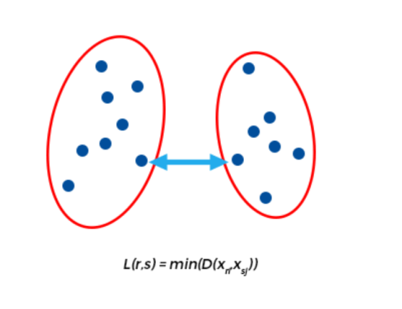
Single Linkage
Also known as minimum method
Distance between two clusters is shortest distance between any point on one cluster with any point on the other
Creates ‘loose’ clusters
Disadvantage: can cause premature merging of groups with close pairs

Slide 18
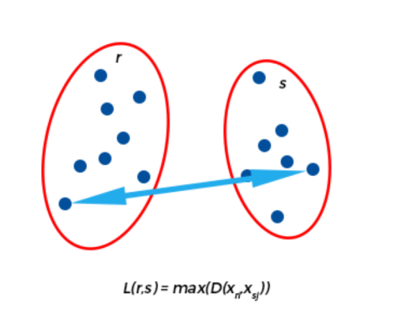
Complete Linkage
Also known as maximum method
Distance between two clusters is longest distance between any point on one cluster with any point on the other
Creates compact clusters
Disadvantage: can cause close groups to be merged later than what is optimal

Slide 19
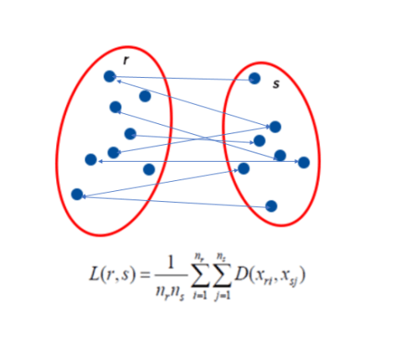
Average Linkage
Also known as mean method
Distance between two clusters is average distance between any point on one cluster with any point on the other

Slide 20
Centroid and Ward method
Centroid method:
Distance is distance between centroid’s of two clusters
Ward’s method:
Minimize the increase of total within-cluster variance (difference between any point and it’s centroid) when two clusters are combined

Slide 21
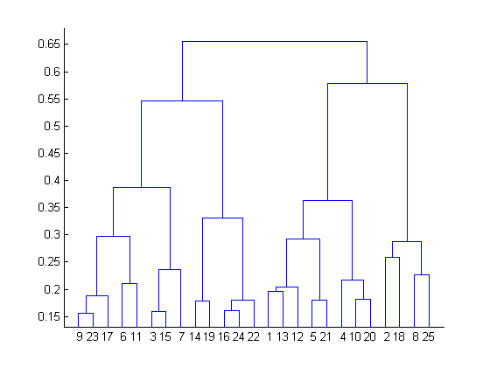
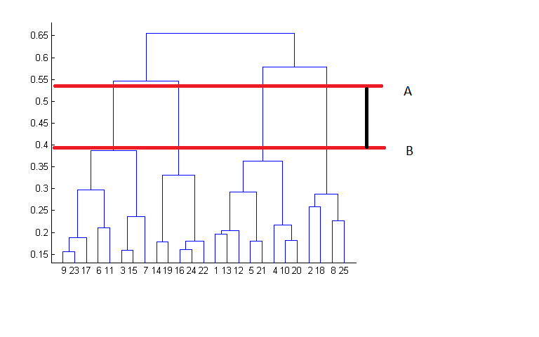
Dendogram
A cluster tree where each group is linked to two or more successor groups
Height represents the distance betwee two clusters
How to choose correct clustering?
Best choice to cut is place with maximum vertical distance

Slide 22
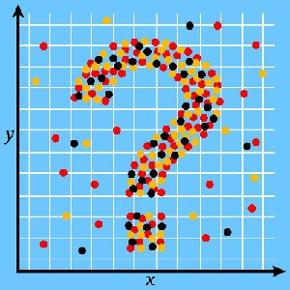
Questions
Handson:
https://bit.ly/2MrbmdS
or
https://github.com/AMIS-Services/machine-learning-session-two-14-june-2018

