Slide 1
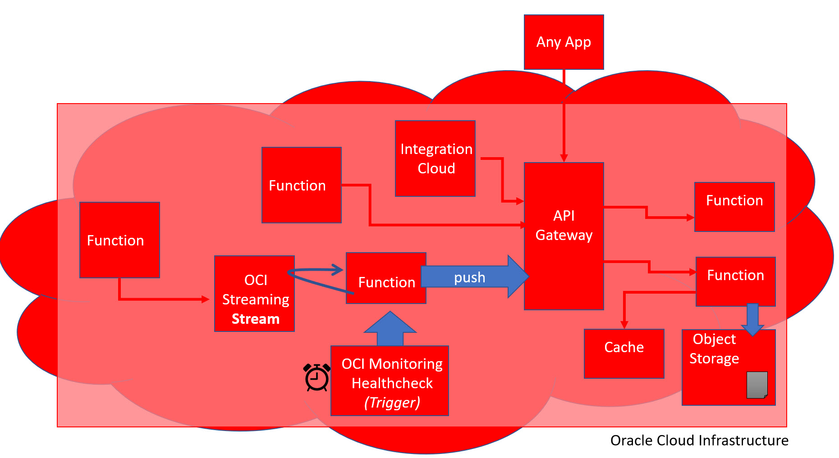
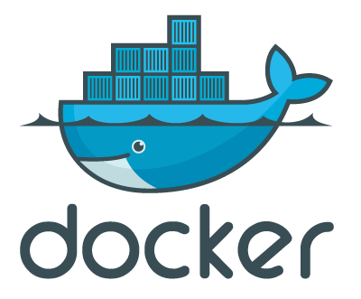


Oracle Cloud Native Application Development
Developer MeetUp – 20th January
Lucas Jellema, CTO & Architect AMIS, Oracle Groundbreaker Ambassador

Slide 2
What is Cloud Native?
Born in Cloud
No explicit Infrastructure (serverless) & Fully Managed Platform components
Quick Ramp Up
Scalable/Elastic
Pay per Use
Automation
Infrastructure/Platform as Code (automation)
Automated CI/CD [pipelines]

Slide 3
Cloud Capabilities for Cloud Native development
Functions
API Gateway
Events
Data Persistence
Cache
Security
Network access
Web Application Firewall (DDOS & more)
Authentication & Authorization
Key Management
Monitoring
Metrics, notification, logging
Auditing
Cost Control
Automation – CI/CD & DevOps Pipelines
Monitoring
API Gateway
Function
Security (WAF, Network, Authorization
Event Topic
Data Storage
Cache
CI/CD & DevOps Pipelines

Slide 4
Introducing Oracle Cloud Infrastructure

Slide 5

Cloud Native on Oracle Cloud Infrastructure
Any App
Integration Cloud
Function
Function
API Gate-way
Function
Web Application Firewall, IdCS, Key Management
push
Function
OCI Streaming
Stream
Function
“Cache”
Object Storage
OCI Monitoring Healthcheck
Oracle Cloud Infrastructure

Slide 6

Serverless Functions
Project Fn
Open Source
Docker based
Development done with a CLI and a local Server
Out of the box support for various runtimes
Java, JavaScript, Python, Go, Ruby
Support for any Docker Image
Every Function is built upon deployment into a Docker Container Image
Function instances are running containers based such images
Triggered by HTTP requests
Clusters functions in applications
Support Configuration Settings on Functions and Applications
Provided to function as environment variable

Slide 7


Fn Functions – request handling
With method, headers, query parameters, url path, body
Function
FDK
HTTP Request
Function Implementation (Node, Java, Go, Python,…)
input – derived from body
ctx – raw HTTP request components

Slide 8
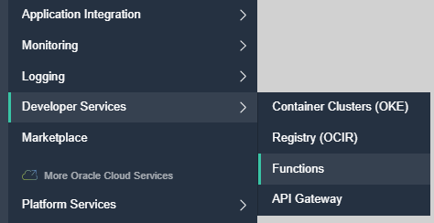
Serverless Functions
Functions on OCI – based on Fn
Oracle is one of the Fn providers
Function Container Images are stored in OCI Container Registry
Triggers can be:
HTTP Requests
OCI Events
API Gateway calls
OCI gathers logs (on OCI Object Storage) and metrics
A function instance will be removed after 5-10 minutes of inactivity
Note: an instance can handle multiple requests

Slide 9


Oracle Cloud Infrastructure
invoke
Application
invoke
Function
OCIR
Project Fn
Container Image for Function
oci fn function invoke …
oci raw-request …
deploy
OCI Config
Docker Container with Function & Runtime
OCI CLI
Docker 19.03.5
Ubuntu 18.04 Guest (on Virtual Box)
My Windows 10 Laptop

Slide 10
API Gateway
Expose private endpoints publicly
Stable (public) endpoints
Routing (verb & wildcard based)
Parameter and Header mapping
Request Policies
Rate limiting (per client & general)
CORS (for direct web client access)
Metrics Monitoring & Logging
Authentication & Validation
Handle HTTP calls:
Authorize
Route
Map
Monitor/ Audit
GA was Mid December 2019
Function
Any Service Invoker
API Gateway
Stock
Any 3rd party HTTP endpoint
VM
Any HTTP Endpoint on OCI
OKE
OIC
…
Oracle Cloud Infrastructure

Slide 11
API Gateway Authorizer Function
Authorizer Function can be configured on Route or on API Deployment
Any backend – HTTP destination, Oracle Function, Stock Response – can be subject to an authorizer function
Invoke API, provide token in header
JSON returned by Authorizer Function is embedded in request to backend
Any Service Invoker
API deployment
/path
Any backend
API Gateway
Authorizer Function
Authorizer Function that allows or denies access based on Header [Token]
Oracle Cloud Infrastructure

Slide 12
Object Storage
Object Storage service
“an internet-scale, high-performance storage platform that offers reliable and cost-efficient data durability. The Object Storage service can store an unlimited amount of unstructured data of any content type, including analytic data and rich content, like images and videos.”
Organized in Buckets (similar to Folders)
Max Object Size is 10TB
Object Storage is Always Free eligible
Object Storage provides
Durability – multiple copies, automatically maintained
Encryption - 256-bit Advanced Encryption Standard (AES-256)
S3 Compatible REST API
Pre-authorized requests for time-limited, direct access
Life Cycle Rules

Slide 13
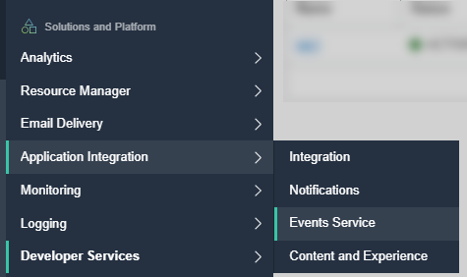
OCI Events Service
Is not what you might expect
OCI Events
Cloud Events produced by OCI upon administrative actions
For example: Creation, Update, Deletion of Service Instances
Object Storage publishes events when Objects are created, updated or deleted

Slide 14
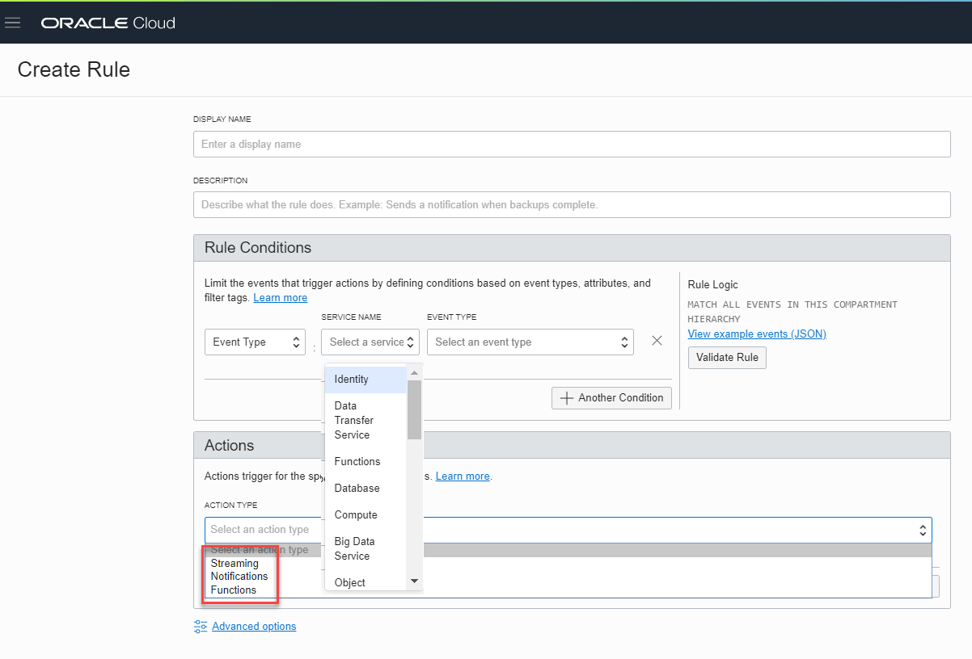
Events can trigger a Notification, Function and Streaming Event

Slide 15
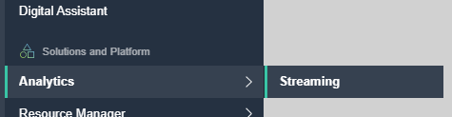
OCI Streaming Service
Kafka Like – Event Queue
Support for partitions and consumer groups
Events are Published and Consumed through REST API calls
Java SDK available
No Push!
Message retrieval is done through a Cursor
Similar to a (long running) query
Cursor indicates where to read from Stream
Earliest, latest, at offset, from offset, from time
No Filter to apply upon reading
Message Retention: 7 days
Max throughput: 1 MB/s
Max message size: 1 MB
Oracle Cloud Infrastructure
OCI Streaming
Stream
Listener
Publisher
Listener
Listener
On prem
3rd Party Cloud

Slide 16
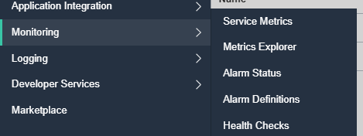
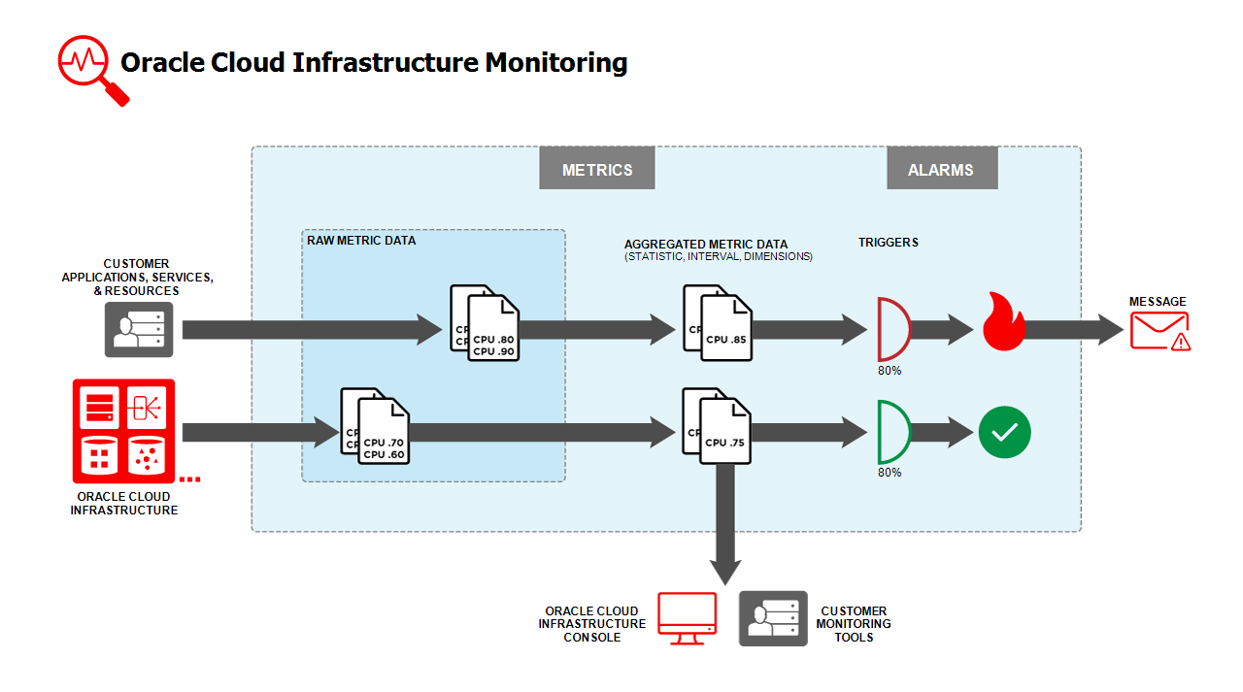

Slide 17
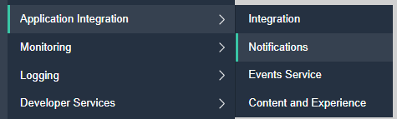
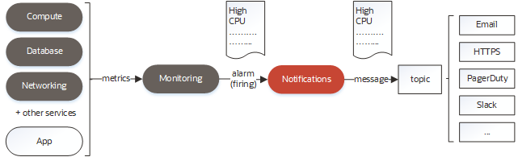
Monitoring
Metrics
Analyze number and performance of actions
Alarms
Trigger notification when condition is observed
Notifications
Send email or call WebHook
Triggered by Alarm or by direct API call

Slide 18
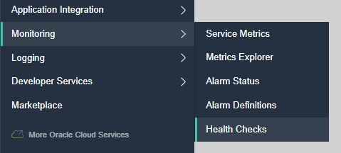
Monitoring – Health Checks
Periodic or Adhoc call to an endpoint
HTTP(S) or Ping
Specify Headers
Specify Interval
From selected Vantage Points
3rd party clouds, geographic location
Health Check results can be inspected through the Monitor
OCI does not currently have a way to schedule jobs
Health Checks are scheduled HTTP(S) requests

Slide 19
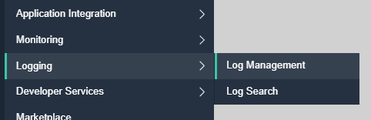
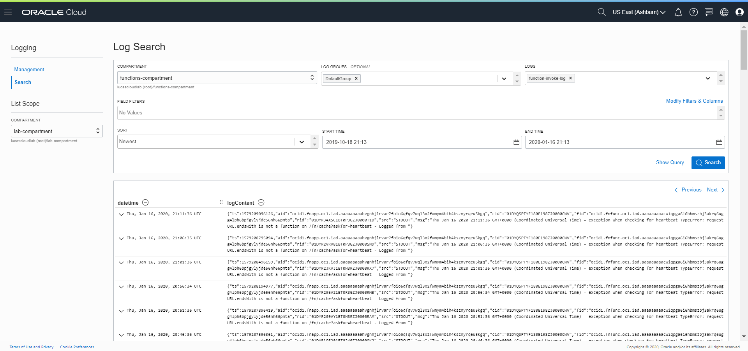
Logging
Currently in Preview
All OCI Log Files are collected and retained
At least 90 days
Log Files can be combined and searched
Similar to Elastic Search

Slide 20
Cache
There currently is no cache on OCI
However:
Function instances live while they are busy (and 5-10 minutes of inactivity) – so they are a little stateful
Functions can write to and read from Object Storage or Autonomous Database
State can be read from and persisted to a backend persistence mechanism
A container is started when the function is first invoked. After X minutes of idleness, the container is killed off
Object Storage
API Gateway
Function
Autonomous Database
State inside Function is retained during lifetime of container
When traffic load increases, multiple instance of the function container can be started; these do not share state with each other
Oracle Cloud Infrastructure

Slide 21
DIY Cache
Cache contents are read from file on Object Storage when the function initialized upon first invocation.
Any service invoker (with access) can put values in cache and read values from cache
A container is started when the function is first invoked. After X minutes of idleness, the container is killed off
Object Storage
API Gateway
Function
cache
OCI Monitoring Healthcheck
Trigger Listener
State inside Function is retained during lifetime of container. It can periodically/after changes be saved to Object Storage
Oracle Cloud Infrastructure
Health Check provides heartbeat (once per 3 min) to keep function and its state alive

Slide 22
DIY Cache – CQRS to support scalable, multi instance cache function
The cache-writer is truly stateless. It writes cache updates to the file on Object Storage – thus persisting the change and making it available to the cache function
Cache updates are written to the file Object Storage
Any service invoker (with access) can put values in cache and read values from cache
Function
cache-writer
API Gateway
Object Storage
put
Function
cache
get
Cache contents are read from file on Object Storage when the function initialized upon first invocation – and also every X seconds to gather changes in the cache contents.
OCI Monitoring Healthcheck
Trigger Listener
State inside Function is retained during lifetime of container. It is periodically refreshed from Object Storage
Oracle Cloud Infrastructure
Health Check provides heartbeat (once per 3 min) to keep function and its state alive

Slide 23
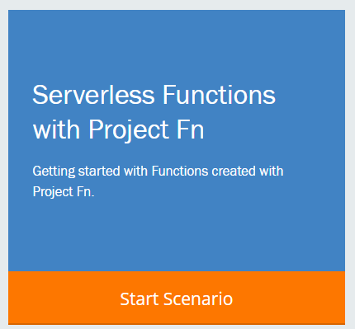
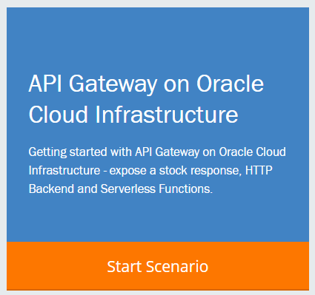
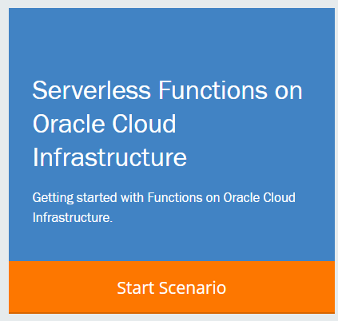

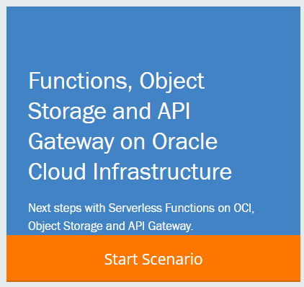
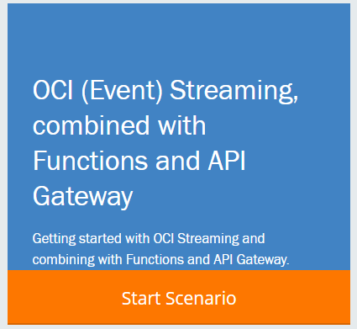
Workshop Scenarios
Introducing serverless functions with Project Fn
Functions on Oracle Cloud Infrastructure
API Gateway on OCI
Functions, Object Storage and API Gateway
OCI Event Streaming, API Gateway and Functions

