Slide 1
SIG CSS architectuur

Slide 2
Agenda
Inleiding: Frameworks vs Methodologiëen
BEM
SMACSS
OOCSS
Oxygen CSS
Hands-on

Slide 3
Frameworks vs Methodologiëen
Framework
Methodologie
Een set van vooraf samengestelde standaard componenten
Groot
Veel mogelijkheden qua componenten
Veel (mogelijk) ongebruikte styling
Een idee of gedachte om eigen styling te structureren
Schaalbaar
Eigen toepassing

Slide 4
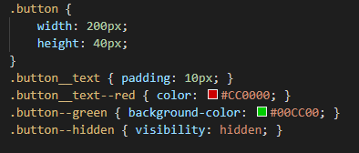
BEM
Block – Element – Modifier
Divide layout into blocks
Blocks contain elements
Define state of block or element with modifiers
Naming convention: block__element--modifier

Slide 5
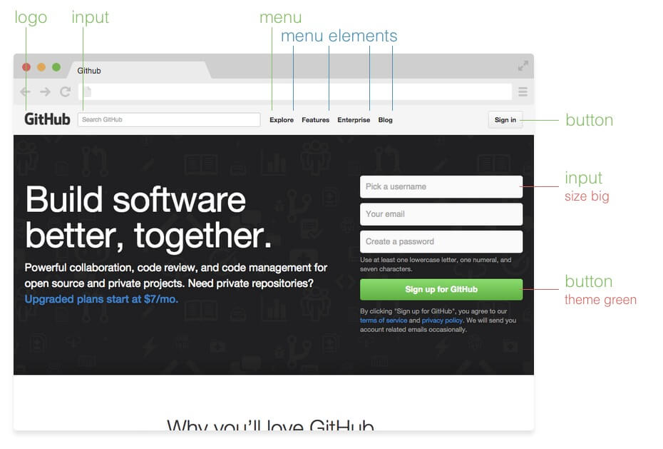
Source: http://getbem.com/introduction/

Slide 6
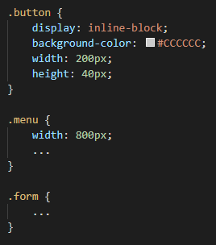
Block
Independent components
Reusable
Defines the purpose

Slide 7
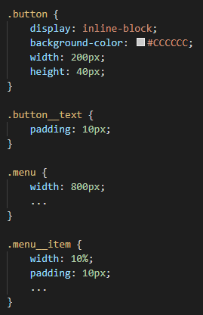
Element
Child of a block
No meaning on its own
Never related to another element
Double underscore as prefix

Slide 8
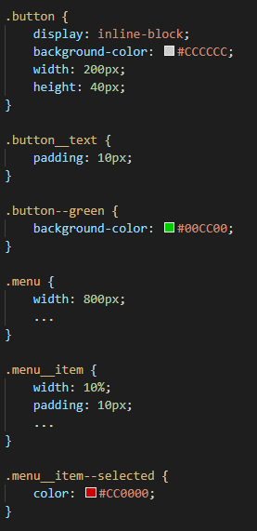

Modifier
Defines state or appearance
Prefix: double hyphen
Modifying element based on block-level modifier is allowed:

Slide 9
Pros & Cons
Easy to use
Reusable styles
Bloated HTML
Components cannot share styles

Slide 10
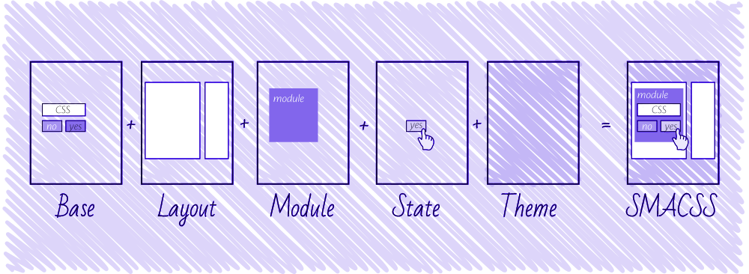
SMACSS
Scalable and Modular Architecture for CSS
CSS rules categorization
5 style categories:
Base
Layout
Module
State
Theme
Source: https://css-tricks.com/methods-organize-css/

Slide 11
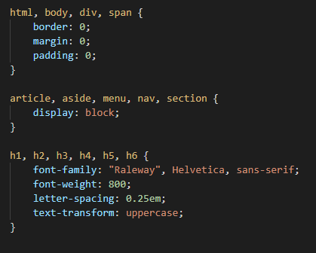
Base Rules
Defaults
Element selector
Example: html, body, form, a

Slide 12
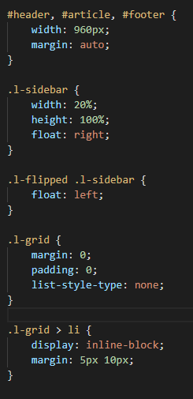
Layout Rules
Defines page sections
Major components
Example: #header, #footer, #sidebar
Combinable with other layout styles
.l- prefix

Slide 13
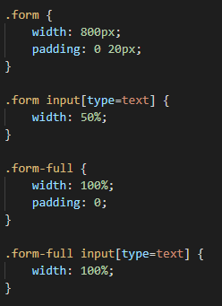
Module Rules
Smaller components
Independent
Reusable
Inside layout components
Related elements: Use module name as prefix
Sub-class modules if necessary

Slide 14
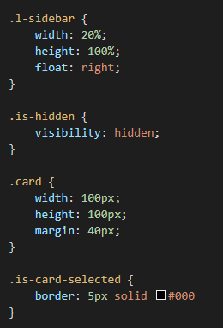
State
Defines current status of element
Applied to layout or module
Overrides other styles
Include module name if it specifically relates to the behavior of a module

Slide 15
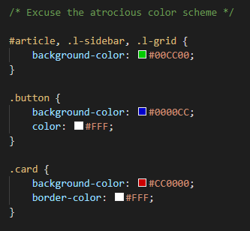
Theme
Replaceable styles
Typically defines the overall look
Can override all other style rules
Not mandatory

Slide 16
Pros & Cons
Organized CSS
Reusable modules
Complicated
Specificity issues

Slide 17

OOCSS

Slide 18

OOCSS
Seperation of skin and structure
Seperation of context and content
?
Object Oriented
2009

Slide 19
Object Oriented CSS
A css object is any repeating visual pattern, which can be abstracted into a snippet of html, css, and sometimes javascript.
The goal of Object Oriented CSS is to encourage code reuse for faster and more efficient stylesheets that are easier to maintain.

Slide 20
Separation of Skin & Structure
Skin:
Font, Color, Shadows, Gradients
Structure:
Width, Height, Margin, Padding, Overflow
Notes:
Concerning your box-shadow in your base class: this is fine as it probably reflects your design. If all your buttons have a box-shadow, this property makes sense in the base class. With base classes, it's not so much about differentiating between structure and skin, it's about finding common denominators. It just so happens that a lot of times, you can separate very easily between structure and skin, that's why it's a recommendation. But the logic, as I understand it, is to move your common styles to a base class so you don't have to repeat yourself. If your buttons all have a box-shadow in common, move it to your base class.

Slide 21
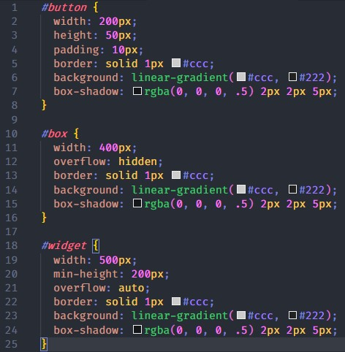
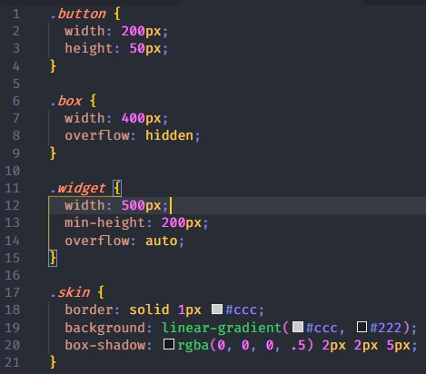
Separation of Skin & Structure

Slide 22
Separation of Context & Content
Never mimic the structure of your HTML in CSS.
Avoiding child selectors
As a general rule, styles should never be scoped to particular containers.

Slide 23
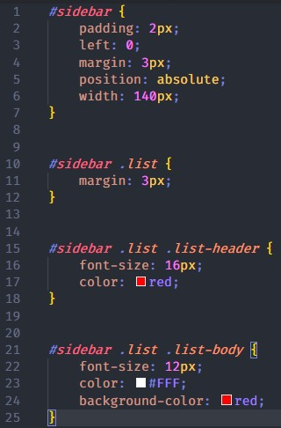
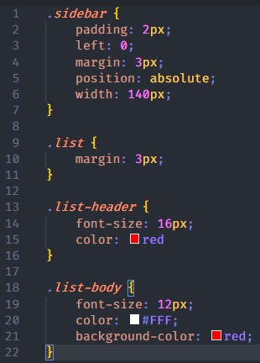
Separation of Context & Content

Slide 24
Pros & Cons
✓ High reusability
✓ Ease of maintainability
You may need to add multiple classes to an element to account for all of the styling elements.
Without a fair amount of repeating visual patterns, separating structure and visual style codes seem unnecessary.

Slide 25

Oxygen CSS

Slide 26
Oxygen CSS
Object Oriented
Object
Child-Object
Modifiers
Subclasses

Slide 27
Oxygen CSS
Oxygen is an object-oriented approach to CSS. It is designed to give teams a simple and consistent way to communicate about stylesheets.
We naturally speak in terms of objects when talking about “buttons”, “menus”, and “controls.”
Notes:
- It is one part a set of naming conventions and one part a way of thinking about CSS. It seeks to take the best of Object-Oriented Programming and apply it to how we write CSS.

Slide 28
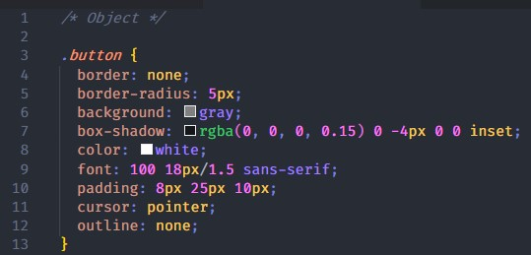
Objects
.noun
are the individual parts that make up a web page or application.

Slide 29
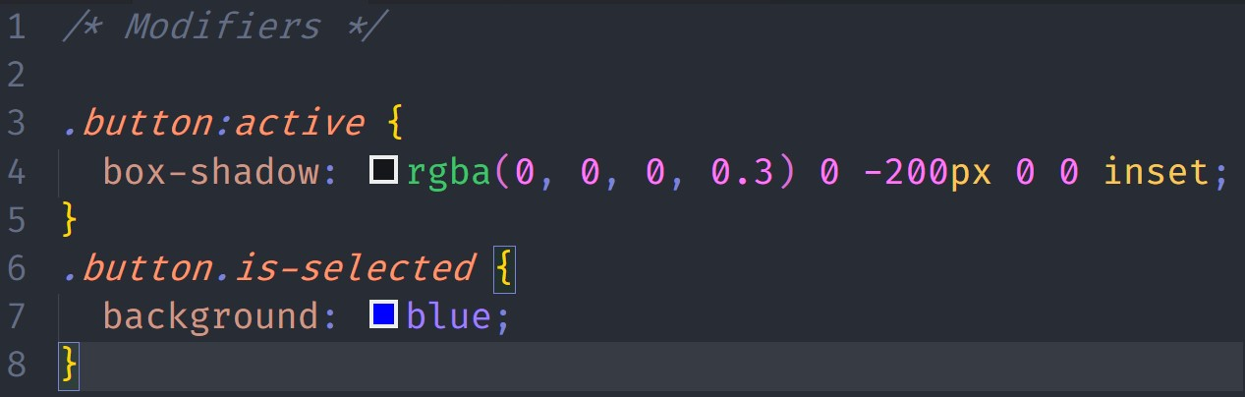
Modifiers
.prefix-adjective / .adjective
state modifiers should almost always be bound directly to the object class name

Slide 30
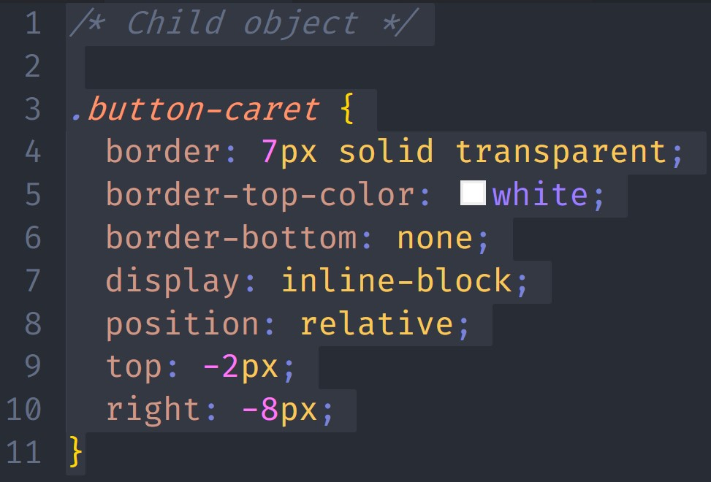
Child objects
.noun-noun
When an object should only ever be used inside of another object, the Oxygen naming convention is to include the name of the parent in the name of the child

Slide 31
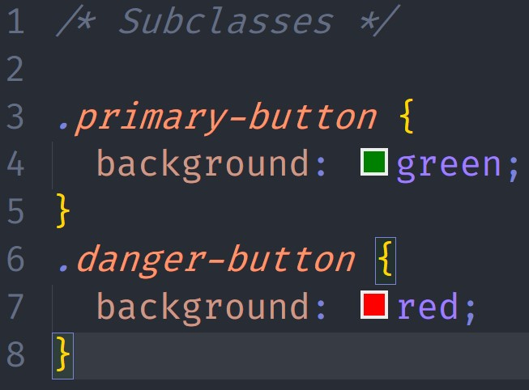
Subclasses
.adjective-noun
when an object is a kind of another object it is called a subclass.

Slide 32
Pros & Cons
✓ High reusability
✓ Ease of maintainability
Can be confusing for new developers. What is an object and what is not? This will force you to document things and introduce new dev to your codebase (which is good to do).

Slide 33
Vragen?

Slide 34
Hands-on
https://bit.ly/2SUypBF

Slide 35
Tips!!
Probeer typografie eenmalig neer te zetten
Gebruik ems over pixels voor layout
Layout voor componenten

