Slide 1

CSS architectuur
Kevin Oosterlaak & Kjettil Hennis

Slide 2
Agenda
Frameworks vs methodologies
The methodologies explained
Hands-on

Slide 3



Frameworks vs Methodologies
Framework
Examples
A pre-defined set of components
Large
Many possibilities
Contains a lot of bloat css

Slide 4
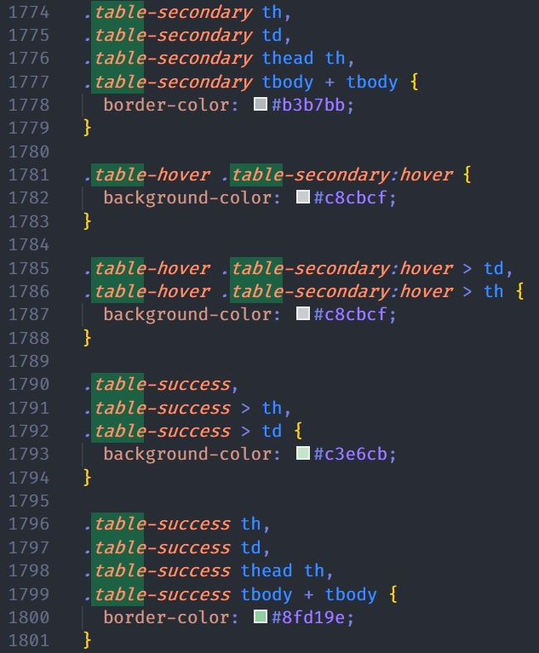
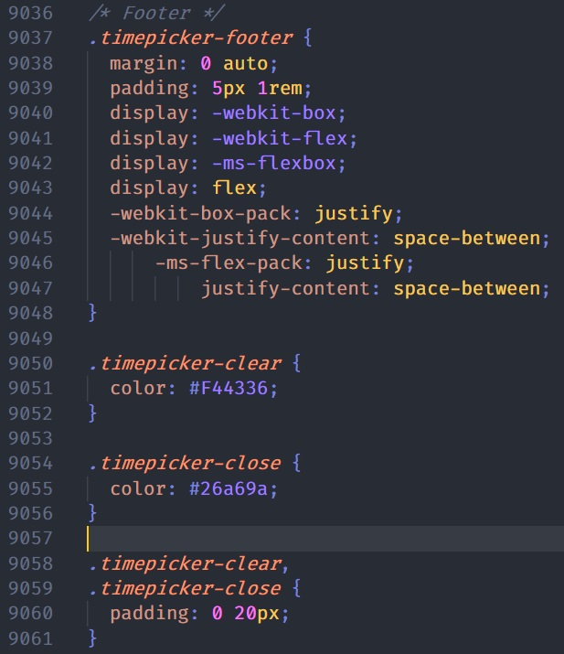
Bloat CSS

Slide 5




Frameworks vs Methodologies
Methodologies
An idea to structure your style rules
Scalability
Own adapation

Slide 6

BEM

Slide 7
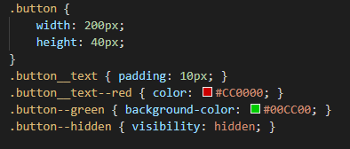
BEM
Block – Element – Modifier
Divide layout into blocks
Blocks contain elements
Define state of block or element with modifiers
Naming convention: block__element--modifier

Slide 8
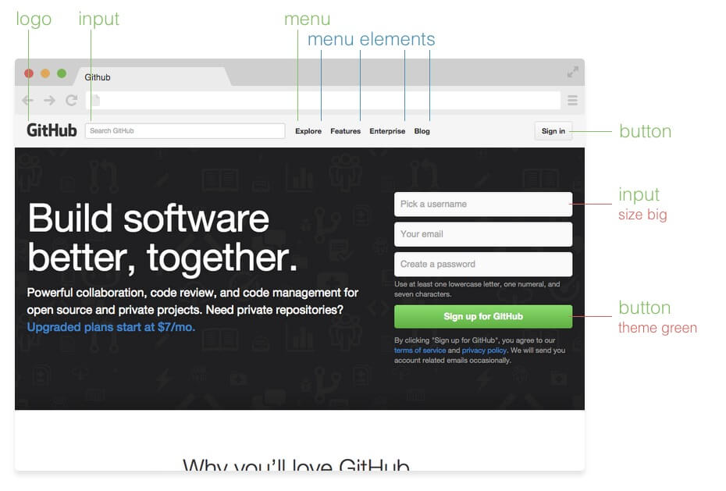
Source: http://getbem.com/introduction/

Slide 9
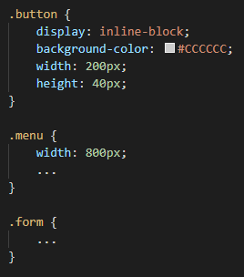
Block
Independent components
Reusable
Defines the purpose

Slide 10
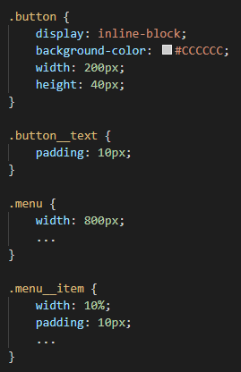
Element
Child of a block
No meaning on its own
Never related to another element
Double underscore as prefix

Slide 11
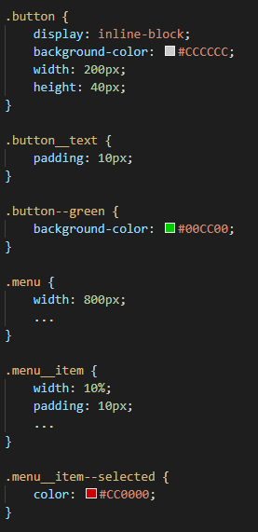

Modifier
Defines state or appearance
Prefix: double hyphen
Modifying element based on block-level modifier is allowed:

Slide 12
Pros & Cons
Easy to use
Reusable styles
Bloated HTML
Components cannot share styles

Slide 13
SMACSS

Slide 14
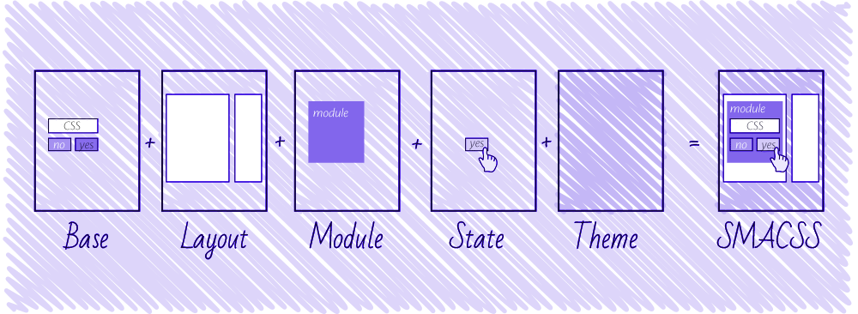
SMACSS
Scalable and Modular Architecture for CSS
CSS rules categorization
5 style categories:
Base
Layout
Module
State
Theme
Source: https://css-tricks.com/methods-organize-css/

Slide 15
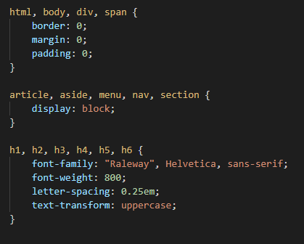
Base Rules
Defaults
Element selector
Example: html, body, form, a

Slide 16
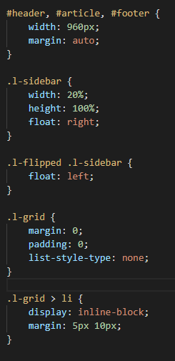
Layout Rules
Defines page sections
Major components
Example: #header, #footer, #sidebar
Combinable with other layout styles
.l- prefix

Slide 17
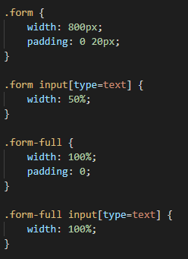
Module Rules
Smaller components
Independent
Reusable
Inside layout components
Related elements: Use module name as prefix
Sub-class modules if necessary

Slide 18
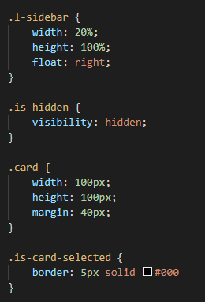
State
Defines current status of element
Applied to layout or module
Overrides other styles
Include module name if it specifically relates to the behavior of a module

Slide 19
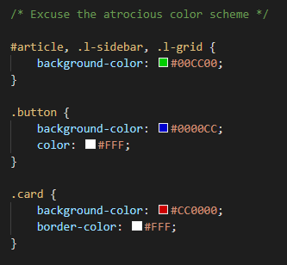
Theme
Replaceable styles
Typically defines the overall look
Can override all other style rules
Not mandatory

Slide 20
Pros & Cons
Organized CSS
Reusable modules
Complicated
Specificity issues

Slide 21

OOCSS

Slide 22
Object Oriented CSS
A css object is any repeating visual pattern, which can be abstracted into a snippet of html, css, and sometimes javascript.
The goal of Object Oriented CSS is to encourage code reuse for faster and more efficient stylesheets that are easier to maintain.

Slide 23
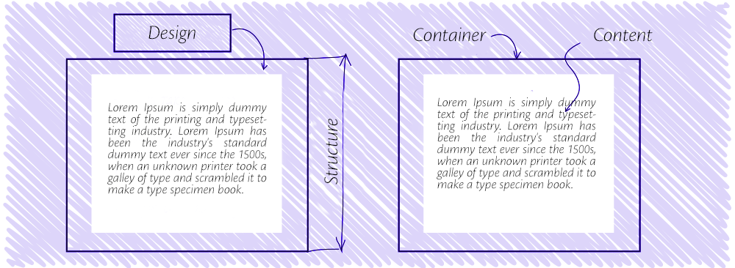
Object Oriented CSS
Seperation of skin and structure
Seperation of context and content

Slide 24
Separation of Skin & Structure
Skin:
Structure:
Font, Color, Shadows, Gradients
Theming
Width, Height, Margin, Padding, Overflow
Base style
Notes:
Concerning your box-shadow in your base class: this is fine as it probably reflects your design. If all your buttons have a box-shadow, this property makes sense in the base class. With base classes, it's not so much about differentiating between structure and skin, it's about finding common denominators. It just so happens that a lot of times, you can separate very easily between structure and skin, that's why it's a recommendation. But the logic, as I understand it, is to move your common styles to a base class so you don't have to repeat yourself. If your buttons all have a box-shadow in common, move it to your base class.

Slide 25
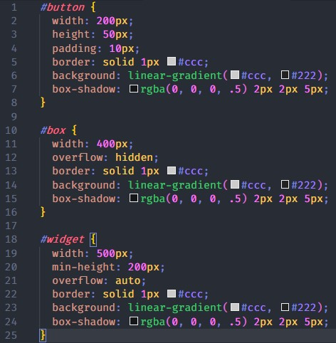
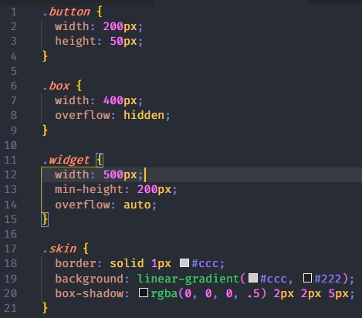
Separation of Skin & Structure

Slide 26
Separation of Context & Content
Never mimic the structure of your HTML in CSS.
Avoiding child selectors
As a general rule, styles should never be scoped to particular containers.

Slide 27
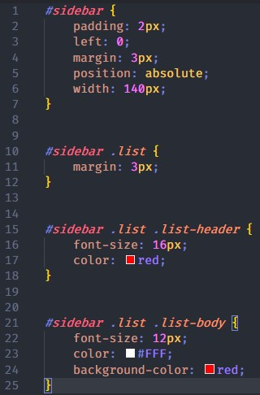
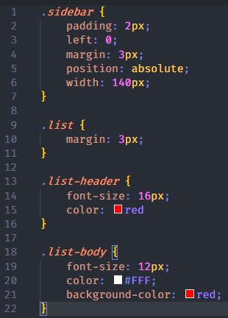
Separation of Context & Content

Slide 28
Pros & Cons
✓ High reusability
✓ Ease of maintainability
You may need to add multiple classes to an element to account for all of the styling elements.
Without a fair amount of repeating visual patterns, separating structure and visual style codes seem unnecessary.

Slide 29

Oxygen CSS

Slide 30
Oxygen CSS
Oxygen is an object-oriented approach to CSS. It is designed to give teams a simple and consistent way to communicate about stylesheets.
We naturally speak in terms of objects when talking about “buttons”, “menus”, and “controls.”
Notes:
- It is one part a set of naming conventions and one part a way of thinking about CSS. It seeks to take the best of Object-Oriented Programming and apply it to how we write CSS.

Slide 31
Oxygen CSS
Object
Child-Object
Modifiers
Subclasses

Slide 32
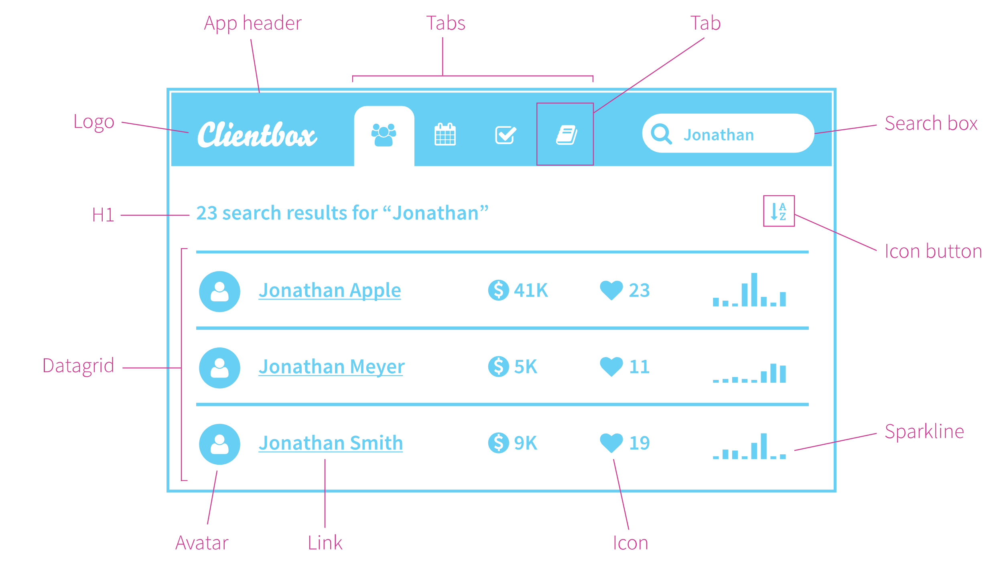
Oxygen CSS

Slide 33
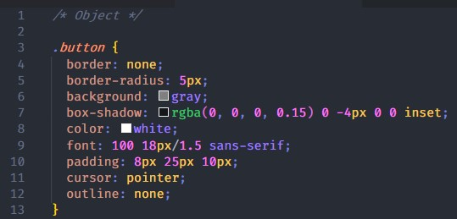
Objects
.noun
are the individual parts that make up a web page or application.

Slide 34
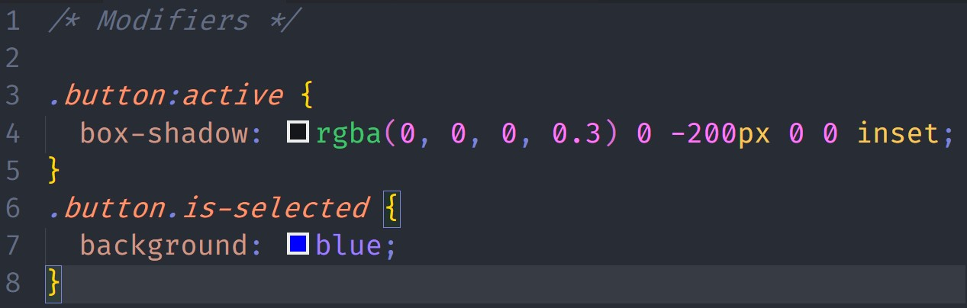
Modifiers
.prefix-adjective / .adjective
state modifiers should almost always be bound directly to the object class name

Slide 35
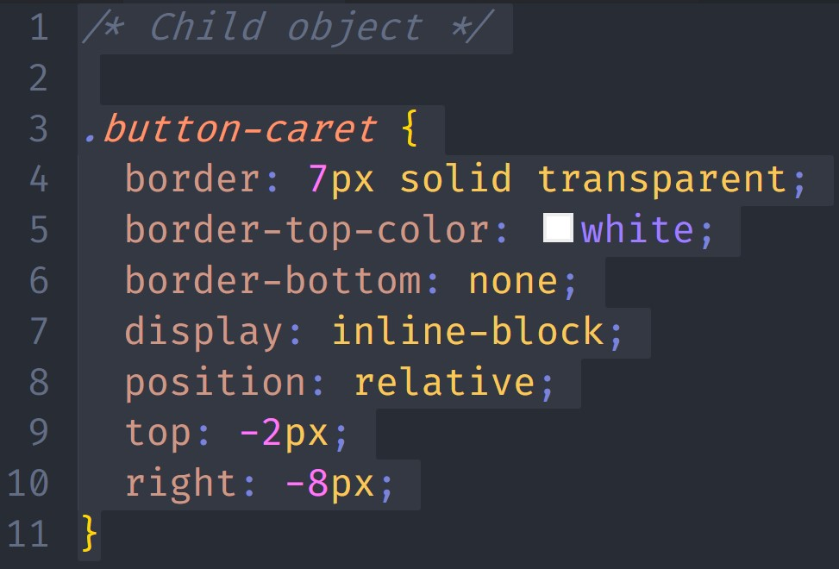
Child objects
.noun-noun
When an object should only ever be used inside of another object.
Notes:
The Oxygen naming convention is to include the name of the parent in the name of the child

Slide 36
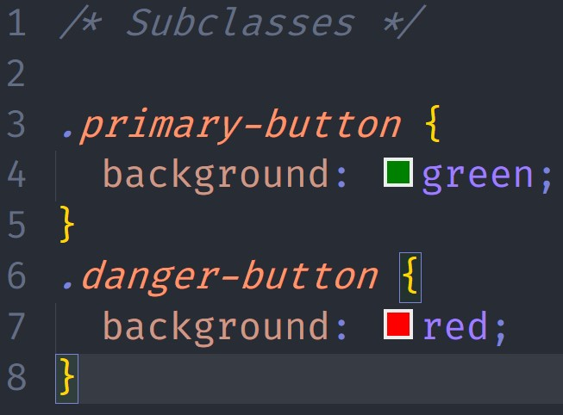
Subclasses
.adjective-noun
when an object is a kind of another object it is called a subclass.

Slide 37
Pros & Cons
✓ High reusability
✓ Ease of maintainability
Can be confusing for new developers. What is an object and what is not?
Notes:
This will force you to document things and introduce new dev to your codebase (which is good to do).

Slide 38
Questions?

Slide 39
Hands-on https://bit.ly/2SUypBF

Slide 40
BEM: http://getbem.com/ SMACSS: http://smacss.com/ OOCSS: https://github.com/stubbornella/oocss/wiki Oxygen CSS: http://oxygencss.com/

