Slide 1

Elasticsearch 14-05-2020 Jeffrey Resodikromo Emmy Hermans

Slide 2
Overview 14-05-2020
Presentation (16:30 – 17:30)
Hands-on (19:00 – 20:00)
Introduction
Cluster
Indexing
Queries
Scoring
Aggregations
Cluster info and Indexing
Queries and aggregations
Connecting to ElasticSearch with Node.js
Connecting to ElasticSearch with Spring

Slide 3
Elasticsearch
A noSQL search engine for:
Prioritizing data
Searching through (a lot of) data
Filtering data
Can be used as primary storage, but often a different noSQL or SQL database is used
Part of the ELK stack:
Logstash – for pushing data to elasticsearch
Kibana – webUI for visualizing data

Slide 4
Advantages and disadvantages
Advantages
Disadvantages
Fast searching of big data sets
Full-text search
Fuzzy searching
Aggregations of data
Easy to index
Easily scalable
Relatively slow at adding new data
No “blocking” of transactions
No feature for authorization or authentication
Cluster can become irrecoverable after hardware failure or power outage resulting in data loss -> use other database as primary
“Complex” query mechanism

Slide 5
Elasticsearch use cases
Textual search of large texts
Fast property search
Auto-suggest or auto-complete
Saving and analysing logging of applications
Metrics of events and real-time data
Geo-searching
Aggregate data

Slide 6
Document
Smallest unit of data
Self contained
Can be hierarchical
Flexible structure (JSON)
{
"name": "Farm Henk",
"foundingDate": "1922-03-11",
"location": {
"name": "Utrecht",
“street": “Dorpstraat“,
“numbe”: “22”
},
"animals": ["Pigs", "Cows", "Chickens"]
}

Slide 7
Index
Container of documents
Index mapping
Settings such as refresh interval, number of shards, number of replica’s
Index is divided into shards
(Deprecated) Subdivided into types

Slide 8
Types (deprecated)
Container of documents
Index mapping
Settings such as refresh interval, number of shards, number of replica’s
Index is divided into shards

Slide 9
Index Mapping
Definition of how a document and the field it contains are stored and indexed.
Types:
text, keyword, date, long, double, boolean, ip.
hierarchical JSON such as object or nested.
Inserted documents are not restricted to those fields only
Existing mappings can be extended
Types can’t be changed

Slide 10
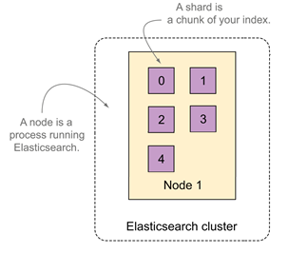
Cluster
Elastic Search always runs in a cluster
Cluster is a group of nodes having the same cluster.name attribute
Nodes can be added to/removed from a cluster

Slide 11
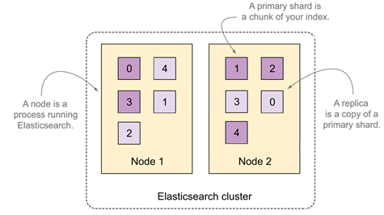
Cluster

Slide 12
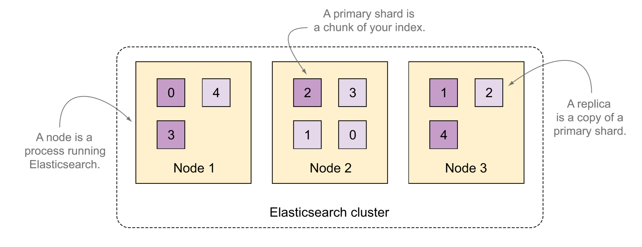
Cluster

Slide 13
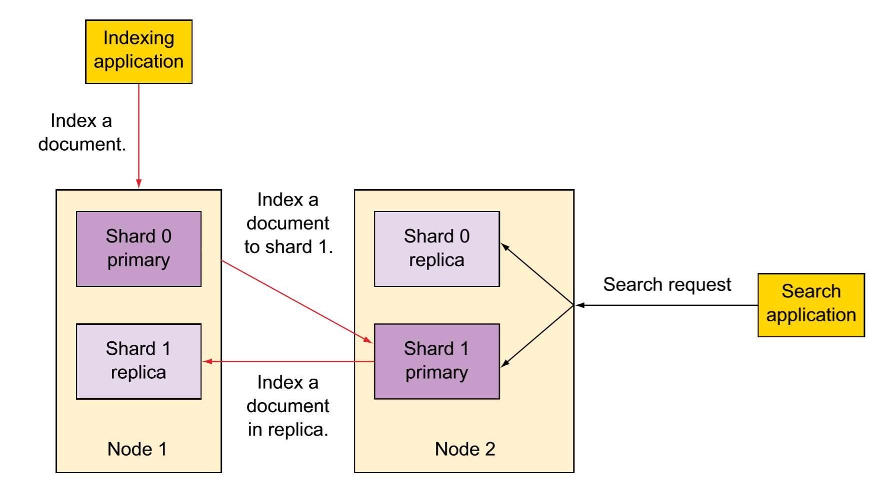
Indexing and Searching in a Cluster

Slide 14
Inverted Index
Maps terms to document
Term is the unit of search
Sorted, which means fast searching
Term | Document | Frequency
burrito | id3 | 2 occurences: id3 -> 2x
nacho | id2, id3 | 4 occurrences: id2 -> 2x, id3 -> 2x
pizza | id1 | 1 occurrence: id1 -> 1x
tomato | id1, id2, id3 | 5 occurences: id1 -> 1x, id2 -> 1x, id3 -> 4x

Slide 15
Analysis
Enables full-text search -> relevant results are returned
Analysis is used to break down text into terms
Analysis is used on indexing and on searching
A Quick Brown Fox Jumps Over the Lazy Hedge”
Produces terms:
a, quick, brown, fox, jumps, over, the, lazy, hedge

Slide 16
REST API
All communications with Elastic Search is done by issuing HTTP requests using the REST API:
Index/update/delete documents or indices
Searching an index
Monitor cluster
Manage cluster
Manage security

Slide 17
GET localhost:9200
{
"name" : "es01",
"cluster_name" : "es-docker-cluster",
"cluster_uuid" : "9Ce4263QRLSQV5X1RlR-Gw",
"version" : {
"number" : "7.6.1",
"build_flavor" : "default",
"build_type" : "docker",
"build_hash" : "aa751e09be0a5072e8570670309b1f12348f023b",
"build_date" : "2020-02-29T00:15:25.529771Z",
"build_snapshot" : false,
"lucene_version" : "8.4.0",
"minimum_wire_compatibility_version" : "6.8.0",
"minimum_index_compatibility_version" : "6.0.0-beta1"
},
"tagline" : "You Know, for Search"
}

Slide 18
Indexing data
Done using the REST API
Using POST or PUT
Automatic creation of index with default settings, including index mapping
type (deprecated)
document id
http://localhost:9200/recipes/_doc/213
indexname

Slide 19
Indexing data
Done using the REST API
Using POST or PUT
Automatic creation of index with default settings, including index mapping
PUT http://localhost:9200/recipes/_doc/1234
POST http://localhost:9200/recipes/_doc/
PUT http://localhost:9200/recipes/_create/1234
POST http://localhost:9200 /recipes/_create/1234

Slide 20
Manual Index Creation
PUT http://localhost:9200/newindex
{
"settings" : {
"number_of_shards" : 3,
"number_of_replicas" : 1
},
"aliases": {
"myfirstindex" : {}
},
"mappings": {
"properties": {
"age": { "type": "integer" },
"email": { "type": "keyword" },
"name": { "type": "text" }
}
}
}
Allows to define
Index mapping
Index settings
Aliases
Some index settings can be changed on runtime (like number of replicas)

Slide 21
REST API’s
Operations are performed on a single document
GET http://localhost:9200/recipes/_doc/213
GET http://localhost:9200/recipes/_doc/213?_source_includes=name
HEAD http://localhost:9200/recipes/_doc/213
POST http://localhost:9200/recipes/_update/213
DELETE http://localhost:9200/recipes/_doc/213

Slide 22
Bulk operations
POST http://localhost:9200/myindex/_bulk
{ "index" : { "_index" : "test", "_id" : "1" } }
{ "field1" : "value1" }
{ "delete" : { "_index" : "test", "_id" : "2" } }
{ "create" : { "_index" : "test", "_id" : "3" } }
{ "field1" : "value3" }
{ "update" : {"_id" : "1", "_index" : "test"} }
{ "doc" : {"field2" : "value2"} }

Slide 23
Queries
URL-based or JSON-based requests on the _search REST endpoint
Search whole cluster or specify index (or type) in the URL
Common components of request:
query - default all
size - default 10
from - default 0
_source - default all
Specify which fields of the document to return
sort - default on score
No score is calculated when score is not included in the sort

Slide 24
URL-based queries
Has less features then JSON-based queries
Often used for request from a command line etc
GET request with query params
query: q=
For syntax and possibilities see: https://www.elastic.co/guide/en/elasticsearch/reference/current/query-dsl-query-string-query.html
size/from: number
_source: separate multiple fields by a ,
sort: <fieldname>:<sort direction(asc or desc)>
sorting will not work on text fields, need to use the keyword field

Slide 25
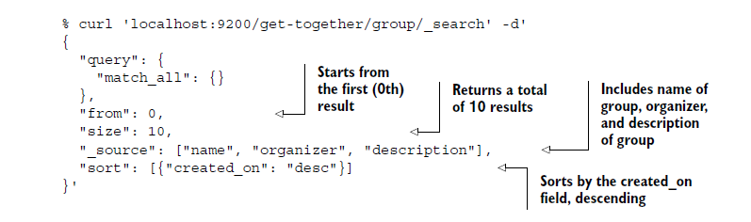
JSON-based queries
More flexible and more options than URL-based queries
POST request with JSON body
Source: Elasticsearch in action -2016
query match_all is default

Slide 26
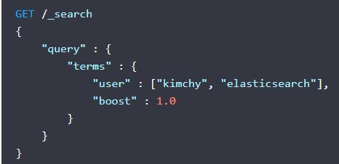
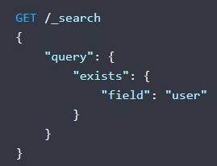
JSON-based queries – term level queries
No analysis of search terms – avoid using on text field
Match the exact term stored in a field
Queries: exists, fuzzy, ids, prefix, range, regexp, term, terms, terms_set, type (deprecated), wildcard
https://www.elastic.co/guide/en/elasticsearch/reference/current/term-level-queries.html

Slide 27
JSON-based queries – full text queries(1)
Search analysed text fields
Query string is analysed in same way as text field
Queries: intervals, match, match_bool_prefix, match_phrase, match_phrase_prefix, multi_match, common terms (deprecated), query_string, simple_query_string
query _string: has the same options and syntax as the q query param in URL-based requests
simple_query_string: more limited but does not return errors for invalid syntax, ignores it instead

Slide 28

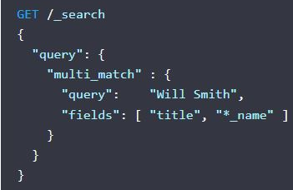
JSON-based queries – full text queries(2)
match: standard query for full-text search
multi_match: same as match, but for multiple fields

Slide 29
JSON-based queries – full text queries(3)
match_phrase: match a phrase precisely or provide the “slop” parameter to allow some words in between.
match_phrase_prefix: last term is treated as prefix, matching any word beginning with that term
match_bool_prefix: match terms in any position, not in specific order
intervals: search documents based on order and proximity of terms
https://www.elastic.co/guide/en/elasticsearch/reference/current/full-text-queries.html

Slide 30
JSON-based queries – compound queries(1)
Wrap other (compound) queries to combine results, change query behaviour or use a filter
No score is calculated for results that are filtered out
Often used filters are cached by elasticsearch
Queries: bool (boolean), boosting, constant_score, dis_max (disjunction max), function_score
For manipulating scores: boosting, constant_score, dis_max, and function_score

Slide 31
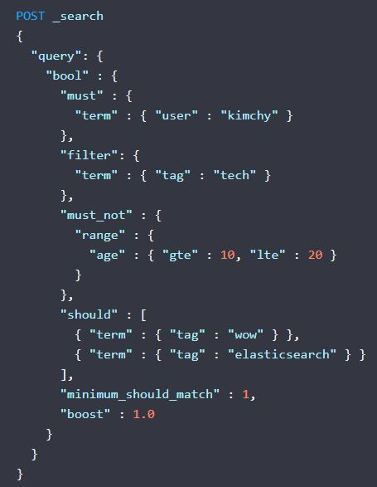
JSON-based queries – compound queries(2)
bool (boolean) query: matching boolean combinations of other queries
Occurrence types:
must: the query must match and will contribute to score
filter: the query must match and scoring is ignored
should: scoring is higher if this query matches
must_not: the query must not match and scoring is ignored
A minimum_should_match parameter can be defined the specify number or percentage of should clauses that must match.
Default is 1 if no must or filter clause is present, otherwise 0.

Slide 32
JSON-based queries – other queries
Geo queries: query on geo points or shapes
Shape queries: query two dimensional shapes
Joining queries: query nested data and parent-child relationships
span queries: low-level positional queries, very specific control over order and proximity of terms
Specialized queries: do not fit in other groups
https://www.elastic.co/guide/en/elasticsearch/reference/current/query-dsl.html

Slide 33
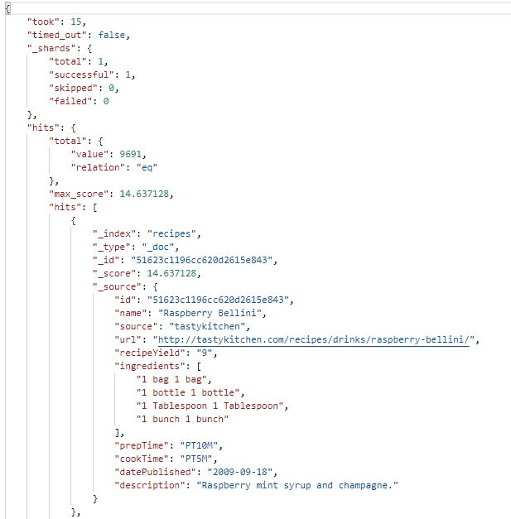
Query results
Took: time in ms
Timed_out: indicating partial results if true
_shards: number of shards that responded
Total – value: number of documents matching the query
Total – relation: eq means it’s this exact number, gte means it’s the lower bound
Max_score: the highest score
Hits: array of the results, default 10 items
_index: index of the document
_score: score of the document
_source: the fields of the document that were requested, default all fields

Slide 34
Scoring
The score indicates the relevance of a result
Default scoring: how often a term occurs in the document (term frequency or TF) compared to how often it occurs in all documents (inverse document frequency or IDF)
Can use other scoring method for whole cluster or for just one field
Rescoring: resource intensive scoring calculations
Only applied to top results, after initial scoring is done
Add “rescore” to JSON body with window_size, query, query_weight and rescore_weight
Window size determines on how many of the top documents a rescore is applied
The relative importance of the original score and rescore can be controller with query_weight and rescore_weight

Slide 35
Boosting(1)
Boosting: change relevance (score) of documents
When indexing (deprecated): can only be altered by re-indexing
When querying
Boosting is relative
By adding “explain”: true to a query an _explanation is added to the result where the TF and IDF and boosting factors can be found
Resource intensive, use only for debugging
Can be done in most term-level and full-text queries and all compound queries
Only relevant when combining queries or searching multiple fields

Slide 36
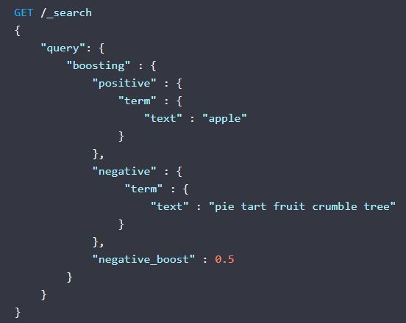
Boosting(2)

Slide 37
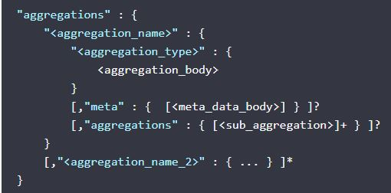
Aggregations(1)
Put in JSON request under aggregations or aggs
Run on the result of a query unless otherwise specified
“global”: {}: runs the aggregations on all documents that are searched in the url
“filter”: {…}: runs the aggregations on the filtered subset
A post_filter can be used to filter the query without applying the filter to the aggregations
4 basic types:
Bucket: define document sets based on criteria
Metrics: compute metrics on values extracted from documents
Matrix: operate on multiple fields and produce a matrix result (experimental)
Pipeline: work on the output of other aggregations

Slide 38
Aggregations(2)
Values used for aggregations can be extracted by setting a field key or by defining a script to generate the values
Aggregations can be nested
The results are shown below the query results
Set size to 0 to only get aggregation results
Results are approximate for values above 2^53
https://www.elastic.co/guide/en/elasticsearch/reference/current/search-aggregations.html

Slide 39
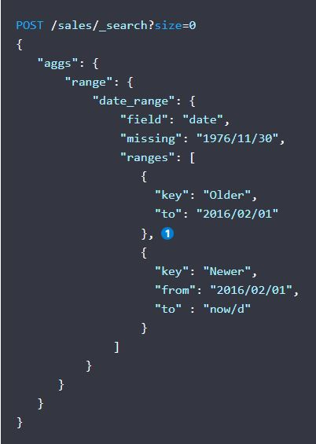
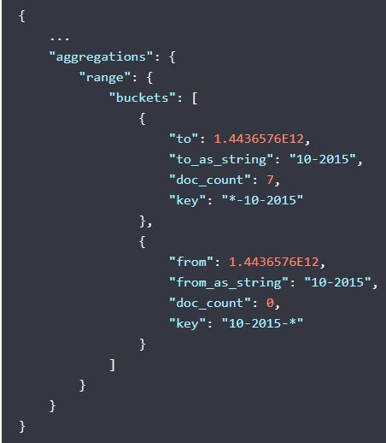
Bucket aggregations
Aggregations: date histogram, filters, geo distance, histogram, ip range rare terms, significant text, terms etc…
https://www.elastic.co/guide/en/elasticsearch/reference/current/search-aggregations-bucket.html

Slide 40
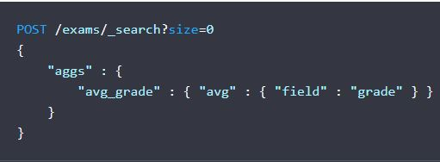
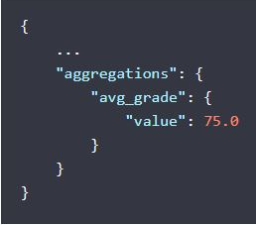
Metrics aggregations
Aggregations: avg, cardinality, max, min, percentiles, stats, sum etc..
https://www.elastic.co/guide/en/elasticsearch/reference/current/search-aggregations-metrics.html

Slide 41
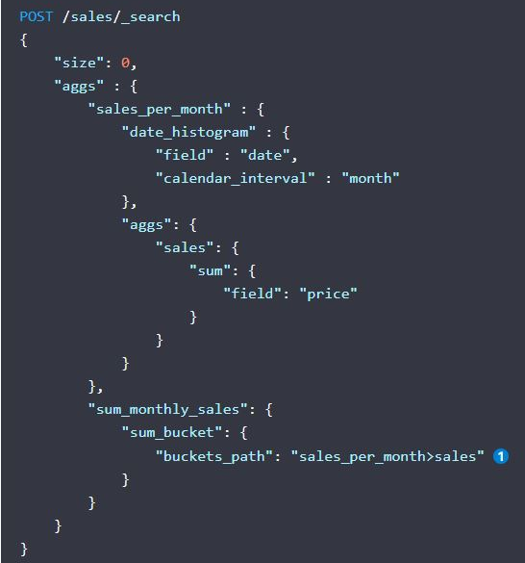
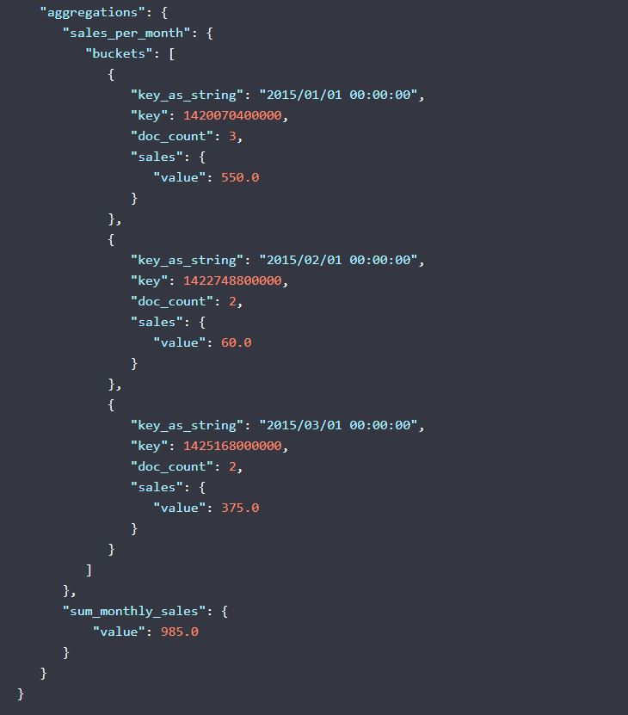
Pipeline aggregations
Aggregations: avg bucket, max bucket, sum bucket, stats bucket, cumulative sum etc..
https://www.elastic.co/guide/en/elasticsearch/reference/current/search-aggregations-pipeline.html
…

Slide 42

Hands-on (19:00 -20:00)
https://github.com/AMIS-Services/sig-elasticsearch-may2020
Running elasticsearch in docker
Use of recipes data from https://openrecip.es/
Topics:
Cluster info and Indexing
Queries and aggregations
Connecting to ElasticSearch with Node.js
Connecting to ElasticSearch with spring

Slide 43


