Slide 1

Microservices with GraalVM & Quarkus
15-08-2019
Microservices with GraalVM & Quarkus
1

Slide 2
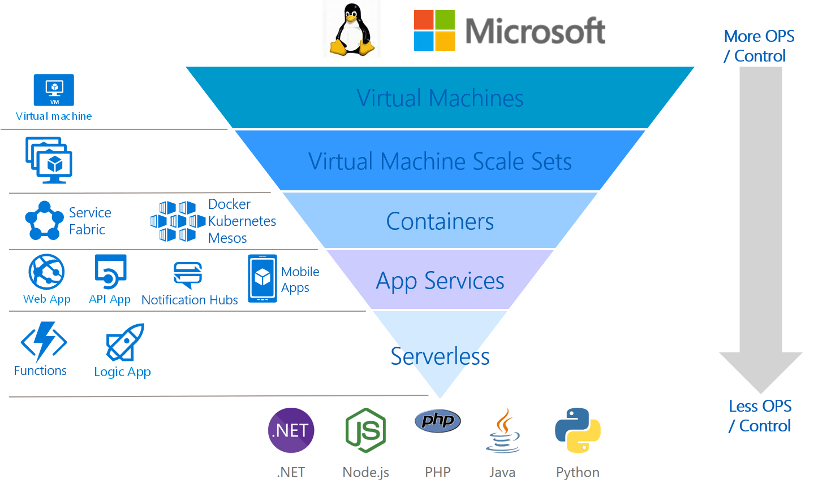
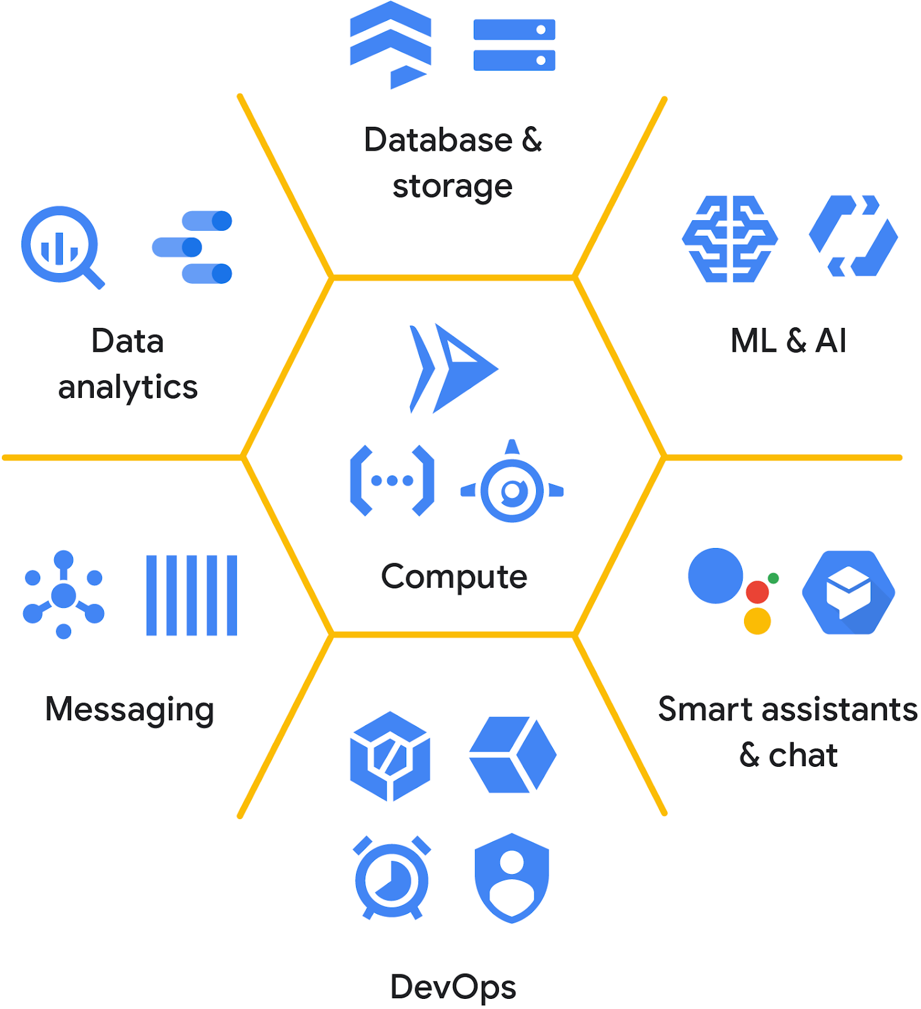



Cloud, microservices, serverless, functions!!
Microservices with GraalVM & Quarkus

Slide 3


Cloud functions out of reach for Java applications …?
Microservices with GraalVM & Quarkus

Slide 4
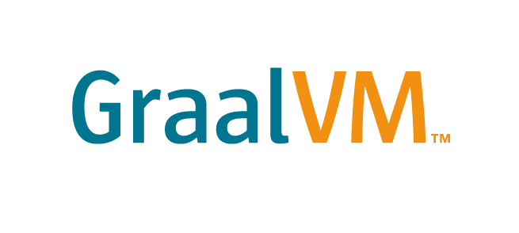

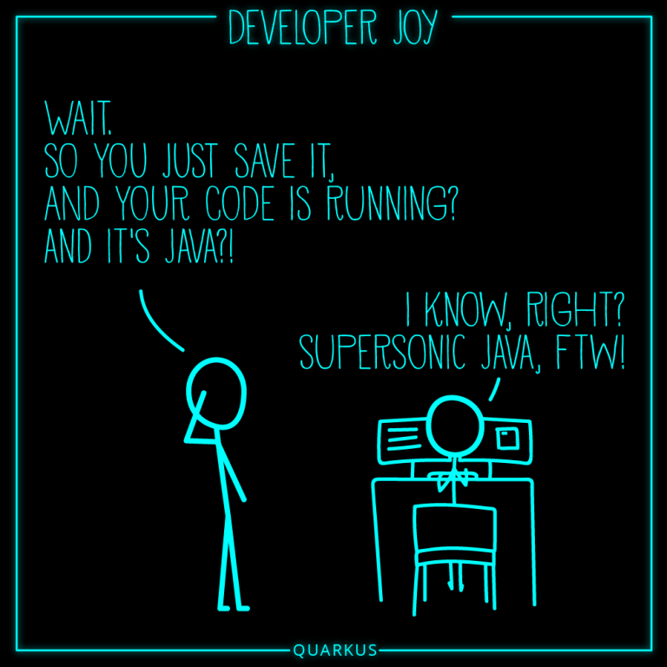
Faster speed
Microservices
Serverless
JVM
Native Executables
Graal
Ahead-Of-Time Compilation
Lower footprint
Substrate VM
Native Image
Microservices with GraalVM & Quarkus

Slide 5
Outline
JVM and JIT compilation
AOT Compilation with GraalVM
AOT vs JIT compilation
GraalVM – A research project
GraalVM – Architecture
GraalVM – A polyglot machine
GraalVM – Differences Community and Enterprise
GraalVM - The Native Image
Limitations of GraalVM

Slide 6
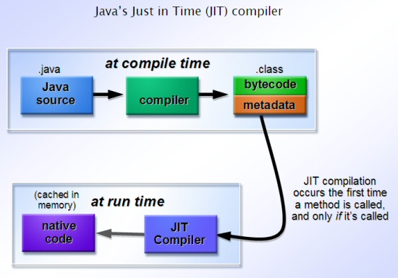
The JVM and Just-In-Time Compilation
HotSpot Virtual Machine
2 separate JIT compilers
C1 - first optimization-based compilation
C2 - extra optimization and recompilation
C2 has neared the end of its life:
Unmaintainable, old and written in old dialect of C++ and its been worked on over years and years.
Therefore near to none enhancements will be done in this area
https://www.barcelonajug.org/2014/11/
Microservices with GraalVM & Quarkus

Slide 7
The JVM and Just-In-Time Compilation
HotSpot Virtual Machine 2 separate JIT compilers
C1 - first optimization-based compilation
C2 - extra optimization and recompilation
C2 has neared the end of its life:
Unmaintainable, old and written in old dialect of C++ and its been worked on over years and years.
Therefore near to none enhancements will be done in this area
Nice
Ahw..
Optimal performance in long-running processes
Java programs are independent of target OS
Final code optimization based on workload
Slow startup time → cloud/serverless/microservices?
C2 is unmaintainable and nearly deprecated
Microservices with GraalVM & Quarkus

Slide 8
Ahead-Of-Time (AOT) Compilation with GraalVM
GOAL: improvement of startup-time
It’s in active development
Compiling at build-time, not run-time
Closed world assumption: Total compilation of all methods in an offline mode without executing the code
“Substrate framework” – allows for AOT compilation
Nice
Faster start up time
Lower runtime memory overhead
Ahw..
JIT will outperform AOT over long run
Dynamic class loading not supported
Reflection needs extensive configuration
Notes:
Substrate VM framework that allows ahead-of-time (AOT) compilation of Java applications under closed-world assumption into executable images or shared objects.

Slide 9
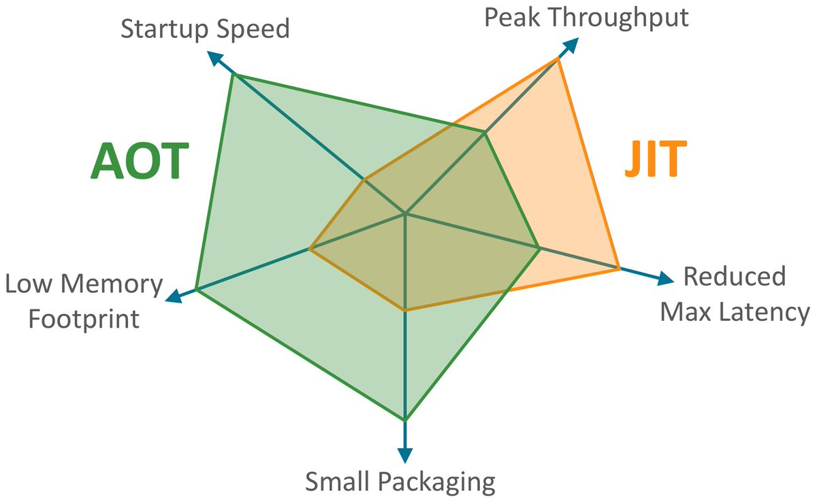
AOT vs JIT Compilation
https://twitter.com/thomaswue/status/1145603781108928513

Slide 10
Why AOT Compilation?
A new win for Java programming language and its slow (cold) start-up time > Java in the run for serverless
Less use of resource will result in cutting cloud costs > Cloud equals payment for use of memory and CPU (PaaS or IaaS)
Serverless cloud: Oracle’s Fn Project actually has GraalVM support inside AWS Lambda, Google Cloud Run, Azure Functions.
Notes:
https://theburningmonk.com/2017/06/aws-lambda-compare-coldstart-time-with-different-languages-memory-and-code-sizes/.

Slide 11
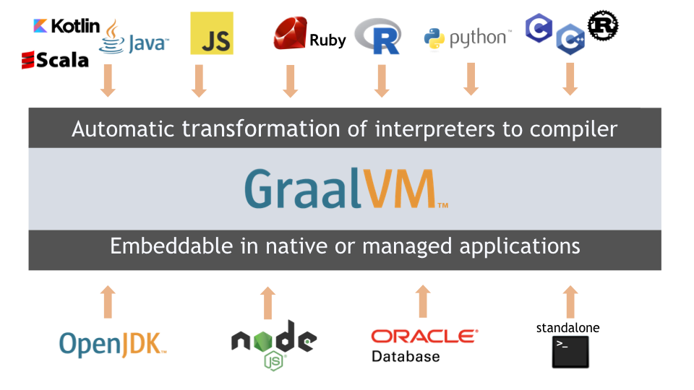
GraalVM – A research project
GraalVM
1 – A new JIT compiler: Graal Available since Java 10 as experimental option
2 – Polyglot VM: GraalVM
Polyglot
Ahead-of-time (AOT) compilation
Graal: replacing Java Hotspot VM?
Fully written in Java code
Still Java 8, Java 11 on the way
https://www.graalvm.org/docs/

Slide 12
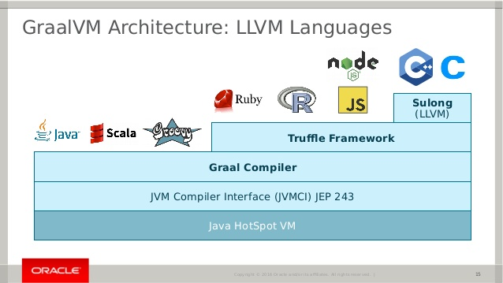
GraalVM – Architecture
LLVM – “Low-Level Virtual Machine Languages” - library to construct, optimize and produce intermediate/binary machine code
Truffle language implementation Framework – Open source library for creating your own languages and instrumentations for GraalVM and supports Graal variant languages such as R, Ruby, JavaScript, Python.
Sulong – An LLVM bytecode interpreter on top of the GraalVM for interpretation of C/C++ and Fortran f.e.
https://image.slidesharecdn.com/dopoledne-ignite-1-jaroslav-tulach-graalvm-180620154636/95/jaroslav-tulach-graalvm-z-vvoje-nejrychlejho-virtulnho-stroje-na-svt-15-638.jpg
Notes:
LLVM is a library that is used to construct, optimize and produce intermediate and/or binary machine code.

Slide 13
GraalVM – Polyglot
Languages supported
Graal variants:
GraalJS – JavaScript & Node.js (ECMAScript 2019 and 10.5.2) for now most trustworthy
FastR – R Language (3.5.1) experimental
GraalPython – Python (3.7) experimental
TruffleRuby – Ruby (2.6.2) very experimental
SimpleLanguage – Simple toy/demonstration language for GraalVM
Notes:
GraalVM allows running of following languages which are being developed and tested in related repositories with GraalVM core to run on top of it using Truffle and the GraalVM compiler. These are:
GraalJS - FastR - GraalPython - TruffleRuby - SimpleLanguage
FastR: https://github.com/oracle/fastr An experimental implementation of the R programming language that aims to be fully compatible with GNU-R
GraalPython This is an early-stage experimental implementation of Python.
GraalVM JavaScript GraalVM JavaScript can execute Node.js applications. It provides high compatibility with existing npm packages, with high likelyhood that your application will run out of the box.
Ruby: TruffleRuby TruffleRuby is progressing fast but is currently probably not ready for you to try running your full Rails application on. However it is ready for experimentation and curious end-users to try on their gems and smaller applications, and to send us reports of issues they find.

Slide 14
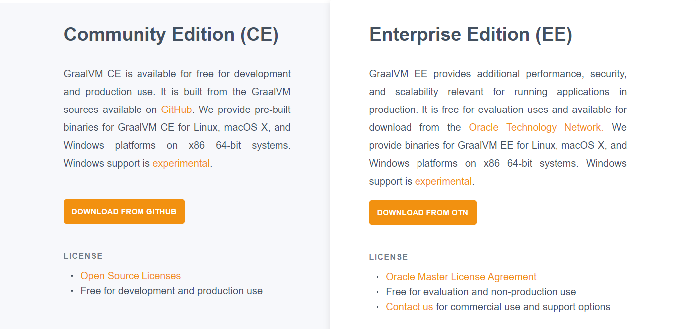
GraalVM: Community vs Enterprise Edition
Community Edition
Open JDK & accompanied dis-/advantages
Release every 6 months, but short term support
You’re on your own with unsafe languages like C and handling illegal arguments while executing your LLVM bytecode
Enterprise Edition
Oracle JDK & accompanied dis-/advantages
Release every 3 years, but long term support and better performance
Sandboxed execution of native code
https://www.graalvm.org/downloads/
Notes:
Sandboxed execution … It not only enables native code to participate in the polyglot programs, passing and receiving the data from any other supported language, but it also executes all native code in a managed environment with additional safety guarantees: catching illegal pointer accesses, accessing arrays outside of the bounds, and so on.
One limitation of LLVM interop in non-sandboxed mode is that you can not store pointers to foreign objects in native memory. Since in sandboxed mode the “native” allocations are actually in managed memory, this limitation does not apply anymore.

Slide 15
The GraalVM-derived Native Image
Includes:
The application
The libraries
The JDK - and does not run on the Java VM
Necessary components like memory management and thread scheduling from a different virtual machine, called “Substrate VM” - the name for the runtime components (like the deoptimizer, garbage collector, thread scheduling etc.) –
How it works
Native-image statically analysis of classes that are reachable and used during application execution. → Gets passed on as input to the GraalVM compiler which ahead-of-time compiles it to the native binary.
Ahw..
Specifically for YOUR operating system
Windows option is still in experimental mode

Slide 16
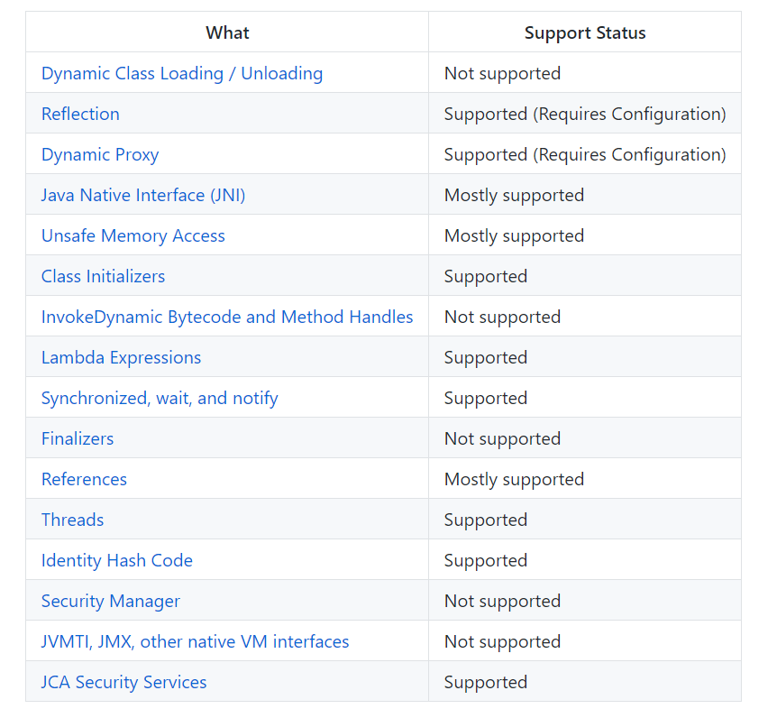
Limitations of GraalVM
Reflection:
Often used by serialization/deserialization frameworks → partially supported (Config)
Use configuration files for the GraalVM Native Image Generator (.json > GraalVM documentation)
Effort: Tracing Agent, uses Java Hotspot VM first. Enable:
-agentlib:native-image-agent=…
Dynamic Class Loading
JDBC programming – loading driver class- Class.forName() → hard limitation
https://github.com/oracle/graal/blob/master/substratevm/LIMITATIONS.md#reflection
Notes:
The closed-world assumption for GraalVM native image static analyses conflicts with the open-world approach of Java reflection: Using functionality from the package java.lang.reflect, an application developer can look up classes, methods, and fields by name and access / invoke them.
Java Reflection is quite powerful and can be very useful. Java Reflection makes it possible to inspect classes, interfaces, fields and methods at runtime, without knowing the names of the classes, methods etc. at compile time. It is also possible to instantiate new objects, invoke methods and get/set field values using reflection

Slide 17


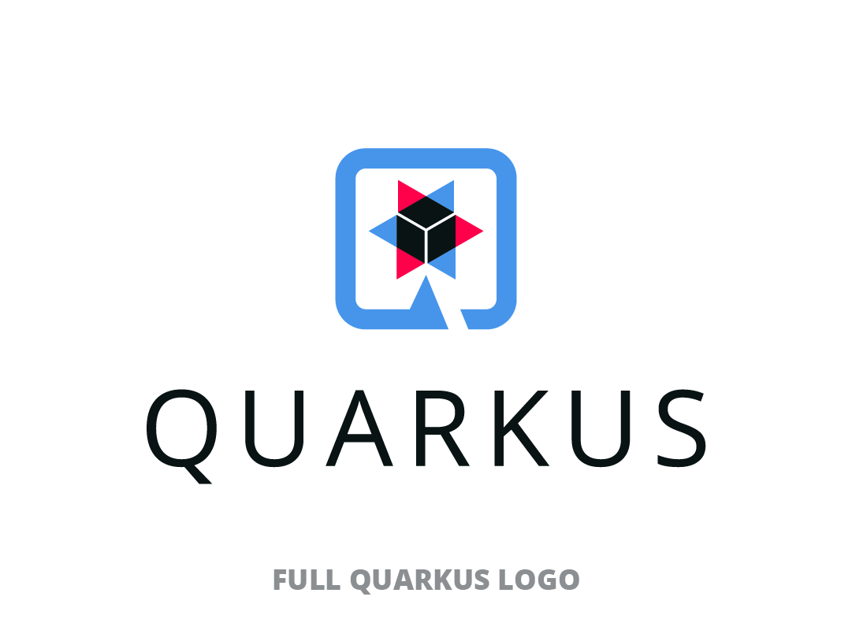
Frameworks around GraalVM to lift Java into microservices
Some frameworks for out of the box native compilation:
Helidon SE (Oracle) A set of Java Libraries for writing microservices
Micronaut JVM-based framework for building light-weight modular applications (microservices)
Quarkus (Red Hat) Kubernetes-native Java framework tailored for GraalVM and Hotspot
The next part will focus on Quarkus.

Slide 18

Questions?
Hands-on
Microservices with GraalVM & Quarkus
18

Slide 19
Hands-on
Hands-on
https://github.com/AMIS-Services/sig-graalvm-quarkus-15082019.git
Microservices with GraalVM & Quarkus
19

