Slide 1


Supersonic Subatomic Java
Quarkus
Microservices with GraalVM & Quarkus
1

Slide 2
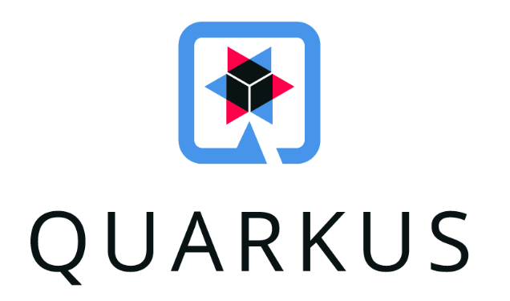




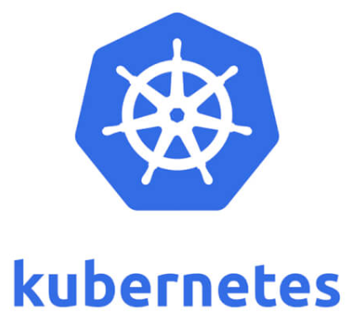



Slide 3
Quarkus
A Kubernetes Native Java stack tailored for GraalVM & OpenJDK HotSpot crafted from the best of breed Java libraries and standards
Full stack Though focus on backend
Using familiar APIs like JAX-RS, JPA, Microprofile metrics
Container first Easy containerization Kubernetes API, resource generation Quickstarts for Knative, Openshift
Fast Fast to start, fast to respond to requests
Ready for native compilation
Focus on developer experience Live reload, a lot OOTB features

Slide 4
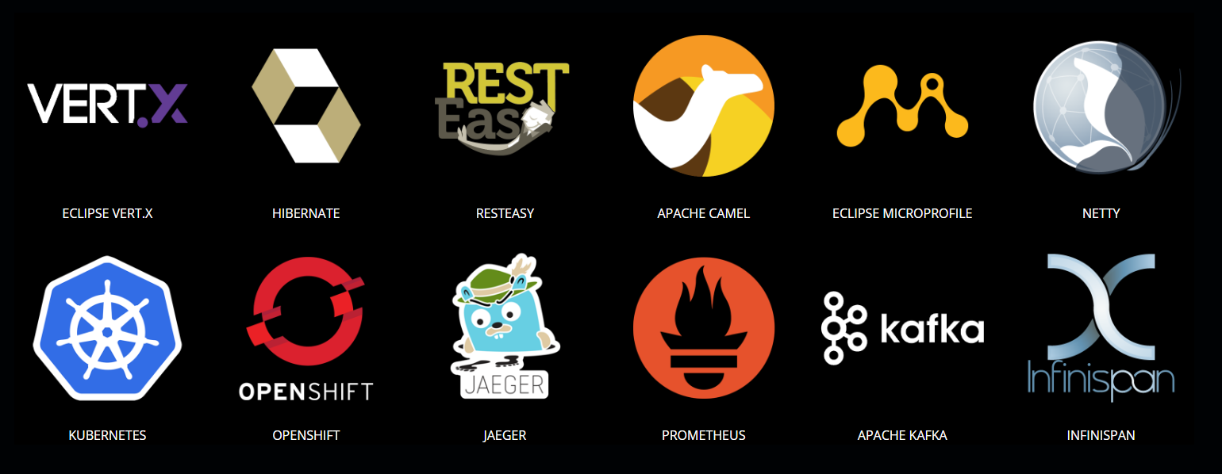
Full stack best of breed

Slide 5
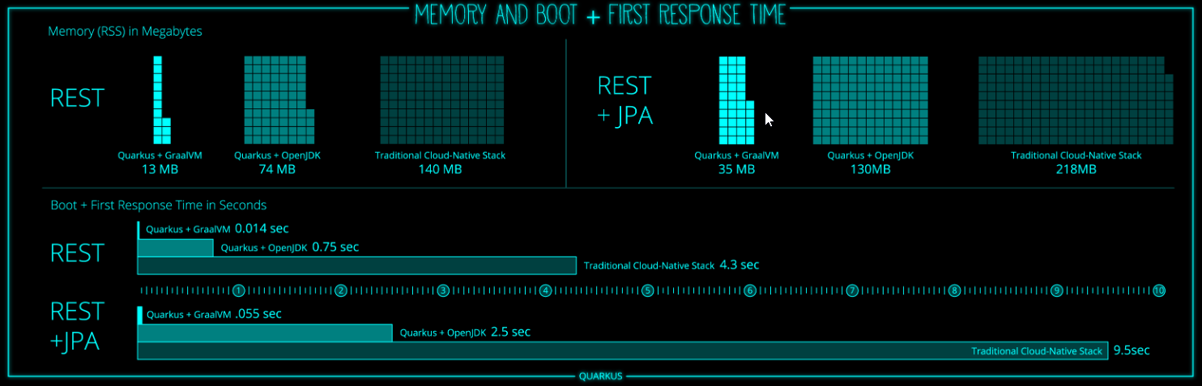
Container first Allows for native compilation Fast startup and small memory footprint

Slide 6
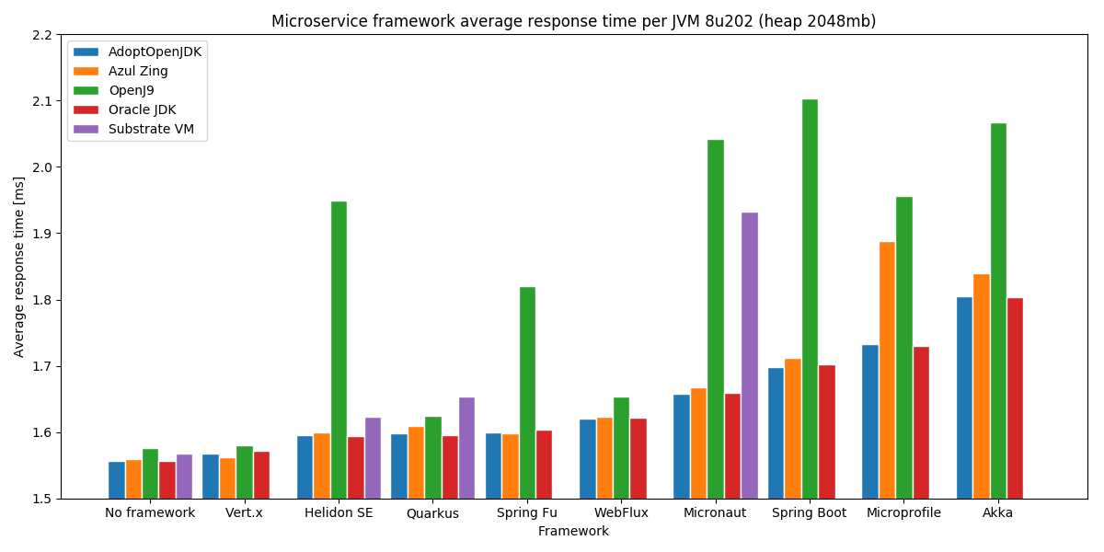
Short response times

Slide 7

Focus on developer experience
Unified configuration
Zero config Live reload in the blink of an eye
Streamlined code for the 80% common usages flexible for the 20%
No hassle native executable generation

Slide 8
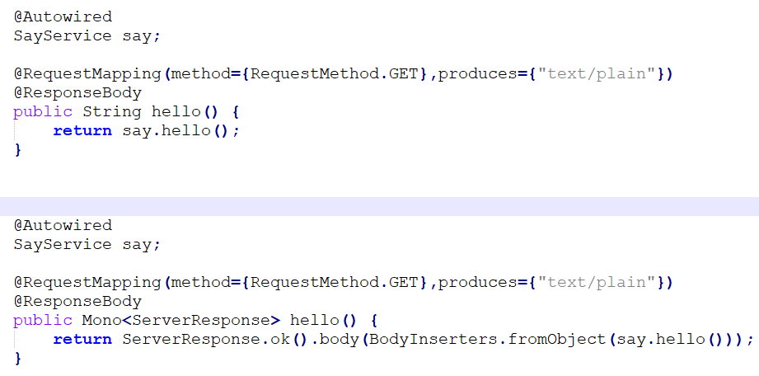
Spring Boot Synchronous and asynchronous
Synchronous
Asynchronous

Slide 9
Spring Boot Challenges
Mono or Flux?
Not part of Microprofile or Jakarta EE standards Maintained by Pivotal
Cumbersome usage (personal)

Slide 10
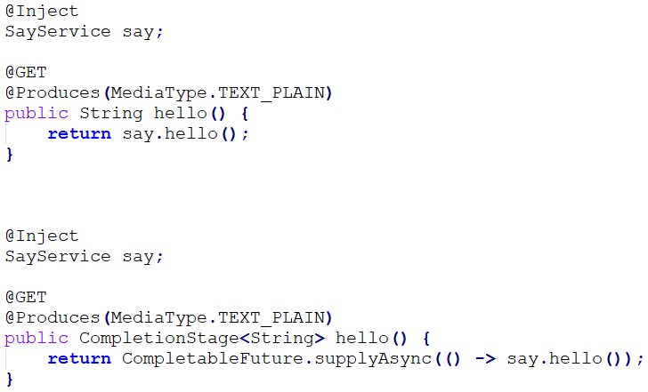
Quarkus
Synchronous
Asynchronous

Slide 11
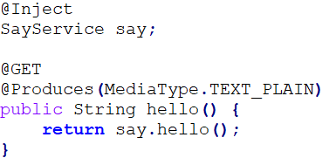
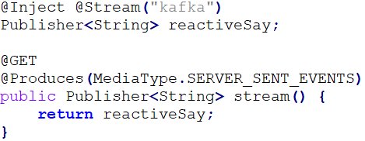
Quarkus unifies Imperative and Reactive Similar syntax. Easy to migrate
Imperative
Reactive

Slide 12
Quarkus extensions
Extensions are like project dependencies
Configure, boot and integrate a framework or technology into your Quarkus application
Providing the right information to GraalVM for your application to compile natively
Can be configured with the Quarkus Maven plugin mvn quarkus:list-extensions mvn quarkus:add-extension -Dextensions="groupId:artifactId"

Slide 13
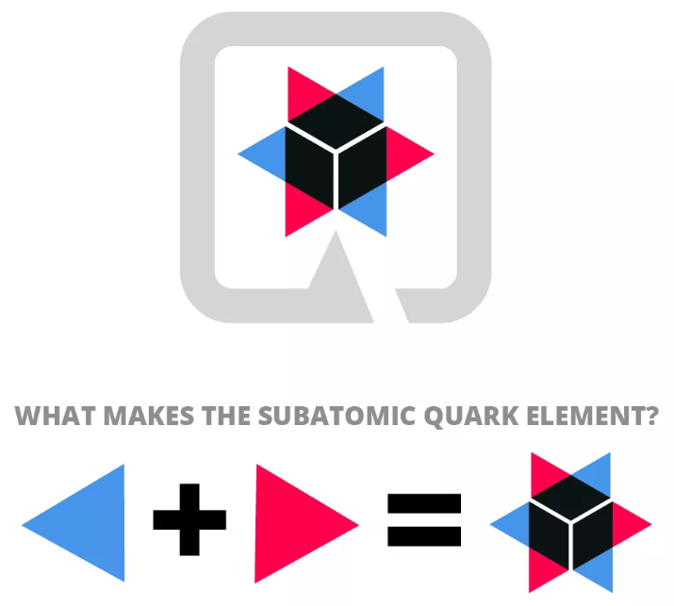
Quarkus available extensions
Netty, Undertow Servlet engines
RESTEasy REST services
SmallRye REST client
Database MariaDB, Postgres, Microsoft SQL server, H2, MongoDB, Neo4J, Flyway, Infinispan No Oracle (license/distribution issue?)
Messaging Kafka, MQTT, AMQP No JMS
Cloud Kubernetes, K8s client
Observability OpenTracing, MicroProfile metrics
Security Keycloak, Elytron, SmallRye JWT
Miscelaneous Scheduler, Mailer, Apache Tika, Kotlin

Slide 14
Quarkus configuration
mvnw quarkus:generate-config This will create a src/main/resources/application.properties.example file contains all the config options exposed via the installed extensions
Accessing properties can be done like; @ConfigProperty(name = "greeting.message") String message;
Support for profiles quarkus.http.port=9090 %dev.quarkus.http.port=8181 Uses 9090 unless the dev profile is chosen; QUARKUS_PROFILE environment variable or -Dquarkus.profile=dev

Slide 15


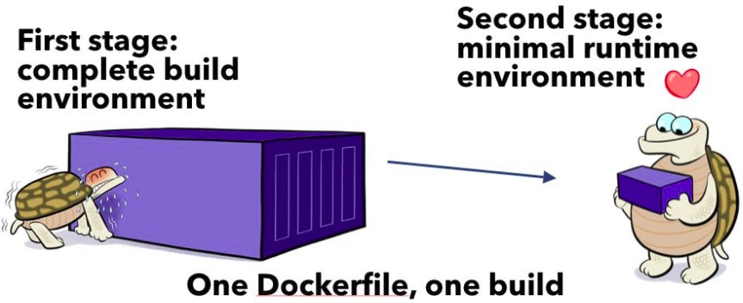
Quarkus native build options
Out of the box Dockerfile.jvm and Dockerfile.native
Build a native executable with: mvn compile –Pnative
No local GraalVM available? Use a provided build container

Slide 16
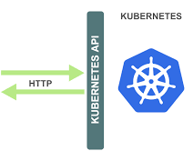
Quarkus and Kubernetes
Generate Kubernetes resource files
Kubernetes client Interact with the Kubernetes API from Java
Maven archetype creates ready to use Dockerfiles For native and JVM deployment
Knative quickstart available Kubernetes-based platform to build, deploy, and manage modern serverless workload

Slide 17
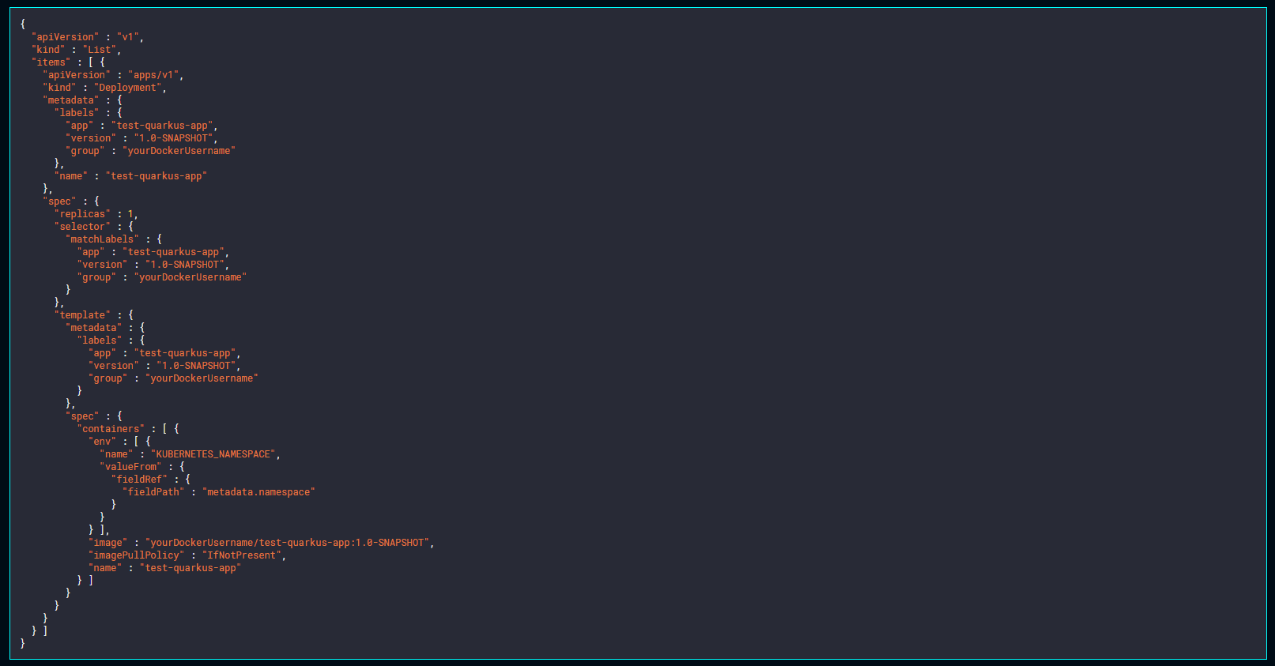
Quarkus and Kubernetes
Add the dependency: <dependency> <groupId>io.quarkus</groupId> <artifactId>quarkus-kubernetes</artifactId> </dependency>
mvn package Generates kubernetes.json and kubernetes.yaml Contains the Service and the Deployment
Details can be configured with properties quarkus.kubernetes.group=yourDockerUsername quarkus.application.name=test-quarkus-app

Slide 18
Quarkus Serverless options
AWS lambda (wrapped by Python) https://medium.com/@biancanhinojosa/running-executables-in-aws-lambda-dc79b8f33ec7
Google Knative framework
Oracle FnProject https://medium.com/criciumadev/serverless-native-java-functions-using-graalvm-and-fn-project-c9b10a4a4859
Microsoft Azure Functions Run native (Windows) executables directly https://azure.microsoft.com/nl-nl/resources/samples/functions-dotnet-migrating-console-apps/

Slide 19
Quarkus limitations
No full set of EE standards support E.g. limited CDI, no EJBs
Caching in very early stages https://github.com/hibernate/quarkus-local-cache
‘smells like Red Hat’ Fedora Docker files, OpenShift JBoss/WildFly libraries: RESTEasy, Infinispan, Elytron security
No Oracle JDBC driver, no JMS support

Slide 20

Hands-on
Microservices with GraalVM & Quarkus
20

