Slide 1

SIG GraphQL
28-2-2019

Slide 2
The history of GraphQL
GraphQL
<number>

Slide 3
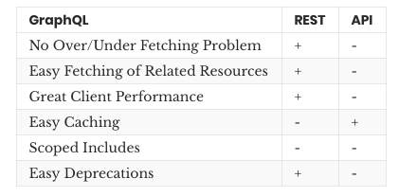
GraphQL
GraphQL
<number>

Slide 4
GraphQL
Query
Mutation
GraphQL
<number>

Slide 5
GraphQL
Schema
Resolvers
GraphQL
<number>

Slide 6
GraphQL
Query inputs
- input types
- automated input validation
- variables for input
GraphQL
<number>

Slide 7
GraphQL
Security (authentication / authorization)
GraphQL
<number>

Slide 8
GraphQL
Apollo
- caching
- subscriptions
Spring GraphQL
- ?
GraphQL
<number>

Slide 9

Hands-on Time!
Getting started
GraphQL
<number>

Slide 10
Inputs from the front-end
Mutations
Custom react component
Caching
(Subscriptions)
Extra external rest endpoint
GraphQL
<number>

