Slide 1

SIG GraphQL
28-2-2019

Slide 2
The history of GraphQL
GraphQL
<number>

Slide 3
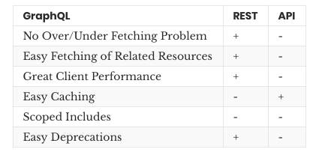
GraphQL
GraphQL
<number>

Slide 4
GraphQL
Query
Mutation
GraphQL
<number>

Slide 5
GraphQL
Schema
Resolvers
GraphQL
<number>

Slide 6
GraphQL
Query inputs
- input types
- automated input validation
- variables for input
GraphQL
<number>

Slide 7
GraphQL
Security (authentication / authorization)
GraphQL
<number>

Slide 8
GraphQL
Apollo
- caching
- subscriptions
Spring GraphQL
- ?
GraphQL
<number>

Slide 9

Hands-on Time!
Getting started
GraphQL
<number>

Slide 10
To the front-end!
In fetch.js add
`const graphqlClient = new ApolloClient({
link: new HttpLink({ uri: "http://localhost:3030/api/graphql" }),
cache: new InMemoryCache()
});`
Provide in App.js: ```
<ApolloProvider client={graphqlClient}>
<Router history={browserHistory}>
<Frame />
</Router>
</ApolloProvider> ```
GraphQL
<number>

Slide 11
To the front-end!
Implement the <Query /> component from react-apollo in the practices component.
As Child, this component accepts a function:
`<Query query={query}>{({loading, error, data}) => { … }}`
Define the query under the component Class by using gql from the package graphql-tag:
``` const query = gql`{
practices {
name
…
}
}`
```
GraphQL
<number>

Slide 12
Inputs from the front-end
You can add inputs to the query just as you could from the backend. Try it out by adding an input for `ids`.
Hardcoded inputs are nice, but in order to handle something like user input we will need variable inputs. Add the variables prop to your Query component and update your query:
```
const query = gql`
query practices($ids: [Int]) {
practices(ids: $ids) {
name
...
}
}
`;
```
GraphQL
<number>

Slide 13
Inputs from the front-end
Mutations
Custom react component
Caching
(Subscriptions)
Extra external rest endpoint
GraphQL
<number>

