Slide 1

SIG graphql
28-2-2019

Slide 2
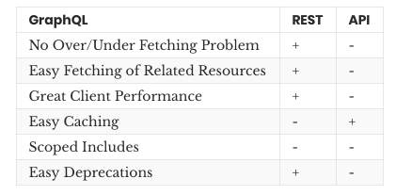
Graphql
GraphQL
<number>

Slide 3
Graphql
Query
Mutation
Subscription
GraphQL
<number>

Slide 4
Graphql
Query inputs
- input types
- automated input validation
- variables for input
GraphQL
<number>

Slide 5
Graphql
Apollo
GraphQL
<number>

Slide 6

Hands-on Time!
Getting started
GraphQL
<number>

Slide 7
Nested resolvers
Next up is the one of great advantages of GraphQL: nested resolvers
Create a practicesPeopleResolver function under your practicesResolver. This async function accepts a practice and returns the people who are member of this practice by doing
` const fetched = await Practice.findByPk(practice.id, { include: [{ model: Person }] });`. Practice can be found on db.practice.
In your resolvers, add an attribute with key `Practice` under query. This key should have the value {people: practicesPeopleResolver }.
Go to the webpage and try requesting practices with nested people!
Then implement a nested resolver for projects under practices.
GraphQL
<number>

Slide 8
To the front-end!
In fetch.js add
`const graphqlClient = new ApolloClient({
link: new HttpLink({ uri: "http://localhost:3030/api/graphql" }),
cache: new InMemoryCache()
});`
Provide in App.js: ```
<ApolloProvider client={graphqlClient}>
<Router history={browserHistory}>
<Frame />
</Router>
</ApolloProvider> ```
GraphQL
<number>

Slide 9
To the front-end!
Implement the <Query /> component from react-apollo in the practices component.
As Child, this component accepts a function:
`<Query query={query}>{({loading, error, data}) => { … }}`
Define the query under the component Class by using gql from the package graphql-tag:
``` const query = gql`{
practices {
name
…
}
}`
```
GraphQL
<number>

Slide 10
Inputs from the front-end
You can add inputs to the query just as you could from the backend. Try it out by adding an input for `ids`.
Hardcoded inputs are nice, but in order to handle something like user input we will need variable inputs. Add the variables prop to your Query component and update your query:
```
const query = gql`
query practices($ids: [Int]) {
practices(ids: $ids) {
name
...
}
}
`;
```
GraphQL
<number>

Slide 11
Inputs from the front-end
Mutations
Custom react component
Caching
(Subscriptions)
Extra external rest endpoint
GraphQL
<number>

