Slide 1

SIG GraphQL
28-2-2019

Slide 2
The history of GraphQL
GraphQL
<number>

Slide 3
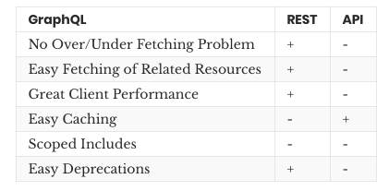
GraphQL
GraphQL
<number>

Slide 4
GraphQL
Query: returns data
Mutation: performs a change and returns data
GraphQL
<number>

Slide 5
GraphQL
Schema
Types ( scalar types: Int, Float, String, Boolean, ID) Wrap as [Int] for array, add Int! To make non-nullable
Resolvers
GraphQL
<number>

Slide 6
GraphQL
Query inputs
- input types
- automated input validation
- variables for input
GraphQL
<number>

Slide 7
GraphQL
Security (authentication / authorization)
GraphQL
<number>

Slide 8
GraphQL
Apollo
- caching
- subscriptions
Spring GraphQL
- ?
GraphQL
<number>

Slide 9

Hands-on Time!
Hands on
GraphQL
<number>

