Slide 1

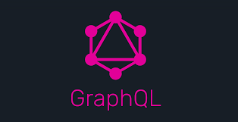
28-2-2019

Slide 2

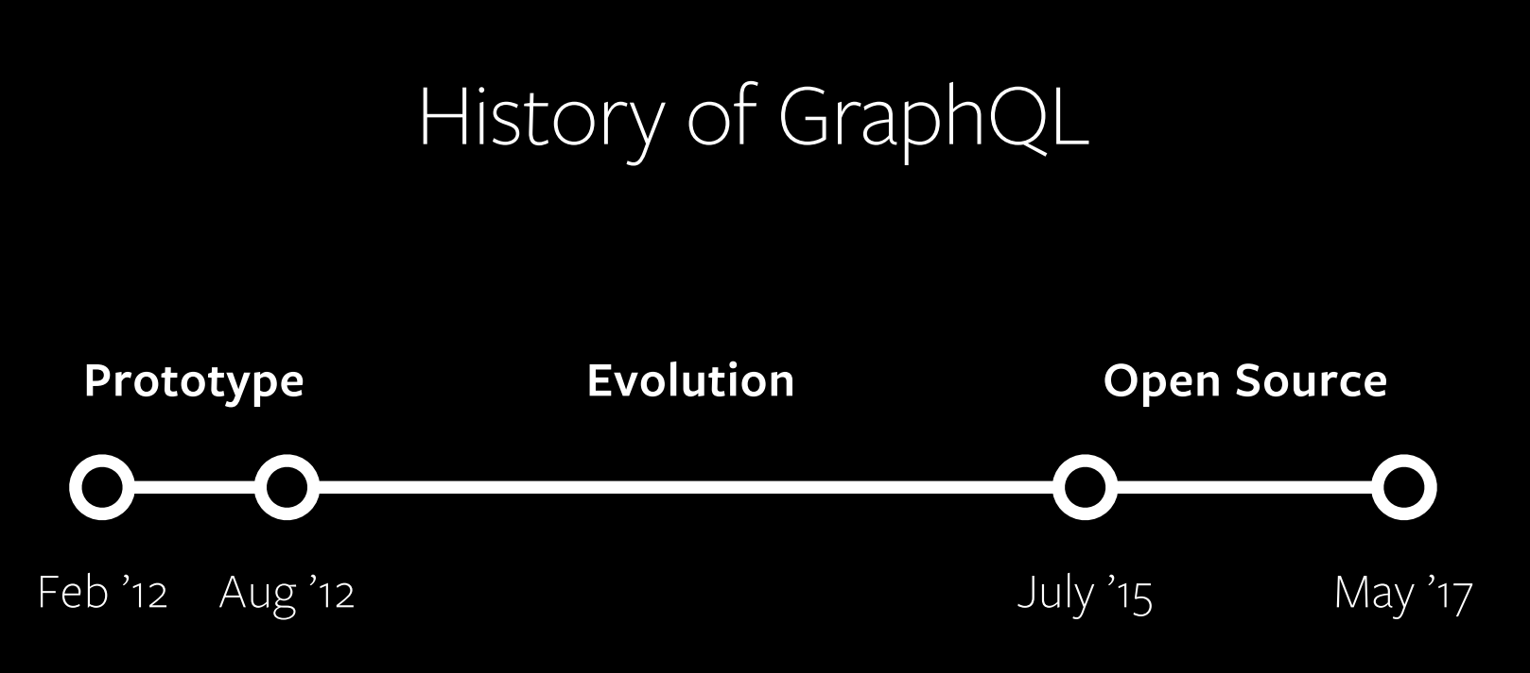
The history of GraphQL
iOS Client
https://about.sourcegraph.com/graphql/graphql-client-driven-development
GraphQL
2

Slide 3
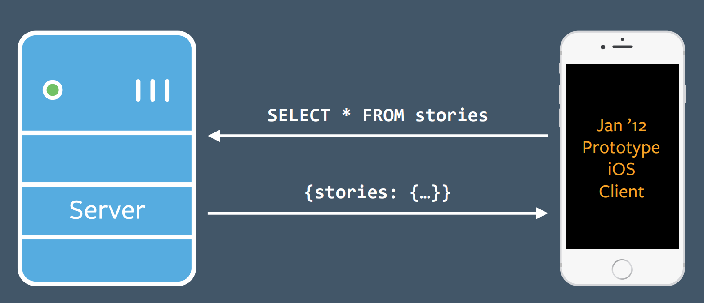
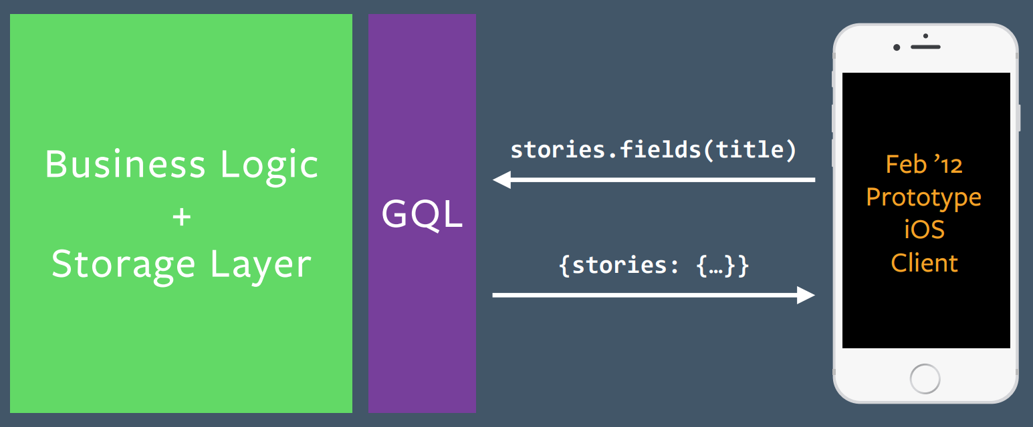
The history of GraphQL
Think "Graphs", not "Endpoints"
Have a Single Source of Truth
Thin API Layer
https://about.sourcegraph.com/graphql/graphql-client-driven-development
GraphQL
3
Notes:
3

Slide 4
“A query language for your API”
“Ask for what you need, get exactly that”
“Get many resources in a single request”
“Evolve your API without versions”
https://graphql.org/
GraphQL
4

Slide 5
GraphQL – How To…
{
hero {
name
}
}
{
hero {
name
height
}
}
{
hero {
name
height
mass
}
}
{
hero {
name
height
mass
friends {
name
}
}
}
{
"hero": {
"name": "Luke Skywalker"
}
}
{
"hero": {
"name": "Luke Skywalker",
"height": 1.72
}
}
{
"hero": {
"name": "Luke Skywalker",
"height": 1.72,
"mass": 77
}
}
{
"hero": {
"name": "Luke Skywalker",
"height": 1.72,
"mass": 77,
"friends": [
{ "name": "Obi-Wan Kenobi" },
{ "name": "R2-D2" },
{ "name": "Han Solo" },
{ "name": "Leia Organa" }
]
}
}
https://graphql.org/
GraphQL
5

Slide 6
GraphQL Schema
type Hero {
name: String
height: Float
mass: Float
friends: [Friend]
...
}
type Friend {
name: String
...
}
type Hero {
name: String
height: Float
mass: Float
friends: [Hero]
...
}
type Query {
hero: Hero
}
Scalar Types:
String
Int
Float
Boolean
ID
no Date!
https://graphql.org/
GraphQL
6

Slide 7
GraphQL Schema
type Hero {
name: String
height: Float
mass: Float
friends: [Friend]
...
}
type Friend {
name: String
...
}
type Query {
hero: Hero
}
Scalar Types:
String
Int
Float
Boolean
ID
no Date!
https://graphql.org/
GraphQL
7

Slide 8
GraphQL Schema
type Hero {
name: String
height: Float
mass: Float
friends: [Hero]
...
}
type Query {
hero: Hero
}
Scalar Types:
String
Int
Float
Boolean
ID
no Date!
https://graphql.org/
GraphQL
8

Slide 9
GraphQL Schema
type Mutation {
updateHero(name: String): Hero
}
type Mutation {
updateHero(name: String): Hero
createHero(
name: String,
height: Float,
weight: Float
): Hero
}
type Mutation {
updateHero(name: String): Hero
createHero(input: HeroInput): Hero
}
input HeroInput {
name: String
height: Float
weight: Float
}
type Query {
hero: Hero
}
type Query {
hero: Hero
friend(name: String): Friend
}
https://graphql.org/
GraphQL
9

Slide 10
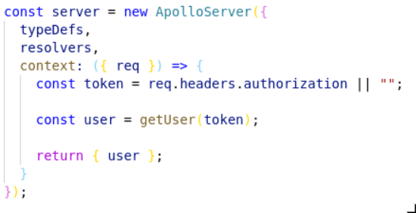
Security
GraphQL
10

Slide 11
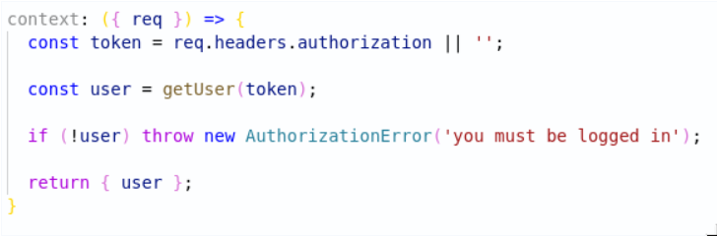
Security: Check in context
GraphQL
11

Slide 12
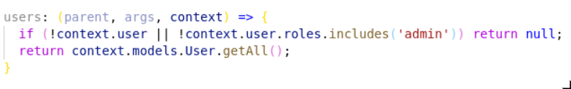
Security: check in resolver
GraphQL
12

Slide 13
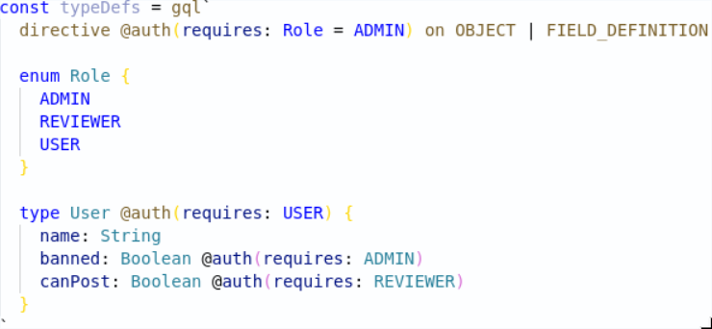
Security: check in typeDefs
GraphQL
13

Slide 14


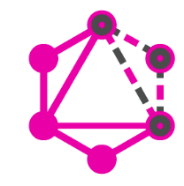









GraphQL Implementations and Tooling
PHP GraphQL
Apollo GraphQL
GraphQL Faker
GraphQL Java
GraphQL Config
GraphQL
14

Slide 15
GraphQL – Top Reasons to Use GraphQL
GraphQL APIs have a strongly typed schema
No more overfetching and underfetching
Builtin support for deprecation removes need for versioning
GraphQL enables rapid product development
Composing GraphQL APIs
Rich open-source ecosystem and an amazing community
https://www.prisma.io/blog/top-5-reasons-to-use-graphql-b60cfa683511/
GraphQL
15

Slide 16
GraphQL – Reasons NOT to Use GraphQL
Exception handling (status codes)
Caching
Performance
https://www.prisma.io/blog/top-5-reasons-to-use-graphql-b60cfa683511/
GraphQL
16

Slide 17

Hands-on Time!
Questions?
GraphQL
17

Slide 18
Hands-on Time!
Demo
GraphQL
18

Slide 19
Hands-on Time!
Hands on
GraphQL
19

