Slide 1
Unittesting in Java Jacco Cijsouw Cha Liang Chu Jeffrey Resodikromo Jeroen Rijnboutt Integratie SIG June 1 2021

Slide 2
Testing – Why?
Does (new) software work like it’s supposed to? (user story / scenarios)
Does software still work like it’s supposed to? (all previous requirements)
Are other components affected/broken?
Is code written correctly?
Are all possible unhappy flows covered? (with logging and feedback)
Is software stable under heavy load?

Slide 3
Testing – What kind of tests exist?
Unit Tests
Integration Tests / Component Tests / API Tests / Acceptance Tests
System Tests / System Integration Tests)
End to End Tests / (G)UI Tests / Smoketest
Manual Tests / Exploratory Tests
Monkey Tests

Slide 4
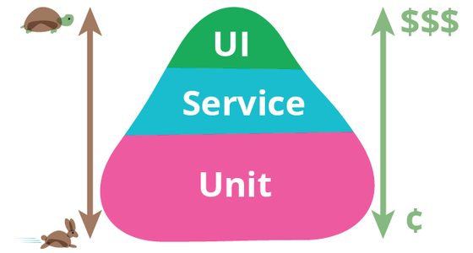
Testing – Test Pyramid

Slide 5
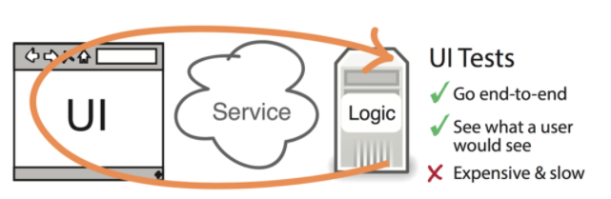
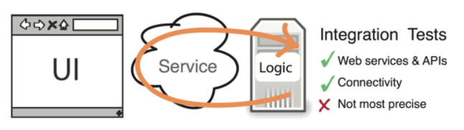
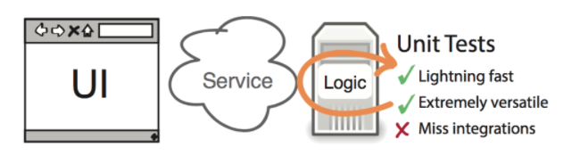
http://www.agilenutshell.com/episodes/41-testing-pyramid

Slide 6
Testing – What is the best testing strategy?
Analyze context of project
What kind of components?
What kind of technology
Which components are critical?
Balance cost (time) of tests against value (repeatability, low maintenance, functional/code coverage, confidence)

Slide 7
Unit testing in Java - Introduction
What setup do you need?
Java 11 JDK
Maven (3.8.1)
Java IDE (IntelliJ , Visual Studio Code, Eclipse)
Where can you find the material/excercises?
https://github.com/AMIS-Services/sig-java-unittesting
What do we hope you will learn?
Basic aspects of Unittesting (assertions, mocking)
How to implement these aspects in Java
The power of unittesting in the test proces

Slide 8
Unit testing in Java - Introduction
What setup do you need?
Java 11 JDK
Maven (3.8.1)
Java IDE (IntelliJ , Visual Studio Code, Eclipse)
Where can you find the material/excercises?
https://github.com/AMIS-Services/sig-java-unittesting
What do we hope you will learn?
Basic aspects of Unittesting (assertions, mocking)
How to implement these aspects in Java
The power of unittesting in the test proces

