Slide 1
Unittesting in Java

Slide 2

JUnit 5
JUnit Jupiter engine
Leverages features from Java 8 (such as lambda’s)
Split up into several packages
New features
Display names
Grouping and organizing tests
Parameterized tests
Conditional tests
Test templates
Dynamic tests

Slide 3
Annotations
@BeforeEach, @AfterEach | Execute the method before/after each test
@BeforeAll, @AfterAll | Execute the method before/after start of all tests. Method must be static
@Test | Mark method as junit test
@DisplayName("<name>") | Provide custom display name
@Disable | Used to disable/ignore a test class or method
@Nested | Used to create nested test classes
@Tag("<name>") | Tag a test method. Test runs can use filtering on tags
@ExtendWith | Register an Extension class that adds functionality to the tests

Slide 4
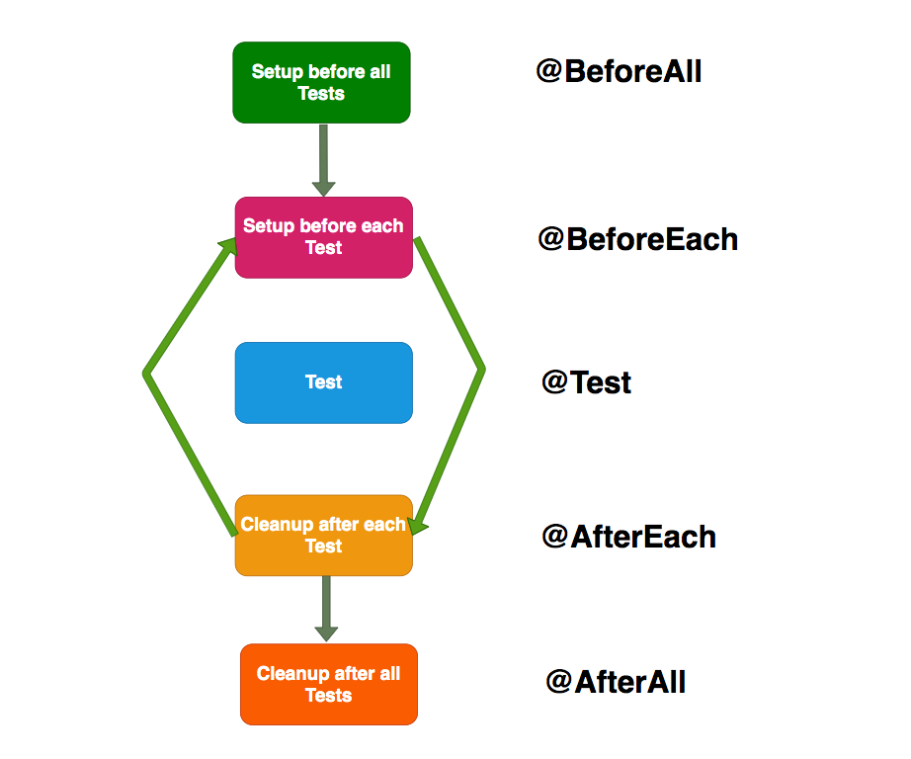
Lifecycle

Slide 5
Assertions
All JUnit assertions are static methods in package org.junit.jupiter.api to help validate the expected output.
assertNull(Object object);
assertEquals(Object expected, Object actual);
assertThrows(Class<T> expectedType, Executable executable)
assertTimeout(Duration timeout, Executable executable)
Most assertion methods accept a string as custom error message
Group assertions using assertAll(Executable... executables)
Or use other third-party libraries:
AssertJ
Hamcrest

Slide 6
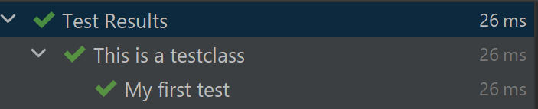
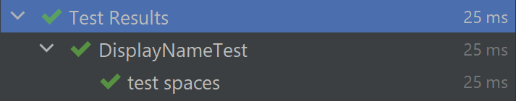
Display names
@DisplayName("This is a testclass") public class DisplayNameTest { @Test @DisplayName("My first test") void test_spaces() {} }
@DisplayNameGeneration(DisplayNameGenerator.ReplaceUnderscores.class) public class DisplayNameTest { @Test void test_spaces() {} }
Or create your own generator by extending DisplayNameGenerator

Slide 7
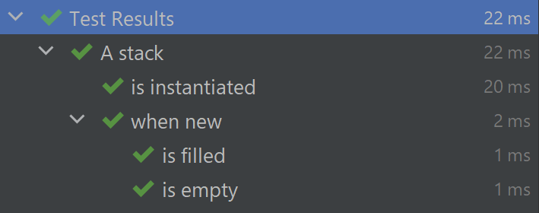
Grouping tests
@DisplayName("A stack") public class NestedTest { @Test @DisplayName("is instantiated") void testInstantiated() {} @Nested @DisplayName("when new") class WhenNew { @Test @DisplayName("is empty") void testIsEmpty() {} @Test @DisplayName("is filled") void testIsFilled() {} } }

Slide 8
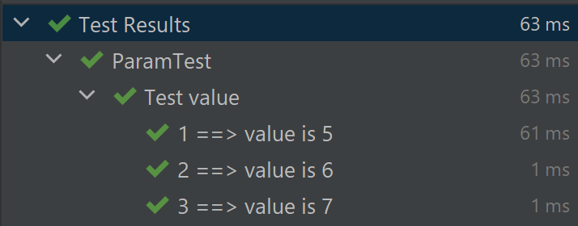
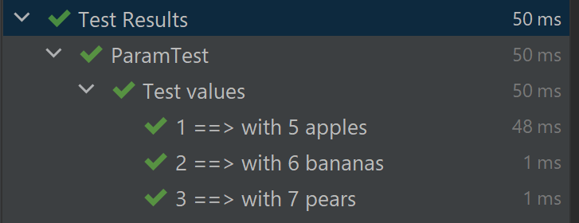
Parameterized tests
@DisplayName("Test value")
@ParameterizedTest(name = "{index} ==> value is {0}") @ValueSource(ints = { 5, 6, 7 }) void testWithValueSource(int argument) { assertTrue(argument > 4 && argument < 8); }
@DisplayName("Test values") @ParameterizedTest(name = "{index} ==> with {0} {1}") @CsvSource({ "5, apples", "6, bananas", "7, pears" }) void testMultipleValues(int argument, String name) { assertTrue(argument > 4 && argument < 8); }

Slide 9

Junit 4 vs 5
JUnit 5 is in new namespace
JUnit 4: org.junit
JUnit 5: org.junit.jupiter
JDK 5 vs JDK 8
Annotations
Assertions
Assumptions
JUnit 5 can run JUnit 3 and 4 tests using the Vintage package

Slide 10
JUnit 4 vs 5 - Annotations
@Test no longer accepts parameters
@Test(expected = Exception.class) public void testThrowsException() throws Exception { // ... }
@Test void testThrowsException() throws Exception { Assertions.assertThrows(Exception.class, () -> { //... }); }
JUnit 4 | JUnit 5
@Before | @BeforeEach
@After | @AfterEach
@BeforeClass | @BeforeAll
@AfterClass | @AfterAll
@Ignore | @Disabled
@Category | @Tag
@Rule and @ClassRule | @ExtendWith and @RegisterExtensions

Slide 11
JUnit 4 vs 5 - Assertions
Most assertions accept lambda to construct an error message
assertTimeout() and assertTimeoutPreemptively() have replaced the @Timeout annotation
JUnit 4 assertions can be used in a JUnit 5 test
Most assertions are available in JUnit 5 with some differences, examples:
assertTrue(condition, message) -> assertTrue(message, condition)
assertThat is not available anymore -> use third party libraries

Slide 12
JUnit 4 vs 5 - Assumptions
Use of lambda in Assumptions.assumingThat(BooleanSupplier, Executable)
@Test public void testAssumptionJUnit4() throws Exception { Assume.assumeThat("hello", is("goodbye")); assertEquals(...); }
@Test void testAssumptionJUnit5() throws Exception { Assumptions.assumingThat("hello".equals(" goodbye"), () -> { assertEquals(...); }); }

Slide 13
JUnit 4 vs 5 - Extensions
@RunWith(SpringJUnit4ClassRunner.class) class MyTestJUnit4 { // ... }
@ExtendWith(SpringExtension.class) class MyTestJUnit5 { // ... }
@ExtendWith is repeatable
Create your own extensions using an interface from org.junit.jupiter.api.extension

Slide 14
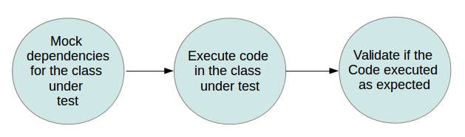
Mockito

Slide 15
Mockito
Annotation | Description
@Mock | Mock object
@Spy | Partial mock
@MockBean | Mock object which replaces object with same type in the Spring application context
@ExtendWith(MockitoExtension.class) | Extension which automatically creates mock objects for any mock annotated object
@InjectMocks | Inject mocks into the object using constructor injection, setter injection or property injection

Slide 16
Mockito - Expectations
when(…).thenReturn(…) – thenReturn can be chained
when(…).thenThrow(…)
When/then does not work on @Spy or void methods. Use:
doReturn().when(…).methodCall
doThrow().when(…).methodCall
List<String> mockList = mock(ArrayList.class); when(mockList.get(anyInt())).thenReturn("TEST").thenReturn("HOI");
List<String> mockList = mock(ArrayList.class); when(mockList.get(eq(0))).thenReturn("TEST");
List<String> mockList = mock(ArrayList.class); when(mockList.get(anyInt())).thenThrow(new RuntimeException("BOEM"));

Slide 17
Mockito - Answer
Use thenAnswer() for calculating response based on arguments
List<String> mockList = mock(ArrayList.class); when(mockList.get(anyInt())).thenAnswer(i -> "answer " + i.getArgument(0)); String result = mockList.get(0); assertEquals("answer 0", result);

Slide 18
Mockito - Verify
Use verify() on mock object to verify specified conditions are met.
Use ArgumentCaptor to access arguments of method calls
List<String> mockList = mock(ArrayList.class); when(mockList.get(anyInt())).thenReturn("TEST"); mockList.get(0); verify(mockList, times(1)).get(0); verify(mockList, never()).get(1); verify(mockList, atMostOnce()).get(0);
ArgumentCaptor<Integer> intCaptor = ArgumentCaptor.forClass(Integer.class); verify(mockList).get(intCaptor.capture()); assertEquals(0, intCaptor.getValue());
Notes:
Mockito tracks all method calls and their parameters.

Slide 19
Mockito – Strict stubbing
MockitoExtension adds strict rule to tests -> UnnecessaryStubbingException
Add Mockito.verifyNoMoreInteractions(Object… mocks) to test

Slide 20
Handson
https://github.com/AMIS-Services/sig-java-unittesting
Info
https://junit.org/junit5/docs/current/user-guide/
https://howtodoinjava.com/junit-5-tutorial/

