Slide 1
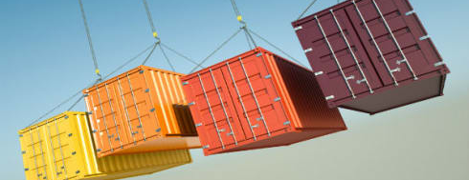
Kubernetes container platform

Slide 2
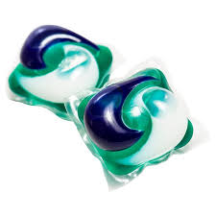
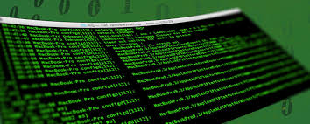
pods

Slide 3

Logging

Slide 4
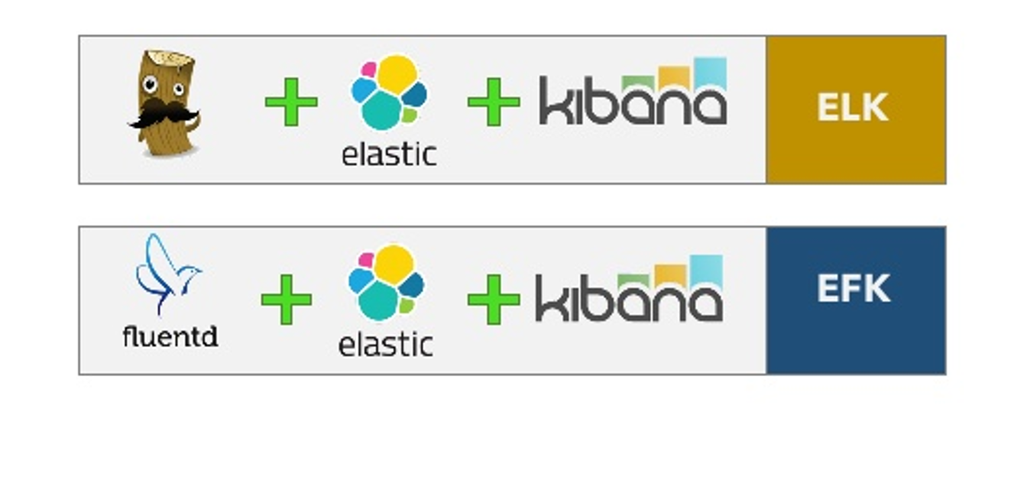
ELK en EFK

Slide 5
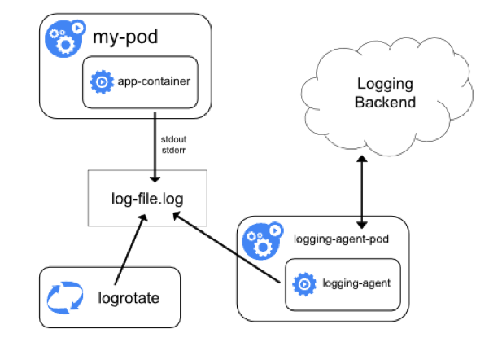
Logging-agent

Slide 6
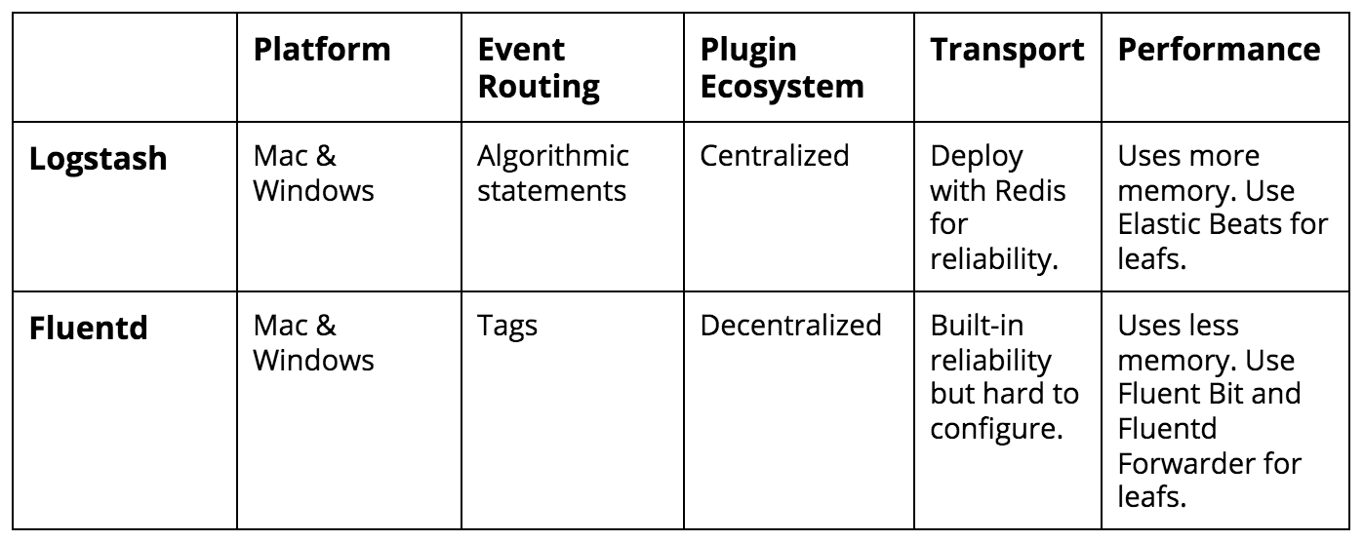

Logstash vs Fluentd

Slide 7

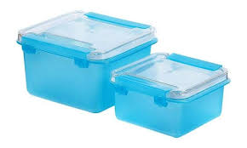
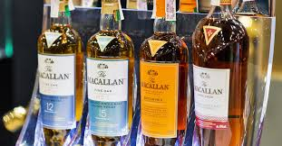
Coming up
https://github.com/AMIS-Services/sig-kubernetes/tree/master/SIG02-logging

