Slide 1
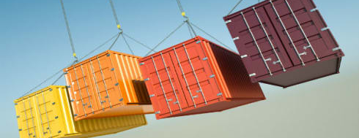
Kubernetes container platform

Slide 2


pods

Slide 3
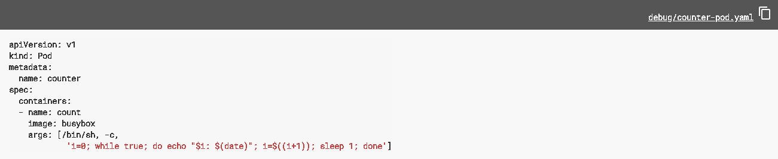

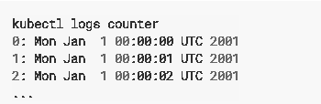
Pods and logging

Slide 4
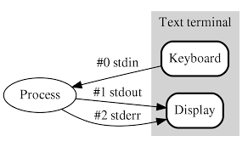

stderr and stdout
By default in Kubernetes, Docker is configured to write a container's stdout and stderr to a file under /var/log/containers on the host system.

Slide 5

Kubernetes system component logs
There are two types of system components:
those that run in a container;
e.g. Kubernetes scheduler and kube-proxy
those that do not run in a container
e.g. Docker
On machines with systemd, the kubelet and container runtime write to journald.
If systemd is not present, they write to .log files in the /var/log directory.
System components inside containers always write to the /var/log directory, bypassing the default logging mechanism. They use the klog logging library.

Slide 6
Log rotation
Logs consume available storage on the node level !!!!
Kubernetes currently is not responsible for rotating logs
A deployment tool should set up a solution to address that:
in Kubernetes clusters, deployed by the kube-up.sh script, there is a logrotate tool configured to run each hour (or when size > 100 MB)
You can also set up a container runtime to rotate application’s logs automatically, e.g. by using Docker’s log-opt

Slide 7

Cluster level logging
Requirements:
Separate backend to store, analyze and query logs

Slide 8
Cluster-level logging architectures
While Kubernetes does not provide a native solution for cluster-level logging
There are several common approaches:
Use a node-level logging agent that runs on every node;
Include a dedicated sidecar container for logging in an application pod.
Push logs directly to a backend from within an application

Slide 9
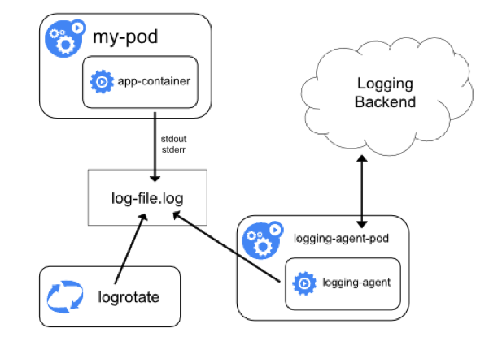
Node logging-agent

Slide 10
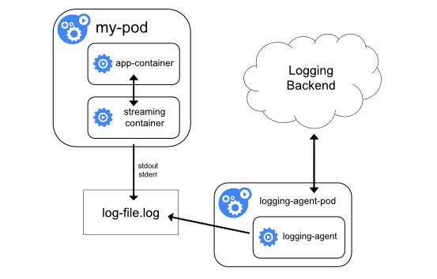
Streaming sidecar container

Slide 11
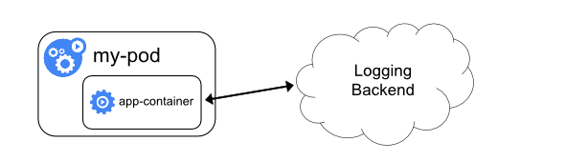
Exposing logs directly from the container

Slide 12
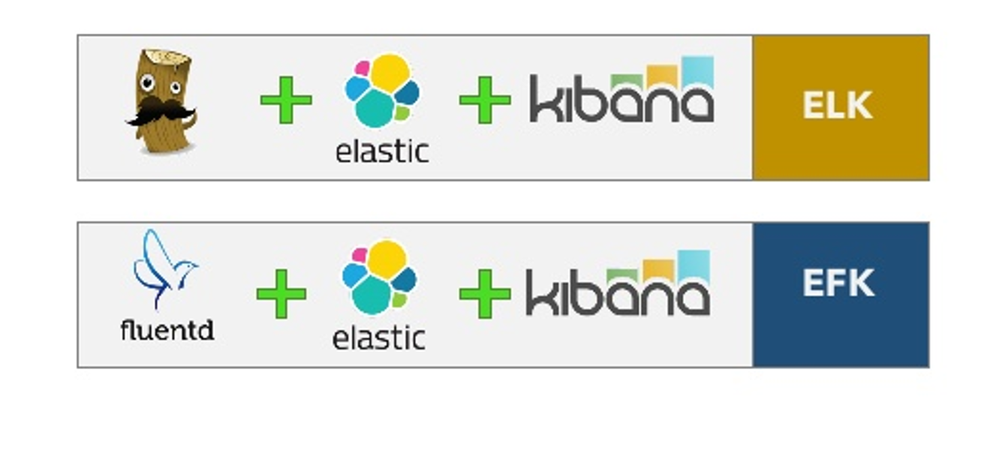
ELK en EFK

Slide 13
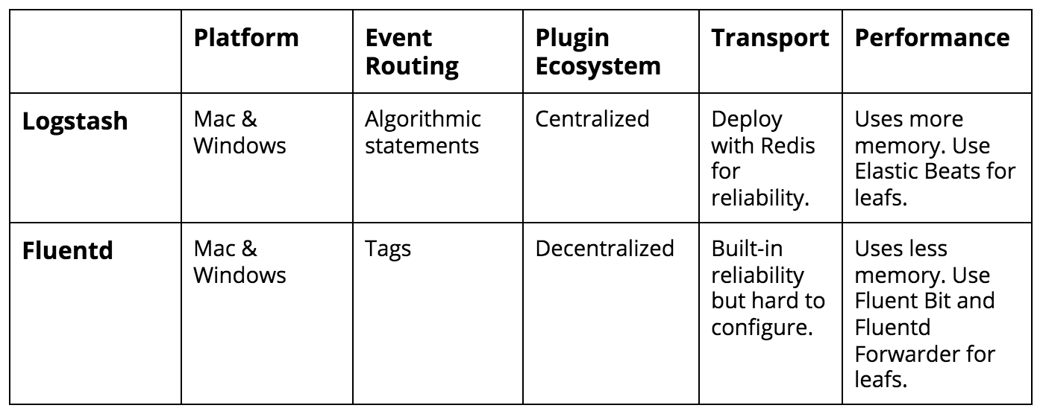
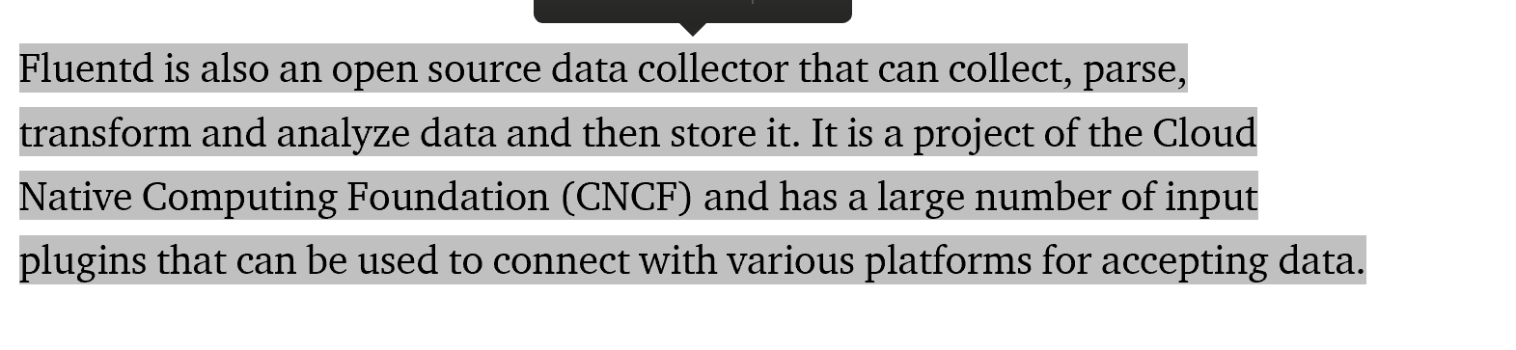
Logstash vs Fluentd

Slide 14
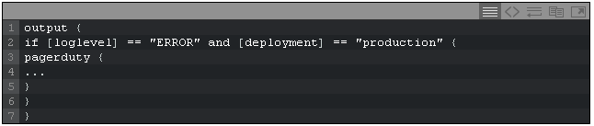



Event routing

Slide 15


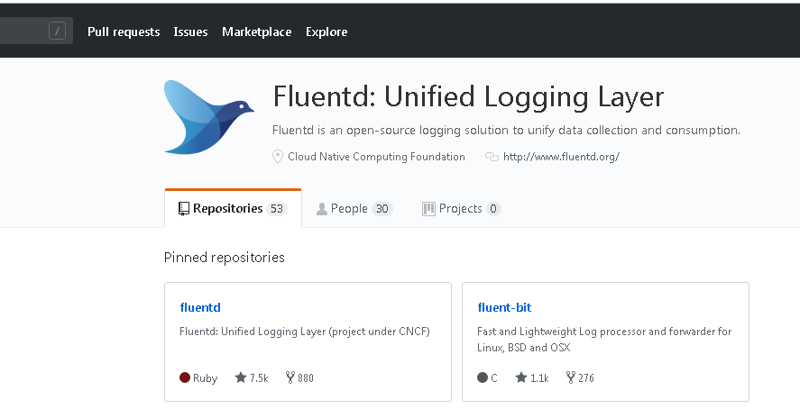

Plugins
> 200 plugins
> 500 plugins
10 official plugins

Slide 16


Lightweight log processor + forwarder

Slide 17

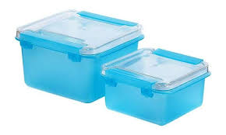

Coming up
https://github.com/AMIS-Services/sig-kubernetes/tree/master/SIG02-logging

