Slide 1


Comparing
MongoDB search
with racle SQL queries
O
MongoDB Find & Aggregate vs comparable Oracle SQL queries
Lucas Jellema

Slide 2
Topics
Filter & Sort (find, sort)
Aggregation ($group, $project, $match, $sort)
Lookup & Outer Join ($lookup, $arrayElemAt)
Facet Search ($facet, $bucket, $sortByCount)
Update (findAndModify, forEach, save, update, upsert, $set, $unset)
Date and Time operations
Materialized View ($out)
Nested documents/tables ($unwind, $reduce)
Geospatial (ensureIndex, 2dsphere, $near, $geoNear)
Text Search (createIndex, text, $text, $search)
Stored Procedures (db.system.js.save, $where)

Slide 3
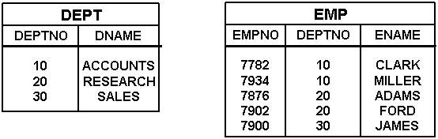
Data Set
HRM
Collections emp and dept – JSON documents in MongoDB database
Tables EMP and DEPT – relational records in Oracle Database

Slide 4

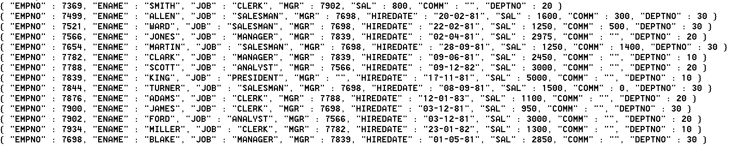
HRM Data SET JSON document Collections emp and dept

Slide 5
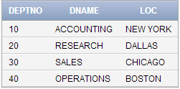
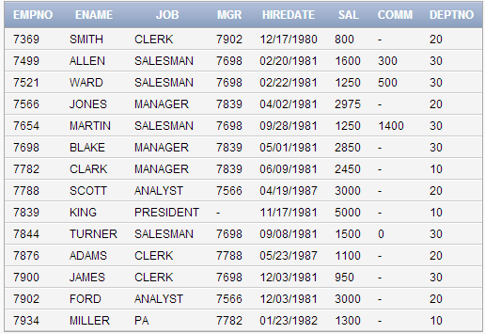
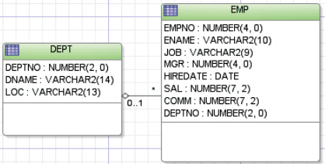
HRM Data Set TABLES EMP and DEPT

Slide 6
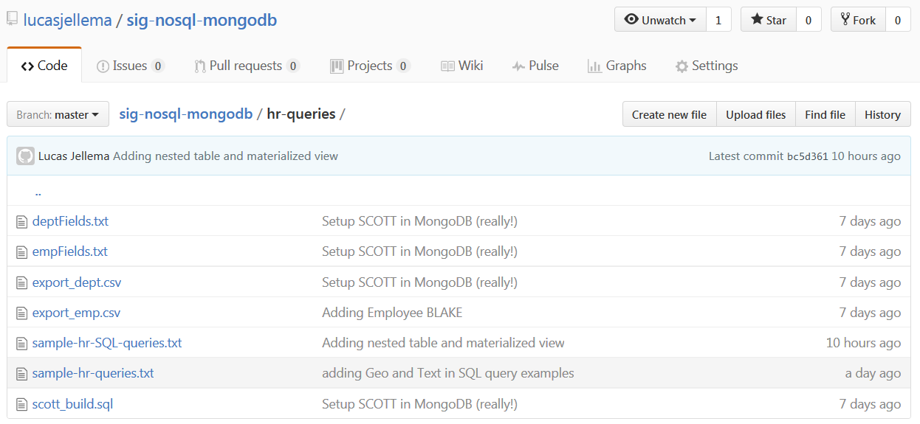
All sources are available on Github
https://github.com/lucasjellema/sig-nosql-mongodb

Slide 7
find the names of all managers
db.emp.find ( {"JOB":"MANAGER"} , {ENAME:1} )
select ename
from emp
Where job = 'MANAGER'

Slide 8
find name and salary of Salesmen ordered by salary from high to low
db.emp.find ( {"JOB":"SALESMAN"} , { ENAME:1 , SAL:1} ) .sort ( {'SAL':-1})
select ename , sal
from emp
where job = 'SALESMAN'
order
by sal desc

Slide 9
find name and salary of two highest earning Salesmen – best paid first
db.emp.find ( {"JOB":"SALESMAN"} , { ENAME:1 , SAL:1} ) .sort ( {'SAL':-1}) .limit(2)
select ename , sal
from emp
where job = 'SALESMAN'
order
by sal desc FETCH FIRST 2 ROWS ONLY

Slide 10
find employees with ‘AR’ in their name – in alphabetical order by name
db.emp.find ( {"ENAME":{$regex: "AR"} } , { ENAME:1 , SAL:1} ) .sort ( {'ENAME':1})
select ename , sal
from emp
where ename like '%AR%'
order
by ename

Slide 11
find employees not in department 10, name and salary and sorted alphabetically by name
db.emp.find ( { "DEPTNO":{$ne: 10} } , { ENAME:1 , SAL:1 , DEPTNO:1 } ) .sort ( {'ENAME':1})
select ename , sal , deptno
from emp
where deptno != 10
order
by ename

Slide 12
Set DATE type property startdate derived from string type property hiredate
db.emp.find().forEach ( function (elem) {
elem.startdate = new Date( "19“ + elem.HIREDATE.substring(6)
+ "-" + elem.HIREDATE.substring(3,5)
+ "-" + elem.HIREDATE.substring(0,2)
);
db.emp.save(elem);
}
)
alter table emp
add (startdate date) update emp
set startdate = to_date( hiredate, 'DD-MM-RR')

Slide 13
Find Salesmen with a total income higher than 2000
-- use $where with embedded JavaScript db.emp.find
( {"JOB":"SALESMAN" , $where : " this.SAL + (this.COMM != null? this.COMM: 0) > 2000"
}
)
select *
from emp
where sal + nvl(comm, 0) > 2000

Slide 14
Create stored function salary cap to return max salary per job; use salary cap to find employees earning over their cap
db.system.js.save({
"_id": "salaryCap",
"value": function(job) {
return job=='CLERK'?1000
:(job=='ANALYST'?3500
:(job=='SALESMAN'?2000
:(job=='MANAGER'?3000
:10000
)));
}
})
-- load function in current database
db.loadServerScripts();
db.emp.find( { $where : " this.SAL > salaryCap(this.JOB)"} , {ENAME:1, SAL:1, JOB:1})
create or replace
function salary_cap
(p_job in varchar2)
return number
is
begin
return
case p_job
when 'CLERK' then 1000
when 'ANALYST' then 3500
when 'SALESMAN' then 2000
when 'MANAGER' then 3000
else 10000
end;
end salary_cap;
select ename
, sal
, job
from emp
where sal > salary_cap( job)

Slide 15
Select name, startmonth and startyear for all employees
db.emp.aggregate(
[{$project: {
"ENAME": 1,
"startmonth": { $month: "$startdate"},
"startyear": { $year: "$startdate"}
}
}
]
)
select ename
, extract (month from startdate) as startmonth
, extract (year from startdate) as startyear
from emp

Slide 16
total salary sum, total number of employees, the highest salary and the earliest startdate
db.emp.aggregate(
[{$group: {
_id: null,
total_salary_sum: { $sum: "$SAL" },
total_staff_count: { $sum: 1 },
max_sal: { $max: "$SAL" },
min_startdate: { $min: "$startdate" }
}
}
]
)
select sum(sal) total_salary_sum
, count(*) total_staff_count
, max(sal) max_sal
, min(startdate) min_startdate
from emp

Slide 17
total salary sum, total number of employees, the highest salary and the earliest startdate PER DEPARTMENT
db.emp.aggregate(
[{$group: {
_id: "$DEPTNO",
total_salary_sum: { $sum: "$SAL" },
total_staff_count: { $sum: 1 },
max_sal: { $max: "$SAL" },
min_startdate: { $min: "$startdate" }
}
}
]
)
select deptno
, extract (year from startdate) hireyear
, sum(sal) total_salary_sum
, count(*) total_staff_count
, max(sal) max_sal
, min(startdate) min_startdate
from emp
group
by deptno
, extract (year from startdate)

Slide 18
total salary sum, number of employees, highest salary and earliest startdate PER DEPARTMENT and hireyear with number of employees two or more
db.emp.aggregate(
[{$group: {
_id: { deptno: "$DEPTNO“ , hireyear : { $year: "$startdate"} },
total_salary_sum: { $sum: "$SAL" },
total_staff_count: { $sum: 1 },
max_sal: { $max: "$SAL" },
min_startdate: { $min: "$startdate" }
}
}
,{$match: { total_staff_count: { $gt: 1 } } }
]
)
select deptno
, extract (year from startdate) hireyear
, sum(sal) total_salary_sum
, count(*) total_staff_count
, max(sal) max_sal
, min(startdate) min_startdate
from emp
having count(*) > 1
group
by deptno
, extract (year from startdate)

Slide 19
All employees with their department details (when available)
db.emp.aggregate(
[{$lookup: {
from:"dept",
localField:"DEPTNO",
foreignField:"deptno",
as:"dept"
}
,{$project: {
"EMPNO": 1,
"ENAME": 1,
"DEPT": { $arrayElemAt:["$dept", 0]}
}
}
]
)
select e.*
, d.*
from emp e
left outer join
dept d
on (e.deptno = d.deptno)

Slide 20
All departments with a list of the names of their employees
db.dept.aggregate(
[{$lookup: {
from:"emp",
localField:"deptno",
foreignField:"DEPTNO",
as:"emps"
}
}
,{$project: {
"deptno": 1,
"dname": 1,
"staff": { $reduce: {
input: "$emps",
initialValue: "",
in: { $concat : ["$$value" , ", " ,"$$this.ENAME"] }
} // reduce
} // staff
} // project
}
])
select d.deptno, d.dname
, listagg( ename, ',') within group (order by ename) as "staff"
from dept d
left outer join
emp e
on (d.deptno = e.deptno)
group
by d.deptno , d.dname

Slide 21
all employees who work in NEW YORK
db.emp.aggregate(
[{$lookup: {
from:"dept",
localField:"DEPTNO",
foreignField:"deptno",
as:"dept"
}
,{$project: {
"EMPNO": 1,
"ENAME": 1,
"DEPT": { $arrayElemAt:["$dept", 0]}
}
}
, {$match: { "DEPT.loc" :"NEW YORK"} }
]
)
select e.*
, d.*
from emp e
left outer join
dept d
on (e.deptno = d.deptno)
where d.loc = 'NEW YORK'

Slide 22
Employee named KING with all employees who work under her or him and a neat list of the names of these subordinate staff
db.emp.aggregate(
[{$match: { ENAME: "KING"}}
,{$lookup: {
from:"emp",
localField:"EMPNO",
foreignField:"MGR",
as:"subordinates"
}
}
,{$project: {
"EMPNO": 1,
"ENAME": 1,
"subordinates": 1,
"staff": { $reduce: {
input: "$subordinates",
initialValue: "",
in: { $concat : ["$$value", ", ","$$this.ENAME"] } //in
} // reduce
},
}
}
]
)
select e.*
, cursor( select * from emp s where s.mgr = e.empno ) subordinates
, ( select listagg( s.ename, ',')
within group (order by ename)
from emp s
where s.mgr = e.empno
) as "staff"
from emp e
where e.ename = 'KING'

Slide 23
Facet aggregation: # employees by job, by salary bucket, by department and by startdate (1)
db.emp.aggregate(
[{$facet: {
"categorizedByJob": [
{ $sortByCount: "$JOB" }
],
"categorizedBySalary": [
{$bucket: {
groupBy: "$SAL",
boundaries: [0, 1000, 2000 ,3000 ,10000 ],
default: "Other",
output: {
"count": { $sum: 1 },
"employees": { $push: "$ENAME" }
} // output
}// bucket
}
],
"categorizedByDepartment": [
{ $sortByCount: "$DEPTNO" }
],
"categorizedByHiredate(Auto)": [
{
$bucketAuto: {
groupBy: "$startdate",
buckets: 4
}
}
]
}
}
])
-- categorizedByJob
select job
, count(*) as "count"
from emp
group
by job
order
by "count" desc
-- categorizedByDepartment
select deptno
, count(*) as "count"
from emp
group
by deptno
order
by "count" desc

Slide 24
Facet aggregation: # employees by job, by salary bucket, by department and by startdate (2)
db.emp.aggregate(
[{$facet: {
"categorizedByJob": [
{ $sortByCount: "$JOB" }
],
"categorizedBySalary": [
{$bucket: {
groupBy: "$SAL",
boundaries: [0, 1000, 2000 ,3000 ,10000 ],
default: "Other",
output: {
"count": { $sum: 1 },
"employees": { $push: "$ENAME" }
} // output
}// bucket
}
],
"categorizedByDepartment": [
{ $sortByCount: "$DEPTNO" }
],
"categorizedByHiredate(Auto)": [
{
$bucketAuto: {
groupBy: "$startdate",
buckets: 4
}
}
]
}
}
])
-- categorizedBySalary
with bucket_boundaries as
( select 10000 lower_boundary from dual
union all
select 2000 lower_boundary from dual
union all
select 3000 lower_boundary from dual
union all
select 10000 lower_boundary from dual
)
, buckets as
( select lower_boundary
, lead(lower_boundary) over (order by lower_boundary)-1 upper_boundary
from bucket_boundaries
)
select lower_boundary
, count(*)
from emp
left outer join
buckets
on (sal between lower_boundary and upper_boundary)
group
by lower_boundary

Slide 25
Facet aggregation: # employees by job, by salary bucket, by department and by startdate (3)
db.emp.aggregate(
[{$facet: {
"categorizedByJob": [
{ $sortByCount: "$JOB" }
],
"categorizedBySalary": [
{$bucket: {
groupBy: "$SAL",
boundaries: [0, 1000, 2000 ,3000 ,10000 ],
default: "Other",
output: {
"count": { $sum: 1 },
"employees": { $push: "$ENAME" }
} // output
}// bucket
}
],
"categorizedByDepartment": [
{ $sortByCount: "$DEPTNO" }
],
"categorizedByHiredate(Auto)": [
{
$bucketAuto: {
groupBy: "$startdate",
buckets: 4
}
}
]
}
}
])
-- categorizedByHiredate
with tiled as
( select ename
, startdate
, ntile(4) over (order by startdate asc) as size_bucket
from emp
)
select size_bucket
, count(*) as "count"
, listagg( ename, ',') within group (order by startdate) employees
from tiled
group
by size_bucket
order
by size_bucket

Slide 26
Create materialized collection from query departments with nested employees
db.dept.aggregate(
[ {$lookup:
{
from:"emp",
localField:"deptno",
foreignField:"DEPTNO",
as:"emps"
}
}
, {$out: "departments"
}
]
)
create or replace type emp_t as object
( EMPNO NUMBER(4)
, ENAME VARCHAR2(10)
, JOB VARCHAR2(9)
, MGR NUMBER(4)
, SAL NUMBER(7,2)
, COMM NUMBER(7,2)
, STARTDATE DATE
)
create or replace type emp_tbl_t as table of emp_t -- create materialized view
-- with nested table
create materialized view departments
BUILD IMMEDIATE
REFRESH FORCE
ON DEMAND
as
select deptno
, dname
, loc
, cast ( multiset ( select empno, ename, job , mgr, sal, comm, hiredate
from emp e
where e.deptno = d.deptno ) as emp_tbl_t) staff
from dept d

Slide 27
Find department that contains employee named KING from departments collection with nested employees
db.departments.find ( {"emps.ENAME":"KING"}
)
select d.deptno
, d.dname
, d.loc
from departments d
where ( select count(*) from table(d.staff) where ename ='KING' ) > 0

Slide 28
only find Employee KING (and not all employees in the department) from departments collection with nested employees
db.departments.aggregate(
[
{$unwind: {path:"$emps"}}
, {$match: { "emps.ENAME": "KING"}}
, {$project: {
"EMPNO": "$emps.EMPNO",
"JOB": "$emps.JOB",
"ENAME": "$emps.ENAME",
"STARTDATE": "$emps.startdate",
"DNAME": 1
}
}
]
)
select d.deptno
, d.dname
, d.loc
, staff.*
from departments d
, table(d.staff) staff
where staff.ename = 'KING'

Slide 29
Find names of all managers from departments collection with nested employees
db.departments.aggregate(
[
{$unwind: {path:"$emps"}}
, {$match: { "emps.JOB": "MANAGER"}}
, {$project: {
"ENAME": "$emps.ENAME",
}
}
]
)
select staff.ename
from departments d
, table(d.staff) staff
where staff.job = 'MANAGER'

Slide 30
find all employees who are not in department 10, with their name and salary and sorted alphabetically by name from departments collection with nested employees
db.departments.aggregate(
[
{$match: { "DEPTNO": {$ne:10}}}
, {$unwind: {path:"$emps"}}
, {$project: {
"ENAME": "$emps.ENAME",
"SAL": "$emps.SAL",
"DEPTNO": 1,
}
}
, {$sort : {"ENAME":1}}
]
)
select staff.ename
, staff.sal
, d.deptno
from departments d
, table(d.staff) staff
where d.deptno != 10
order
by staff.ename

Slide 31
total salary sum, total number of employees, the highest salary and the earliest startdate, per department from departments collection with nested employees
db.departments.aggregate(
[
{$unwind: {path:"$emps"}}
, {$group:{ _id: '$deptno'
, total_salary_sum : {$sum: "$emps.SAL"}
, total_staff_count : {$sum: 1}
, max_sal : {$max: "$emps.SAL"}
, min_startdate : {$min: "$emps.startdate"}
}
}
]
)
select d.deptno
, sum(staff.sal) total_salary_sum
, count(staff.empno) total_staff_count
, max(staff.sal) max_sal
, min(staff.startdate) min_startdate
from departments d
, table(d.staff) staff
group
by d.deptno

Slide 32
Adding geo locations and create geo index
db.dept.findAndModify({
query: { loc: "NEW YORK" },
update: { $set: { "location" : {
"type" : "Point",
"coordinates" : [ -73.9352, 40.7306 ]
}
} },
upsert: true
})
db.dept.findAndModify({
query: { loc: "DALLAS" },
update: { $set: { "location" : {
"type" : "Point",
"coordinates" : [ -96.8005, 32.7801 ]
}
} },
upsert: true
})
db.dept.findAndModify({
query: { loc: "BOSTON" },
update: { $set: { "location" : {
"type" : "Point",
"coordinates" : [ -71.0598, 42.3584 ]
}
} },
upsert: true
}) ... -- create spatial index
db.dept.ensureIndex( { location : "2dsphere" } );
-- add column geo_location to hold SDO_GEOMETRY
alter table dept
add (geo_location SDO_GEOMETRY)
-- add geo location to each department
update dept
set geo_location = SDO_GEOMETRY(2001, 8307, SDO_POINT_TYPE (-73.935242, 40.730610,NULL) , NULL, NULL)
where loc = 'NEW YORK'
update dept
set geo_location = SDO_GEOMETRY(2001, 8307, SDO_POINT_TYPE (-96.8005, 32.7801,NULL), NULL, NULL)
where loc = 'DALLAS'
-- insert dimensional meta information for the spatial column
INSERT INTO USER_SDO_GEOM_METADATA
(TABLE_NAME, COLUMN_NAME, DIMINFO, SRID)
VALUES ('DEPT', 'GEO_LOCATION',
SDO_DIM_ARRAY
(SDO_DIM_ELEMENT('LONG', -180.0, 180.0, 0.5),
SDO_DIM_ELEMENT('LAT', -90.0, 90.0, 0.5)
),
8307
);
-- create spatial index
CREATE INDEX dept_spatial_idx
ON dept(geo_location)
INDEXTYPE IS mdsys.spatial_index;

Slide 33
find departments within 500 km from Washington DC ( [ -77.0364, 38.8951 ])
db.dept.find(
{
location : {
$near : {
$geometry : {
type : "Point" ,
coordinates : [ -77.0364, 38.8951 ]
},
$maxDistance : 500000
}
}
}
)
with d as
( SELECT loc
, SDO_GEOM.SDO_DISTANCE
( SDO_GEOMETRY(2001, 8307 , SDO_POINT_TYPE ( -77.0364, 38.8951,NULL) , NULL, NULL )
, geo_location
, 0.005
, 'unit=KM'
) distance
from dept
)
select d.*
from d
where d.distance < 500

Slide 34
all departments, the distance for each department in kilometer from Washington DC, ordered by that distance
db.dept.aggregate([
{ "$geoNear": {
"near": {
"type": "Point",
"coordinates": [ -77.0364, 38.8951 ]
},
"spherical": true,
"distanceField": "distanceFromTarget",
"distanceMultiplier": 0.001 // from meter to km
}}
, {$sort : {"distanceFromTarget":1}}
, {$project: {
_id: 0,
dname: 1,
loc: 1,
"distance from Washington DC": { $trunc : "$distanceFromTarget"},
}
}
])
with d as
( SELECT loc
, dname
, SDO_GEOM.SDO_DISTANCE
( SDO_GEOMETRY(2001, 8307 , SDO_POINT_TYPE ( -77.0364, 38.8951,NULL) , NULL, NULL )
, geo_location
, 0.005
, 'unit=KM'
) distance
from dept
)
select d.dname
, d.loc
, d.distance “distance from Washington DC”
from d
order
by d.distance

Slide 35
Add biographies to employees (preparing for text index and search) and create text index
db.emp.findAndModify({
query: { ENAME: "KING" },
update: { $set: { "bio" : "Gerald Ford was born ...." }
},
upsert: true
})
db.emp.findAndModify({
query: { ENAME: "BLAKE" },
update: { $set: { "bio" : "Jamaican sprinter Yohan Blake ..." }
},
upsert: true
})
db.emp.findAndModify({
query: { ENAME: "FORD" },
update: { $set: { "bio" : "Harrison Ford is one of ...Han Solo." }
},
upsert: true
})
-- create text index, allowing use of text search
db.emp.createIndex(
{ ENAME:'text',
JOB:'text',
BIO:'text',
}
,{ weights: { ENAME:10, JOB:5, bio:1}
, name: 'employee_text_index'
}
)
update emp
set bio = q'[Gerald Ford was born ... in 2006.]'
where ename = 'KING‘
update emp
set bio = q'[Jamaican sprinter Yohan Blake holds ...]'
where ename = 'BLAKE'
-- create a multi column text index
exec ctx_ddl.create_preference ( 'my_mcds', 'multi_column_datastore' )
exec ctx_ddl.set_attribute ( 'my_mcds', 'columns', 'bio, ename, job' )
-- to support stemming
exec ctxsys.ctx_ddl.create_preference ('my_lexer','BASIC_LEXER');
exec ctxsys.ctx_ddl.set_attribute ('my_lexer','index_stems','1');
exec ctxsys.ctx_ddl.create_preference ('my_wordlist','BASIC_WORDLIST');
exec ctxsys.ctx_ddl.set_attribute ('my_wordlist','stemmer','ENGLISH');
create index emp_txt_idx on emp( ename )
indextype is ctxsys.context
parameters( 'datastore my_mcds WORDLIST my_wordlist LEXER my_lexer' )

Slide 36
which employees are found when looking for someone to lead?
db.emp.find( {$text: {$search: 'lead'}} ,{ENAME:1}
)
-- leveraging the multicolumn text index -- on ename, bio and job
SELECT ename
, SCORE(1)
FROM emp
WHERE CONTAINS(ename, 'lead', 1) > 0

Slide 37
Text search including scoring - applying weight and deriving applicability
db.emp.aggregate(
[{ $match: { $text: { $search: 'managing' } } }
,{ $project: {
_id:0,
ENAME: 1,
score: { $meta: 'textScore' } }
}
,{ $sort: {score:-1} }
]
)
-- leveraging stemming and the multicolumn text index -- on ename, bio and job
SELECT ename
, SCORE(1) score
FROM emp
WHERE CONTAINS(ename, '$manage', 1) > 0
order
By score desc

