Slide 1
What is SpringBoot?
Spring
Boot
Spring Boot makes it easy to create stand-alone, production-grade Spring based Applications that you can "just run".

Slide 2
Spring
Pros
- Application Framework, many solutions for common problems
- Annotations
Cons
- Huge Framework
- Multiple Setup, Configuration, Build & Deploy Steps
Lots of capability & flexibility, comes with costs.
- Need to do a whole lot
- No starting point

Slide 3
SpringBoot
Convention over configuration
Stand alone
Production ready

Slide 4
Spring Initializr
start.spring.io
Starting-point setting up apps
Add dependencies easily
Import generated project in IDE
or generate project in IDE with integrated support for Spring Initializr

Slide 5
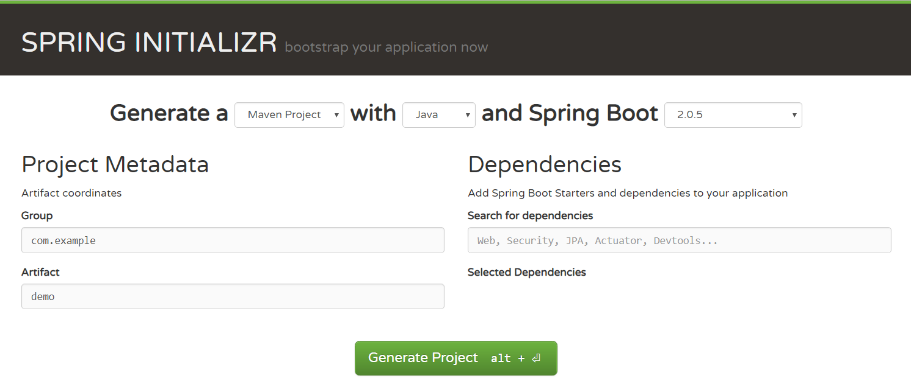
Spring Initializr

Slide 6
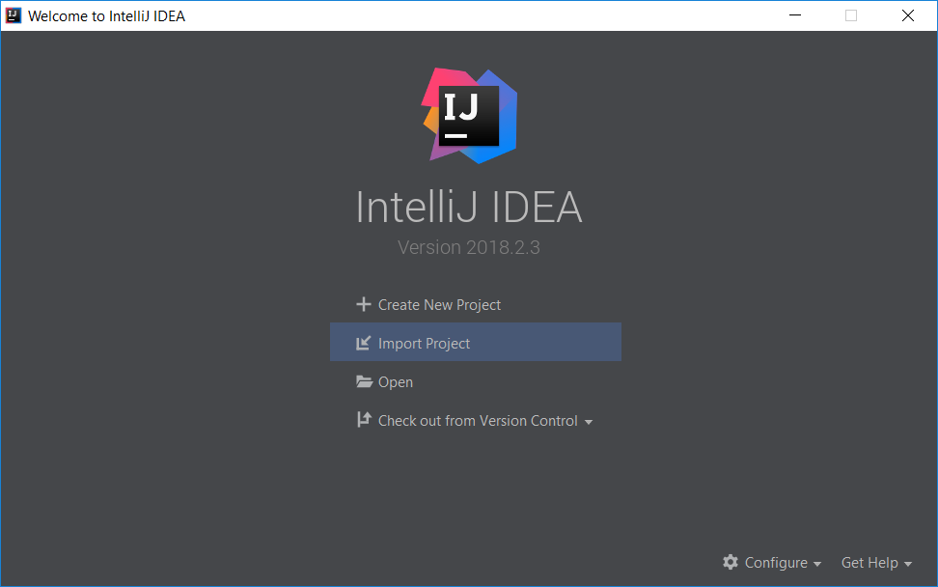
Import Project

Slide 7

Boot parent added
pom.xml

Slide 8
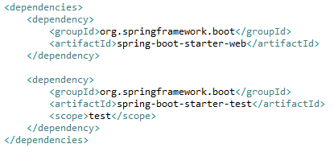
Dependencies added
pom.xml

Slide 9
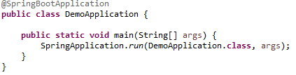
Application Configuration added
DemoApplication.java

