Slide 1
Context Dependency Injection

Slide 2

Context and Dependency Injection
https://www.baeldung.com/java-ee-cdi
CDI (Contexts and Dependency Injection) is a standard dependency injection framework included in Java EE 6 and higher
It allows us to manage the lifecycle of stateful components via domain-specific lifecycle contexts and inject components (services) into client objects in a type-safe way.

Slide 3
What is dependency injection?
Loose coupling instead of tight coupling
keep application code isolated from object creation by passing the required dependencies into the client classes through plain old factories/builders

Slide 4
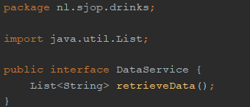
Example
DataService interface

Slide 5
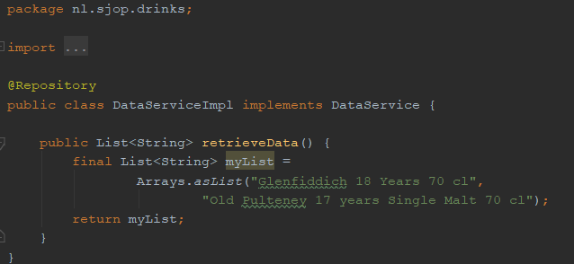
Example
DataService implementation

Slide 6
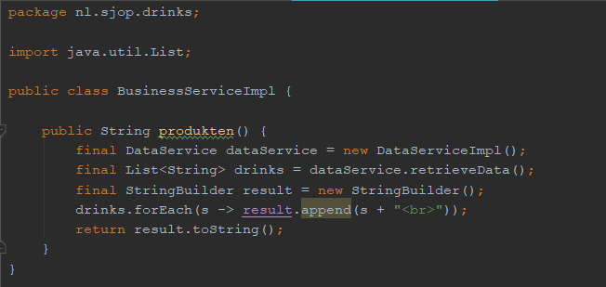
Tight coupling
DataService dataService = new DataServiceImpl();

Slide 7
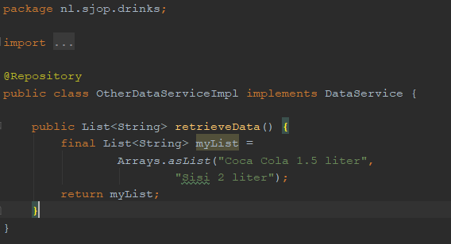
Example continued
Other implementation of DataService

Slide 8
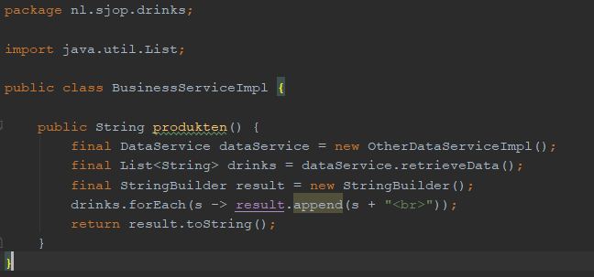
Tight coupling (2)
DataService dataService = new DataServiceImpl(); new OtherDataServiceImpl();
UNWANTED Code CHANGE

Slide 9
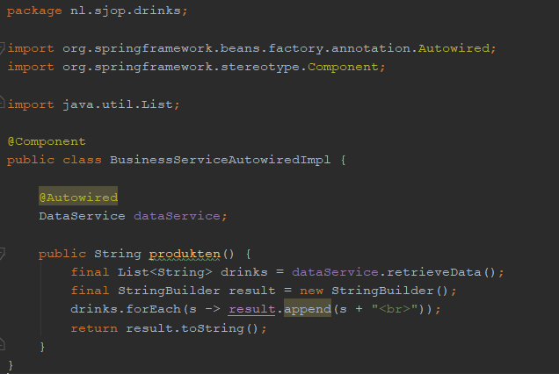
Loose coupling
@Autowired
DataService dataService;

Slide 10

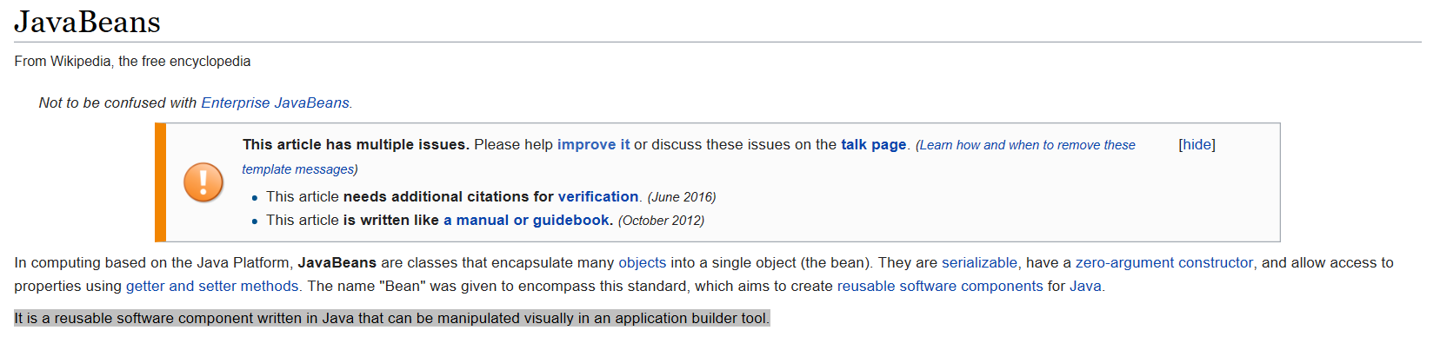
Beans
How are beans instantiated
Which beans to create
How to wire the correct bean
Where to look for beans

Slide 11
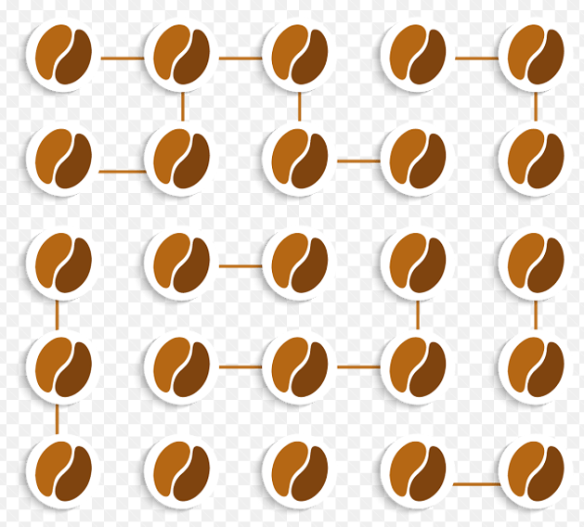
Inversion of Control (IoC) container
Responsible for the instantiation and wiring of beans
Spring IoC container can be created in 2 ways:
Bean factory
Application context (preferred way)

Slide 12
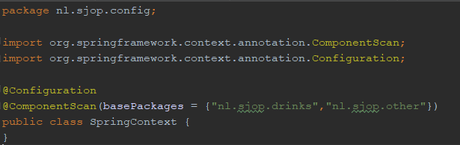
Inversion of Control (IoC) container
Construction via application context
@Configuration

Slide 13
Application context interfaces
For web applications
WebApplicationContext
For standalone applications:
ClassPathXmlApplicationContext
FileSystemXmlApplicationContext

Slide 14
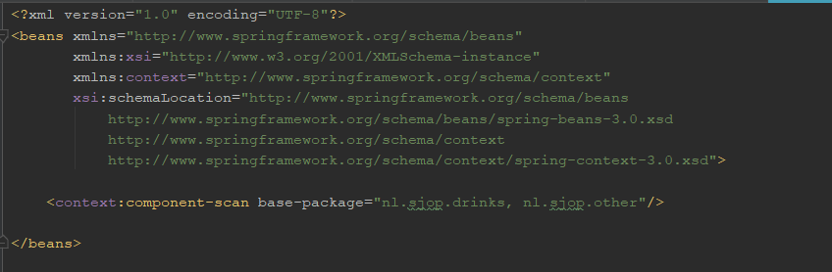
Application context interfaces
Xml based bean configuration: applicationContext.xml

Slide 15
Which beans to create
Beans are annotated classes:
@Component
@Repository
@Service

Slide 16
Which beans to create
Beans are annotated classes:
@Component
generic way of defining a Spring bean
@Repository
Data Access Object (DAO) components
@Service
annotation is used in business service components

Slide 17
@Autowire : injection types
Field injection
Constructor injection
Setter injection

Slide 18
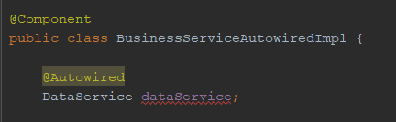
@Autowire : field injection

Slide 19
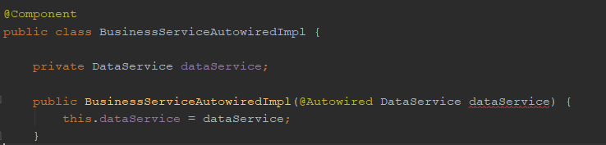

@Autowire : constructor injection

Slide 20
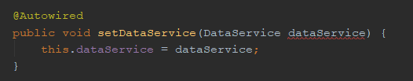
@Autowire : setter injection

Slide 21

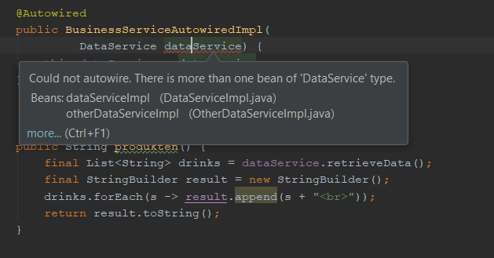

Which bean to wire?

Slide 22
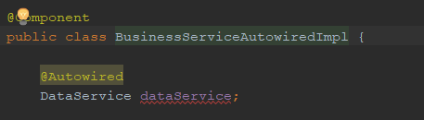


Conflicts : how to wire the correct beans
?

Slide 23
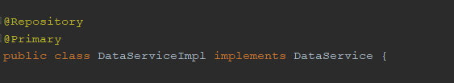
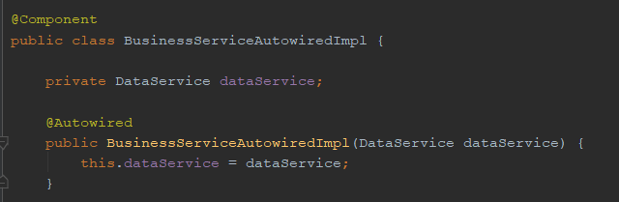
@Primary

Slide 24


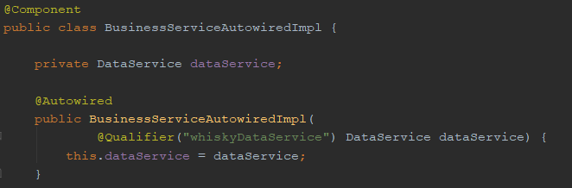
@Qualifier

Slide 25

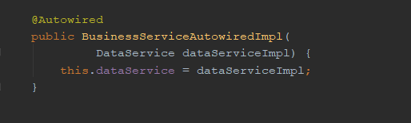
Autowire by (default) name
Class name = DataServiceImpl, Bean property name = class name,
with first character set to lower case

Slide 26


Slide 27


Slide 28


Slide 42



Slide 43


Slide 47


Slide 48


Slide 49


Slide 52


Slide 53


Slide 54


Slide 56


Slide 57


Slide 58


