Slide 1
Intro REST and microservices

Slide 2
Structure of the SIG
Presentations:
Intro REST and microservices
Spring initializer
Exposing REST Services in Spring Boot
Consuming REST Services in Spring Boot
Context and Dependency Injection
Workshop consisting of 4 labs
Lab 1: ShoppingService : http GET
Lab 2: ProductService : http GET via Rest client
Lab 3: Http POST and http PUT
Lab 4: CDI
https://github.com/AMIS-Services/sig-springboot-1

Slide 3
Software
Install:
JDK 8 or higher
Postman
Intellij Community Edition or Spring Tool Suite

Slide 4
Representational state transfer (REST)
Bound by a number of principles:
All resources are uniquely addressable
All resources can be manipulated through a constrained set of well-known actions, usually CRUD (create, read, update, delete)
The data for all resources is transferred through any of a constrained number of well-known representations, usually HTML, XML or JSON
The communication between the client and the application is performed over a stateless protocol that allows for multiple layered intermediaries that can reroute and cache the requests and response packets transparently for the client and the application

Slide 5
Implementing REST using HTTP
Usage of HTTP methods:
GET: Nullipotent (safe, no data change); use to retrieve data
Return 200 (OK), 404 (Not Found) or 400 (Bad Request)
POST: Not idempotent; use to create (collections of) resources
Return 200 (OK), 201 (Created) or 204 (No Content)
PUT: Idempotent; use to update existing resource in its entirety
Return 200 (OK), 201 (Created), 204 (No Content) or 404 (Not Found)
DELETE: Idempotent; use to delete resource
Return 200 (OK), 202 (Accepted) or 204 (No Content)
PATCH: Idempotent; use to update existing resource partially
Return 200 (OK), 204 (No Content) or 404 (Not Found)

Slide 6
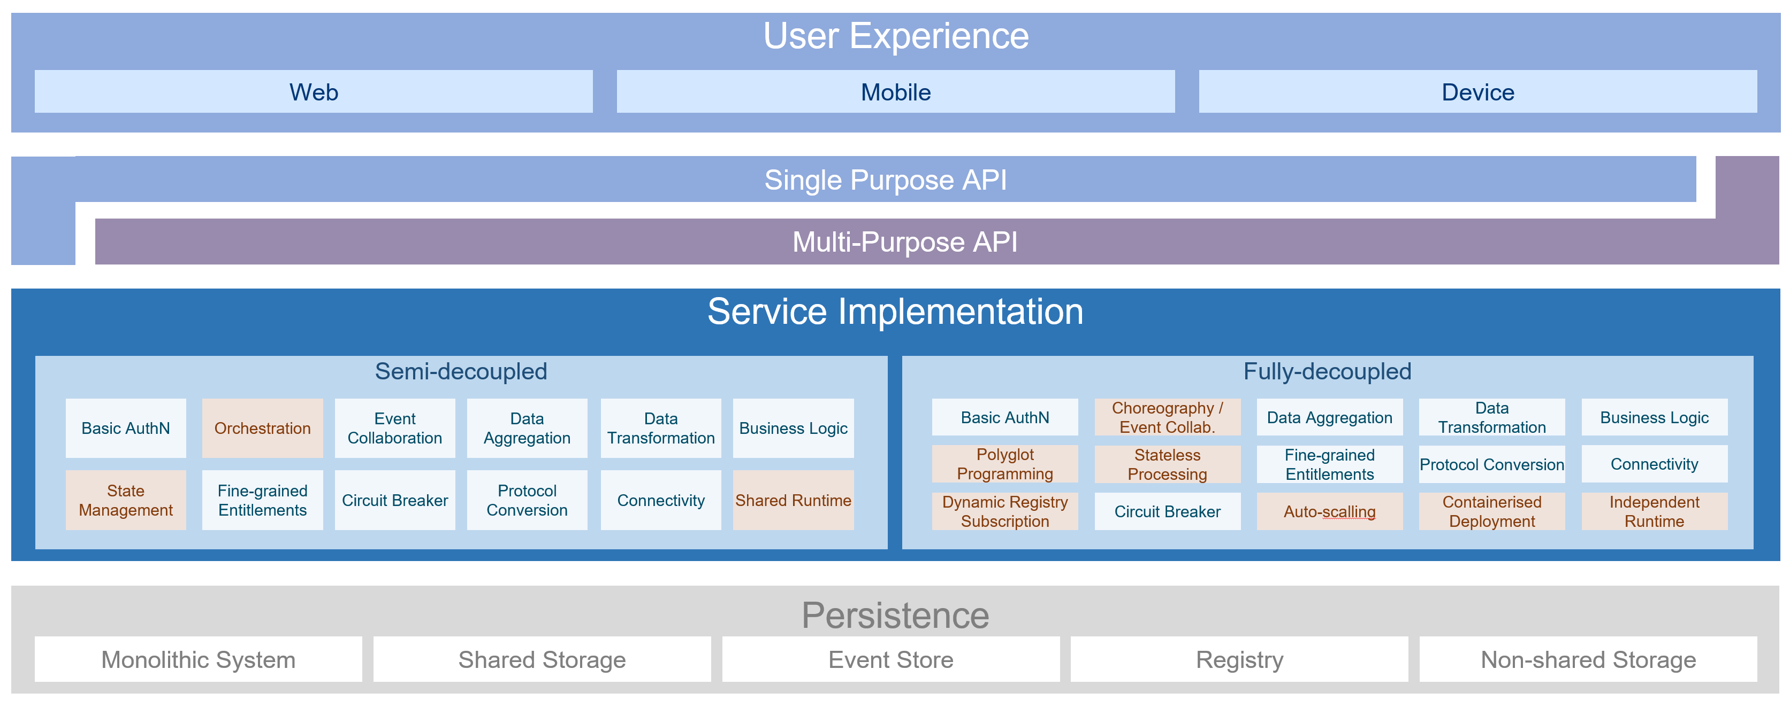
Microservices Architecture: OMESA

Slide 8


Slide 9


Slide 10


Slide 24



Slide 25


Slide 29


Slide 30


Slide 31


Slide 34


Slide 35


Slide 36


Slide 38


Slide 39


Slide 40


