Slide 1
Exposing REST Services in Spring Boot

Slide 2
Expose a REST API
public class Greeting { @JsonProperty("identificatie") private int id; @JsonProperty("bericht") private final String message; @JsonProperty("stad") private final String city; @JsonProperty("land") private final String country; public Greeting(){ id = 7; message = "Hallo Pim!"; city = "Ede"; country = "Nederland"; } public int getId() { return this.id; } public void setId(int id) { this.id = id; } public String getMessage(){ return this.message; } public String getCity() { return this.city; } public String getCountry() { return this.country; } }
REST contract based on annotated objects
Use controller bean to define actual operations
@RestController @RequestMapping("/hello") public class HelloWorldController { @RequestMapping(method = RequestMethod.GET, value = "/world") public ResponseEntity<Greeting> getAll() { Greeting greeting = new Greeting(); return new ResponseEntity<>(greeting, HttpStatus.OK); } @GetMapping(value = "/world/{id}") public ResponseEntity<Greeting> getById(@PathVariable int id) { Greeting greeting = new Greeting(); greeting.setId(id); return new ResponseEntity<>(greeting, HttpStatus.OK); } }

Slide 3
Annotations
@SpringBootApplication, defines runnable class:
Actually, @SpringBootApplication is a collection of 3 annotations:
@Configuration: make this the main configuration class for instantiating beans for dependency injection – more on this later
@EnableAutoConfiguration: setup basic infrastructure – makes guesses for configuring beans based on classpath and defined beans
@ComponentScan: indicates where to look for components (beans) - more on this later
@SpringBootApplication public class HelloWorldRestServiceApplication { public static void main(String[] args) { SpringApplication.run(HelloWorldRestServiceApplication.class, args); } }
//@SpringBootApplication @Configuration @EnableAutoConfiguration @ComponentScan public class HelloWorldRestServiceApplication { public static void main(String[] args) { SpringApplication.run(HelloWorldRestServiceApplication.class, args); } }

Slide 4
Annotations
@RestController and @RequestMapping("/relative/url") (class):
@RestController to define class as a REST service bean
@RequestMapping to define default path for service
@RequestMapping(GET) (method):
Specify GET action on relative url
Alternatively: @GetMapping
Use @PathVariable to receive parameters
@RestController @RequestMapping("/hello") public class HelloWorldController {
@RequestMapping(method = RequestMethod.GET, value = "/world") public ResponseEntity<Greeting> getAll() {
@GetMapping(value = "/world/{id}") public ResponseEntity<Greeting> getById(@PathVariable int id) {

Slide 5
Annotations
@RequestMapping (POST), @RequestBody:
@RequestMapping: Specify POST action on url; alternatively: @PostMapping
@RequestBody: Specify the body of the post message by specifying which class/parameter is responsible for translating the JSON into a java object
@RequestMapping(method = RequestMethod.POST) public ResponseEntity<OrderSummary> update(@RequestBody Order order) { OrderSummary orderSummary = new OrderSummary(order, partsDAO); return new ResponseEntity<OrderSummary>(orderSummary, HttpStatus.OK); }
@PostMapping public ResponseEntity<OrderSummary> update(@RequestBody Order order) { OrderSummary orderSummary = new OrderSummary(order, partsDAO); return new ResponseEntity<OrderSummary>(orderSummary, HttpStatus.OK); }

Slide 6
Annotations
@JsonProperty to rename class properties to json naming:
On class property:
On getter:
On setter:
Use @JsonProperty on the class property to adjust the get response & post request json
Use @JsonProperty on the getter to adjust the get response json
Use @JsonProperty on the setter to adjust the post request json
@JsonProperty("identificatie") private int id;
@JsonProperty("identificatie") public int getId() { return this.id; }
@JsonProperty("identificatie") public void setId(int id) { this.id = id; }

Slide 7
Application properties
Application.properties file used to set application-wide properties, like:
The server port (default 8080):
The server adress (to deploy to, default localhost):
The server relative url (default empty):
And..... DONE ☺
server.port=8090
server.address=localhost
server.servlet.context-path=/helloworld

Slide 8
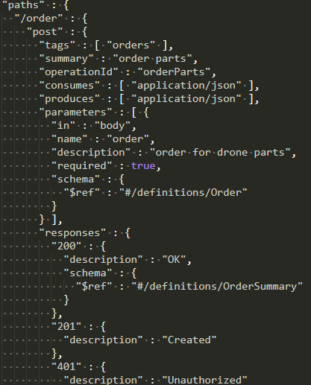
Contract-first development using SwaggerHub
Define a contract in the Swagger/OpenAPI specification
Specify operations in detail, including expected request&response bodies
Provide documentation
Can generate a Spring Boot project based on the provided information, generating lots of packages, classes and properties

Slide 9
Contract-first development using SwaggerHub
DEMO TIME

Slide 10


Slide 11


Slide 12


Slide 26



Slide 27


Slide 31


Slide 32


Slide 33


Slide 36


Slide 37


Slide 38


Slide 40


Slide 41


Slide 42


