Slide 1
Docker data persistency

Slide 2
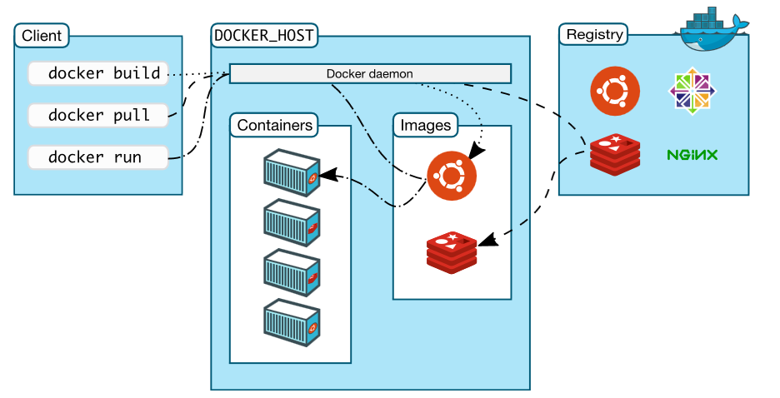
Docker architecture

Slide 3

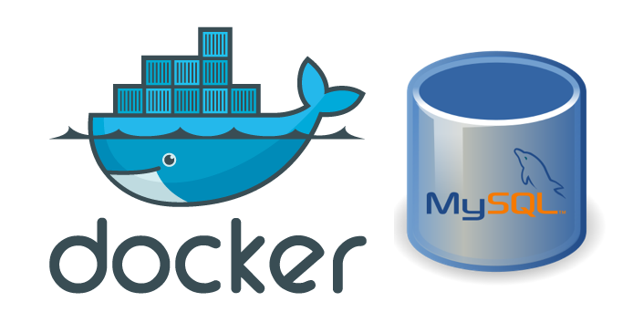
Reminder lab 7

Slide 4
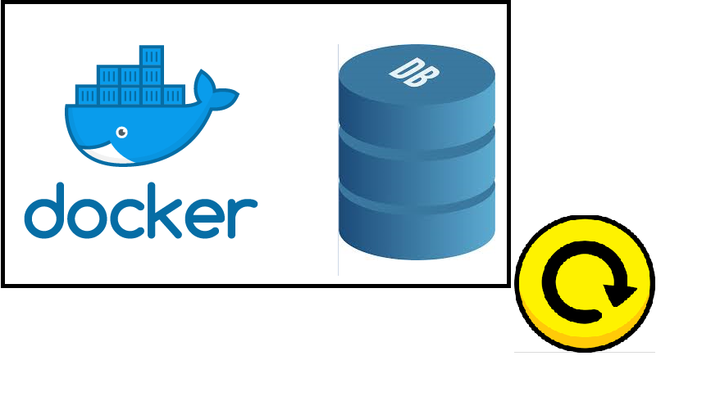
Design problem

Slide 5
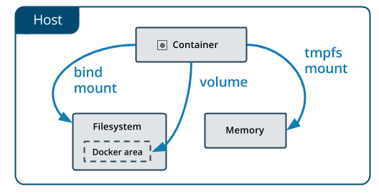
Data management in Docker

Slide 6
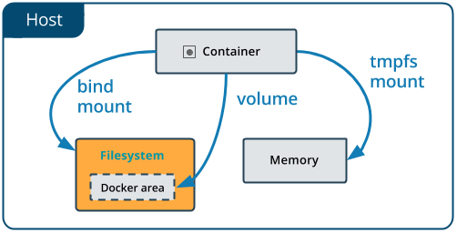
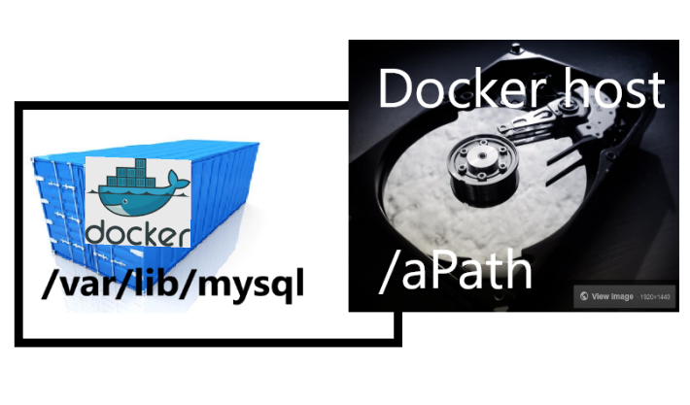
Bind mount

Slide 7
Bind mount: --mount
--mount option available from docker version 17.06
$ docker run -d \
-it \
--name devtest \
--mount type=bind,source="$(pwd)"/target, target=/app \
nginx:latest
--mount DOES NOT create folder or file
--mount flag was originally used for/with swarm services

Slide 8
Bind mount: -v
$ docker run -d -it --name mysql-dev
-v d:\someDir\:/var/lib/mysql mysql
$ docker run -d \
-it \
--name devtest \
-v "$(pwd)"/target:/app \
nginx:latest
The $(pwd) sub-command expands to the current working directory on Linux or macOS hosts
-v DOES create folder or file if it not already exists

Slide 9
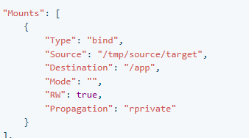
Docker inspect
$ docker inspect devtest

Slide 10
Read only
--mount:
$ docker run -d \ -it \ --name devtest \ --mount type=bind,source="$(pwd)"/target,target=/app,readonly \ nginx:latest
-v:
$ docker run -d \ -it \ --name devtest \ -v "$(pwd)"/target:/app:ro \ nginx:latest

Slide 11
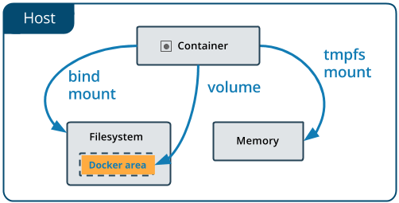
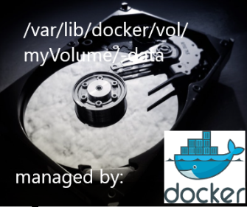
Volumes

Slide 12
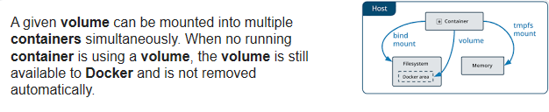
Volumes : life span

Slide 13
Volumes
$ docker volume create myVolume
$ docker volume ls
$ docker volume inspect myVolume
$ docker volume rm myVolume
[
{ "Driver": "local",
"Labels": {},
"Mountpoint": "/var/lib/docker/volumes/myVolume/_data",
"Name": "myVolume",
"Options": {},
"Scope": "local"
}
]

Slide 14
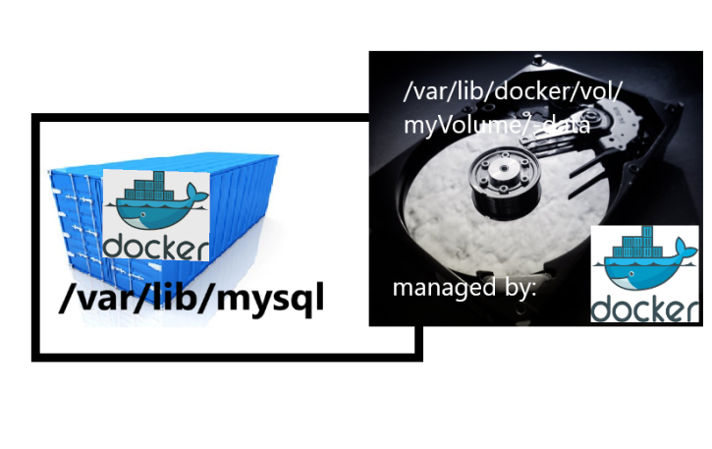
Start container with a volume: --mount
$ docker run -d \ --name devtest \ --mount source=myVolume,target=/app \ nginx:latest
$ docker run --mount source=myVolume,target=/var/lib/mysql
-e MYSQL_ROOT_PASSWORD=pass -e MYSQL_DATABASE=test -p 3306:3306 -d mysql

Slide 15
Start container with a volume: -v
$ docker run -d \ --name devtest \ -v myVolume:/app \ nginx:latest

Slide 16
Inspect mounts
$ docker inspect devtest
"Mounts": [
{ "Type": "volume",
"Name": "myvol2",
"Source": "/var/lib/docker/volumes/myvol2/_data",
"Destination": "/app",
"Driver": "local",
"Mode": "",
"RW": true,
"Propagation": ""
}
],

Slide 17
Volume containers
$ docker create -v /config --name dataContainer busybox
$ docker cp config.conf dataContainer:/config/
$ docker run --volumes-from dataContainer ubuntu ls/config
docker create -v /var/lib/mysql --name vc_mySql busybox
docker run --volumes-from vc_mySql
-e MYSQL_ROOT_PASSWORD=pass
-e MYSQL_DATABASE=test
-p 3306:3306 -d mysql
lab 9

Slide 18
tmpfs: unix only
temporary, and only persisted in the host memory
$ docker run -d \
-it \
--name tmptest \
--mount type=tmpfs,destination=/app
\ nginx:latest
$ docker run -d \
-it \
--name tmptest \
--tmpfs /app \
nginx:latest

Slide 19
Github lab 9
https://github.com/AMIS-Services/sig-springboot-1/tree/master/lab9-docker-volumes

