Slide 1
Docker with SpringBoot

Slide 2
Docker
Docker is a software platform that enables developers to develop, ship, and run applications anywhere with the help of containers.
Docker creates:
lightweight, standalone, executable package
Packages includes everything needed to run it:
the code, the runtime, the libraries, tools, environments & configurations
Docker images are the executable packages.
Docker containers are the running instances of Docker images.

Slide 3
Advantages Docker containers
Advantages of containers:
Can be shared, shipped & run anywhere in any environment
Will behave the same regardless of environment run in
Run completely isolated & independently from each other

Slide 4
Dockerize a SpringBoot Application
Define a Docker image with a Dockerfile
Build the Application as a jar
Build the Docker image
Run the Docker image

Slide 5
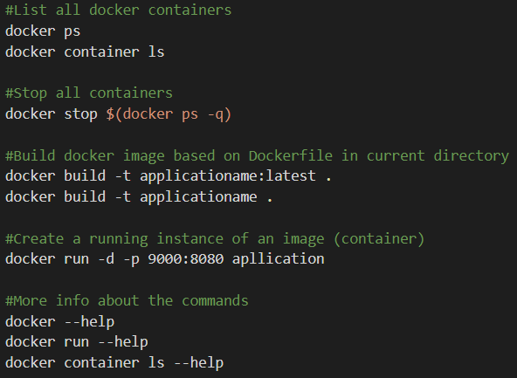
Useful docker commands

Slide 6
Activate different Spring profiles with Docker
Different profile configurations can be used to switch between different environment configurations. For example use an embedded in-memory database for development, while production uses an external database.
application-{profile}.properties
application-dev.properties
application-prod.properties
To activate a Spring profile in a Docker container,
set the active profile as environment variable
docker run -p 9000:8080 -e spring.profiles.active="dev" whiskeyshop

