Slide 1
Intro REST and microservices

Slide 2
Structure of the SIG
Presentations:
Intro REST and microservices
Spring initializer
Exposing REST Services
Consuming REST Services
Context and Dependency Injection
Workshop consisting of 3 labs

Slide 3
HTTP in the context of RESTful APIs
Usage of 5 methods:
GET: Safe (no data change); use to retrieve data
Return 200 (OK), 404 (Not Found) or 400 (Bad Request)
POST: Not idempotent; use to create (collections of) resources
Return 200 (OK), 201 (Created) or 204 (No Content)
PUT: Idempotent; use to update existing resource in its entirety
Return 200 (OK), 201 (Created), 204 (No Content) or 404 (Not Found)
DELETE: Idempotent; use to delete resource
Return 200 (OK), 202 (Accepted) or 204 (No Content)
PATCH: Idempotent; use to update existing resource partially
Return 200 (OK), 204 (No Content) or 404 (Not Found)

Slide 4
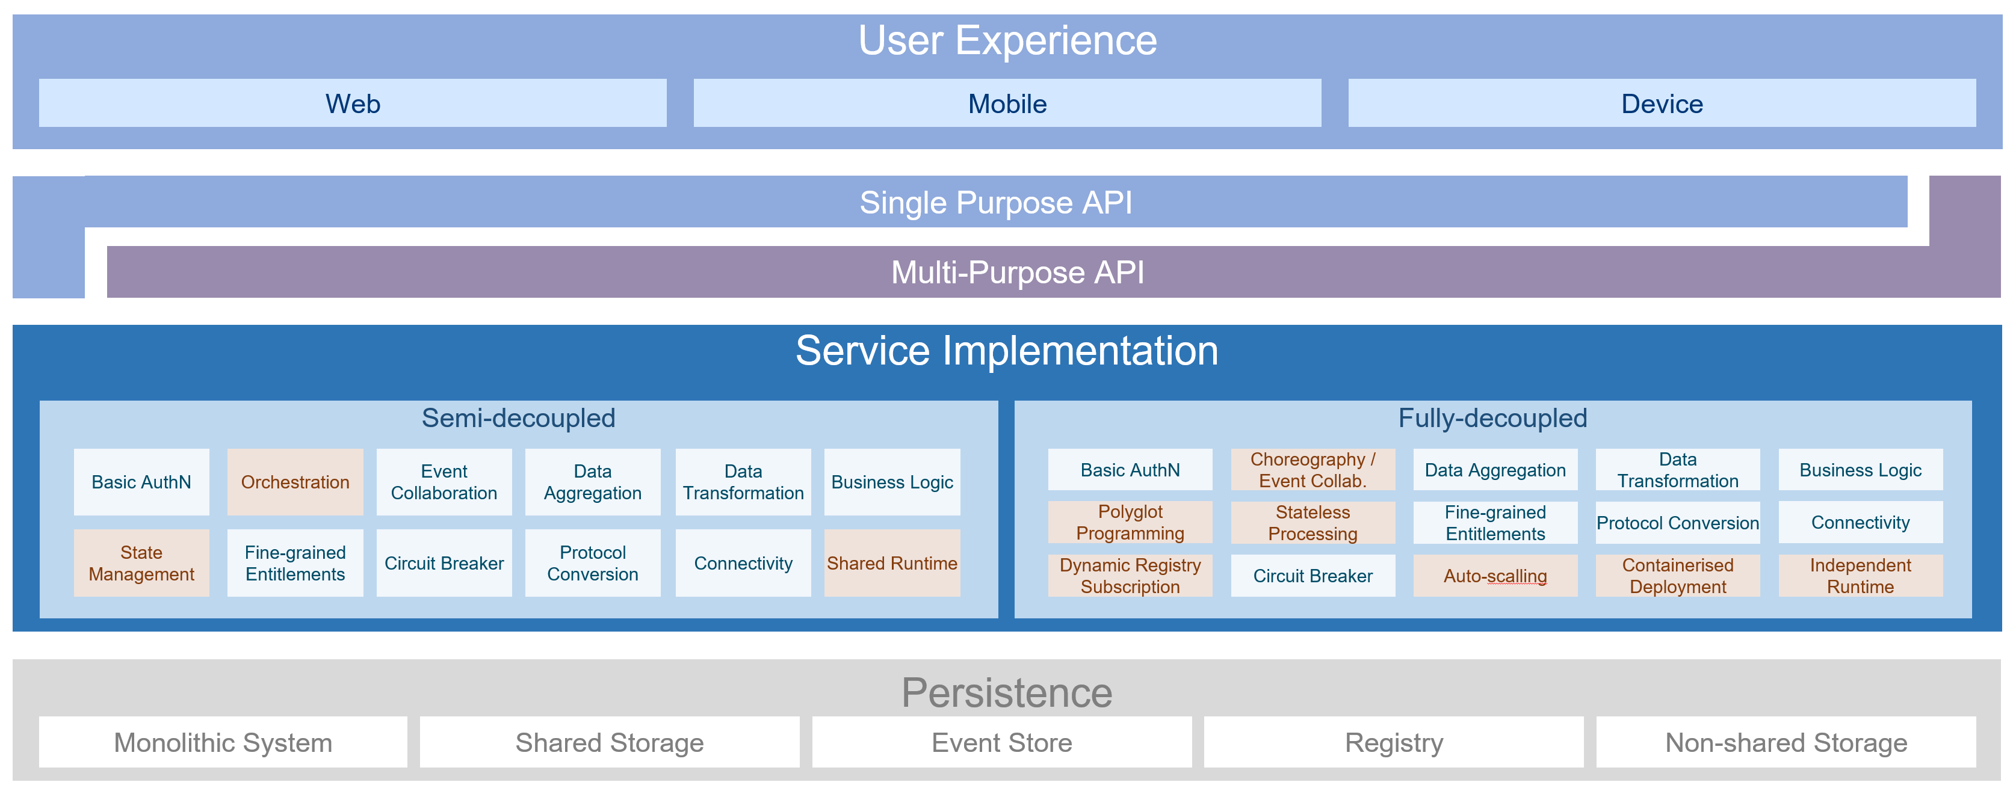
Microservices Architecture: OMESA

Slide 6


Slide 7


Slide 8


Slide 22



Slide 23


Slide 27


Slide 28


Slide 29


Slide 32


Slide 33


Slide 34


Slide 36


Slide 37


Slide 38


