Slide 1

Web-security
06-06-2019
Web-security
1

Slide 2
Secure Socket Layer (deprecated) / Transport Layer Security
SSL / TLS
Web-security
2
Web-security
2

Slide 3
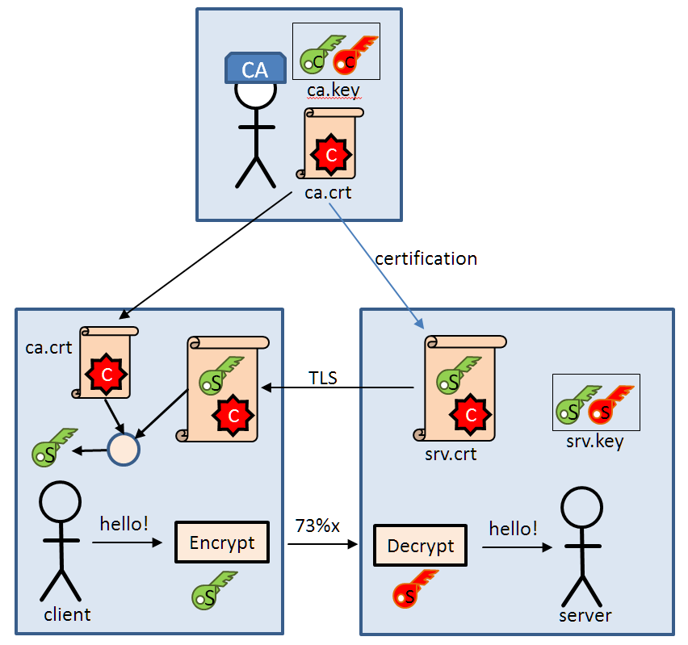
SSL / TLS
Web-security
3
Web-security
3

Slide 4
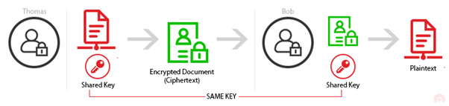
SSL / TLS
Web-security
4
Web-security
4

Slide 5
JWT
Web-security
5
Web-security
5

Slide 6
Dynamic Routing / Rendering
Web-security
6
Web-security
6

Slide 7
XSS
Web-security
7
Web-security
7

Slide 8
CSRF
Web-security
8
Web-security
8

Slide 9

Demo
Web-security
9

Slide 10
Questions?
Web-security
10

Slide 11
Hands-on
Web-security
11

