Slide 1
Programma:
Why Vitest?
What is Vitest?
Vitest setup
Migrate from Jest
Vitest basics
Mocking
Labs

Slide 2
Jeroen Rijnboutt
Andras Hetényi
Joost Lambregts

Slide 3
Why Vitest?
Vitest
Better Typescript support
Better ESModules support
Jest
Better CommonJS module support
Larger community
Watch mode

Slide 4

What is Vitest
Testing framework for Javascript / Typescript
Almost identical to Jest
Originally built for Vite framework
Resources:
https://vitest.dev/api/
https://vitest.dev/guide/
Jest documentation

Slide 5
To Do: Setup (Andras)

Slide 6
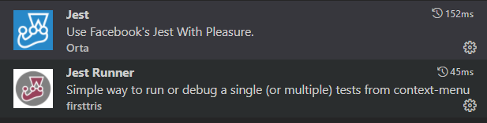
Visual Studio code extensions

Slide 7
Getting started
have node.js installed.
$ mkdir myfirstjest
$ cd myfirstjest
$ npm init –y (creates a package.json file)
$ npm i –D jest

Slide 8
package.json
{
"name": "myfirstjest",
"version": "1.0.0",
"description": "",
"main": "index.js",
"scripts": {
"test": "echo \"Error: no test specified\" && exit 1" “jest”
},
"keywords": [],
"author": "",
"license": "ISC"
}

Slide 9
Migrating Jest to Vitest
Multiple projects JavaScript + Jest (Eneco, NS, Feenstra, Studio)
Years of code
TypeScript as new standard but Jest was not always replaced
TypeScript standard includes Vitest now

Slide 10
Migrating Jest to Vitest
Case study migrating TypeScript with Jest to TypeScript with Vitest
Fully based on TypeScript standard
Basic Azure FunctionApp
2 HTTP Triggers
2 Eventgrid Triggers

Slide 11
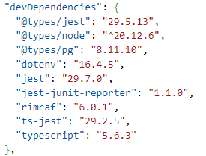
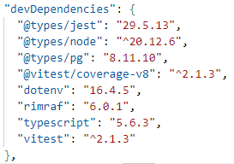
Migrating Jest to Vitest
Package.json – Dev Dependencies
Old
New

Slide 12


Migrating Jest to Vitest
Package.json – Scripts
Old
New

Slide 13
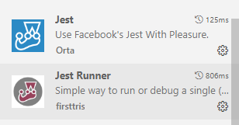
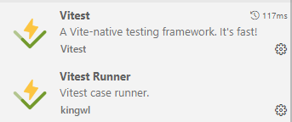
Migrating Jest to Vitest
VS Code plugins
Disable
Enable

Slide 14
Migrating Jest to Vitest
Build Error
Update moduleResolution to node16 or NodeNext

Slide 15
Migrating Jest to Vitest
Delete jest.config.js (if present)
Add vitest.config.ts en vitest.setup.ts (AMIS TS Standard)
Add explicit imports
First (simple) test already works

Slide 16
Migrating Jest to Vitest
Replace jest.mock with vi.mock
Replace jest.fn() with vi.fn()
Replace jest.clearMocks() with vi.clearMocks()
Replace jest.spyOn() with vi.spyOn()

Slide 17
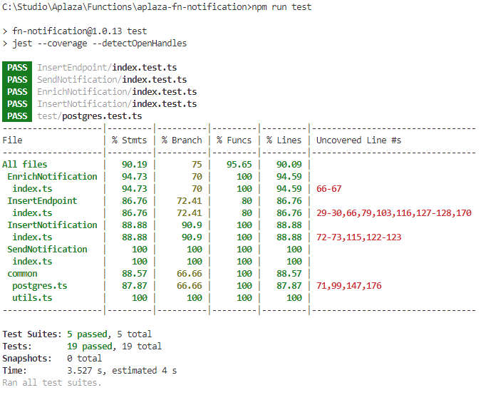
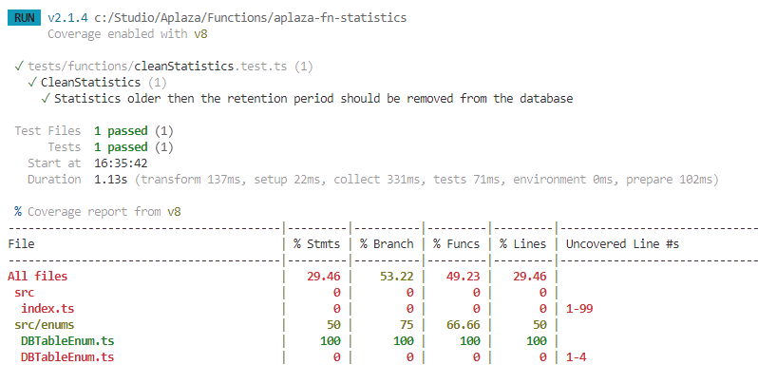
Migrating Jest to Vitest
Test results in terminal
Old
New

Slide 18
Vitest Basics: Expects and Matchers
//file: functions.js
export function add(a: number, b: number): number {
return a + b
}
import { describe, it, expect, test } from 'vitest'
import { add } from './toRemove.js'
test('add', () => {
expect(add(1, 2)).toBe(3)
})

Slide 19
Matchers
Readable way to make assertions
Specialized matchers exist for many kinds of values
https://jestjs.io/docs/expect
// matcher examples
test('matcher examples', () => {
expect([1,2,3]).toContain(1)
expect([1,2,3]).not.toContain(4)
expect([]).toHaveLength(0)
expect('hello').toMatch(/hello/)
expect(5).toBeGreaterThan(4)
expect({a: 1, b:2}).toMatchObject({a: 1})
expect({a: 1, b:2}).toHaveProperty('a')
expect(3.1).toBeCloseTo(3, 0)
expect(null).toBeNull()
})

Slide 20
Asymetric Matchers
Use in equals, and in some other matchers
// matcher examples
test('asymetric matchers', () => {
const obj = { a: 1, b: 2, c: 3 }
expect(obj).toEqual(expect.objectContaining({ a: 1, b: expect.any(Number) }))
expect([1,2,3]).toEqual(expect.arrayContaining([1,2]))
})

Slide 21
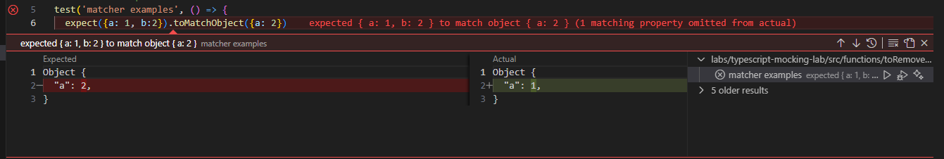
Failing matchers in Visual Studio Code

Slide 22
Comparing objects
test('obect comparisons', () => {
const ob = {a: 1, b: 2}
expect(ob).toBe(ob) // pass
expect(ob).toBe({a: 1, b: 2}) // fail
expect(ob).toEqual({a: 1, b: 2}) // pass
expect(ob).toMatchObject({a: 1}) // pass
})

Slide 23
Matchers for Exceptions
async function helloWorld(name: string): Promise<string> {
throw new Error('Not implemented')
}
test('matcher examples', () => {
expect(helloWorld).rejects.toThrow('Not implemented')
})
function helloWorld(): string {
throw new Error('Not implemented')
}
test('matcher examples', () => {
expect(helloWorld).toThrowError('Not implemented')
})

Slide 24
Testing async functions
async function helloWorld(): Promise<string> {
return 'hello!'
}
test('matcher examples', async () => {
const greeting = await helloWorld()
expect(greeting).toBe('hello')
})

Slide 25


Setup and teardown

Slide 26
One time setup and teardown
beforeAll(() => {
//do some setup
startRepository ();
});
afterAll(() => {
//do some teardown
teardownRepository ();
});

Slide 27
Repeating setup and teardown: for each test
beforeEach(() => {
//do some setup
initializeRepository ();
});
afterEach(() => {
//do some teardown
clearRepository ();
});
test(‘some test', () => {
expect(…).toBeTruthy();
});
test(‘some other test', () => {
expect(…).toBeTruthy();
});

Slide 28
Scoping: describe
beforeEach(() => {…});
afterEach(() => {…});
test(‘some test', () => {..});
describe(‘this is a scoped block', () => {
// Applies only to tests in this block
beforeEach(() => {… });
beforeAll(() => {…});
test(‘some test within scope', () => {…});
test(‘some 2nd test within scope', () => {…});
afterEach(() => {…});
afterAll(() => {…});
});

Slide 29


Mock testing

Slide 30
Documentation is your friend
https://vitest.dev/guide/mocking

Slide 31
Mocking modules
Working with mock functions
Injecting mock functions in dependencies
To test
Dependency to mock
user.js
userDb.js
getUser()
getUserFromDb()
import

Slide 32
Working with mock functions: vi.fn
vi.fn() creates a mock function:
Verify function calls / arguments
Modify function behavior
const getApples = vi.fn(() => 0)
getApples()
expect(getApples).toHaveBeenCalled()
expect(getApples).toHaveReturnedWith(0)
getApples.mockReturnValueOnce(5)
const res = getApples()
expect(res).toBe(5)
expect(getApples).toHaveNthReturnedWith(2, 5)

Slide 33
Working with mock functions: Implementations
const isTheBestTestingFramework = vi.fn()
// full implementation
isTheBestTestingFramework.mockImplementation((name) => {
if (name === 'vitest') {
return true
}
return false
})
// return value (non async)
isTheBestTestingFramework.mockReturnValue(true)
// return value (async)
isTheBestTestingFramework.mockResolvedValue(true)
isTheBestTestingFramework.mockRejectedValue(new Error('error message'))

Slide 34
Working with mock functions: Mock once or more
const myMock = vi.fn()
// default implementation
myMock.mockReturnValue(true)
// first call
myMock.mockReturnValueOnce(false)
// second call
myMock.mockReturnValueOnce('maybe’)
console.log(`${myMock()} ${myMock()} ${myMock()}`)
//result: false maybe true
// reset mock implementation to empty implementation (return undefined)
vi.resetAllMocks()
isTheBestTestingFramework.mockReset()

Slide 35
Working with mock functions: Verifying calls
expect(myMock).not.toHaveBeenCalled()
myMock('foo')
expect(myMock).toHaveBeenCalledTimes(1)
expect(myMock).toHaveBeenCalledWith('foo')
myMock('bar')
expect(myMock).toHaveBeenCalledWith('foo') // does not fail!
expect(myMock).toHaveBeenLastCalledWith('foo') // fails!
myMock.mockClear()
vi.clearAllMocks()
expect(myMock).not.toHaveBeenCalled() // true!

Slide 36
Use asymmetric matchers!
expect(myMock).toHaveBeenCalledWith(expect.any(Date), expect.arrayContaining([1,2]))

Slide 37
Working with mock functions: Utilizing mock.calls
console.log(myMock.mock)
{
calls: [Getter],
contexts: [Getter],
instances: [Getter],
invocationCallOrder: [Getter],
results: [Getter],
settledResults: [Getter],
lastCall: [Getter]
}
myMock('foo’)
myMock('bar', 'baz’)
const secondCall = myMock.mock.calls[1]
expect(secondCall).toEqual(['bar', 'baz'])

Slide 38
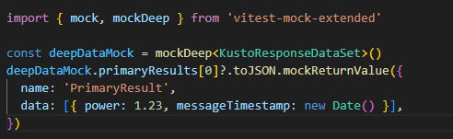
Mocking complex objects: vitest-mock-extended
Sometimes the functions we want to mock are located in an object. We can use vitest-mock-extended to easily create mock objects from types, classes,or interfaces.
const loggerMock = mock<Logger>()
const result = await myFunction(loggerMock, ‘test)
expect(loggerMock.logError).toHaveBeenCalledTimes(1)

Slide 39
Mocking modules
How dow we inject a mock function into an imported module?
To test
Dependency to mock
user.js
userDb.js
getUser()
getUserFromDb()
import

Slide 40
Mocking modules: vi.mock(): Automocking algorithm
import { getUserFromDb } from '../../src/common/userDb.js’;
vi.mock('../../src/common/userDb.js')
beforeAll(() => {
vi.mocked(getUserFromDb).mockResolvedValue({ name: 'Joost', age: 37 })
})
Automocking algorithm:
All arrays will be emptied
All primitives and collections will stay the same
All objects will be deeply cloned
All instances of classes and their prototypes will be deeply cloned

Slide 41
Mocking modules: vi.mock(): Custom mock factory
import { getUserFromDb } from '../../src/common/userDb.js';
// this will not work!: const getUserFromDbMock = vi.fn()
const getUserFromDbMock = vi.hoisted(vi.fn())
vi.mock('../../src/common/userDb.js', () => ({
getUserFromDb: getUserFromDbMock
}))
beforeAll(() => {
vi.mocked(getUserFromDb).mockResolvedValue({ name: 'Joost', age: 37 })
})
vi.mock() is hoisted to the top of the file. All dependencies must be hoisted as well

Slide 42
Mocking modules: Default implementations with __mocks__ folders
- __mocks__
- axios.js
- src
__mocks__
- increment.js
- increment.js
- tests
- increment.test.js
Gives default mock implementations to reuse
Test functionality in source folders is ugly
Alternatively, put default mock implementations in vitest.setup.ts

Slide 43
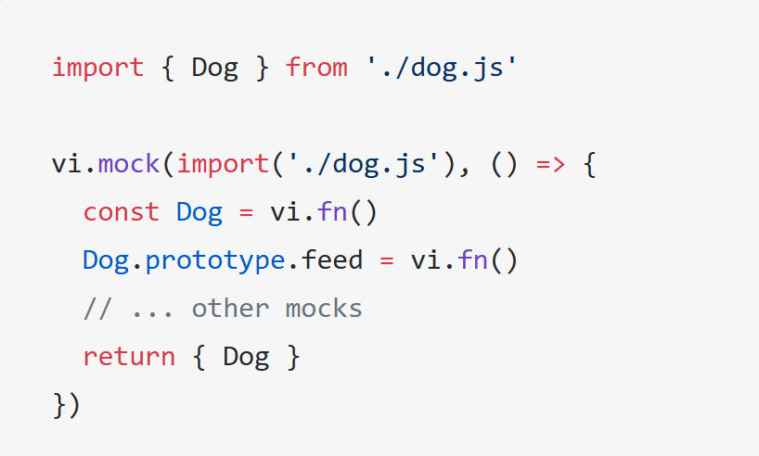
Mocking modules: Mocking exported classes
A class in javascript is just a constructor function.
Use vi.fn() to mock the class
Use .prototype to inject mock functions

Slide 44
Mocking modules: Mocking partials
// foo-bar-baz.js
export const foo = 'foo';
export const bar = () => 'bar';
export default () => 'baz';
//foo-bar-baz.test.js
import defaultExport, {bar, foo} from '../foo-bar-baz’;
vi.mock('../foo-bar-baz’, async () => {
const originalModule = vi.importActual('../foo-bar-baz'); //Mock the default export and named export 'foo'
return {
...originalModule,
default: vi.fn(() => 'mocked baz'),
foo: 'mocked foo',
};
});

Slide 45
Labs
Labs en projecten staan in Github:
AMIS-Services/sig-javascript-unittesting

