Slide 1
Programma:
Why Vitest?
What is Vitest?
Vitest setup
Migrate from Jest
Vitest basics
Mocking
Labs

Slide 2
Jeroen Rijnboutt
Andras Hetényi
Joost Lambregts

Slide 3
Why Vitest?
Vitest
Better Typescript support
Better ESModules support
Jest
Better CommonJS module support
Larger community
Watch mode

Slide 4

What is Vitest
Testing framowerk for Javascript / Typescript
Almost identical to Jest
Originally built for Vite framework
Resources:
https://vitest.dev/api/
https://vitest.dev/guide/
Jest documentation

Slide 5
To Do: Setup (Andras)

Slide 6
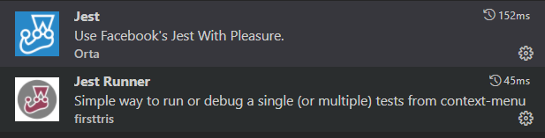
Visual Studio code extensions

Slide 7
Getting started
have node.js installed.
$ mkdir myfirstjest
$ cd myfirstjest
$ npm init –y (creates a package.json file)
$ npm i –D jest

Slide 8
package.json
{
"name": "myfirstjest",
"version": "1.0.0",
"description": "",
"main": "index.js",
"scripts": {
"test": "echo \"Error: no test specified\" && exit 1" “jest”
},
"keywords": [],
"author": "",
"license": "ISC"
}

Slide 9
To Do: migration (Jeroen)

Slide 10
To do: Vitest basics (Cha)

Slide 11
Example
//file: functions.js
export function add(a: number, b: number): number {
return a + b
}
import { describe, it, expect, test } from 'vitest'
import { add } from './toRemove.js'
test('add', () => {
expect(add(1, 2)).toBe(3)
})

Slide 12
Matchers
Readable way to make assertions
Specialized matchers exist for many kinds of values
Autocomplete, documentation, copilot are friends
// matcher examples
test('matcher examples', () => {
expect([1,2,3]).toContain(1)
expect([1,2,3]).not.toContain(4)
expect([]).toHaveLength(0)
expect('hello').toMatch(/hello/)
expect(5).toBeGreaterThan(4)
expect({a: 1, b:2}).toMatchObject({a: 1})
expect({a: 1, b:2}).toHaveProperty('a')
expect(3.1).toBeCloseTo(3, 0)
expect(null).toBeNull()
})

Slide 13
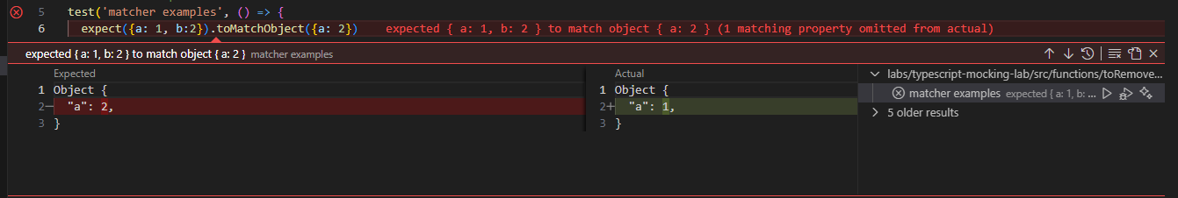
Failing matchers in Visual Studio Code

Slide 14
Comparing objects
test('obect comparisons', () => {
const ob = {a: 1, b: 2}
expect(ob).toBe(ob) // pass
expect(ob).toBe({a: 1, b: 2}) // fail
expect(ob).toEqual({a: 1, b: 2}) // pass
expect(ob).toMatchObject({a: 1}) // pass
})

Slide 15
Matchers for Exceptions
async function helloWorld(name: string): Promise<string> {
throw new Error('Not implemented')
}
test('matcher examples', () => {
expect(helloWorld).rejects.toThrow('Not implemented')
})
function helloWorld(): string {
throw new Error('Not implemented')
}
test('matcher examples', () => {
expect(helloWorld).toThrowError('Not implemented')
})

Slide 16
Testing async functions
async function helloWorld(): Promise<string> {
return 'hello!'
}
test('matcher examples', async () => {
const greeting = await helloWorld()
expect(greeting).toBe('hello')
})

Slide 17


Setup and teardown

Slide 18
One time setup and teardown
beforeAll(() => {
//do some setup
startRepository ();
});
afterAll(() => {
//do some teardown
teardownRepository ();
});

Slide 19
Repeating setup and teardown: for each test
beforeEach(() => {
//do some setup
initializeRepository ();
});
afterEach(() => {
//do some teardown
clearRepository ();
});
test(‘some test', () => {
expect(…).toBeTruthy();
});
test(‘some other test', () => {
expect(…).toBeTruthy();
});

Slide 20
Scoping: describe
beforeEach(() => {…});
afterEach(() => {…});
test(‘some test', () => {..});
describe(‘this is a scoped block', () => {
// Applies only to tests in this block
beforeEach(() => {… });
beforeAll(() => {…});
test(‘some test within scope', () => {…});
test(‘some 2nd test within scope', () => {…});
afterEach(() => {…});
afterAll(() => {…});
});

Slide 21
Scoping: execution order
Jest executes all describe handlers in a test file before it executes any of the actual tests.
Top level beforeEach will be executed before the beforeEach inside each present describe block
Once the describe blocks are complete, by default Jest runs all the tests serially in the order they were encountered in the collection phase, waiting for each to finish and be tidied up before moving on

Slide 22

Scoping: execution order
beforeAll(() => console.log('1 - beforeAll'));
afterAll(() => console.log('1 - afterAll'));
beforeEach(() => console.log('1 - beforeEach'));
afterEach(() => console.log('1 - afterEach'));
test('', () => console.log('1 - test'));
describe('Scoped / Nested block', () => {
beforeAll(() => console.log('2 - beforeAll'));
afterAll(() => console.log('2 - afterAll'));
beforeEach(() => console.log('2 - beforeEach'));
afterEach(() => console.log('2 - afterEach'));
test('', () => console.log('2 - test'));
});

Slide 23
Scoping: execution order
beforeAll(() => console.log('1 - beforeAll'));
afterAll(() => console.log('1 - afterAll'));
beforeEach(() => console.log('1 - beforeEach'));
afterEach(() => console.log('1 - afterEach'));
test('', () => console.log('1 - test'));
describe('Scoped / Nested block', () => {
beforeAll(() => console.log('2 - beforeAll'));
afterAll(() => console.log('2 - afterAll'));
beforeEach(() => console.log('2 - beforeEach'));
afterEach(() => console.log('2 - afterEach'));
test('', () => console.log('2 - test'));
});
1 - beforeAll
1 - beforeEach
1 - test
1 - afterEach
2 - beforeAll
1 - beforeEach
2 - beforeEach
2 - test
2 - afterEach
1 - afterEach
2 - afterAll
1 - afterAll

Slide 24


Mock testing

Slide 25
Documentation is your friend
https://vitest.dev/guide/mocking

Slide 26
Mocking modules
Working with mock functions
Injecting mock functions in dependencies
To test
Dependency to mock
user.js
userDb.js
getUser()
getUserFromDb()
import

Slide 27
Working with mock functions: vi.fn
vi.fn() creates a mock function:
Verify function calls / arguments
Modify function behavior
const getApples = vi.fn(() => 0)
getApples()
expect(getApples).toHaveBeenCalled()
expect(getApples).toHaveReturnedWith(0)
getApples.mockReturnValueOnce(5)
const res = getApples()
expect(res).toBe(5)
expect(getApples).toHaveNthReturnedWith(2, 5)

Slide 28
Working with mock functions: Implementations
const isTheBestTestingFramework = vi.fn()
// full implementation
isTheBestTestingFramework.mockImplementation((name) => {
if (name === 'vitest') {
return true
}
return false
})
// return value (non async)
isTheBestTestingFramework.mockReturnValue(true)
// return value (async)
isTheBestTestingFramework.mockResolvedValue(true)
isTheBestTestingFramework.mockRejectedValue(new Error('error message'))

Slide 29
Working with mock functions: Mock once or more
const myMock = vi.fn()
// default implementation
myMock.mockReturnValue(true)
// first call
myMock.mockReturnValueOnce(false)
// second call
myMock.mockReturnValueOnce('maybe’)
console.log(`${myMock()} ${myMock()} ${myMock()}`)
//result: false maybe true
// reset mock implementation to empty implementation (return undefined)
vi.resetAllMocks()
isTheBestTestingFramework.mockReset()

Slide 30
Working with mock functions: Verifying calls
expect(myMock).not.toHaveBeenCalled()
myMock('foo')
expect(myMock).toHaveBeenCalledTimes(1)
expect(myMock).toHaveBeenCalledWith('foo')
myMock('bar')
expect(myMock).toHaveBeenCalledWith('foo') // does not fail!
expect(myMock).toHaveBeenLastCalledWith('foo') // fails!
myMock.mockClear()
vi.clearAllMocks()
expect(myMock).not.toHaveBeenCalled() // true!

Slide 31
Working with mock functions: Utilizing mock.calls
console.log(myMock.mock)
{
calls: [Getter],
contexts: [Getter],
instances: [Getter],
invocationCallOrder: [Getter],
results: [Getter],
settledResults: [Getter],
lastCall: [Getter]
}
myMock('foo’)
myMock('bar', 'baz’)
const secondCall = myMock.mock.calls[1]
expect(secondCall).toEqual(['bar', 'baz'])

Slide 32
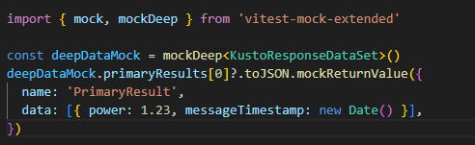
Mocking complex objects: vitest-mock-extended
Sometimes the functions we want to mock are located in an object. We can use vitest-mock-extended to easily create mock objects from types, classes,or interfaces.
const loggerMock = mock<Logger>()
const result = await myFunction(loggerMock, ‘test)
expect(loggerMock.logError).toHaveBeenCalledTimes(1)

Slide 33
Mocking modules
How dow we inject a mock function into an imported module?
To test
Dependency to mock
user.js
userDb.js
getUser()
getUserFromDb()
import

Slide 34
Mocking modules: vi.mock(): Automocking algorithm
import { getUserFromDb } from '../../src/common/userDb.js’;
vi.mock('../../src/common/userDb.js')
beforeAll(() => {
vi.mocked(getUserFromDb).mockResolvedValue({ name: 'Joost', age: 37 })
})
Automocking algorithm:
All arrays will be emptied
All primitives and collections will stay the same
All objects will be deeply cloned
All instances of classes and their prototypes will be deeply cloned

Slide 35
Mocking modules: vi.mock(): Custom mock factory
import { getUserFromDb } from '../../src/common/userDb.js';
// this will not work!: const getUserFromDbMock = vi.fn()
const getUserFromDbMock = vi.hoisted(vi.fn())
vi.mock('../../src/common/userDb.js', () => ({
getUserFromDb: getUserFromDbMock
}))
beforeAll(() => {
vi.mocked(getUserFromDb).mockResolvedValue({ name: 'Joost', age: 37 })
})
vi.mock() is hoisted to the top of the file. All dependencies must be hoisted as well

Slide 36
Mocking modules: Default implementations with __mocks__ folders
- __mocks__
- axios.js
- src
__mocks__
- increment.js
- increment.js
- tests
- increment.test.js
Gives default mock implementations to reuse
Test functionality in source folders is ugly
Alternatively, put default mock implementations in vitest.setup.ts

Slide 37
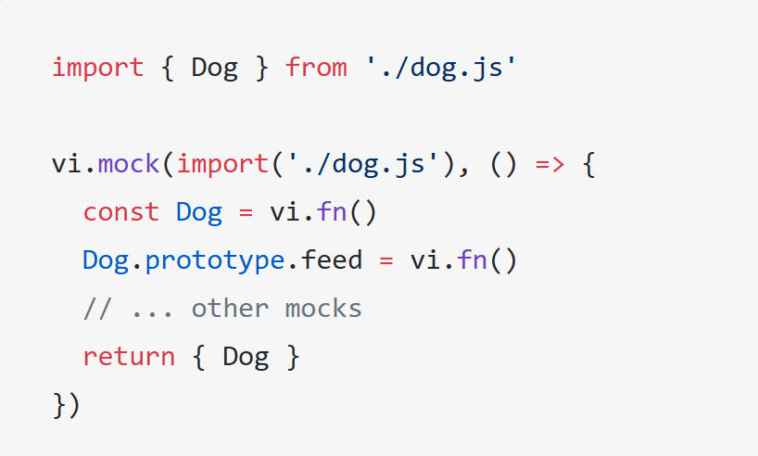
Mocking modules: Mocking exported classes
A class in javascript is just a constructor function.
Use vi.fn() to mock the class
Use .prototype to inject mock functions

Slide 38
Mocking modules: Mocking partials
// foo-bar-baz.js
export const foo = 'foo';
export const bar = () => 'bar';
export default () => 'baz';
//foo-bar-baz.test.js
import defaultExport, {bar, foo} from '../foo-bar-baz’;
vi.mock('../foo-bar-baz’, async () => {
const originalModule = vi.importActual('../foo-bar-baz'); //Mock the default export and named export 'foo'
return {
...originalModule,
default: vi.fn(() => 'mocked baz'),
foo: 'mocked foo',
};
});

Slide 39
Labs
Labs en projecten staan in Github:
AMIS-Services/sig-javascript-unittesting

