Slide 1
Programma:
Jest
Eten tot 18.30 uur
Nock + Azure functions
BDD Cucumber
Labs in groepjes

Slide 2
Cha Liang Chu
Henk Jan van Wijk
Jacco Cijsouw
Jeffrey Resodikromo
Jeroen Rijnboutt
Robert van Mölken

Slide 3

JEST

Slide 4

JEST
Jest is a JavaScript testing framework maintained by Facebook, Inc.
designed and built by Christoph Nakazawa
with a focus on simplicity and support for large web applications.
It works with projects using Babel, TypeScript, Node.js, React, Angular, Vue.js and Svelte.
Wikipedia
Developer: Facebook
Programming language: JavaScript

Slide 5

Prerequisite
http://nodejs.org

Slide 6
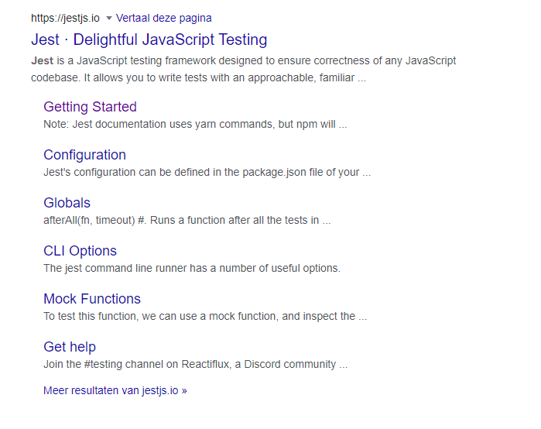
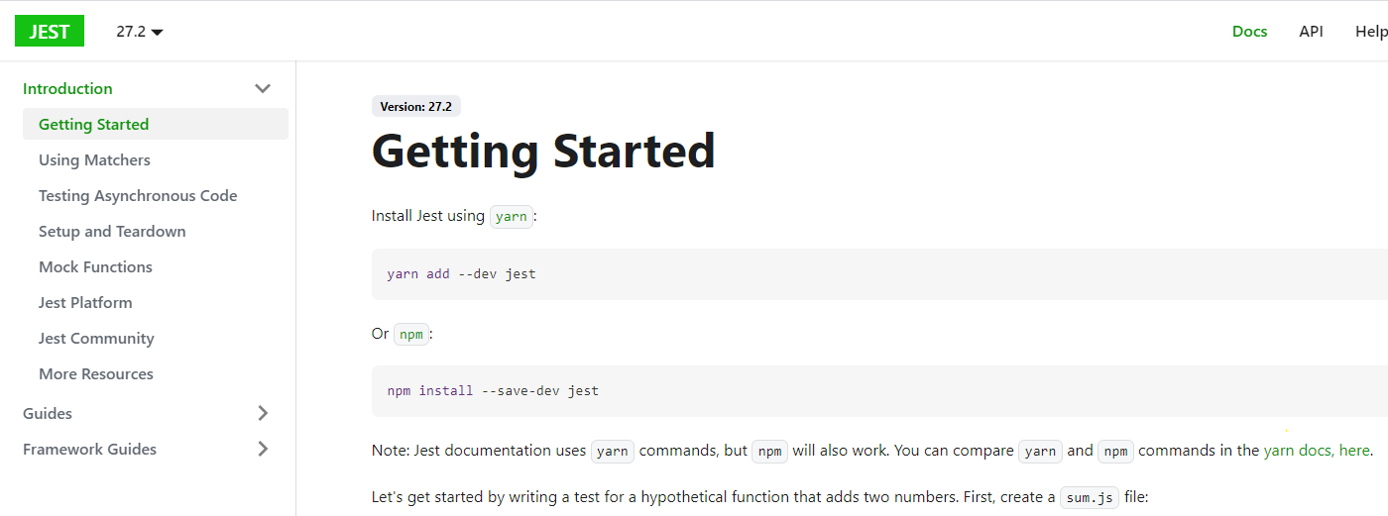
HTTPS://JESTJS.IO

Slide 7
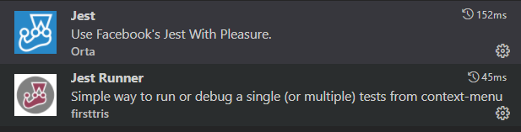
Visual Studio code extensions

Slide 8
Getting started
have node.js installed.
$ mkdir myfirstjest
$ cd myfirstjest
$ npm init –y (creates a package.json file)
$ npm i –D jest

Slide 9
package.json
{
"name": "myfirstjest",
"version": "1.0.0",
"description": "",
"main": "index.js",
"scripts": {
"test": "echo \"Error: no test specified\" && exit 1" “jest”
},
"keywords": [],
"author": "",
"license": "ISC"
}

Slide 10
Example
//file: functions.js
const functions = {
add: (num1, num2) => num1 + num2
};
module.exports = functions;
// file: tests/functions.js
const functions = require('../functions.js');
test('adds 2 + 2 should equal 4', () => {expect(functions.add(2,2)).toBe(4)});
$ npm test

Slide 11
Matchers
test('adds 2 + 2 should equal 4', () => {expect(functions.add(2,2)).toBe(4)});
test('adds 2 + 2 should equal 4', () => {expect(functions.add(2,2)).not.toBe(5)});

Slide 12
Check for truthy & falsy values
toBeNull : matches only null
toBeUndefined : matches only undefined
toBeDefined : opposite of toBeUndefined
toBeTruthy : matches anything that an if statement treats as true
toBeFalsy : matches anything that an if statement treats as false

Slide 13
Example : check for truthy & falsy values
//file: functions.js
const functions = {
add: (num1, num2) => num1 + num2,
isNull: () => null,
checkValue: (x) => x
};
module.exports = functions;
// file: tests/functions.js
const functions = require('../functions.js');
test('should be null', () => {expect(functions.isNull()).toBeNull()});
test('should be falsy', () => {expect(functions.checkValue(null)).toBeFalsy()});

Slide 14
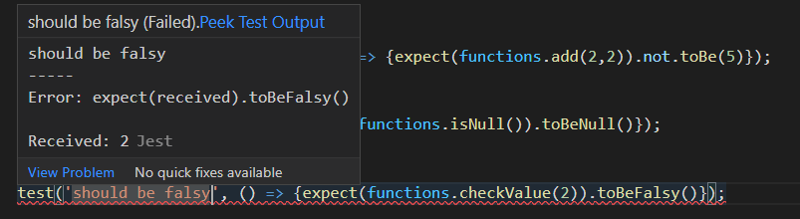
Failing toBeFalsy in Visual Studio Code

Slide 15
Comparing objects
//file: functions.js
const functions = {
createUser: () => {
const user = {
firstName: ‘Brad’
}
user[‘lastName’] = ‘Pitt’;
return user;
}
};
module.exports = functions;

Slide 16
toEqual()
// file: tests/functions.js
const functions = require('../functions.js');
test(‘user should be Brad Pitt', () => {
expect(functions.createUser().toBetoEqual({
firstName: ‘Brad’,
lastName: ‘Pitt’
})
});

Slide 17
Matchers to be used for numbers
test('two plus two', () => {
const value = 2 + 2;
expect(value).toBeGreaterThan(3);
expect(value).toBeGreaterThanOrEqual(3.5);
expect(value).toBeLessThan(5);
expect(value).toBeLessThanOrEqual(4.5);
// toBe and toEqual are equivalent for numbers
expect(value).toBe(4);
expect(value).toEqual(4);
});

Slide 18
Matchers to be used for Strings
//regex can be used
test('there is no B in AMIS', () => {
expect('AMIS').not.toMatch(/B/);
});
test('but there is a "grate" in Integrate', () => {
expect('Integrate').toMatch(/grate/);
});

Slide 19
Matchers for arrays and iterables
const someList = [
'stone',
'paper',
'scissors',
];
test('the list has paper on it', () => {
expect(someList).toContain('paper');
expect(new Set(someList)).toContain('paper');
});

Slide 20
Matchers for Exceptions
function throwSomeError() {
throw new Error('this is a random Error');
}
test('throwing error as expected', () => {
expect(() => throwSomeError()).toThrow();
expect(() => throwSomeError()).toThrow(Error);
expect(() => throwSomeError()).toThrow('this is a random Error');
expect(() => throwSomeError()).toThrow(/random/);
});

Slide 21


Asynchronous testing

Slide 22
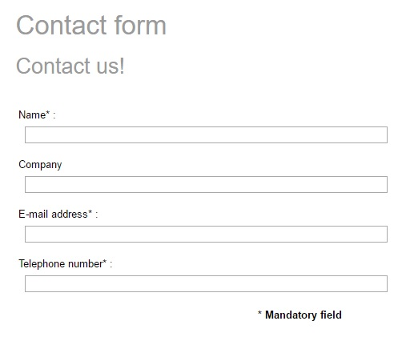

Callback

Slide 23
Callback function
// some io intensive function ☺
async function fetchData(callback){
let data = 'fetched data from some data source';
callback(data);
};

Slide 24
Testing callback functions
test('the data is fetched data from some data source', () => {
function callback(data) {
console.log('in callback');
expect(data).toBe('fetched data from some data source');
}
fetchData(callback);
});

Slide 25

Testing callback functions
test('the data is fetched data from some data source', () => {
function callback(data) {
console.log('in callback');
expect(data).toBe('fetched data from some data source');
}
fetchData(callback);
});

Slide 26

Reason why this is bad code
async function fetchData(callback){
let data = 'fetched data from some data source';
callback(data);
};
test('the data is fetched data from some data source', () => {
function callback(data) {
console.log('in callback');
expect(data).toBe('fetched data from some data source');
}
fetchData(callback);
});

Slide 27
Reason why this is bad code
async function fetchData(callback){
let data = 'fetched data from some data source’;
let data = Error;
callback(data);
};
test('the data is fetched data from some data source', () => {
function callback(data) {
console.log('in callback');
expect(data).toBe('fetched data from some data source');
}
fetchData(callback);
});

Slide 28
Testing callback functions the correct way
test('the data is fetched data from some data source', done => {
function callback(data) {
try {
expect(data).toBe('fetched data from some data source');
done();
} catch (error) {
done(error);
}
}
fetchData(callback);
});

Slide 29
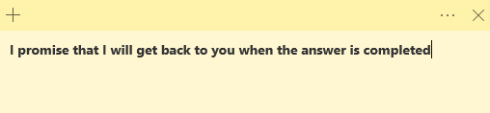
Promise

Slide 30
Promise state and chaining
Promise
Pending (initial state)
Fullfilled
Rejected
.then()
.catch()
.finally()

Slide 31
Promise chaining
const myPromise = new Promise((resolve, reject) => {
setTimeout(() => {
resolve('foo');
}, 300);
});
myPromise
.then(handleResolvedA, handleRejectedA)
.then(handleResolvedB, handleRejectedB)
.then(handleResolvedC, handleRejectedC);

Slide 32
Promise chaining
const myPromise = new Promise((resolve, reject) => {
setTimeout(() => {
resolve('foo');
}, 300);
});
myPromise
.then(handleResolvedA)
.then(handleResolvedB)
.then(handleResolvedC)
.catch(handleRejectedAny);

Slide 33
Testing promises (resolve state)
//function that returns a resolved Promise
function fetchSomeMoreData(){
return new Promise((resolve, reject) => {
resolve('fetched some more data from data source’)
});
};

Slide 34
Testing promises (resolve state)
//function that returns a resolved Promise
function fetchSomeMoreData(){
return new Promise((resolve, reject) => {
resolve('fetched some more bits from data source’)
});
};
test('the data is fetched some more bits from data source', () => {
expect.assertions(1);
return fetchSomeMoreData().then(data => {
expect(data).toBe('fetched some more bits from data source');
});
});

Slide 35
Testing promises (resolve state)
//function that returns a resolved Promise
function fetchSomeMoreData(){
return new Promise((resolve, reject) => {
resolve('fetched some more bits from data source’)
});
};
test('the data is fetched some more bits from data source', () => {
expect.assertions(1);
return expect(fetchSomeMoreData()).resolves.toBe(
'fetched some more data from data source’
);
});

Slide 36
Testing promises (rejected state)
//function that returns a rejected Promise
function rejectedToFetchSomeMoreData(){
return new Promise((resolve, reject) => {
reject('failed to fetch some more data from data source’)
});
};

Slide 37
Testing promises (rejected state)
//function that returns a rejected Promise
function rejectedToFetchSomeMoreData(){
return new Promise((resolve, reject) => {
reject('failed to fetch some more data…’)
});
};
test('the data is failed to fetched some more data…', () => {
expect.assertions(1);
return expect(rejectedToFetchSomeMoreData()).rejects.toBe(
'failed to fetch some more data…');
});

Slide 38
async / await
//async function that returns a Promise
async function asyncFetchData(){
return new Promise((resolve, reject) => {
resolve('fetched async’)
});
};

Slide 39
async / await
//async function that returns a Promise
async function asyncFetchData(){
return new Promise((resolve, reject) => {
resolve('fetched async’)
});
};
test('the data is fetched async', async () => {
const data = await asyncFetchData();
expect(data).toBe('fetched async');
});

Slide 40
async / await
//async function that returns a Promise
async function asyncFetchError(){
return new Promise((resolve, reject) => { reject(‘some error') });
};
test('the asyncFetchError fails with some error', async () => {
expect.assertions(1);
try {
await asyncFetchError();
} catch (e) {
expect(e).toMatch('some error');
}
});

Slide 41


Setup and teardown

Slide 42
One time setup and teardown
beforeAll(() => {
//do some setup
startRepository ();
});
afterAll(() => {
//do some teardown
teardownRepository ();
});

Slide 43
Repeating setup and teardown: for each test
beforeEach(() => {
//do some setup
initializeRepository ();
});
afterEach(() => {
//do some teardown
clearRepository ();
});
test(‘some test', () => {
expect(…).toBeTruthy();
});
test(‘some other test', () => {
expect(…).toBeTruthy();
});

Slide 44
Scoping: describe
beforeEach(() => {…});
afterEach(() => {…});
test(‘some test', () => {..});
describe(‘this is a scoped block', () => {
// Applies only to tests in this block
beforeEach(() => {… });
beforeAll(() => {…});
test(‘some test within scope', () => {…});
test(‘some 2nd test within scope', () => {…});
afterEach(() => {…});
afterAll(() => {…});
});

Slide 45
Scoping: execution order
Jest executes all describe handlers in a test file before it executes any of the actual tests.
Top level beforeEach will be executed before the beforeEach inside each present describe block
Once the describe blocks are complete, by default Jest runs all the tests serially in the order they were encountered in the collection phase, waiting for each to finish and be tidied up before moving on

Slide 46

Scoping: execution order
beforeAll(() => console.log('1 - beforeAll'));
afterAll(() => console.log('1 - afterAll'));
beforeEach(() => console.log('1 - beforeEach'));
afterEach(() => console.log('1 - afterEach'));
test('', () => console.log('1 - test'));
describe('Scoped / Nested block', () => {
beforeAll(() => console.log('2 - beforeAll'));
afterAll(() => console.log('2 - afterAll'));
beforeEach(() => console.log('2 - beforeEach'));
afterEach(() => console.log('2 - afterEach'));
test('', () => console.log('2 - test'));
});

Slide 47
Scoping: execution order
beforeAll(() => console.log('1 - beforeAll'));
afterAll(() => console.log('1 - afterAll'));
beforeEach(() => console.log('1 - beforeEach'));
afterEach(() => console.log('1 - afterEach'));
test('', () => console.log('1 - test'));
describe('Scoped / Nested block', () => {
beforeAll(() => console.log('2 - beforeAll'));
afterAll(() => console.log('2 - afterAll'));
beforeEach(() => console.log('2 - beforeEach'));
afterEach(() => console.log('2 - afterEach'));
test('', () => console.log('2 - test'));
});
1 - beforeAll
1 - beforeEach
1 - test
1 - afterEach
2 - beforeAll
1 - beforeEach
2 - beforeEach
2 - test
2 - afterEach
1 - afterEach
2 - afterAll
1 - afterAll

Slide 48


Mock testing

Slide 49
Documentation is your friend
https://vitest.dev/guide/mocking

Slide 50
Mocking modules
Working with mock functions
Injecting mock functions in dependencies
To test
Dependency to mock
user.js
userDb.js
getUser()
getUserFromDb()
import

Slide 51
Working with mock functions: vi.fn
vi.fn() creates a mock function:
Verify function calls / arguments
Modify function behavior
const getApples = vi.fn(() => 0)
getApples()
expect(getApples).toHaveBeenCalled()
expect(getApples).toHaveReturnedWith(0)
getApples.mockReturnValueOnce(5)
const res = getApples()
expect(res).toBe(5)
expect(getApples).toHaveNthReturnedWith(2, 5)

Slide 52
Working with mock functions: Implementations
const isTheBestTestingFramework = vi.fn()
// full implementation
isTheBestTestingFramework.mockImplementation((name) => {
if (name === 'vitest') {
return true
}
return false
})
// reutrn value (non async)
isTheBestTestingFramework.mockReturnValue(true)
// return value (async)
isTheBestTestingFramework.mockResolvedValue(true)
isTheBestTestingFramework.mockRejectedValue(new Error('error message'))

Slide 53
Working with mock functions: Mock once or more
const myMock = vi.fn()
// default implementation
myMock.mockReturnValue(true)
// first call
myMock.mockReturnValueOnce(false)
// second call
myMock.mockReturnValueOnce('maybe’)
console.log(`${myMock()} ${myMock()} ${myMock()}`)
//result: false maybe true
// reset mock implementation to empty implementation (return undefined)
vi.resetAllMocks()
isTheBestTestingFramework.mockReset()

Slide 54
Working with mock functions: Verifying calls
expect(myMock).not.toHaveBeenCalled()
myMock('foo')
expect(myMock).toHaveBeenCalledTimes(1)
expect(myMock).toHaveBeenCalledWith('foo')
myMock('bar')
expect(myMock).toHaveBeenCalledWith('foo') // does not fail!
expect(myMock).toHaveBeenLastCalledWith('foo') // fails!
myMock.mockClear()
vi.clearAllMocks()
expect(myMock).not.toHaveBeenCalled() // true!

Slide 55
Working with mock functions: Utilizing mock.calls
console.log(myMock.mock)
{
calls: [Getter],
contexts: [Getter],
instances: [Getter],
invocationCallOrder: [Getter],
results: [Getter],
settledResults: [Getter],
lastCall: [Getter]
}
myMock('foo’)
myMock('bar', 'baz’)
const secondCall = myMock.mock.calls[1]
expect(secondCall).toEqual(['bar', 'baz'])

Slide 56
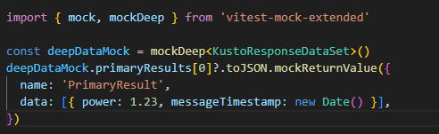
Mocking complex objects: vitest-mock-extended
Sometimes the functions we want to mock are located in an object. We can use vitest-mock-extended to easily create mock objects from types, classes,or interfaces.
const loggerMock = mock<Logger>()
const result = await myFunction(loggerMock, ‘test)
expect(loggerMock.logError).toHaveBeenCalledTimes(1)

Slide 57
Mocking modules
How dow we inject a mock function into an imported module?
To test
Dependency to mock
user.js
userDb.js
getUser()
getUserFromDb()
import

Slide 58
Mocking modules: vi.mock(): Automocking algorithm
import { getUserFromDb } from '../../src/common/userDb.js’;
vi.mock('../../src/common/userDb.js')
beforeAll(() => {
vi.mocked(getUserFromDb).mockResolvedValue({ name: 'Joost', age: 37 })
})
Automocking algorithm:
All arrays will be emptied
All primitives and collections will stay the same
All objects will be deeply cloned
All instances of classes and their prototypes will be deeply cloned

Slide 59
Mocking modules: vi.mock(): Custom mock factory
import { getUserFromDb } from '../../src/common/userDb.js';
// this will not work!: const getUserFromDbMock = vi.fn()
const getUserFromDbMock = vi.hoisted(vi.fn())
vi.mock('../../src/common/userDb.js', () => ({
getUserFromDb: getUserFromDbMock
}))
beforeAll(() => {
vi.mocked(getUserFromDb).mockResolvedValue({ name: 'Joost', age: 37 })
})
vi.mock() is hoisted to the top of the file. All dependencies must be hoisted as well

Slide 60
Mocking modules: Default implementations with __mocks__ folders
- __mocks__
- axios.js
- src
__mocks__
- increment.js
- increment.js
- tests
- increment.test.js
Gives default mock implementations to reuse
Test functionality in source folders is ugly
Alternatively, put default mock implementations in vitest.setup.ts

Slide 61
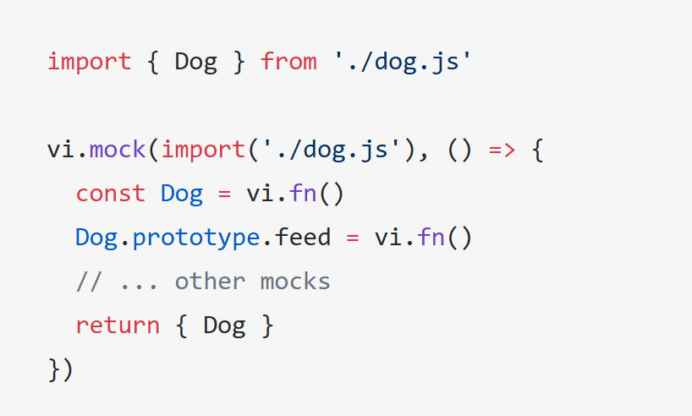
Mocking modules: Mocking exported classes
A class in javascript is just a constructor function.
Use vi.fn() to mock the class
Use .prototype to inject mock functions

Slide 62
Mocking modules: Mocking partials
// foo-bar-baz.js
export const foo = 'foo';
export const bar = () => 'bar';
export default () => 'baz';
//foo-bar-baz.test.js
import defaultExport, {bar, foo} from '../foo-bar-baz’;
vi.mock('../foo-bar-baz’, async () => {
const originalModule = vi.importActual('../foo-bar-baz'); //Mock the default export and named export 'foo'
return {
...originalModule,
default: vi.fn(() => 'mocked baz'),
foo: 'mocked foo',
};
});

Slide 63
Labs
Labs en projecten staan in Github:
AMIS-Services/sig-javascript-unittesting

