Slide 1
Meeting agenda
Why Vitest?
What is Vitest?
Vitest setup
Migrate from Jest
Reporters
Coverage
Vitest basics
Mocking
Labs

Slide 2
Joost Lambregts
András Hetényi
Jeroen Rijnboutt

Slide 3
Why Vitest?
Vitest
Better Typescript support
Better ESModules support
Jest
Better CommonJS module support
Larger community
Watch mode

Slide 4

What is Vitest
Testing framework for Javascript / Typescript
Almost identical to Jest
Originally built for Vite framework
Resources:
https://vitest.dev/api/
https://vitest.dev/guide/
Jest documentation

Slide 5
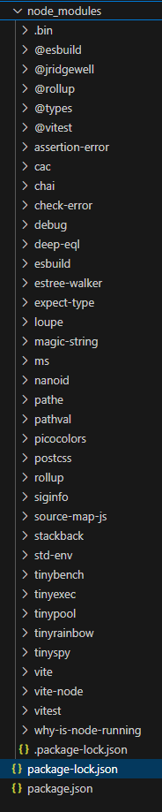
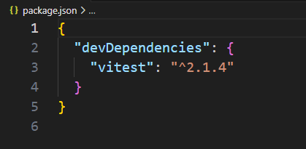
Vitest setup: Getting started
Vitest requires Vite >=v5.0.0 and Node >=v18.0.0.
$ mkdir myfirstvitest
$ cd myfirstvitest
$ npm install –D vitest
Without source code, this results in a package.json with one dev dependency vitest (and a ./node-modules folder with a bunch of modules from indirect dependencies package-lock.json).
If a package.json exists, the dependency will be inserted.

Slide 6
Vitest setup: Configuring Vitest
Vitest relies heavily on Vite (build tool for web projects) for its transformation pipeline. Vite uses a root configuration file vite.config.ts
Without Vite (or to override Vite config):
Create vitest.config.ts
Pass --config option to CLI, e.g.
vitest --config ./path/to/vitest.config.ts
Vitest supports configuration file types .js, .mjs, .cjs, .ts, .cts, .mts. It does not support .json.
You can configure Vitest using the test property in the config file:
import { defineConfig } from 'vitest/config'
export default defineConfig({
test: {
// ...
},
})

Slide 7
Vitest setup: Workspaces
Run different project configurations inside the same project
Define in vitest.workspace the list of files and folders the workspace consists of. The file supports .js / .ts / .json
import { defineWorkspace } from 'vitest/config'
export default defineWorkspace([
// you can use a list of glob patterns to define your workspaces
// Vitest expects a list of config files
// or directories where there is a config file
'packages/*',
'tests/*/vitest.config.{e2e,unit}.ts',
// you can even run the same tests,
// but with different configs in the same "vitest" process
{
test: {
name: 'happy-dom',
root: './shared_tests',
environment: 'happy-dom',
setupFiles: ['./setup.happy-dom.ts'],
},
},
{
test: {
name: 'node',
root: './shared_tests',
environment: 'node',
setupFiles: ['./setup.node.ts'],
},
},
])

Slide 8
Vitest setup: Command Line Interface
You can run it directly with npx vitest
or use the vitest binary in your npm scripts
{
"scripts":
{
"coverage": "vitest run --coverage",
"test": "vitest"
}
}
To run tests once without watching for file changes, use vitest run.
You can specify additional CLI options like --port or --https. For a full list of CLI options, run npx vitest --help in your project.

Slide 9
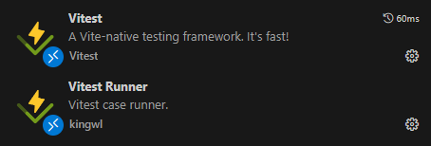


Vitest setup: IDE extensions
Visual Studio Code
JetBrains IDE
WebStorm, PhpStorm, IntelliJ IDEA Ultimate, and other JetBrains IDEs
Wallaby.js
runs your Vitest tests immediately as you type, highlighting results in your IDE right next to your code

Slide 10
Migrating Jest to Vitest
Multiple projects JavaScript + Jest (Eneco, NS, Feenstra, Studio)
Years of code
TypeScript as new standard but a lot of JavaScript + Jest still around
Changing to TypeScript should include Vitest as well.

Slide 11
Migrating Jest to Vitest
Case study migration
TypeScript with Jest → TypeScript with Vitest
New implementation based on TypeScript standard
Basic Azure FunctionApp with HTTP Trigger

Slide 12
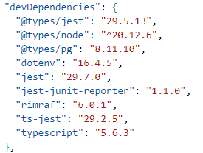
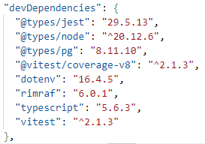
Migrating Jest to Vitest
Package.json – Dev Dependencies
Old (TS + Jest)
New

Slide 13


Migrating Jest to Vitest
Package.json – Scripts
Old
New

Slide 14
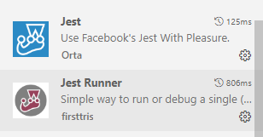

Migrating Jest to Vitest
VS Code plugins
Remove / Disable
Install / Enable

Slide 15
Migrating Jest to Vitest
Delete jest.config.js (if present)
Add vitest.config.ts en vitest.setup.ts (AMIS TS Standard)
Add explicit imports to test file
First (simple) test already works

Slide 16
Migrating Jest to Vitest
Replace jest.mock with vi.mock
Replace jest.fn() with vi.fn()
Replace jest.clearMocks() with vi.clearMocks()
Replace jest.spyOn() with vi.spyOn()

Slide 17
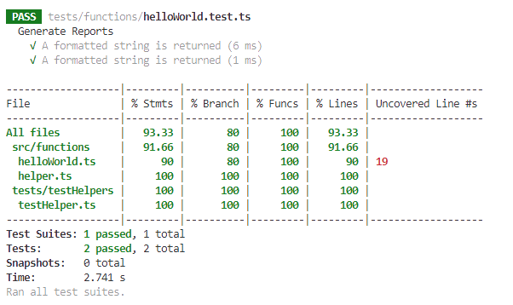
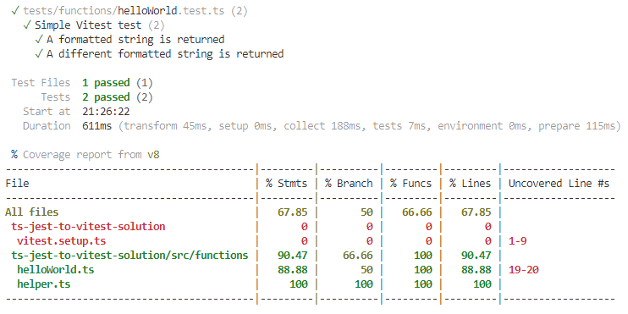
Migrating Jest to Vitest
Test results in terminal
Old
New

Slide 18


Migrating Jest to Vitest
Build Error
Update moduleResolution to node16 or NodeNext (tsconfig)
Has the biggest impact!

Slide 19
Reporters: Usage
Reporters are used to display test output in different formats
Vitest provides several built-in reporters
Custom reporters are also supported
Multiple reporters can be used simultaneously
Using reporters in command line:
npx vitest --reporter=default --reporter=json --outputFile=./test-output.json
Configuration file:
export default defineConfig({
test: {
reporters: [‘json’, ‘default’],
outputFile: ‘./test-output.json’
}
})
This combination will print the test results to the terminal (default) and write it to the given file in json format.

Slide 20
Reporters: Usage
When using multiple reporters, it's also possible to designate multiple output files
CLI:
npx vitest --reporter=verbose --reporter=junit --reporter=json --outputFile.junit=./junit-report.xml --outputFile.json=./json-report.json
Configuration file:
export default defineConfig({
test: {
reporters: [‘junit’, ‘json’, ‘verbose’],
outputFile: {
junit: ‘./junit-report.xml’,
json: ‘./json-report.json’,
}
})

Slide 21
Built-in reporters: Default
Identical to when no reporter is specified
Vitest will display results for each test suite hierarchically as they run, and then collapse after a suite passes.
✓ __tests__/file1.test.ts (2) 725ms
✓ __tests__/file2.test.ts (5) 746ms
✓ second test file (2) 746ms
✓ 1 + 1 should equal 2
✓ 2 - 1 should equal 1
When all tests have finished running, the final terminal output will display a summary of results and details of any failed tests.
✓ __tests__/file1.test.ts (2) 725ms
✓ __tests__/file2.test.ts (2) 746ms
Test Files 2 passed (2)
Tests 4 passed (4)
Start at 12:34:32
Duration 1.26s (transform 35ms, setup 1ms, collect 90ms, tests 1.47s, environment 0ms, prepare 267ms)

Slide 22
Built-in reporters: Verbose
Same as Default without collapsing the subtrees.
Individual tests are included in the report passed as well as failed.
✓ __tests__/file1.test.ts (2) 725ms
✓ second test file (2) 746ms
✓ 1 + 1 should equal 2
✓ 2 - 1 should equal 1
✓ __tests__/file2.test.ts (5) 746ms
✓ second test file (2) 746ms
✓ 1 + 1 should equal 2
✓ 2 - 1 should equal 1
Test Files 2 passed (2)
Tests 4 passed (4)
Start at 12:34:32
Duration 1.26s (transform 35ms, setup 1ms, collect 90ms, tests 1.47s, environment 0ms, prepare 267ms)

Slide 23
Built-in reporters: Basic
Displays the test files that have run and a summary of results after the entire suite has finished running.
Individual tests are only included in the report when they fail.
✓ __tests__/file1.test.ts (2) 725ms
✓ __tests__/file2.test.ts (2) 746ms
Test Files 2 passed (2)
Tests 4 passed (4)
Start at 12:34:32 Duration 1.26s (transform 35ms, setup 1ms, collect 90ms, tests 1.47s, environment 0ms, prepare 267ms)

Slide 24
Built-in reporters: Dot
Prints only a single dot for each completed test to provide minimal output
Details are provided for failed tests, along with the basic reporter summary
. . . .
Test Files 2 passed (2)
Tests 4 passed (4)
Start at 12:34:32 Duration 1.26s (transform 35ms, setup 1ms, collect 90ms, tests 1.47s, environment 0ms, prepare 267ms)

Slide 25
Built-in reporters: JUnit
Outputs a report of the test results in JUnit XML format.
Can either be printed to the terminal or written to an XML file using the outputFile configuration option.
The nested tags testsuites and testcase can be configured like:
reporters: [‘junit’, { suiteName: ‘custom suite name’, classname: ‘custom-classname’}]
<?xml version="1.0" encoding="UTF-8" ?>
<testsuites name="vitest tests"
tests="2"
failures="1"
errors="0"
time="0.503">
<testsuite name="__tests__/test-file-1.test.ts" timestamp="2023-10-19T17:41:58.580Z" hostname="My-Computer.local"
tests="2" failures="1" errors="0" skipped="0“ time="0.013"> <testcase classname="__tests__/test-file-1.test.ts" name="first test file &gt; 2 + 2 should equal 4“ time="0.01">
<failure message="expected 5 to be 4 // Object.is equality"
type="AssertionError">
AssertionError: expected 5 to be 4 // Object.is equality
? __tests__/test-file-1.test.ts:20:28
</failure>
</testcase>
<testcase classname="__tests__/test-file-1.test.ts"
name="first test file &gt; 4 - 2 should equal 2"
time="0">
</testcase>
</testsuite>
</testsuites>

Slide 26
Built-in reporters: JSON
Outputs a report of the test results in JSON format.
Can either be printed to the terminal or written to an XML file using the outputFile configuration option.
{
"numTotalTestSuites": 4,
"numPassedTestSuites": 2,
"numFailedTestSuites": 1,
"numPendingTestSuites": 1,
"numTotalTests": 4,
"numPassedTests": 1,
"numFailedTests": 1,
"numPendingTests": 1,
"numTodoTests": 1,
"startTime": 1697737019307,
"success": false,
"testResults": [
{
"assertionResults": [
{
"ancestorTitles": [
"",
"first test file"
],
"fullName": " first test file 2 + 2 should equal 4",
"status": "failed",
"title": "2 + 2 should equal 4",
"duration": 9,
"failureMessages": [
"expected 5 to be 4 // Object.is equality"
],
"location": {
"line": 20,
"column": 28
},
"meta": {}
}
],
"startTime": 1697737019787,
"endTime": 1697737019797,
"status": "failed",
"message": "",
"name": "/root-directory/__tests__/test-file-1.test.ts"
}
]
}

Slide 27
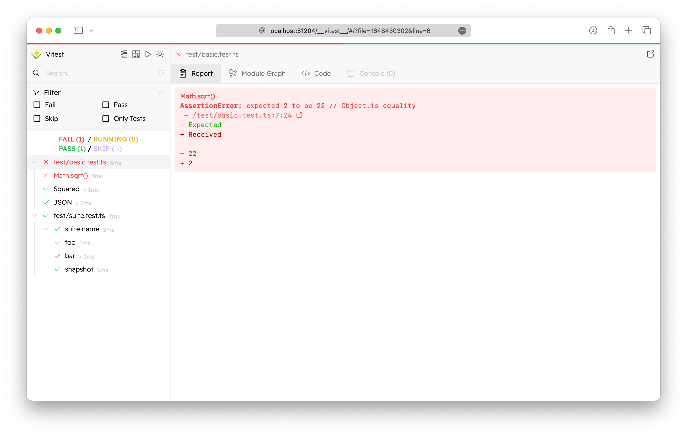
Built-in reporters: HTML
Generates an HTML file to view test results through an interactive GUI.
The Vitest UI is optional and need to be installed separately:
npm I –D @vitest/ui
Starting the tests with UI:
vitest --ui
After the file has been generated, Vitest will keep a local development server running and provide a link to view the report in a browser.
http://localhost:51204/__vitest__/

Slide 28
Coverage
Commonly used to determine how thoroughly a test suite exercises a particular codebase. Use cases:
Code quality check, refactoring legacy projects
Replacement for console.log and manual step-in debug
Execution count, finding hot spots to optimize speed
The process typically includes the following steps:
Instrumentation: Modifying the code to insert probes or counters that track execution.
Execution: Running the instrumented code with your test suite.
Collection: Gathering data on which parts of the code were executed.
Reporting: Generating a report that shows the coverage metrics, often highlighting lines or branches that were not executed.

Slide 29
Coverage: Tools
Vitest supports two engines:
native code coverage via v8
instrumented coverage via Istanbul
Both v8 and Istanbul are optional. By default, v8 is used.

Slide 30
Coverage: Tools
Configuration file:
When starting vitest, this will prompt to install the package automatically
export default defineConfig({
test: {
setupFiles: ['./vitest.setup.ts'],
poolOptions: {
forks: {
singleFork: true
}
},
coverage: {
provider: 'istanbul' // or 'v8'
}
}
})

Slide 31
Coverage: Tools
Manual installation:
v8:
npm i –D @vitest/coverage-v8
Istanbul:
npm i –D @vitest/coverage-Istanbul

Slide 32
Coverage: Comparison
V8
No upfront instrumentation. Counters are inserted in the compiled byte code
Instrumentation is at block level
Less precise results than from Istanbul
Very high raw speed vs. Istanbul
Everything executed is instrumented, including the npm modules your own code lies upon
Data collected on those modules is post-processed and thrown away
May negate the raw speed benefits at high proportion of third-party modules
Reported issues:
Can get mixed up between user code and generated code
Marks non-executable code like Typescript type definitions as uncovered
Doesn’t track coverage of an if-statement that evaluates to false unless it has an explicit else clause.
v8 output is converted to istanbul compatible format and then fed into the istanbul reporting tools. This can lead to a loss of precision where v8 and Istanbul formats don’t align.
Produces higher percentage marking blank and comment lines as executed

Slide 33
Coverage: Comparison
Istanbul
Requires a transpilation pass implemented using a Babel plugin. Vitest, however, is taking care of that.
Instrumentation happens at the level of individual lines of code
Provides very precise results
Only the own code being tested gets instrumented, compensating the raw speed of v8
Instrumenting source code depends on a deep understanding of the Javascript language to instrument correctly without altering meaning.
In the past, updates to Istanbul have lagged behind changes to the Javascript spec.

Slide 34
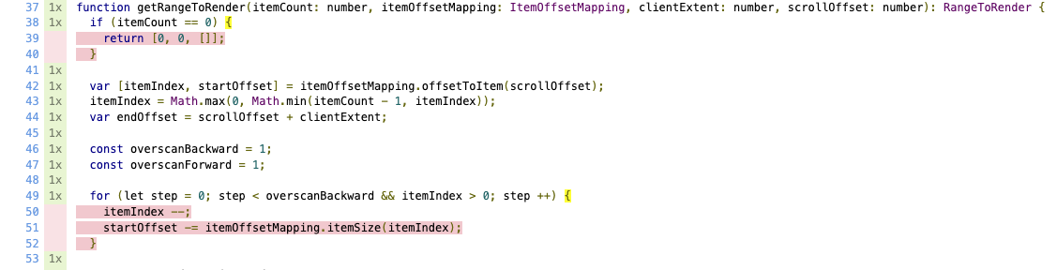
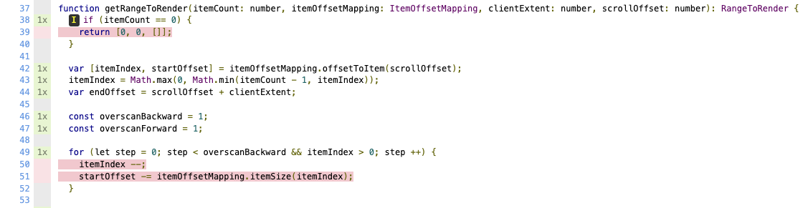
Coverage: Comparison
v8
Istanbul

Slide 35
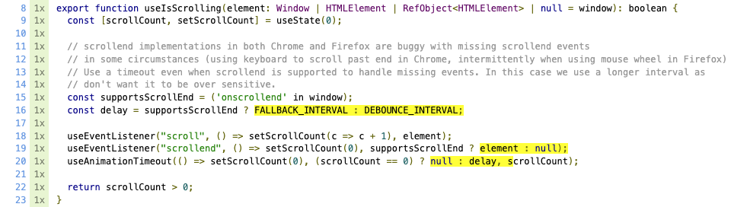
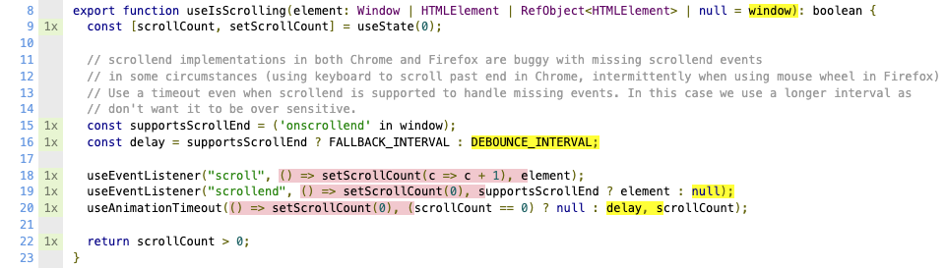
Coverage: Comparison
v8
Istanbul

Slide 36
Vitest Basics: Expects and Matchers
//file: functions.js
export function add(a: number, b: number): number {
return a + b
}
import { describe, it, expect, test } from 'vitest'
import { add } from './toRemove.js'
test('add', () => {
expect(add(1, 2)).toBe(3)
})

Slide 37
Matchers
Readable way to make assertions
Specialized matchers exist for many kinds of values
https://jestjs.io/docs/expect
// matcher examples
test('matcher examples', () => {
expect([1,2,3]).toContain(1)
expect([1,2,3]).not.toContain(4)
expect([]).toHaveLength(0)
expect('hello').toMatch(/hello/)
expect(5).toBeGreaterThan(4)
expect({a: 1, b:2}).toMatchObject({a: 1})
expect({a: 1, b:2}).toHaveProperty('a')
expect(3.1).toBeCloseTo(3, 0)
expect(null).toBeNull()
})

Slide 38

Asymetric Matchers
Use in equals, and in some other matchers
// matcher examples
test('asymetric matchers', () => {
const obj = { a: 1, b: 2, c: 3 }
expect(obj).toEqual(expect.objectContaining({ a: 1, b: expect.any(Number) }))
expect([1,2,3]).toEqual(expect.arrayContaining([1,2]))
})

Slide 39
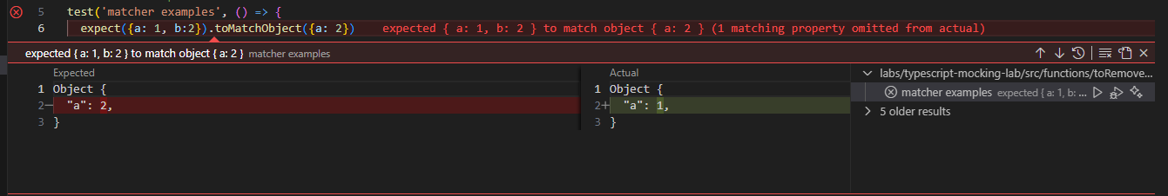
Failing matchers in Visual Studio Code

Slide 40
Comparing objects
test('obect comparisons', () => {
const ob = {a: 1, b: 2}
expect(ob).toBe(ob) // pass
expect(ob).toBe({a: 1, b: 2}) // fail
expect(ob).toEqual({a: 1, b: 2}) // pass
expect(ob).toMatchObject({a: 1}) // pass
})

Slide 41
Matchers for Exceptions
async function helloWorld(name: string): Promise<string> {
throw new Error('Not implemented')
}
test('matcher examples', () => {
expect(helloWorld).rejects.toThrow('Not implemented')
})
function helloWorld(): string {
throw new Error('Not implemented')
}
test('matcher examples', () => {
expect(helloWorld).toThrowError('Not implemented')
})

Slide 42
Testing async functions
async function helloWorld(): Promise<string> {
return 'hello!'
}
test('matcher examples', async () => {
const greeting = await helloWorld()
expect(greeting).toBe('hello')
})

Slide 43


Setup and teardown

Slide 44
One time setup and teardown
beforeAll(() => {
//do some setup
startRepository ();
});
afterAll(() => {
//do some teardown
teardownRepository ();
});

Slide 45
Repeating setup and teardown: for each test
beforeEach(() => {
//do some setup
initializeRepository ();
});
afterEach(() => {
//do some teardown
clearRepository ();
});
test(‘some test', () => {
expect(…).toBeTruthy();
});
test(‘some other test', () => {
expect(…).toBeTruthy();
});

Slide 46
Scoping: describe
beforeEach(() => {…});
afterEach(() => {…});
test(‘some test', () => {..});
describe(‘this is a scoped block', () => {
// Applies only to tests in this block
beforeEach(() => {… });
beforeAll(() => {…});
test(‘some test within scope', () => {…});
test(‘some 2nd test within scope', () => {…});
afterEach(() => {…});
afterAll(() => {…});
});

Slide 47
Manipulating time
beforeEach (() => {
vi.useFakeTimers()
})
afterEach(() => {
vi.useRealTimers()
})
vi.setSystemTime(new Date(2021, 1, 1))
vi.advanceTimersByTime(1000) // Sometimes fails with asynchronous code
vi.advanceTimersByTimeAsync(1000) // Always works

Slide 48


Mock testing

Slide 49
Documentation is your friend
https://vitest.dev/guide/mocking

Slide 50
Mocking modules
Working with mock functions
Injecting mock functions in dependencies
To test
Dependency to mock
user.js
userDb.js
getUser()
getUserFromDb()
import

Slide 51
Working with mock functions: vi.fn
vi.fn() creates a mock function:
Verify function calls / arguments
Modify function behavior
const getApples = vi.fn(() => 0)
getApples()
expect(getApples).toHaveBeenCalled()
expect(getApples).toHaveReturnedWith(0)
getApples.mockReturnValueOnce(5)
const res = getApples()
expect(res).toBe(5)
expect(getApples).toHaveNthReturnedWith(2, 5)

Slide 52
Working with mock functions: Implementations
const isTheBestTestingFramework = vi.fn()
// full implementation
isTheBestTestingFramework.mockImplementation((name) => {
if (name === 'vitest') {
return true
}
return false
})
// return value (non async)
isTheBestTestingFramework.mockReturnValue(true)
// return value (async)
isTheBestTestingFramework.mockResolvedValue(true)
isTheBestTestingFramework.mockRejectedValue(new Error('error message'))

Slide 53
Working with mock functions: Mock once or more
const myMock = vi.fn()
// default implementation
myMock.mockReturnValue(true)
// first call
myMock.mockReturnValueOnce(false)
// second call
myMock.mockReturnValueOnce('maybe’)
console.log(`${myMock()} ${myMock()} ${myMock()}`)
//result: false maybe true
// reset mock implementation to empty implementation (return undefined)
vi.resetAllMocks()
isTheBestTestingFramework.mockReset()

Slide 54
Working with mock functions: Verifying calls
expect(myMock).not.toHaveBeenCalled()
myMock('foo')
expect(myMock).toHaveBeenCalledTimes(1)
expect(myMock).toHaveBeenCalledWith('foo')
myMock('bar')
expect(myMock).toHaveBeenCalledWith('foo') // does not fail!
expect(myMock).toHaveBeenLastCalledWith('foo') // fails!
myMock.mockClear()
vi.clearAllMocks()
expect(myMock).not.toHaveBeenCalled() // true!

Slide 55
Use asymmetric matchers!
expect(myMock).toHaveBeenCalledWith(expect.any(Date), expect.arrayContaining([1,2]))

Slide 56
Working with mock functions: Utilizing mock.calls
console.log(myMock.mock)
{
calls: [Getter],
contexts: [Getter],
instances: [Getter],
invocationCallOrder: [Getter],
results: [Getter],
settledResults: [Getter],
lastCall: [Getter]
}
myMock('foo’)
myMock('bar', 'baz’)
const secondCall = myMock.mock.calls[1]
expect(secondCall).toEqual(['bar', 'baz'])

Slide 57
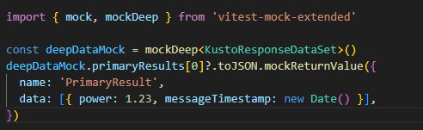
Mocking complex objects: vitest-mock-extended
Sometimes the functions we want to mock are in an object. We can use vitest-mock-extended to easily create mock objects from types, classes or interfaces.
const loggerMock = mock<Logger>()
const result = await myFunction(loggerMock, ‘test)
expect(loggerMock.logError).toHaveBeenCalledTimes(1)

Slide 58
Mocking modules
How do we inject a mock function into an imported module?
To test
Dependency to mock
user.js
userDb.js
getUser()
getUserFromDb()
import

Slide 59
Mocking modules: vi.mock(): Automocking algorithm
import { getUserFromDb } from '../../src/common/userDb.js’;
vi.mock('../../src/common/userDb.js')
beforeAll(() => {
vi.mocked(getUserFromDb).mockResolvedValue({ name: 'Joost', age: 37 })
})
Automocking algorithm:
All arrays will be emptied
All primitives and collections will stay the same
All objects will be deeply cloned
All instances of classes and their prototypes will be deeply cloned

Slide 60
Mocking modules: vi.mock(): Custom mock factory
import { getUserFromDb } from '../../src/common/userDb.js';
// this will not work!: const getUserFromDbMock = vi.fn()
const getUserFromDbMock = vi.hoisted(vi.fn())
vi.mock('../../src/common/userDb.js', () => ({
getUserFromDb: getUserFromDbMock
}))
beforeAll(() => {
vi.mocked(getUserFromDb).mockResolvedValue({ name: 'Joost', age: 37 })
})
vi.mock() is hoisted to the top of the file. All dependencies must be hoisted as well

Slide 61
Mocking modules: Default implementations with __mocks__ folders
- __mocks__
- axios.js
- src
__mocks__
- increment.js
- increment.js
- tests
- increment.test.js
Gives default mock implementations to reuse
Test functionality in source folders is ugly
Alternatively, put default mock implementations in vitest.setup.ts

Slide 62
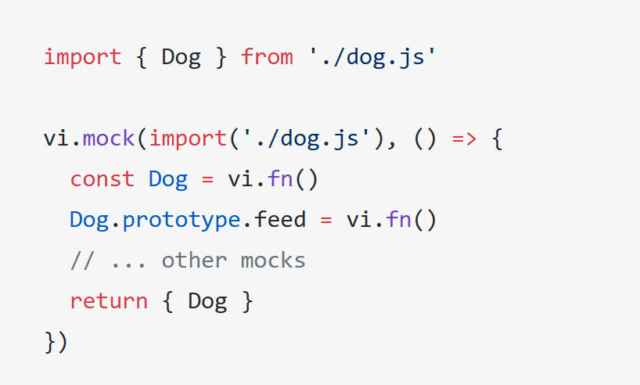
Mocking modules: Mocking exported classes
A class in javascript is just a constructor function.
Use vi.fn() to mock the class
Use .prototype to inject mock functions

Slide 63
Mocking modules: Mocking partials
// foo-bar-baz.js
export const foo = 'foo';
export const bar = () => 'bar';
export default () => 'baz';
//foo-bar-baz.test.js
import defaultExport, {bar, foo} from '../foo-bar-baz’;
vi.mock('../foo-bar-baz’, async () => {
const originalModule = vi.importActual('../foo-bar-baz'); //Mock the default export and named export 'foo'
return {
...originalModule,
default: vi.fn(() => 'mocked baz'),
foo: 'mocked foo',
};
});

Slide 64
Labs
Labs staan in Github:
https://github.com/AMISConclusion/sig-typescript-unit-testing

