Slide 1
Programma:
Why Vitest?
What is Vitest?
Vitest setup
Migrate from Jest
Reporters and Coverage
Vitest basics
Mocking
Labs

Slide 2
Jeroen Rijnboutt
Andras Hetényi
Joost Lambregts

Slide 3
Why Vitest?
Vitest
Better Typescript support
Better ESModules support
Jest
Better CommonJS module support
Larger community
Watch mode

Slide 4

What is Vitest
Testing framework for Javascript / Typescript
Almost identical to Jest
Originally built for Vite framework
Resources:
https://vitest.dev/api/
https://vitest.dev/guide/
Jest documentation

Slide 5
Setup

Slide 6
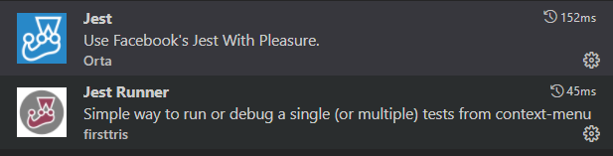
Visual Studio code extensions

Slide 7
Getting started
have node.js installed.
$ mkdir myfirstjest
$ cd myfirstjest
$ npm init –y (creates a package.json file)
$ npm i –D jest

Slide 8
package.json
{
"name": "myfirstjest",
"version": "1.0.0",
"description": "",
"main": "index.js",
"scripts": {
"test": "echo \"Error: no test specified\" && exit 1" “jest”
},
"keywords": [],
"author": "",
"license": "ISC"
}

Slide 9
Migrating Jest to Vitest
Multiple projects JavaScript + Jest (Eneco, NS, Feenstra, Studio)
Years of code
TypeScript as new standard but Jest was not always replaced
TypeScript standard includes Vitest now

Slide 10
Migrating Jest to Vitest
Case study migrating TypeScript with Jest to TypeScript with Vitest
New implementation based on TypeScript standard
Basic Azure FunctionApp with HTTP Trigger

Slide 11
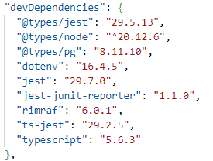
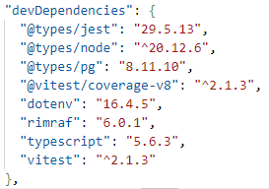
Migrating Jest to Vitest
Package.json – Dev Dependencies
Old
New

Slide 12


Migrating Jest to Vitest
Package.json – Scripts
Old
New

Slide 13
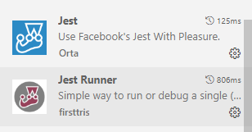
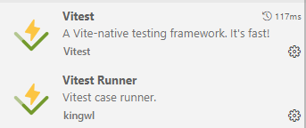
Migrating Jest to Vitest
VS Code plugins
Disable
Enable

Slide 14
Migrating Jest to Vitest
Build Error
Update moduleResolution to node16 or NodeNext
Has the biggest impact!

Slide 15
Migrating Jest to Vitest
Delete jest.config.js (if present)
Add vitest.config.ts en vitest.setup.ts (AMIS TS Standard)
Add explicit imports to test file
First (simple) test already works

Slide 16
Migrating Jest to Vitest
Replace jest.mock with vi.mock
Replace jest.fn() with vi.fn()
Replace jest.clearMocks() with vi.clearMocks()
Replace jest.spyOn() with vi.spyOn()

Slide 17
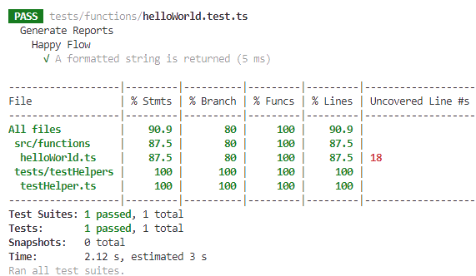
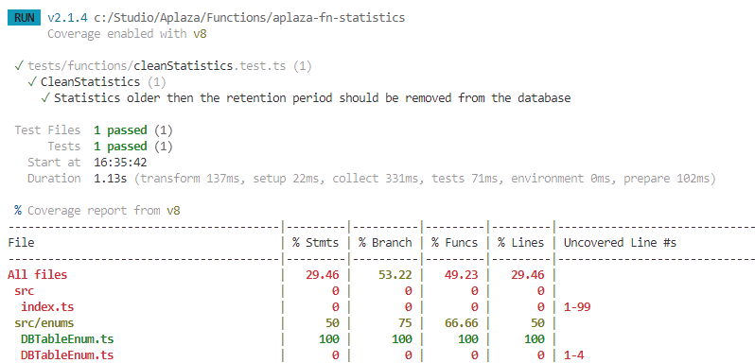
Migrating Jest to Vitest
Test results in terminal
Old
New

Slide 18
Reporters: Usage
Reporters are used to display test output in different formats
Vitest provides several built-in reporters
Custom reporters are also supported
Multiple reporters can be used simultaneously
Using reporters in command line:
npx vitest --reporter=default --reporter=json --outputFile=./test-output.json
Configuration file:
export default defineConfig({
test: {
reporters: [‘json’, ‘default’],
outputFile: ‘./test-output.json’
}
})
This combination will print the the test results to the terminal (default) and write it to the given file in json format.

Slide 19
Reporters: Usage
When using multiple reporters, it's also possible to designate multiple output files
CLI:
npx vitest --reporter=verbose --reporter=junit --reporter=json –outputFile.junit=./junit-report.xml –outputFile.json=./json-report.json
Configuration file:
export default defineConfig({
test: {
reporters: [‘junit’, ‘json’, ‘verbose’],
outputFile: {
junit: ‘./junit-report.xml’,
json: ‘./json-report.json’,
}
})

Slide 20
Built-in reporters: Default
Identical when no reporter is specified
Vitest will display results for each test suite hierarchically as they run, and then collapse after a suite passes.
✓ __tests__/file1.test.ts (2) 725ms
✓ __tests__/file2.test.ts (5) 746ms
✓ second test file (2) 746ms
✓ 1 + 1 should equal 2
✓ 2 - 1 should equal 1
When all tests have finished running, the final terminal output will display a summary of results and details of any failed tests.
✓ __tests__/file1.test.ts (2) 725ms
✓ __tests__/file2.test.ts (2) 746ms
Test Files 2 passed (2)
Tests 4 passed (4)
Start at 12:34:32
Duration 1.26s (transform 35ms, setup 1ms, collect 90ms, tests 1.47s, environment 0ms, prepare 267ms)

Slide 21
Built-in reporters: Basic
Displays the test files that have run and a summary of results after the entire suite has finished running.
Individual tests are only included in the report when they fail.
✓ __tests__/file1.test.ts (2) 725ms
✓ __tests__/file2.test.ts (2) 746ms
Test Files 2 passed (2)
Tests 4 passed (4)
Start at 12:34:32 Duration 1.26s (transform 35ms, setup 1ms, collect 90ms, tests 1.47s, environment 0ms, prepare 267ms)

Slide 22
Built-in reporters: Dot
Prints only a single dot for each completed test to provide minimal output
Details are provided for failed tests, along with the basic reporter summary
. . . .
Test Files 2 passed (2)
Tests 4 passed (4)
Start at 12:34:32 Duration 1.26s (transform 35ms, setup 1ms, collect 90ms, tests 1.47s, environment 0ms, prepare 267ms)

Slide 23
Built-in reporters: Verbose
Same as Default without collapsing the subtrees.
Individual tests are included in the report passed as well as failed.
✓ __tests__/file1.test.ts (2) 725ms
✓ second test file (2) 746ms
✓ 1 + 1 should equal 2
✓ 2 - 1 should equal 1
✓ __tests__/file2.test.ts (5) 746ms
✓ second test file (2) 746ms
✓ 1 + 1 should equal 2
✓ 2 - 1 should equal 1
Test Files 2 passed (2)
Tests 4 passed (4)
Start at 12:34:32
Duration 1.26s (transform 35ms, setup 1ms, collect 90ms, tests 1.47s, environment 0ms, prepare 267ms)

Slide 24
Built-in reporters: JSON
Outputs a report of the test results in JSON format.
Can either be printed to the terminal or written to an XML file using the outputFile configuration option.
{
"numTotalTestSuites": 4,
"numPassedTestSuites": 2,
"numFailedTestSuites": 1,
"numPendingTestSuites": 1,
"numTotalTests": 4,
"numPassedTests": 1,
"numFailedTests": 1,
"numPendingTests": 1,
"numTodoTests": 1,
"startTime": 1697737019307,
"success": false,
"testResults": [
{
"assertionResults": [
{
"ancestorTitles": [
"",
"first test file"
],
"fullName": " first test file 2 + 2 should equal 4",
"status": "failed",
"title": "2 + 2 should equal 4",
"duration": 9,
"failureMessages": [
"expected 5 to be 4 // Object.is equality"
],
"location": {
"line": 20,
"column": 28
},
"meta": {}
}
],
"startTime": 1697737019787,
"endTime": 1697737019797,
"status": "failed",
"message": "",
"name": "/root-directory/__tests__/test-file-1.test.ts"
}
]
}

Slide 25
Built-in reporters: JUnit
Outputs a report of the test results in JUnit XML format.
Can either be printed to the terminal or written to an XML file using the outputFile configuration option.
The nested tags testsuites and testcase can be configured like:
reporters: [‘junit’, { suiteName: ‘custom suite name’, classname: ‘custom-classname’}]
<?xml version="1.0" encoding="UTF-8" ?>
<testsuites name="vitest tests"
tests="2"
failures="1"
errors="0"
time="0.503">
<testsuite name="__tests__/test-file-1.test.ts" timestamp="2023-10-19T17:41:58.580Z" hostname="My-Computer.local"
tests="2" failures="1" errors="0" skipped="0“ time="0.013"> <testcase classname="__tests__/test-file-1.test.ts" name="first test file &gt; 2 + 2 should equal 4“ time="0.01">
<failure message="expected 5 to be 4 // Object.is equality"
type="AssertionError">
AssertionError: expected 5 to be 4 // Object.is equality
? __tests__/test-file-1.test.ts:20:28
</failure>
</testcase>
<testcase classname="__tests__/test-file-1.test.ts"
name="first test file &gt; 4 - 2 should equal 2"
time="0">
</testcase>
</testsuite>
</testsuites>

Slide 26
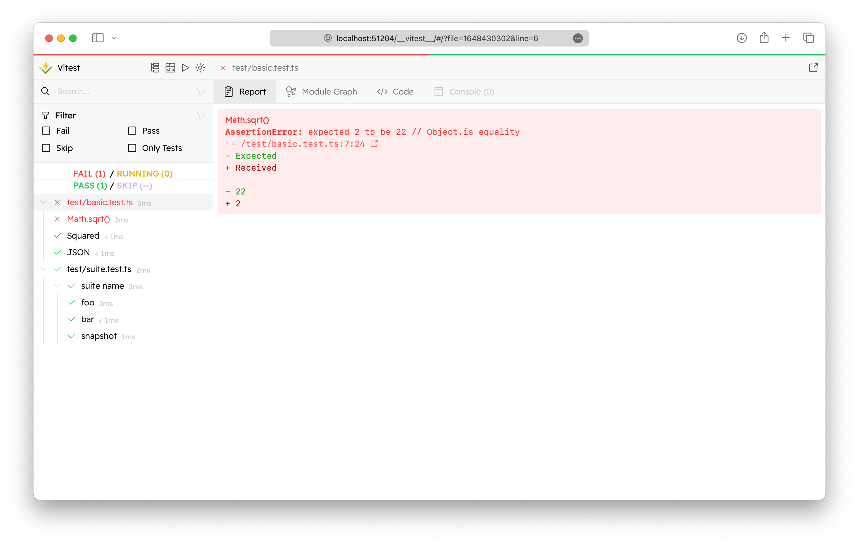
Built-in reporters: HTML
Generates an HTML file to view test results through an interactive GUI.
The Vitest UI is optional and need to be installed separately:
npm I –D @vitest/ui
Starting the tests with UI:
vitest --ui
After the file has been generated, Vitest will keep a local development server running and provide a link to view the report in a browser.
http://localhost:51204/__vitest__/

Slide 27
Coverage
Vitest supports
native code coverage via v8
Instrumented coverage via Istanbul
Both v8 and Istanbul are optional. By default v8 is used.
export default defineConfig({
test: {
setupFiles: ['./vitest.setup.ts'],
poolOptions: {
forks: {
singleFork: true
}
},
coverage: {
provider: 'istanbul' // or 'v8'
}
}
})

Slide 28
Vitest Basics: Expects and Matchers
//file: functions.js
export function add(a: number, b: number): number {
return a + b
}
import { describe, it, expect, test } from 'vitest'
import { add } from './toRemove.js'
test('add', () => {
expect(add(1, 2)).toBe(3)
})

Slide 29
Matchers
Readable way to make assertions
Specialized matchers exist for many kinds of values
https://jestjs.io/docs/expect
// matcher examples
test('matcher examples', () => {
expect([1,2,3]).toContain(1)
expect([1,2,3]).not.toContain(4)
expect([]).toHaveLength(0)
expect('hello').toMatch(/hello/)
expect(5).toBeGreaterThan(4)
expect({a: 1, b:2}).toMatchObject({a: 1})
expect({a: 1, b:2}).toHaveProperty('a')
expect(3.1).toBeCloseTo(3, 0)
expect(null).toBeNull()
})

Slide 30
Asymetric Matchers
Use in equals, and in some other matchers
// matcher examples
test('asymetric matchers', () => {
const obj = { a: 1, b: 2, c: 3 }
expect(obj).toEqual(expect.objectContaining({ a: 1, b: expect.any(Number) }))
expect([1,2,3]).toEqual(expect.arrayContaining([1,2]))
})

Slide 31
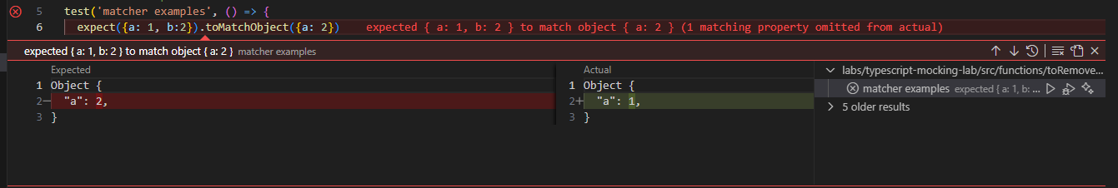
Failing matchers in Visual Studio Code

Slide 32
Comparing objects
test('obect comparisons', () => {
const ob = {a: 1, b: 2}
expect(ob).toBe(ob) // pass
expect(ob).toBe({a: 1, b: 2}) // fail
expect(ob).toEqual({a: 1, b: 2}) // pass
expect(ob).toMatchObject({a: 1}) // pass
})

Slide 33
Matchers for Exceptions
async function helloWorld(name: string): Promise<string> {
throw new Error('Not implemented')
}
test('matcher examples', () => {
expect(helloWorld).rejects.toThrow('Not implemented')
})
function helloWorld(): string {
throw new Error('Not implemented')
}
test('matcher examples', () => {
expect(helloWorld).toThrowError('Not implemented')
})

Slide 34
Testing async functions
async function helloWorld(): Promise<string> {
return 'hello!'
}
test('matcher examples', async () => {
const greeting = await helloWorld()
expect(greeting).toBe('hello')
})

Slide 35


Setup and teardown

Slide 36
One time setup and teardown
beforeAll(() => {
//do some setup
startRepository ();
});
afterAll(() => {
//do some teardown
teardownRepository ();
});

Slide 37
Repeating setup and teardown: for each test
beforeEach(() => {
//do some setup
initializeRepository ();
});
afterEach(() => {
//do some teardown
clearRepository ();
});
test(‘some test', () => {
expect(…).toBeTruthy();
});
test(‘some other test', () => {
expect(…).toBeTruthy();
});

Slide 38
Scoping: describe
beforeEach(() => {…});
afterEach(() => {…});
test(‘some test', () => {..});
describe(‘this is a scoped block', () => {
// Applies only to tests in this block
beforeEach(() => {… });
beforeAll(() => {…});
test(‘some test within scope', () => {…});
test(‘some 2nd test within scope', () => {…});
afterEach(() => {…});
afterAll(() => {…});
});

Slide 39


Mock testing

Slide 40
Documentation is your friend
https://vitest.dev/guide/mocking

Slide 41
Mocking modules
Working with mock functions
Injecting mock functions in dependencies
To test
Dependency to mock
user.js
userDb.js
getUser()
getUserFromDb()
import

Slide 42
Working with mock functions: vi.fn
vi.fn() creates a mock function:
Verify function calls / arguments
Modify function behavior
const getApples = vi.fn(() => 0)
getApples()
expect(getApples).toHaveBeenCalled()
expect(getApples).toHaveReturnedWith(0)
getApples.mockReturnValueOnce(5)
const res = getApples()
expect(res).toBe(5)
expect(getApples).toHaveNthReturnedWith(2, 5)

Slide 43
Working with mock functions: Implementations
const isTheBestTestingFramework = vi.fn()
// full implementation
isTheBestTestingFramework.mockImplementation((name) => {
if (name === 'vitest') {
return true
}
return false
})
// return value (non async)
isTheBestTestingFramework.mockReturnValue(true)
// return value (async)
isTheBestTestingFramework.mockResolvedValue(true)
isTheBestTestingFramework.mockRejectedValue(new Error('error message'))

Slide 44
Working with mock functions: Mock once or more
const myMock = vi.fn()
// default implementation
myMock.mockReturnValue(true)
// first call
myMock.mockReturnValueOnce(false)
// second call
myMock.mockReturnValueOnce('maybe’)
console.log(`${myMock()} ${myMock()} ${myMock()}`)
//result: false maybe true
// reset mock implementation to empty implementation (return undefined)
vi.resetAllMocks()
isTheBestTestingFramework.mockReset()

Slide 45
Working with mock functions: Verifying calls
expect(myMock).not.toHaveBeenCalled()
myMock('foo')
expect(myMock).toHaveBeenCalledTimes(1)
expect(myMock).toHaveBeenCalledWith('foo')
myMock('bar')
expect(myMock).toHaveBeenCalledWith('foo') // does not fail!
expect(myMock).toHaveBeenLastCalledWith('foo') // fails!
myMock.mockClear()
vi.clearAllMocks()
expect(myMock).not.toHaveBeenCalled() // true!

Slide 46
Use asymmetric matchers!
expect(myMock).toHaveBeenCalledWith(expect.any(Date), expect.arrayContaining([1,2]))

Slide 47
Working with mock functions: Utilizing mock.calls
console.log(myMock.mock)
{
calls: [Getter],
contexts: [Getter],
instances: [Getter],
invocationCallOrder: [Getter],
results: [Getter],
settledResults: [Getter],
lastCall: [Getter]
}
myMock('foo’)
myMock('bar', 'baz’)
const secondCall = myMock.mock.calls[1]
expect(secondCall).toEqual(['bar', 'baz'])

Slide 48
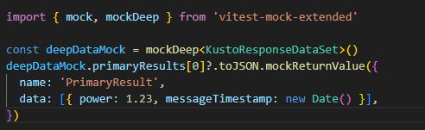
Mocking complex objects: vitest-mock-extended
Sometimes the functions we want to mock are located in an object. We can use vitest-mock-extended to easily create mock objects from types, classes,or interfaces.
const loggerMock = mock<Logger>()
const result = await myFunction(loggerMock, ‘test)
expect(loggerMock.logError).toHaveBeenCalledTimes(1)

Slide 49
Mocking modules
How dow we inject a mock function into an imported module?
To test
Dependency to mock
user.js
userDb.js
getUser()
getUserFromDb()
import

Slide 50
Mocking modules: vi.mock(): Automocking algorithm
import { getUserFromDb } from '../../src/common/userDb.js’;
vi.mock('../../src/common/userDb.js')
beforeAll(() => {
vi.mocked(getUserFromDb).mockResolvedValue({ name: 'Joost', age: 37 })
})
Automocking algorithm:
All arrays will be emptied
All primitives and collections will stay the same
All objects will be deeply cloned
All instances of classes and their prototypes will be deeply cloned

Slide 51
Mocking modules: vi.mock(): Custom mock factory
import { getUserFromDb } from '../../src/common/userDb.js';
// this will not work!: const getUserFromDbMock = vi.fn()
const getUserFromDbMock = vi.hoisted(vi.fn())
vi.mock('../../src/common/userDb.js', () => ({
getUserFromDb: getUserFromDbMock
}))
beforeAll(() => {
vi.mocked(getUserFromDb).mockResolvedValue({ name: 'Joost', age: 37 })
})
vi.mock() is hoisted to the top of the file. All dependencies must be hoisted as well

Slide 52
Mocking modules: Default implementations with __mocks__ folders
- __mocks__
- axios.js
- src
__mocks__
- increment.js
- increment.js
- tests
- increment.test.js
Gives default mock implementations to reuse
Test functionality in source folders is ugly
Alternatively, put default mock implementations in vitest.setup.ts

Slide 53
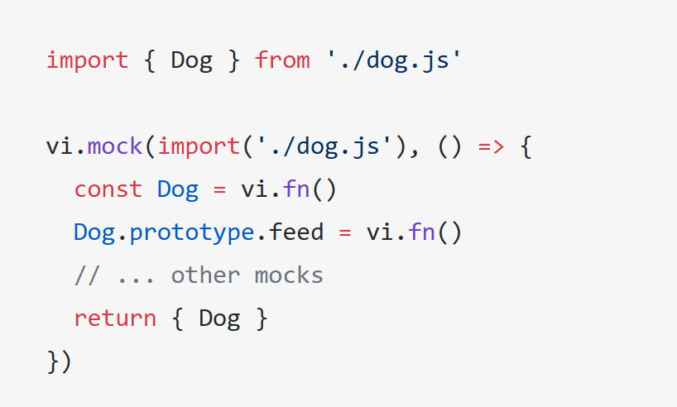
Mocking modules: Mocking exported classes
A class in javascript is just a constructor function.
Use vi.fn() to mock the class
Use .prototype to inject mock functions

Slide 54
Mocking modules: Mocking partials
// foo-bar-baz.js
export const foo = 'foo';
export const bar = () => 'bar';
export default () => 'baz';
//foo-bar-baz.test.js
import defaultExport, {bar, foo} from '../foo-bar-baz’;
vi.mock('../foo-bar-baz’, async () => {
const originalModule = vi.importActual('../foo-bar-baz'); //Mock the default export and named export 'foo'
return {
...originalModule,
default: vi.fn(() => 'mocked baz'),
foo: 'mocked foo',
};
});

Slide 55
Labs
Labs staan in Github:
https://github.com/AMISConclusion/sig-typescript-unit-testing

