Slide 1

INTERNSHIP

Slide 2
Acknowledgment
I would like to thank Optum to provide such a wonderful Opportunity .
I would also like to thank my mentors Sweta Ma’am, Jagannadha Sir,Somnath Sir, Jasti and my co-intern Charvi to support and guide me through whole journey.I will also Like to thank technical department for providing support and quickly resolving issue.

Slide 3
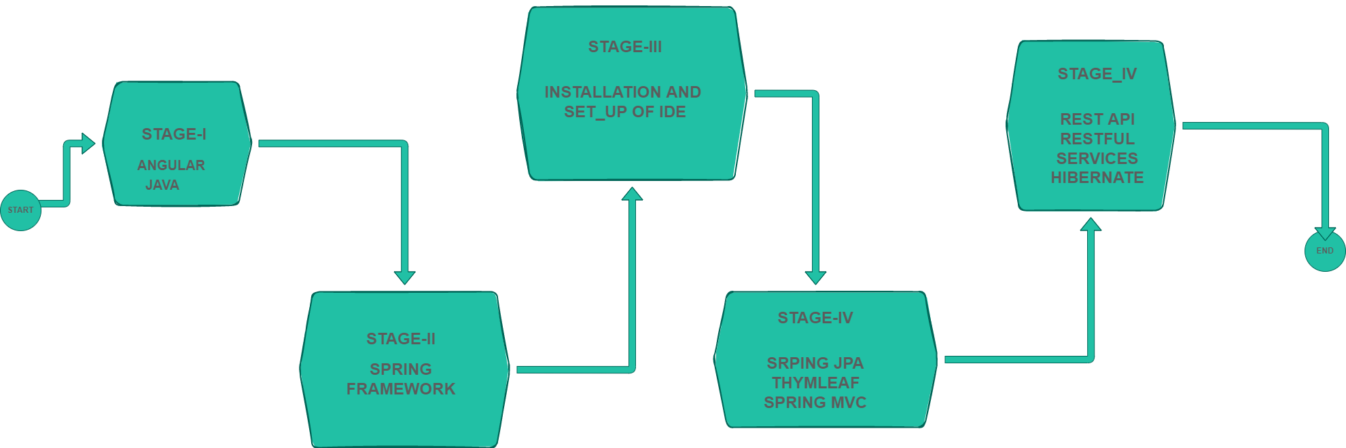
LEARNING

Slide 4



THYMLEAF
WHAT I HAVE LEARNED
Ways to write HTML + thymleaf expression
Standard Expression syntax
${…..}-for variable
*{…….}-for selction expression
#{…….}-for message
@{….}-for adding link
Loops- th:each
Thymeleaf is a modern server-side Java template engine for both web and standalone environments,capable of processing HTML ,XML,JavaScriptc,CSS and even plain text.
The Main goal of Thymleaf is to provide an elegant and highly maintainable way of Creating templates
Mostly used to generate html views for web applications

Slide 5
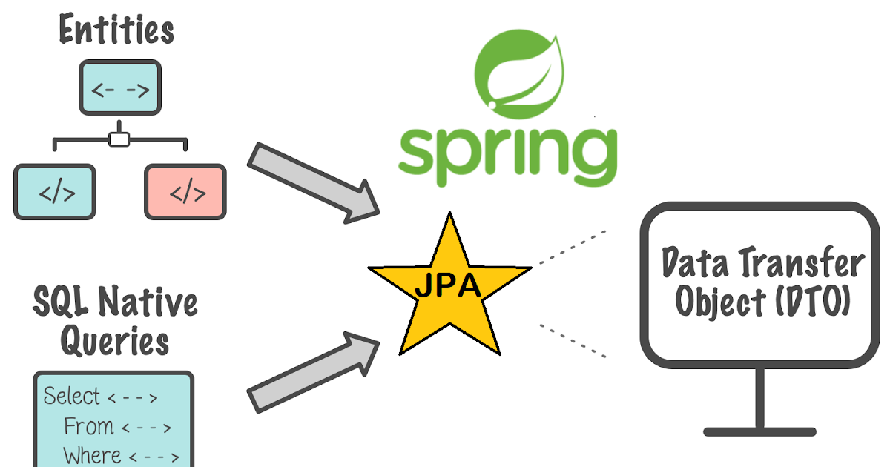
SPRING DATA JPA
WHAT I HAVE LEARNED
Overview of how Jpa is implemented using hibernate.
Extending JPA repository and using it to create a repository
Using predefined query method to perform Curd Operation
Some of the method used
Findbyid()
Findall
Save
Deleteby id
JPA stands for Java Persistence API which is a Java standard for defining persistence layer and Spring Data JPA is a sub-project under the Spring Framework umbrella which allows Spring applications to integrate with JPA.
Spring Data JPA comes with a concept called JPA Repository and Query methods. JPA Repository is nothing a set of interfaces that defines query methods like findByFirstName or findByLastName etc. These methods are converted into low-level SQL queries by Spring.

Slide 6
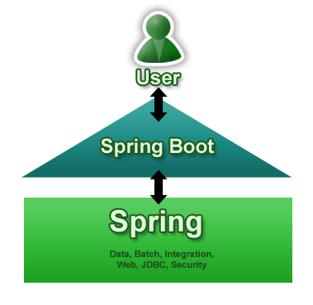
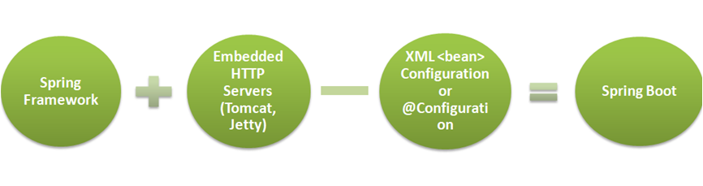
Spring Boot
WHAT I HAVE
LEARNED
Spring Boot is a lightweight framework that takes up most of the work in configuring Spring-based applications. The main goal of the Spring Boot Framework is to reduce overall development time and increase efficiency by having a default setup for unit and integration tests.
Spring Boot makes it easy to create stand-alone, production-grade Spring-based Applications that you can “just run”.
Using Spring MVC and spring boot together
Using annotation and making an application loosely coupled

Slide 7

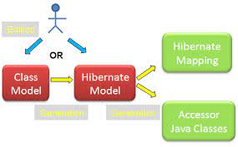
HIBERNATE
WHAT I HAVE LEARNED
There are a few types of relationships:
ONE to ONE
ONE TO MANY
MANY TO ONE
MANY TO MANY
ANOTATIONS AND ATTRIBUTES
@onetoone
@onetomany
@manytoone
@manytomany
@Joincoloumn
Mappedby
Referencecoloumn name
Cascade
Hibernate is an Object-Relational Mapping (ORM) solution for JAVA.
Object relational mapping is based on the containerization of objects and the abstraction that provides that capacity. Abstraction makes it possible to address, access and manipulate objects without having to consider how they are related to their data sources

Slide 8
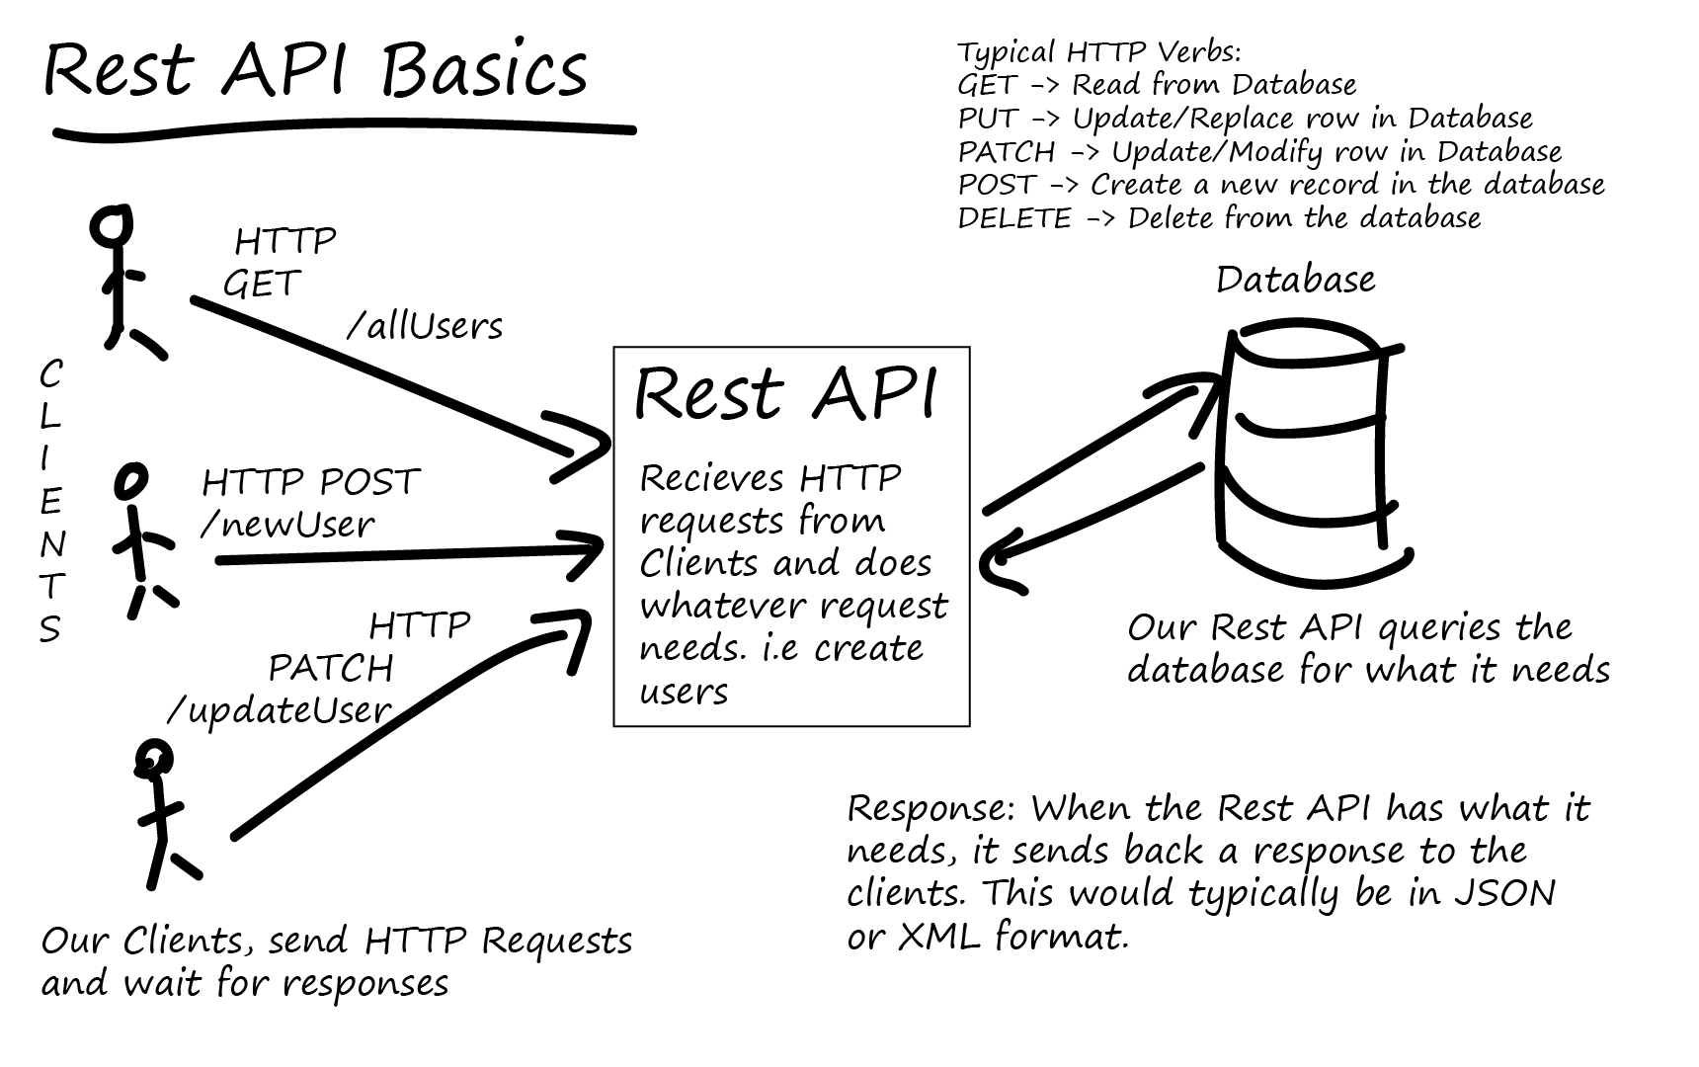
REST(REpresentational State Transfer)
REST (REpresentational State Transfer) is an architectural style for developing web services. REST is popular due to its simplicity and the fact that it builds upon existing systems and features of the internet's Hypertext Transfer Protocol in order to achieve its objectives, as opposed to creating new standards, frameworks and technologies.
We are able to communicate with servers using the HTTP protocol. With these protocols, we can Create, Read, Update and Delete data – otherwise known as CRUD operations.
WHAT I HAVE LEARNED
. The most commonly used methods are:
GET: The get method is used to Read data on the server.
POST: The post method is used to Create data.
PATCH/PUT: The patch method is used to Update data.
DELETE: The delete method is used to Delete data.

Slide 9
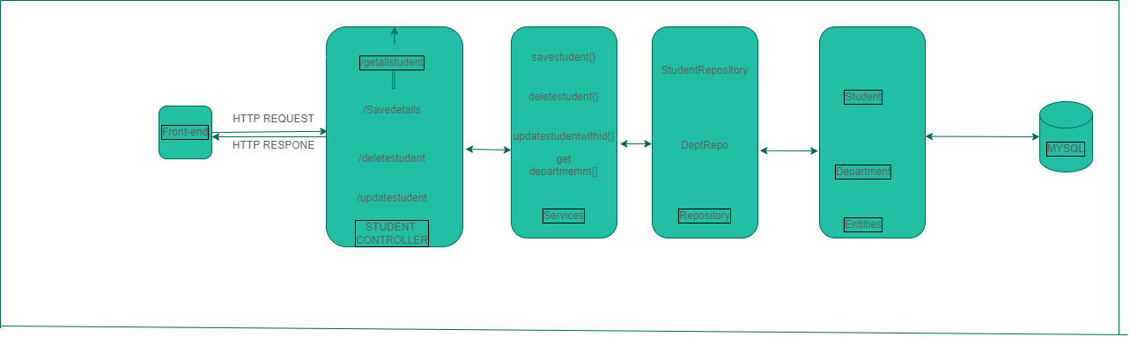
High Level Schema

Slide 10
WORKFLOW
1
Build A application to perform CURD Operation Using Spring JPA
11
Added User Interface Used Thymleaf
111
Added New entity and performed join Operation Using Spring JPA and hibernate
1V
Converted services to Restful Services using Rest API
Converted services to Restful Services using Rest API

Slide 11
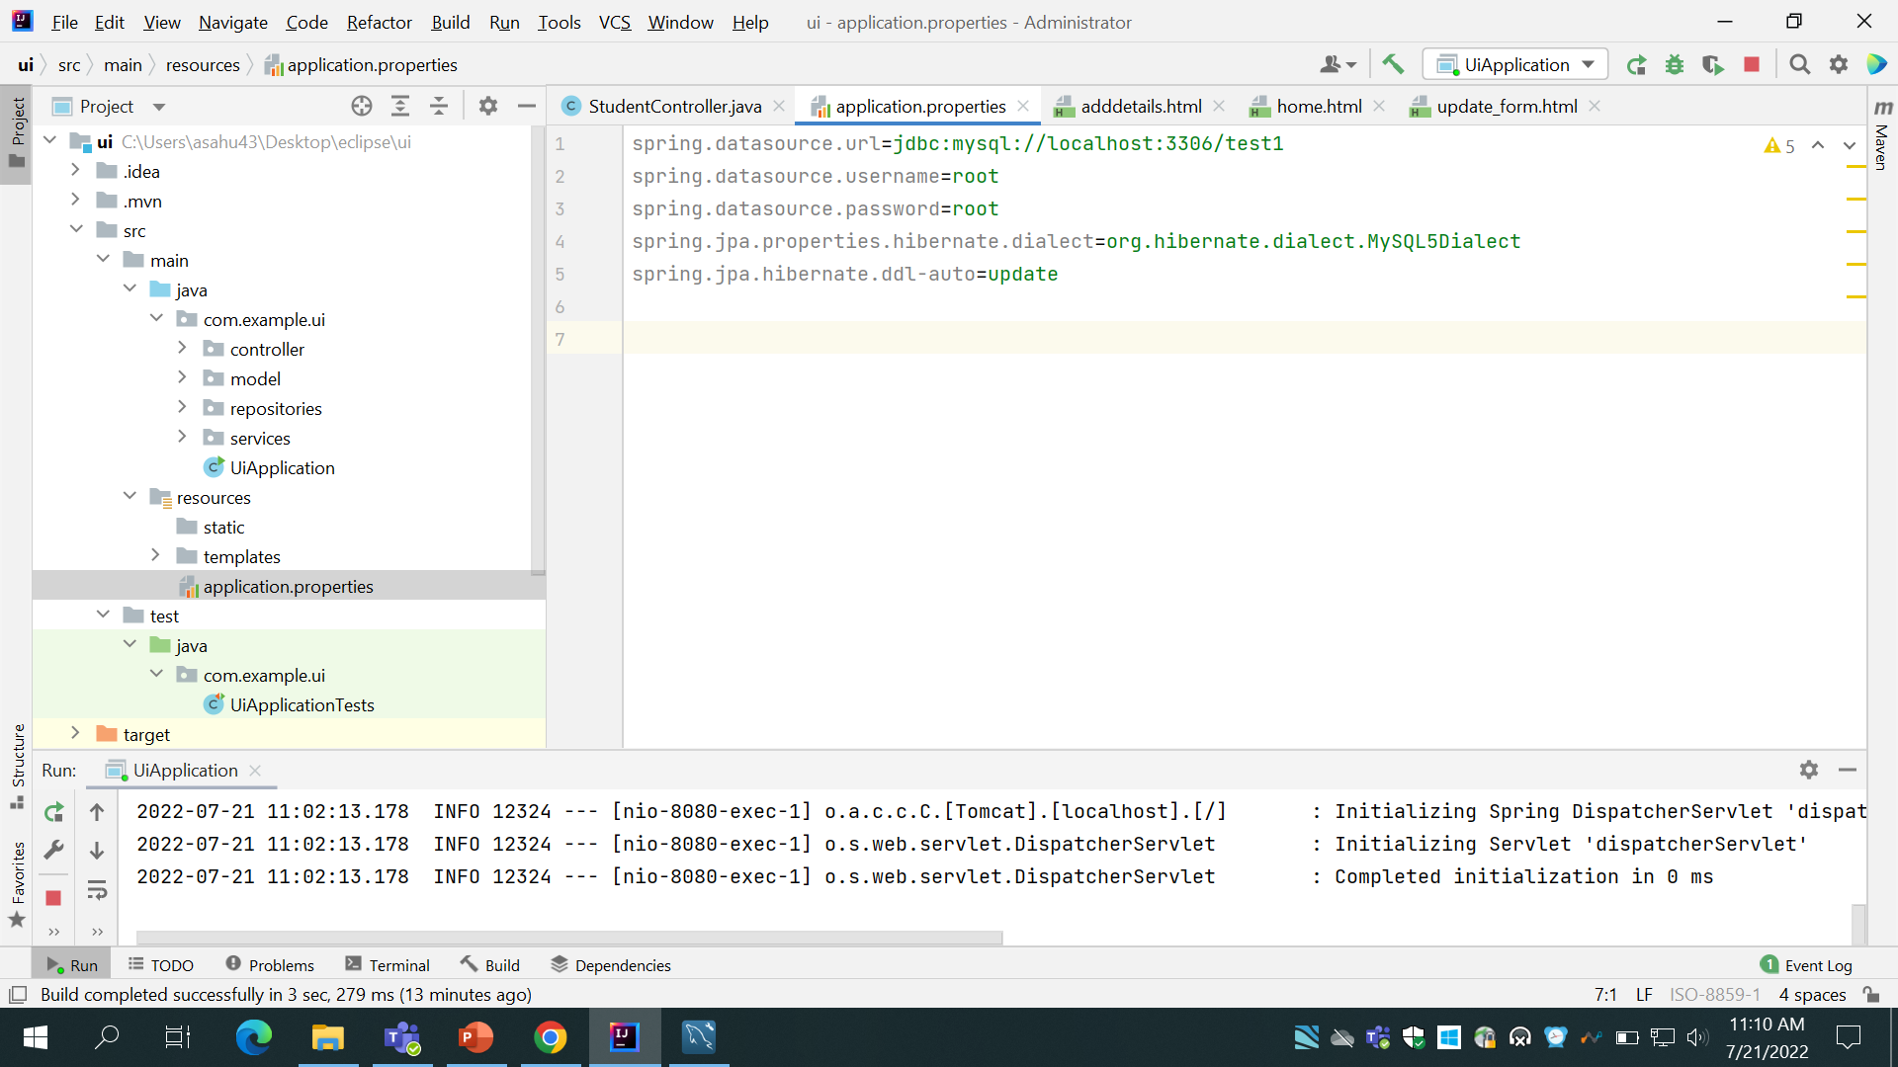
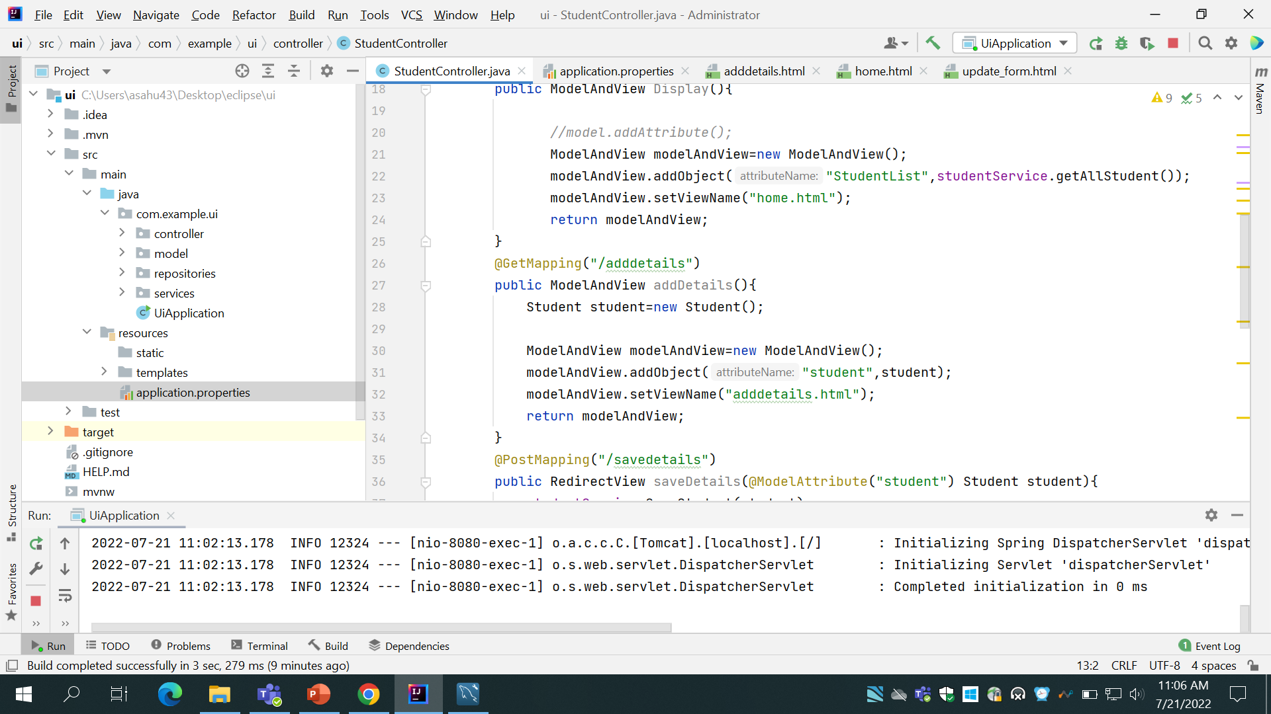
I
1
Resolved the error while installing MySQL
Build A application to perform CURD Operation Using Spring JPA
Application.properties files which configures database
Used Intellij and Configures Mysql DB names test1 and made Student entity and student controller
To perform CURD operation on Student Table .I have autowired Services in controller to perform various operation and In services operation is being performed using Student Repository which is exted using JPA Repository

Slide 12
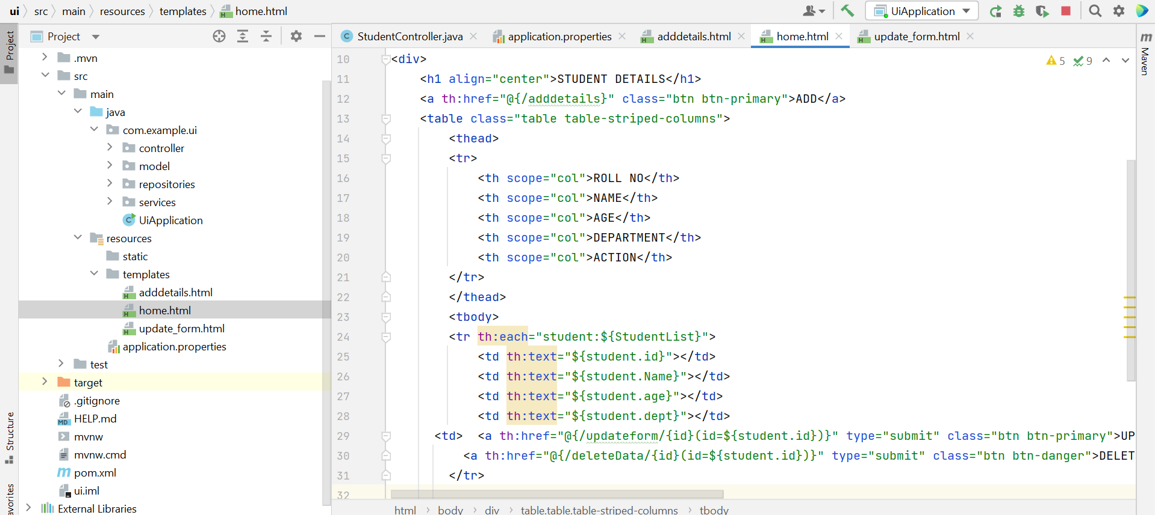
11
Added User Interface Used Thymleaf
Bootstrap codes for designing
I have used Thymleaf template engine to build UI of the project
I have used BootStrap to design the UI
I have learnt How to send data and receive data front front end to backend
LOCATION OF HTML FILE
Explored and learned Bootstrap
Some segments of code
Dynamic binding of data

Slide 13
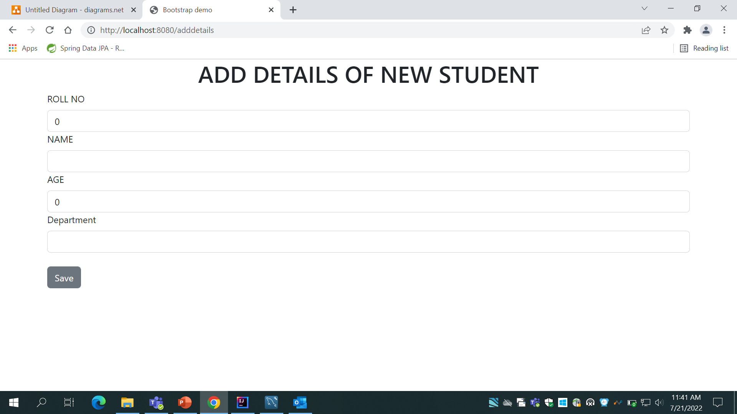
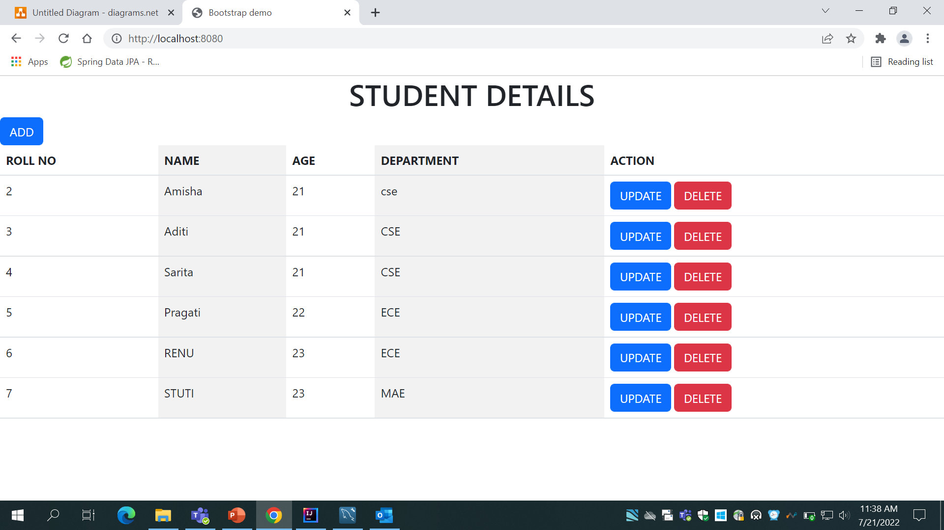
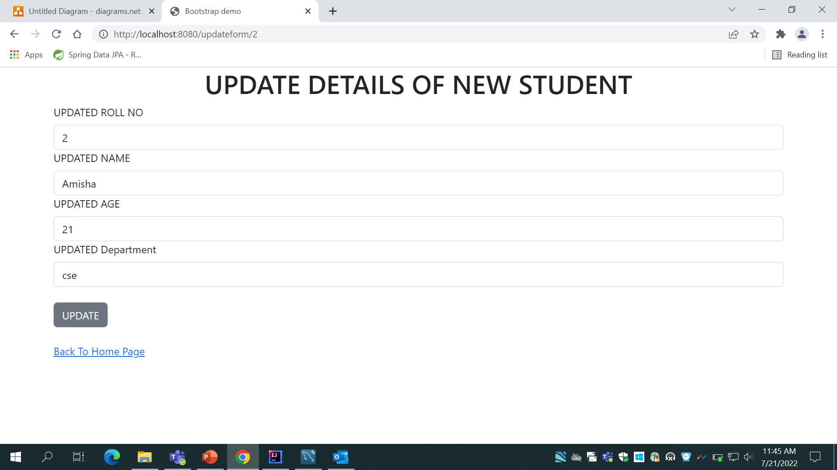
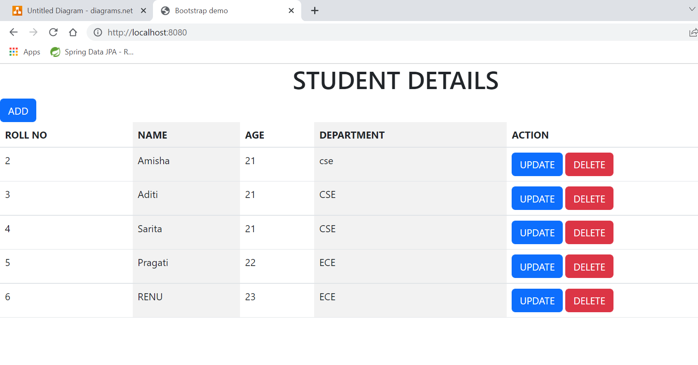
/adddetails
On clicking ADD button
On clicking
DELETE
button
On clicking
UPDATEbutton
/updatedetails

Slide 14
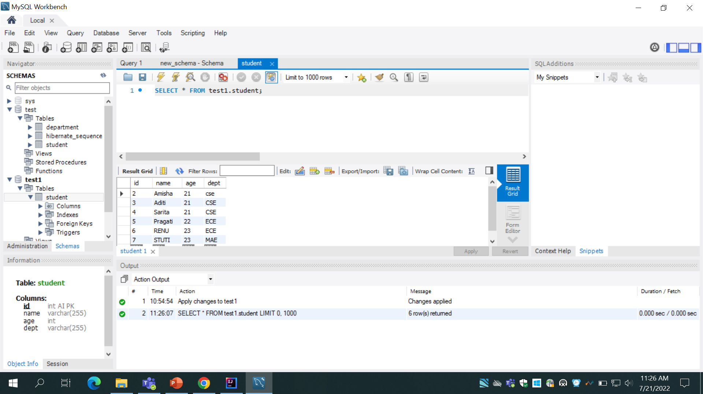
111
Added New entity and performed join Operation Using Spring JPA and hibernate
Added a Department entity and performed join operation between these data using One to many and Many to one mapping .Used Mapped by to bidirectionally join both entities
Used @onetomany and @manytoone annotation and @JoinColoumn as there can be many students belonging to a department but each student can belong to only one department

Slide 15
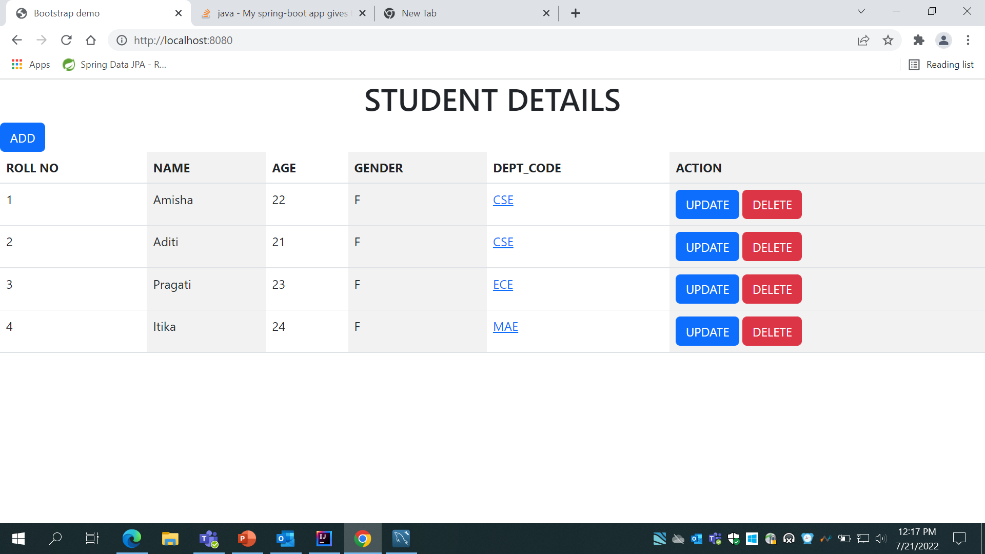
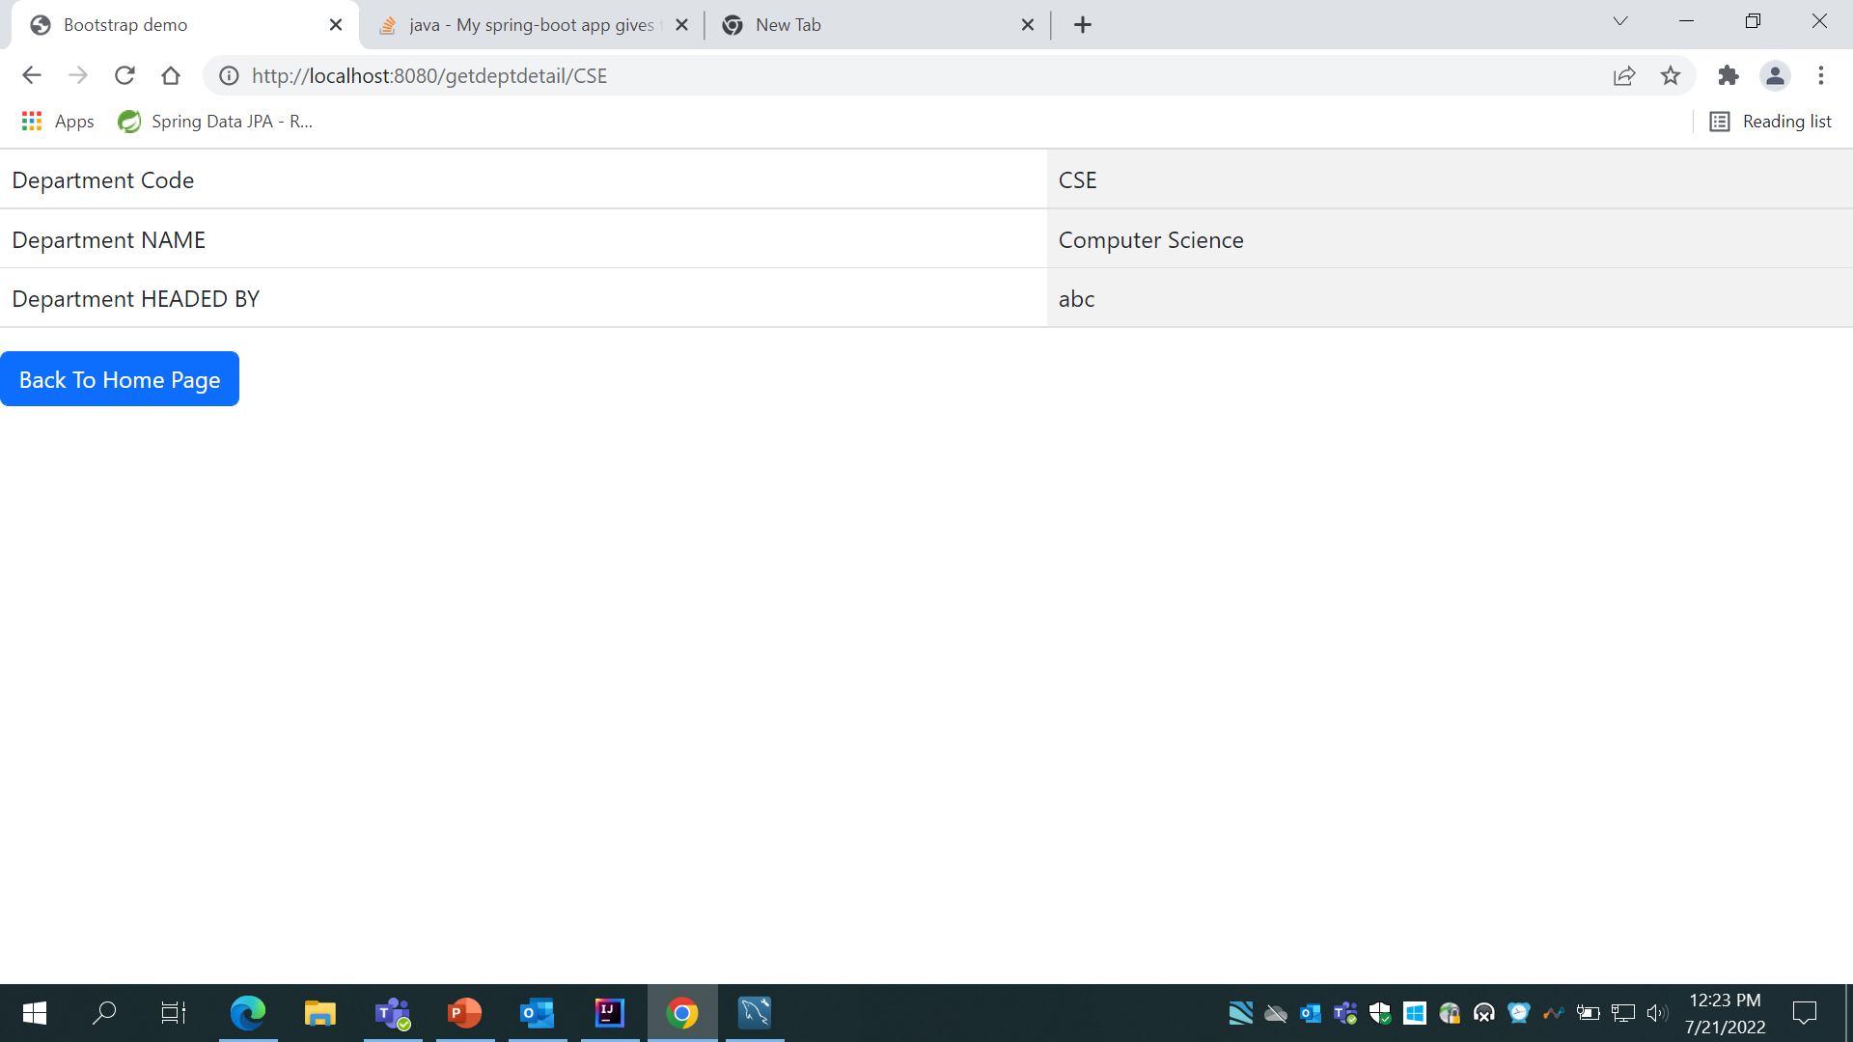
CHANGE IN UI AFTER ADDING AN ENTITY
After Adding department entity one more field is appended and it is hyperlinked .Onclicking on this field will show the detail of department which is fetched from department table

Slide 16
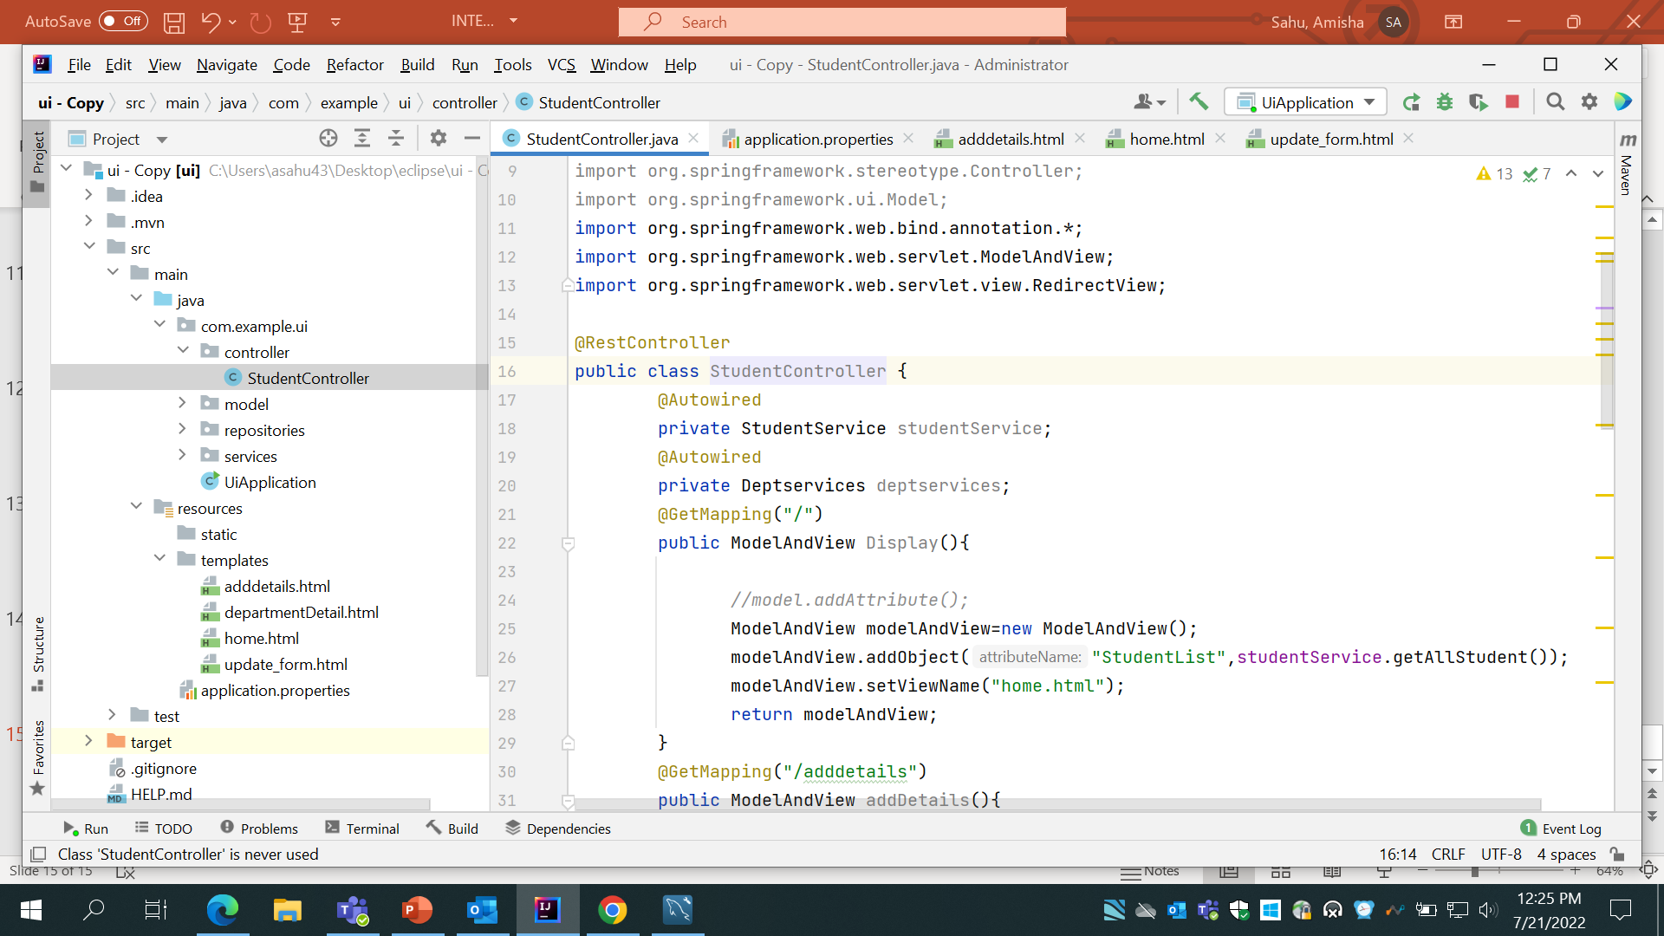
1V
Converted services to Restful Services using Rest API
Converted services to Restful Services using Rest API
Used @RestController to make Services restful and used Model And View to send html file ans RestController works with text/JSON file
Model and View can store object of any type like list ,collection ,maps etc
Uset addobject method to add attribute and setview to set view to html

Slide 17
THANK YOU!!!!

