Slide 1




Microbial Electrolysis Cells (MECs)
An Innovative Bioelectrochemical Approach for High-Yield Clean Hydrogen Production and Wastewater Remediation

Slide 2







Hydrogen Production Overview
Zero-Emission Fuel
Energy System Integration
Superior Efficiency
Hydrogen is a premier clean fuel source that emits strictly water vapor when combusted, eliminating greenhouse gas emissions completely at point of use.
Essential for next-generation sustainable energy architectures, serving as an energy carrier for heavy transport, industrial feedstock, and seasonal grid storage.
Modern fuel cell power conversion achieves approximately ~60% electrical efficiency, vastly outperforming internal combustion engines (ICEs).

Slide 3




Bioelectrochemical History
1911
2005+
Michael Potter
MEC Emergence
Demonstrates first electrical current generated directly by E. coli and yeast cultures.
Pivot from power generation to bioproducts, utilizing low voltage inputs to produce H₂ gas.
1791
2002
Luigi Galvani
MFC Boom
Discovers bioelectric phenomena, laying foundational concepts of biological charge transfer.
Microbial Fuel Cells gain research momentum to generate direct electricity from waste.

Slide 4

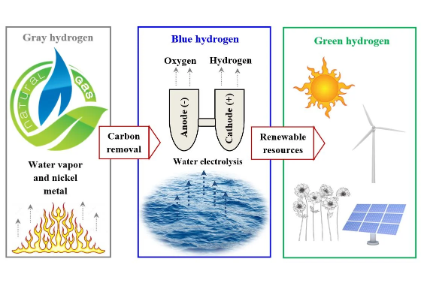
MEC System Fundamentals
Microbial Electrolysis Cells (MECs) leverage electroactive microorganisms to catalyze the conversion of organic waste into bio-hydrogen gas.
External Power Source: Provides small bias voltage (0.2–0.8V) to drive endothermic H₂ evolution.
Exoelectrogenic Biofilm: Anode-attached bacteria (e.g. Geobacter) oxidize organic substrates.
Electrodes & Membrane: Carbon-based porous anode and metallic cathode separated by an Ion Exchange Membrane.

Slide 5


Core Reaction Mechanisms
Anodic Oxidation (Bio-Catalysis)
Cathodic Reduction (H₂ Evolution)
Exoelectrogenic bacteria colonizing the anode oxidize substrate organic molecules (e.g., acetate), producing carbon dioxide, protons, and electrons.
Protons migrate across the exchange membrane to the cathode chamber. With supplemental applied potential, protons accept electrons to evolve pure H₂ gas.
Electrons are transferred to the conductive anode and flow through the external circuit.
Applied voltage of 0.2–0.8V overcomes thermodynamic barrier (-0.414V vs SHE).

Slide 6
Operational Parameters
System Architecture
Biological Parameters
Control Sweet Spot
Choice between single or double-chamber configurations; membrane selection (PEM/AEM) and high surface-area carbon anode materials govern internal resistance.
Selecting robust mixed consortia vs pure electrochemically active cultures, alongside targeted operational strategies to suppress H₂-consuming methanogens.
Maintaining optimal neutral pH (6.5–7.0), controlled mesophilic temperatures, and precise applied potential (sweet spot around ~0.7V for peak yield).

Slide 7






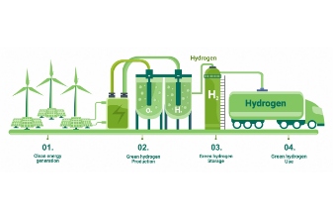
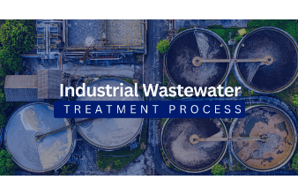
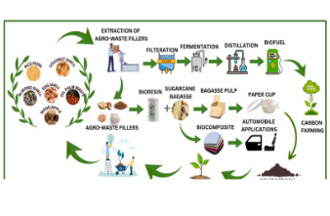
Key MEC Applications
Bio-Hydrogen Production
Wastewater Remediation
Resource Recovery
Generates high-purity clean H₂ gas directly from renewable biomass and municipal wastewater streams.
Effective organic pollutant removal while offsetting plant operational energy costs through fuel recovery.
Drives electrosynthesis of valuable organic chemicals (acetate, ethanol) and captures nitrogen & phosphorus.

Slide 8

Environmental Benefits
High Efficiency Wastewater Treatment
MECs deliver exceptional organic degradation performance, removing up to 88% of Chemical Oxygen Demand (COD) from complex wastewater streams.
88%
Low Carbon Footprint: Minimal net greenhouse gas emissions compared to activated sludge systems.
COD Removal Efficiency
Cost Effective: Produces net positive energy output and reduces sludge production by up to 60%.

Slide 9

Technology Comparison
Metric / Parameter | Water Electrolysis | Microbial Fuel Cell (MFC) | Microbial Electrolysis Cell (MEC)
Primary Output | Hydrogen Gas (H₂) | Direct Electricity | Bio-Hydrogen Gas (H₂)
Energy Input Required | High (~4.5–5.0 kWh/m³ H₂) | None (Power Producer) | Very Low (~0.6 kWh/m³ H₂)
Feedstock / Substrate | High-Purity Purified Water | Organic Wastewater | Wastewater / Biomass Waste
Applied Voltage | > 1.23 V (Typically 1.8–2.0V) | 0.0 V (Self-Generating) | 0.2 V – 0.8 V (Low External Bias)

Slide 10
Challenges & Innovation
Reactor Scale-Up Bottlenecks: Bridging the performance gap between small-scale laboratory reactors and large industrial pilot installations requires minimizing internal ohmic resistance.
Electron Transfer Kinetics: Enhancing extracellular electron transfer efficiency between bacterial biofilms and electrode surfaces via synthetic biology and bio-engineering.
Advanced Materials & Magnetic Fields: Developing platinum-free cathode catalysts, nanostructured 3D carbon anodes, and using localized magnetic fields to accelerate biofilm growth.

Slide 11

Strategic Technology Roadmap
Commercialization Pathway
Transitioning MECs into commercial biorefineries demands multi-disciplinary optimization across electrochemistry, microbial genetics, and materials science.
Priorities include non-precious catalysts (e.g., Ni-based compounds), optimized flow-field designs, and continuous methanogen inhibition strategies to maximize pure hydrogen yields.

Slide 12



Questions & Discussion
Unlocking Sustainable Biohydrogen Production & Circular Wastewater Economy Through MECs

Slide 13





Image Sources
https://static-01.extrica.com/articles/21985/21985-gabs-1119x642.webp
Source: www.extrica.com
https://www.thermofisher.com/blog/identifying-threats/wp-content/uploads/sites/11/2024/09/iStock-2136054419_greenhydrogendiagram-scaled.jpg
Source: www.thermofisher.com
https://cwt-global.com/wp-content/uploads/2025/07/Sub-pillar-Industrial-Wastewater-Treatment-Process-1.png
Source: cwt-global.com
https://www.mdpi.com/reactions/reactions-05-00059/article_deploy/html/images/reactions-05-00059-g001.png
Source: www.mdpi.com
https://images.stockcake.com/public/c/5/f/c5fc6a7c-3cb8-4331-b6e3-8b3eb5d7ad89_large/renewable-energy-research-stockcake.jpg
Source: stockcake.com

