Slide 1
🏛️ BPUT HACKATHON 2026 • HEALTHCARE INNOVATION TRACK
Saransh (सारांश)
Multimodal Human-in-the-Loop Healthcare Triage Assistant for Government & Institutional Health Facilities
“Right Priority. Right Facility. Right on Time.”
An explainable, non-diagnostic clinical triage assistant that combines Vernacular Voice (Odia/Hindi), Lab Report OCR, Visual Symptom Signals, and Deterministic Vital Checks to structure chaotic hospital queues into prioritized clinical lanes—without replacing clinical judgment.
🎤 Multimodal Voice
Odia, Hindi & English speech + Vernacular Dialect Normalizer (SNOMED-CT)
🛡️ Safety-First Rule Floor
MAX(Rule, AI) guarantee — SpO2 < 90% locks RED, AI cannot downgrade
🏥 3-Lane Doctor Command
Live clinical queue (🔴 Emergency, 🟠 Urgent, 🟢 Routine) with bed telemetry
📄 NHM Government Referral
1-Click formal transfer slip from PHC Jatni to SCB Cuttack with 108 escort

Slide 2
BPUT HACKATHON 2026 • AI HEALTHCARE TRACK
The Ground Reality: Outpatient Bottlenecks in Government PHCs/CHCs
🚨 1. Unprioritized First-Come Queues
• 200–400 patients arrive during crowded morning hours at PHCs/CHCs.
• Critical cases (silent hypoxia SpO2 < 90%, crushing chest pain, pre-eclampsia) wait in the exact same first-come queue as mild tension headaches.
• Clinical deterioration occurs silently while waiting for consultation.
🗣️ 2. Vernacular Idioms & Linguistic Barrier
• Rural patients describe pain in colloquial cultural idioms ('Chhati fatijiba', 'Pathara bhali bhari', 'Jhalare thanda').
• Generic AI and translation tools fail or translate literally.
• Rotating medical officers from other regions struggle with speed and local dialect transcription.
📑 3. Paper Lab Overload & Missing Info
• Patients carry crumpled paper CBC slips, prior ECGs, and handwritten slips.
• Frontline nurses have under 90 seconds per patient.
• Critical details (drug allergies like Penicillin anaphylaxis, exact pain onset timing) are missed in the rush.
🚑 4. Broken Referral Handoff Continuity
• When a rural PHC transfers an emergency to District Hospital or SCB Medical College, referral notes are scribbled on paper scrap.
• Destination hospital has zero pre-arrival telemetry or baseline vital trends, wasting precious golden hour time.

Slide 3
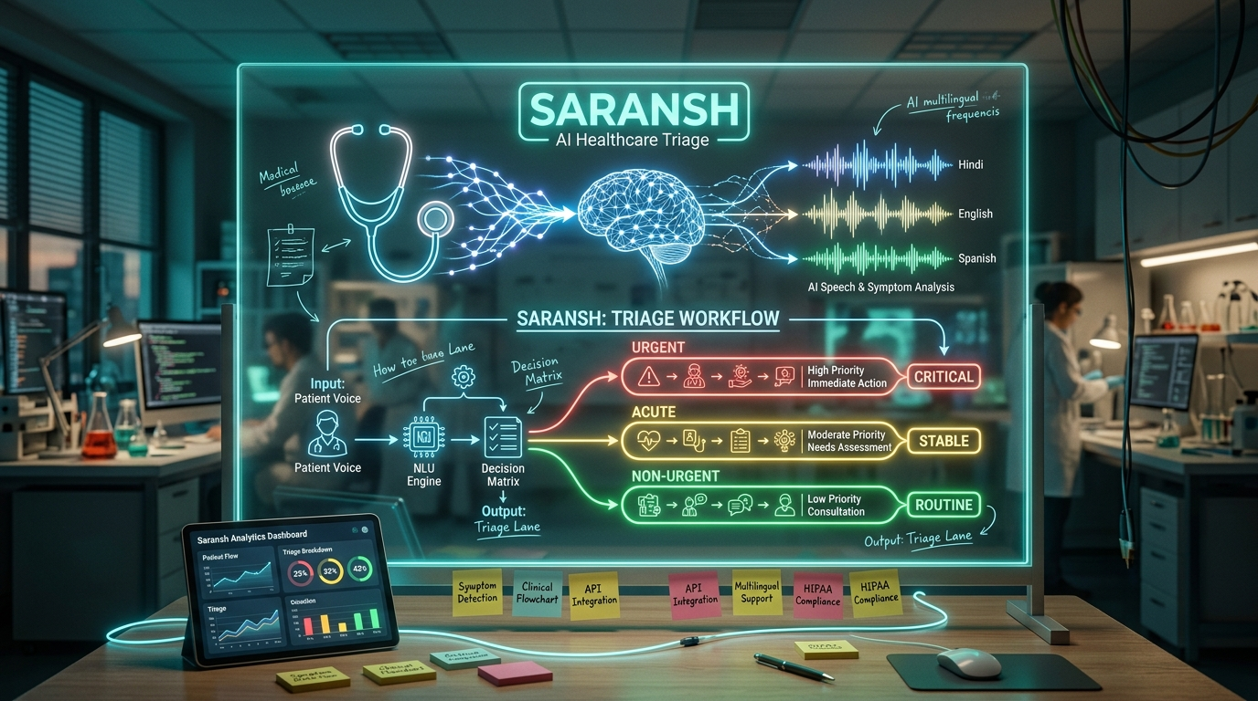
BPUT HACKATHON 2026 • AI HEALTHCARE TRACK
System Ideation: From Waiting Room Chaos to Prioritized Triage Lanes
⚙️ Design Thinking & Technology Convergence
• 1. User-Centric Empathy (The ASHA/ANM Reality):
Frontline staff have under 90s per patient. We designed an interactive 2D Anatomical Body Map so non-literate patients can visually tap pain points with zero typing.
• 2. Sovereign Indic Vernacular AI (Sarvam AI):
Integrating India's Saaras:v3 & Bulbul:v3 to recognize spoken Odia & Hindi cultural idioms, outputting phonetic transcripts & standardized medical English.
• 3. The Mathematical Safety Guardrail (AIIMS/WHO):
Refusing black-box LLM risk: vital thresholds enforce an unbreakable floor via MAX(Rule, AI). If SpO2 < 90%, it locks RED regardless of AI output.
• 4. National Health Continuity (ABDM FHIR R4):
Transitioning from lost paper scraps to tamper-evident referral slips with SHA-256 cryptographic hashes for seamless PHC-to-MCH ambulance handoffs.
💡 The Ideation Genesis & Core Hypothesis
“Can we convert subjective colloquial distress ('Chhati pathara bhali bhari') into objective, life-saving clinical urgency lanes in <30 seconds—while guaranteeing zero AI hallucination on vital signs?”

Slide 4
BPUT HACKATHON 2026 • AI HEALTHCARE TRACK
Our Solution: Hybrid Deterministic + Generative Triage Engine
Why NOT a Generic Black-Box LLM?
❌ Pure LLM Pitfall: Autonomous LLMs can hallucinate, downgrade critical vitals, or generate unauthorized medical prescriptions.
🛡️ The Saransh Hybrid Innovation: We separate Clinical Safety from Linguistic Processing:
1. Deterministic Rule Engine (100% Explainable): Hard clinical vital checks in pure Python/JS. SpO2 < 90% = RED. Systolic BP >= 180 = RED. Severe Chest Pain = RED. Zero AI hallucination on vitals.
2. Generative Multimodal AI (Gemini 2.5 Flash): Used strictly for multimodal transcription, CBC/ECG OCR extraction, chronological timeline stepper, and Odia/Hindi follow-up question generation.
3. MAX(Rule, AI) Safety Floor Ceiling: Programmatic guarantee: The AI model cannot downgrade a patient flagged as an emergency by clinical rules.
4. Strict Advisory Mandate: Persistent disclaimer: Clinical decision support tool for qualified staff; does not diagnose or prescribe.
🔴 RED — EMERGENCY (P1)
Queue SLA: Immediate Medical Officer Care (0 min wait)
Clinical Triggers: SpO2 < 90% • Systolic BP >= 180 or < 85 • Severe Retrosternal Chest Pain • Acute Dyspnea • Active Seizure • Anaphylaxis
🟠 YELLOW — URGENT (P2)
Queue SLA: Priority Fast-Track OPD (< 15-20 min target)
Clinical Triggers: SpO2 90-93% • Temp >= 101.5°F • Abnormal CBC (Platelets < 100k) • High-Risk Maternal Pre-eclampsia (BP 168/110)
🟢 GREEN — ROUTINE (P3)
Queue SLA: Standard Outpatient Queue Consultation
Clinical Triggers: SpO2 >= 94% • Baseline Stable Vitals • Mild Tension Headache • Chronic Medication Refill • Minor Cold/Cough

Slide 5
BPUT HACKATHON 2026 • AI HEALTHCARE TRACK
Multimodal Ingestion: Voice, Vision, Vitals & Vernacular Dialects
🗣️ Vernacular Dialect Normalizer
• Solves Indian cultural idiom gap by mapping to SNOMED-CT & ICD-10:
- 'ଛାତି ଫାଟିଯିବା' ➔ Severe Stabbing Chest Pain [ALERT]
- 'ପଥର ଭଳି ଭାରି' ➔ Crushing Chest Heaviness [ALERT]
- 'ଝାଳରେ ଥଣ୍ଡା' ➔ Cold Diaphoresis / Shock Sign [ALERT]
- '୨ ଘଣ୍ଟା ହେଲା' ➔ Acute Onset (2 hours ago)
• Preserves exact spoken voice for legal records while outputting clinical English for doctors.
🪪 Holographic ABDM / ABHA Sync
• Ayushman Bharat Digital Mission (ABDM) Integration:
• 1-Click mock QR scan fetches verified ABHA ID (e.g. 91-4821-9923-0192)
• Instantly pulls synced longitudinal medical history (Hypertension 5y, Type 2 Diabetes)
• Highlights critical drug allergy alerts (Penicillin Anaphylaxis) before nurse enters symptoms.
👤 2D Anatomical Body Map
• Visual symptom selector for non-literate patients:
• Head/Neuro, Chest/Cardiac, Lungs/Dyspnea, Abdomen, Limbs/Edema, Skin/Rashes
• Clicking body zones automatically suggests corresponding clinical symptoms
• Bridges language and literacy barriers in rural health camps.
📑 Single-Call Multimodal OCR
• Document extraction via Gemini 2.5 Flash in a single API call:
• Reads quantitative values from CBC reports (Platelets 85k), ECG slips (LVH strain pattern), prescriptions
• Tags non-diagnostic supporting photos of pedal edema and rashes.

Slide 6
BPUT HACKATHON 2026 • AI HEALTHCARE TRACK
Doctor Command Dashboard & Human-in-the-Loop Governance
🏥 HOSPITAL LIVE TRIAGE COMMAND CENTER
Bed Telemetry: Emergency Bays: 3/5 Available • Doctors On Duty: 5 • Active Waiting: 6
🔴 RED LANE (Immediate Emergency Care)
T-024 • Ramesh K. (62M) • SpO2 89% • Crushing Chest Pain • Wait: 1m
🔴 RED LANE (Maternal Pre-eclampsia)
T-019 • Meena D. (28F) • BP 168/110 • 34w Gestation • Wait: 3m
🟠 YELLOW LANE (Priority Outpatient)
T-025 • Priya S. (34F) • Temp 102.8°F • CBC Platelets 85k • Wait: 7m
🟠 YELLOW LANE (Occupational Screening)
T-027 • Rajesh M. (45M) • Paradeep Chemical Inhalation • Wait: 9m
🟢 GREEN LANE (Routine Consultation)
T-026 • Subhash P. (24M) • Mild Study Tension Headache • Wait: 12m
⚖️ Human-in-the-Loop Safeguards (15% Rubric)
1. Doctor Verification Drawer: Reviewing Medical Officer (MO) reviews the structured timeline, missing information gaps, and raw voice statement before patient enters.
2. 1-Click Priority Override: Doctor can upgrade (e.g. YELLOW to RED) or downgrade priority with complete clinical freedom.
3. Mandatory Clinical Justification: System forces clinician to enter reason (e.g. 'Repeat SpO2 is 97% on warm finger; chest tenderness is reproducible muscular strain').
4. Immutable Audit Trail: Every decision records Reviewer ID (e.g. DR-MO-402), timestamp, AI original priority vs. final clinician priority for clinical accountability.
5. Dynamic Follow-Up Questions: Presents 3 high-yield questions in Odia/Hindi for nurse to ask at bedside.

Slide 7
BPUT HACKATHON 2026 • AI HEALTHCARE TRACK
Odisha Public Health Network & Official NHM Referral Engine
🏛️ Complete 6-Tier All-India Facility Network (National Health Facility Registry / NIN Standard):
• PHC Jatni, Khordha (OD-KHD-PHC-102) ➔ Rural First-Line Triage
• CHC Tangi, Khordha (OD-KHD-CHC-204) ➔ Block-Level Community Health Center
• Capital Hospital, Bhubaneswar (OD-DHH-401) ➔ 750-Bed District Headquarter Hospital
• SCB Medical College, Cuttack (OD-MCH-001) ➔ Apex Tertiary Emergency & Trauma Bay
• Paradeep Industrial Unit (OD-JSP-IEH-301) ➔ Industrial Port Trust Occupational Screening
• Koraput Mobile Health Camp (OD-KPT-MOBI-501) ➔ Tribal Health Mission Outreach
• Flagship National Anchors: AIIMS New Delhi (DL-NDLS-AIIMS-001) & Thane MIDC Maharashtra (MH-THN-MIDC-402)
📄 GOVERNMENT OF ODISHA • HEALTH & FAMILY WELFARE DEPARTMENT — NHM CLINICAL REFERRAL SLIP
Referring Facility: Primary Health Center (PHC) Jatni, Khordha (NIN: OD-KHD-PHC-102)
Referred To: Emergency Resuscitation Bay, Capital Hospital Bhubaneswar / SCB Medical College, Cuttack
Patient: Ramesh K. | ABHA ID: 91-4821-9923-0192 | Token: T-024 | Age/Sex: 62y/Male
Chief Complaint: Retrosternal crushing chest pain & severe dyspnea (2 hours duration)
Triage Classification: 🔴 RED PRIORITY (Immediate Medical Officer Assessment Required)
Departure Vitals: SpO₂ 89% (Room Air), BP 158/96 mmHg, Pulse 112 bpm, RR 26/min, Temp 99.8°F
Pre-Referral Stabilization: Oxygen initiated via nasal cannula at 4 L/min. Aspirin 300mg stat administered.
Escort Logistics: 108 Emergency Ambulance Dispatched • Emergency Transfer Barcode Generated for Zero-Wait Reception

Slide 8
BPUT HACKATHON 2026 • AI HEALTHCARE TRACK
Technical Architecture: Modern, Scalable & Offline-Resilient
🎨 Modern React Frontend
• React 18, Vite, Tailwind CSS
• Lucide Medical Icons & Bento Vitals
• Web Speech API (or-IN, hi-IN, en-IN)
• SpeechSynthesis audio question playback
• Interactive 2D Anatomical Body Map
• Holographic ABHA verified card widget
⚡ FastAPI High-Speed Backend
• Python 3.11+ with async FastAPI
• Strict Pydantic v2 schemas (all 10 domains)
• Interactive OpenAPI 3.1 Swagger Docs (/docs)
• In-memory clinical queue with persistence
• Zero-delay response (<50ms deterministic scoring)
🧠 Gemini 2.5 Flash Multimodal AI
• Official google-genai Python SDK
• Native audio, text, and report OCR in 1 call
• Enforces strict Pydantic JSON response_schema
• Intelligent local fallback mode when offline
• Culturally empathetic Odia & Hindi prompts
📶 Offline-First PWA Resilience
• IndexedDB / LocalStorage queue buffer
• Client-side mirror deterministic rule engine
• If rural PHC internet cuts out, triage never stops
• Auto-syncs queued patients when back online
• 100% demo safety on hackathon stage

Slide 9
Evaluation Criteria Mastery & Future Roadmap
🎯 Official Hackathon Weightage Scorecard:
• Safety-First Triage Workflow (20%): MAX(Rule, AI) priority ceiling; zero LLM downgrade on critical hypoxia
• Information Extraction & Summary (20%): Chronological timeline stepper, missing clinical info, Odia follow-up questions
• Multimodal Capability (15%): Voice in Odia/Hindi + Lab Report OCR + Visual symptom signals + Vitals
• India-Wide Relevance & Accessibility (15%): 8 facilities across 6 tiers, ABDM/ABHA integration, 2D Body Map for non-literate
• Human-Review & Escalation (15%): Doctor command queue, clinician override with audit trail, NHM referral slip
• Privacy & Responsible AI (10%): Informed consent gate, PII masking, local offline storage, advisory disclaimer
• Demo Quality (5%): Instant 1-click synthetic profiles, zero-latency local execution, Swagger docs
🚀 Future Scope & Institutional Deployment:
• ABDM M3 Milestone Integration: Direct connection with official National Health Authority (NHA) health lockers via OAuth2/OTP.
• eSanjeevani Telemedicine Bridge: Automated handoff of YELLOW urgent triage notes to remote specialist tele-consultations.
• IoT Bluetooth Medical Device Pairing: Direct wireless Bluetooth sync with portable pulse oximeters, digital BP cuffs, and glucometers.
• Public Health Outbreak Epidemiology: De-identified spatial clustering of fever/respiratory cases across Odisha districts for early Dengue/Malaria outbreak detection.
“Our mission: Help frontline healthcare staff prioritize patients faster and safer, while keeping clinical decisions strictly in human hands.”

