Slide 1
Course
Outline
Lesson 1
Lesson 2
Lesson 3
Lesson 4
Lesson 5

Slide 2
Course
Outline
Lesson 1
Lesson 2
Lesson 3
Lesson 4
Lesson 5

Slide 3
Course
Outline
We will cover these skills
First skill
Second skill
Third skill

Slide 4
Problem Statement
The placement and internship process is a critical milestone in the life of every engineering student, particularly in their 3rd and 4th year. Students face multiple challenges while preparing:
They must study MCQs for aptitude and technical exams, practice coding problems for online rounds, and prepare for HR/technical interviews.
Currently, students use multiple platforms (GeeksforGeeks, LeetCode, InterviewBit, etc.) but none of them provide all-in-one preparation with AI-powered interview practice.
Many students also lack confidence in answering interview questions. They need feedback on accuracy, communication style, and relevance of their answers.
First Skill
Second Skill
Third Skill
Conclusion

Slide 5
Solution & Significance:
We propose a web-based platform that integrates all preparation stages into a single portal:
MCQ Module – Students can practice aptitude, CS fundamentals, DBMS, OS, CN, etc. with performance tracking.
Coding Module – Online compiler to solve coding challenges with real-time feedback.
AI Interview Module – AI asks job-role specific questions, the student answers (text/audio), and the system evaluates accuracy, clarity, and completeness compared to an AI-generated ideal answer.
Performance Analytics – Students receive a scorecard with strengths, weaknesses, and recommendations for improvement.
Uses AI-driven evaluation, which is innovative and missing in current platforms.
Saves time by eliminating the need to jump between multiple resources.
Builds confidence, communication skills, and technical depth among students.

Slide 6
Timeline
Week 1 (Days 1–7):
Requirement gathering, domain modeling
Cloud & IAM setup
Basic frontend routes + UI mockups
Week 1 (Days 1–7):
Requirement gathering, domain modeling
Cloud & IAM setup
Basic frontend routes + UI mockups
Week 1 (Days 1–7):
Requirement gathering, domain modeling
Cloud & IAM setup
Basic frontend routes + UI mockups
Week 1 (Days 1–7):
Requirement gathering, domain modeling
Cloud & IAM setup
Basic frontend routes + UI mockups

Slide 7
Feasibility
Frontend: React.js / Next.js for interactive UI.
Backend: Node.js ,Express.
Database: MongoDB for users, questions, submissions, results, and feedback.
Authentication & User Management: NextAuth/JWT, bcrypt, role-based access, MongoDB (Users collection).
MCQ Quiz Module: Next.js (server components + API), MongoDB (Questions & QuizResults).
Coding Practice Module: Next.js (editor), Node.js API + Judge0/Docker, MongoDB (Problems & Submissions).
Mock Interview (AI-powered): Next.js API (OpenAI integration), MongoDB (InterviewSessions & Feedback).
Dashboard & Analytics: Next.js frontend (charts), MongoDB (aggregate queries).
Deployment: AWS for scalability & security.
Conclusion
First Skill
Second Skill
Third Skill

Slide 8
Scope of the Project
This project goes beyond being a simple preparation tool — its scope lies in building a global Placement Readiness Ecosystem. Instead of treating MCQs, coding, and interviews as isolated activities, our platform replicates the entire recruitment pipeline in one seamless flow, just like a real company selection process.
At scale, the system can be:
Multi-tenant, allowing universities, training institutes, and even corporates to onboard their students or candidates under their own branded portals.
AI-driven, where personalized learning paths adapt to each student’s strengths and weaknesses, helping them become job-ready faster.
Scalable to millions, with cloud-native deployment ensuring performance and availability across countries.
A placement intelligence hub, where aggregated performance data can guide universities on how prepared their batches are, and help companies directly identify top talent without needing multiple tests.

Slide 9
Methodology & Approach
Step 1: Requirement Analysis – Collect inputs, identify gaps, and define requirements.
Step 2: System Design – Create diagrams, mockups, and plan scalable architecture.
Step 3: Development – Build MCQ, coding, and AI interview chatbot modules.
Step 4: AI Answer Evaluation – Compare student and ideal answers using embeddings.
Step 5: Testing and Deployment – Test, deploy on cloud, and monitor for improvements.
We follow the Agile Methodology to build the project in short development cycles (sprints).Each sprint focuses on delivering one complete module (e.g., MCQ module, coding module, AI interview, integration & testing).
At the end of each sprint, the developed module is tested and refined internally to ensure stability and correctness.
This process ensures steady progress and helps us achieve a fully functional platform in a structured way.
Conclusion
First Skill
Second Skill
Third Skill

Slide 10
Research & Literature Review
Problem with old grading tools – They just check for keyword matches, so they miss whether the student’s answer really means the same as the reference.
New research in ASAG (Automated Short Answer Grading):Liu et al. (2019): Built a model that looks at deep semantic meaning (not just words). It worked very well on school datasets.
Hybrid + Transformer Models:Best results come when we mix BERT/transformers (deep models) with word embeddings + handcrafted features.These “hybrid” methods beat older grading methods.
Learning Analytics Dashboards (LAD):Not just show progress, but also give prescriptions (advice: “do this next”).Helps especially weak/self-regulation students improve.Advanced dashboards can even explain predictions, suggest “what if” scenarios, and improve motivation.
AI-Human Agreement:GPT-4 has been tested for grading and shows very strong correlation with human teachers (almost as reliable as them).
Conclusion
First Skill
Second Skill
Third Skill

Slide 11
ASAG Technologies:
Transformer-based grading tools (e.g., BERT, SBERT) are widely explored for short-answer semantic comparison.
Some systems improve accuracy by combining semantic embeddings with POS tagging and dependency parsing. International Journal of Technology
Learning Analytics Dashsboards:
Most dashboards offer only descriptive analytics; prescriptive features are rare but more effective.
Transparent, predictive, and prescriptive dashboards are emerging but not yet mainstream in education systems.
AI in Interview Simulations:
While nascent research explores AI mock interviews, existing platforms like Pramp rely on human peers and lack semantic or confidence-based evaluation.

Slide 12
Gaps
Gap | How our Project Fills It
1. Fragmented Platforms | One integrated platform combining MCQs, coding, AI mock interviews, and analytics; avoids siloed workflows.
2. Grading Confidence & AI Reliability | Metrics including similarity scores, confidence levels, and correlation with human grading (e.g., ICC) ensure AI reliability.
3. Absence of Role-Specific Training | Platforms rarely offer role-specific question banks (e.g., Cloud Engineer vs. Data Analyst vs. Frontend Developer). This reduces the industry-relevance of preparation and makes practice sessions less effective.

Slide 13
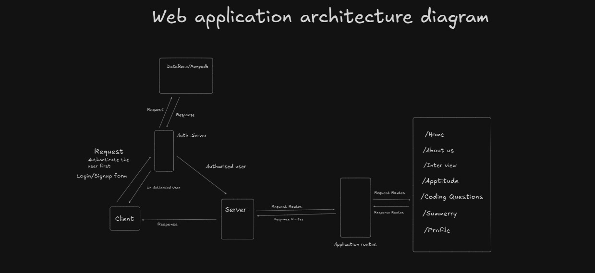
Conclusion
First Skill
Second Skill
Third Skill

