Slide 1


VISUAL ANALYTICS PROJECT · TOPIC 3 — TIME SERIES XAI
Aqua XAI
Explainable Anomaly Detection for Water-Quality Time Series
1D CNN · Grad-CAM · SHAP
94.7%
486,786
2
Aarav Menon (3017723)
Erla Anand Divya Theja (3017656)
Amit Kumar Rawat (3015331)
ACCURACY
RECORDS
XAI METHODS
Dataset: Water Quality (UK) Supervisor: Prof. Dr. Dominik Raab

Slide 2

Project Overview
Detect water-quality anomalies — and explain every decision
486,786
37,211
94.7%
0.13
Grad-CAM
SHAP
TOTAL RECORDS
ANOMALIES
CNN ACCURACY
FINAL LOSS
XAI METHOD 1
XAI METHOD 2
Water samples
7.6% rate
10 epochs
CrossEntropy
Heatmap
Shapley values
AT A GLANCE
ANOMALY DISTRIBUTION
TOPIC
Time-series anomaly detection
DATASET
Water Quality, UK — Ammonia readings
MODEL
1D Convolutional Neural Network
METHODS
Grad-CAM + SHAP explainability
GOAL
Detect anomalies AND explain why

Slide 3

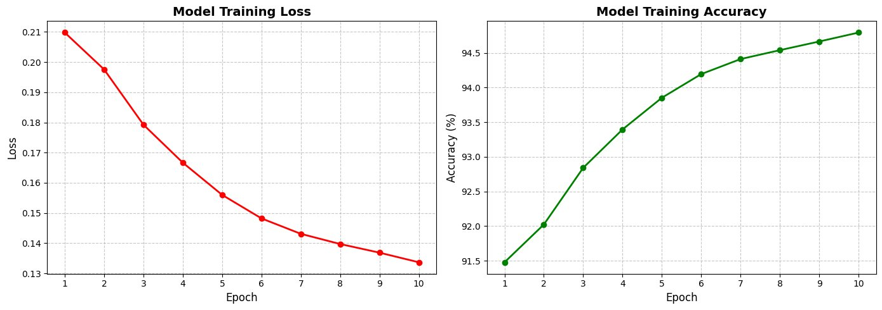
CNN Training Results
1D CNN on 100-timestep sliding windows · imbalanced data (7.6%)
ARCHITECTURE
Conv1D(1→16,k5) → ReLU → MaxPool → Conv1D(16→32,k5) → ReLU → AdaptiveAvgPool → Linear(32→2)
TRAINING
10 epochs · Adam lr=0.005 · CrossEntropy · Batch=32 · Seed=42 · Window = ANOMALY if any timestep anomalous , Dataset: 486,686 windows (from 486,786 rows) | 80% Training (389,348) | 10% Unseen Testing (48,669) | 100 Time Steps
Figure 1 — Training loss (left) & accuracy (right) over 10 epochs
0.21
0.13
START LOSS
FINAL LOSS
ANALYSIS
Loss decays smoothly 0.21 → 0.13 (38% reduction) with no overfitting. Accuracy climbs 91.5% → 94.7% (+3.2%) — consistent learning on a 7.6%-anomaly imbalanced dataset.
91.5%
94.7%
START ACC
FINAL ACC

Slide 4

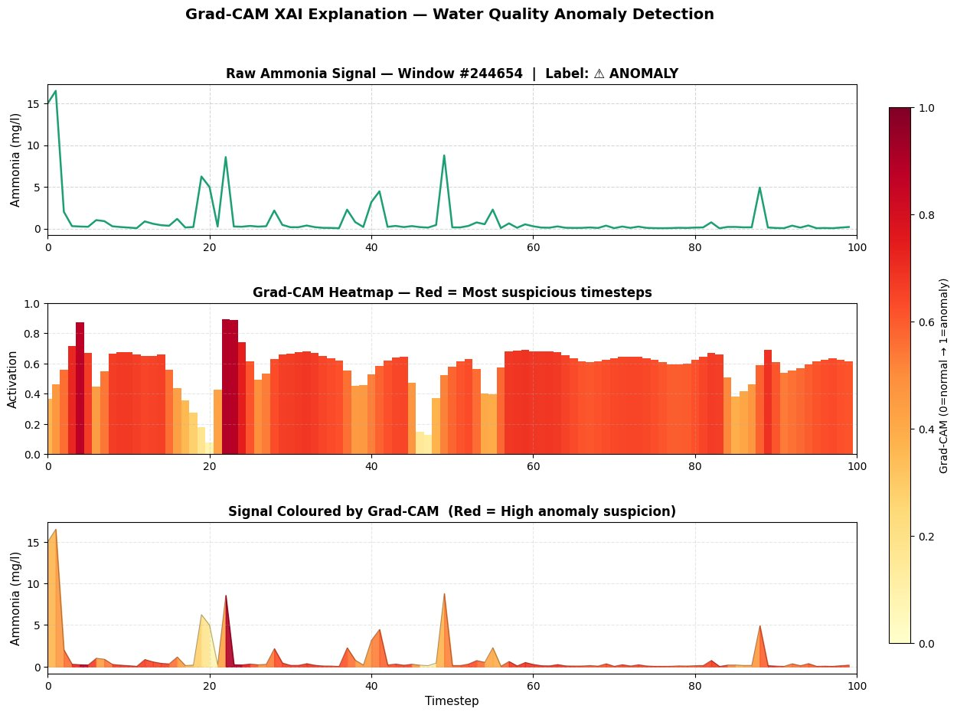
Grad-CAM — Where did the CNN look?
Gradient × last Conv1D activation → importance per timestep · Window #244654 (ANOMALY)
Primary focus — t=3–5, t=22
Darkest red (0.88 / 0.89) at the sharpest Ammonia spikes above 8 mg/l. The last Conv layer fired hardest here.
Secondary focus — t=55–70
Sustained orange (0.60–0.68) over a prolonged elevated-Ammonia period — the CNN recognises pollution, not just spikes.
Low suspicion — t=10–18
Yellow where Ammonia returns to baseline between spikes — correctly judged less suspicious inside the anomaly window.
Figure 2 — Raw signal · heatmap · coloured signal

Slide 5

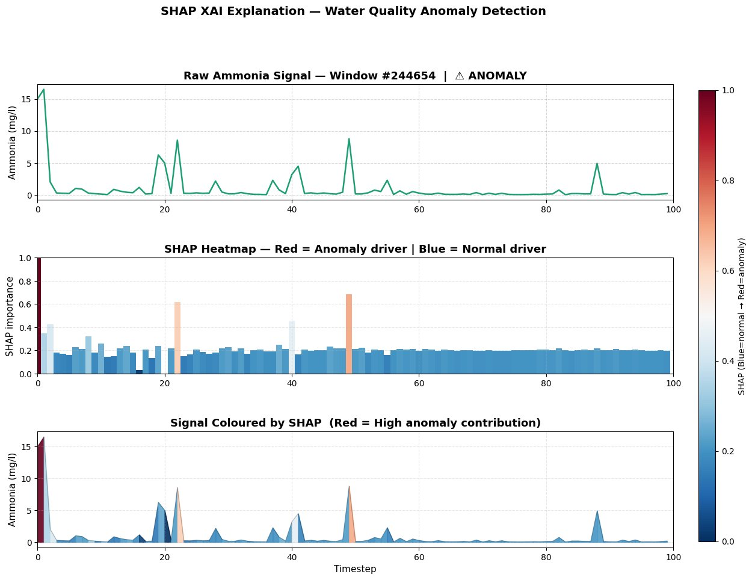
SHAP — How much did each timestep add?
Shapley values vs 50 normal backgrounds · signed attribution · Window #244654 (ANOMALY)
Strongest driver — t=0–1
Dark maroon — the highest positive SHAP value. Initial Ammonia ≈16 mg/l was the single most decisive moment.
Secondary drivers — t=22, t=50
Orange at t=22 (≈0.60) and t=50 (≈0.67) — t=50 ranks higher as it reached ≈9 mg/l, the 2nd-largest spike.
Normal pushers — t=10–18
Blue baseline readings actively reduce the score — SHAP uniquely captures what counteracted the anomaly.
Figure 3 — Raw signal · heatmap · coloured signal

Slide 6


Grad-CAM vs SHAP — Cross-Validation
Same window #244654 · same trained CNN · two independent explanations
KEY DIFFERENCE
Grad-CAM
Positive attention only — where the CNN reacted.
SHAP
Signed ± — how much each step pushed toward anomaly or normal.
Grad-CAM — where the model looked
SHAP — signed contribution (±)
Both methods independently flag the same drivers
t=0–5 (spike 16 mg/l)
t=22 (spike 8.5 mg/l)
t=10–18 (baseline)
Grad-CAM 0.88 · SHAP top +
Grad-CAM 0.89 · SHAP ≈0.60
Grad-CAM low · SHAP blue (−)

Slide 7

Complete Results Summary
One trained model · seed 42 · 10 epochs · 94.7% accuracy · Window #244654
Metric | Value | Interpretation
CNN Accuracy | 94.7% | Strong on imbalanced dataset
Loss (start → final) | 0.21 → 0.13 | 38% reduction — consistent learning
Accuracy (start → final) | 91.5% → 94.7% | +3.2% over 10 epochs
Grad-CAM top timesteps | t=3–5, t=22 | Focused on Ammonia spike peaks
SHAP top timestep | t=0–1 | Highest anomaly contribution (16 mg/l)
SHAP secondary | t=22, t=50 | 2nd & 3rd largest spikes
XAI agreement | High ✓ | Both flag the same spike regions
Window / True label | #244654 · ANOMALY | Middle window, correctly classified

Slide 8

Literature Support — XAI in the Real World
Two recent papers using our chosen XAI methods on real-world problems
Grad-CAM
CNN
Manufacturing
SHAP
Deep Learning
Water Quality
Encoding Time Series as Images for Anomaly Detection Using CNN & Grad-CAM
Real-Time Anomaly Detection for Water-Quality Sensor Monitoring
Hyun et al. · IJPEM · 2024 · DOI 10.1007/s12541-024-01069-6
El-Shafeiy et al. · Sensors (MDPI) · 2023 · DOI 10.3390/s23208613
What they did Encode 1D signals to 2D images (GAF/RP), classify with ResNet50, then use Grad-CAM to pinpoint fault timestamps — 99.6% accuracy.
What they did MCN-LSTM for IoT water-quality anomalies, explained with SHAP/LIME. SHAP values aligned with physical water thresholds.
Link to us We apply Grad-CAM directly to raw 1D Ammonia signals; our t=3–5 / t=22 focus mirrors their temporal-localisation finding.
Link to us Same domain & XAI method. They use SHAP per sensor feature; we apply it per timestep — t=0–1 (16 mg/l) as primary driver.
Conclusion Both confirm XAI is essential for trustworthy sensor anomaly detection — our dual Grad-CAM + SHAP results align with the literature.

Slide 9
KEY TAKEAWAYS
AquaXAI — Detect, then Explain
94.7% accuracy 1D CNN detects water-quality anomalies (loss 0.13) on an imbalanced 7.6%-anomaly dataset.
Grad-CAM = where Highlights the timesteps the CNN reacted to most — sharp Ammonia spikes at t=3–5 and t=22.
SHAP = how much Signed, bidirectional attribution — t=0–1 (16 mg/l) as primary driver, blue baselines as counter-evidence.
Cross-validation Both methods converge on the same Ammonia-spike timesteps — confirming real pollution detection, not noise.
Trust & literature Two complementary XAI methods raise interpretability; results align with Hyun (2024) & El-Shafeiy (2023).
AquaXAI · Visual Analytics — Topic 3 · Supervisor: Prof. Dr. Dominik Raab

