Slide 1

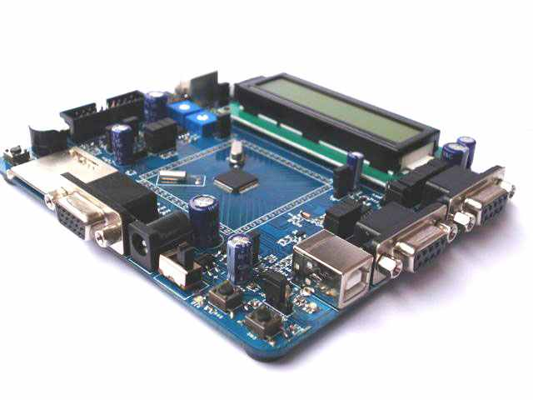
Digital Input/Output Interfacing

Slide 2
Agenda
Atemga32 pin configuration
PORT Registers
Programming for Input Output
Circuits for Simple Input Output
Datasheet Time
LAB

Slide 3
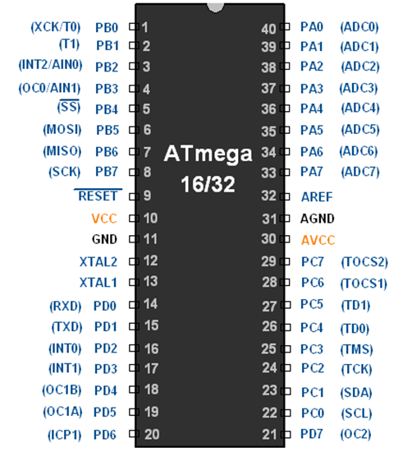
Pin Configuration of ATMEGA32
AVR ATmega16 has 32 pins constituting four ports.
The ports are listed below :
1. PORT A 2. PORT B 3. PORT C 4. PORT D.
Each port has 8 pins.

Slide 4
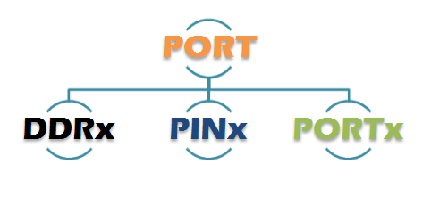
PORT REGISTERS
There are Three Registers for each PORT where PORTx means one of PORTA,PORTB,PORTC and PORTD

Slide 5
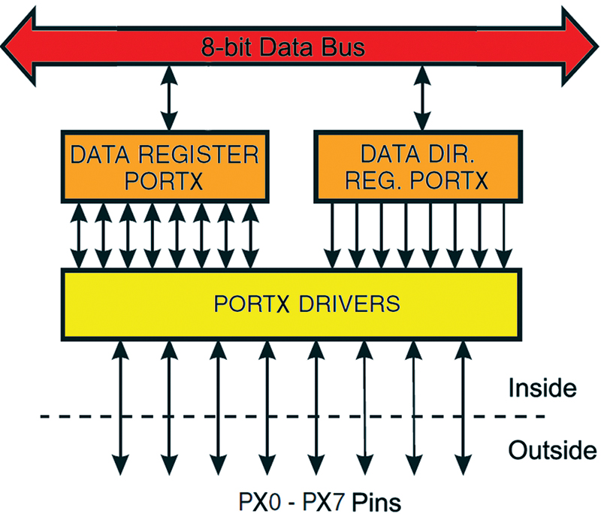
PORT REGISTERS

Slide 6
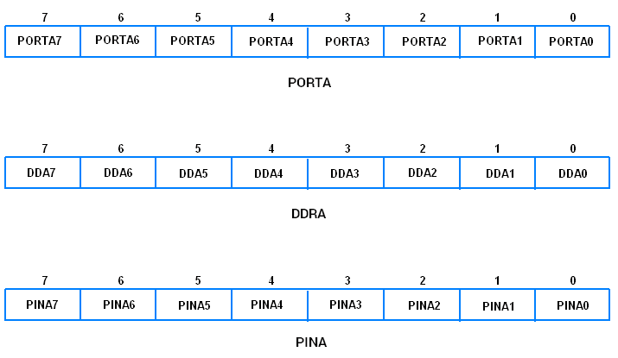
PORT Registers

Slide 7
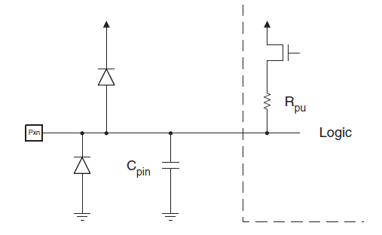
Pin equivalent circuit
All port pins have individually selectable pull-up resistors with a resistance which is independent of the supply voltage. All pins have protection diodes to both VCC and Ground.
Current sinking and sourcing
Each I/O pin can sink or source a maximum current of 40mA.
Although each pin can sink or source 40mA current, it must be ensured that the current sourced or sinked from all the ports combined, should not exceed 200mA.
There are further restrictions on the amount of current sourced or sinked by each port. For information on this, refer page 292 in the datasheet of ATmega16 given in the attachments section of this topic.

Slide 8
Pull Up Resistor

Slide 9
Pin State
DDxn | PORTxn | I/O | Pull-Up | Comment
0 | 0 | I | No | Tri State (High Z)
0 | 1 | I | Yes | Pxn will source current if pulled low externally
1 | 0 | O | No | Output Low (Sink)
1 | 1 | O | No | Output High (Source)
x is Port and can be A, B, C or D n is Pin number of the Port, and can be 0, 1, 2, 3, 4, 5, 6 or 7
As discussed in the equivalent schematic of I/O pins, each port pin has an internal pull-up resistor. This internal pull-up
resistor to all the pins can be disabled by writing one to the PUD bit in the SFIOR register.
When this is done, the pins are in tri state (High impedance states) if DDRxn = 0 and PORTxn = 1.

Slide 10
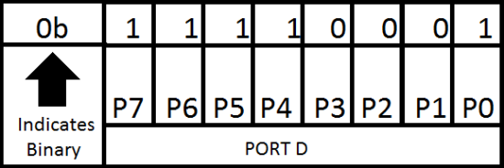
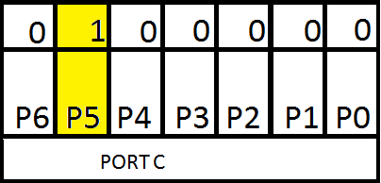
Programming DIO
DDRD=0xFF; //all the pins are output in Hex
PORTD=0b11111111; //
DDRC=0b0010000;
PORTC|=(1<<5);

Slide 11
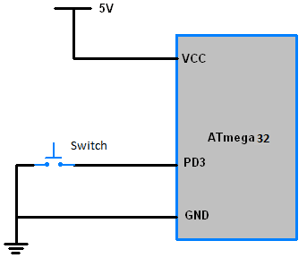
Button Interfacing
In This Circuit the wiring of Button is meant to be active low
Means when Button is pressed the Input to MCU pin PD3 is LOW signal = Logic 0 = GND
Where internal pull-up resister is activated on PD3

Slide 12
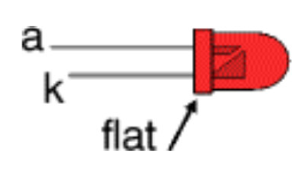
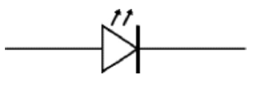
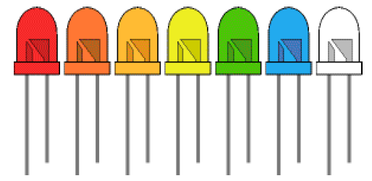
LED Interfacing
LED is a semiconductor device that converts electrical energy directly
into a discrete color of light
LEDs must be connected the correct way round, the diagram may be labeled a or + for anode and k or - for cathode (yes, it really is k, not c, for cathode!). The cathode is the short lead and there may be a slight flat on the body of round LEDs. If you can see inside the LED the cathode is the larger electrode (but this is not an official identification method).
LEDs can be damaged by heat when soldering, but the risk is small unless you are very slow. No special precautions are needed for soldering most LEDs.
LEDs are available in red, orange, amber, yellow, green, blue and white. Blue and white LEDs are much more expensive than the other colors. The color of an LED is determined by the semiconductor material, not by the coloring of the 'package' (the plastic body).
,

Slide 13
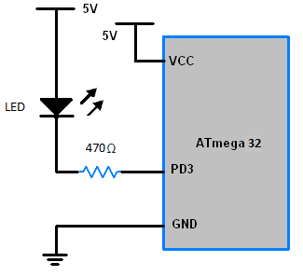

LED Interfacing
In This Circuit the wiring of LED is meant to be active low
Means when PD3 From the MCU outputs LOW signal = GND = Logic 0
Then the LED gets ON
LED has two terminals Anode(+) and Cathode(-)
Calculate Resistor value with the following formula:
,

Slide 14
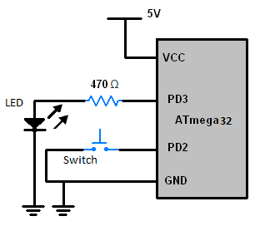
Active High vs Active Low
Draw the circuit diagram on proteus where Button is connected to PD2 and LED is connected to PD3
Write a program for Atmega32 to :
Make the LED glow when the button is pressed.
Note This LED is Active High

Slide 15
LAB
Draw the circuit diagram on proteus where Button is connected to PD2 and LED is connected to PD3
Write a program for Atmega32 to :
Make the LED glow when the button is pressed.
Note This LED is Active High

Slide 16
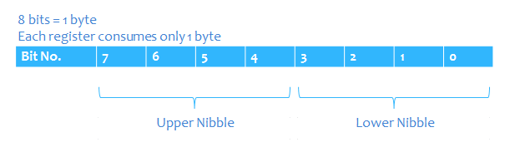
Registers in AVR
Each register is 8 bits
From bit 0 and called Least Significant Bit (LSB) to bit 7 and called Most Significant Bit (MSB)
Maximum value could be held by this register is 2^8=256-1=255
Bits from 0 to 3 are representing the lower nipple while bits from 4 to 7 represent the upper nipple
In other words nipple is half byte = 4 bits

Slide 17
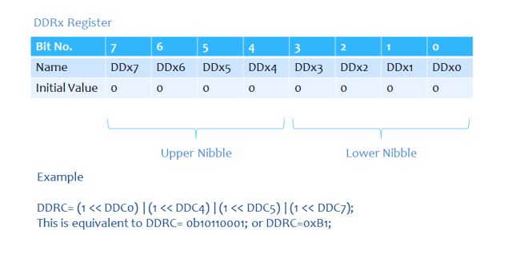
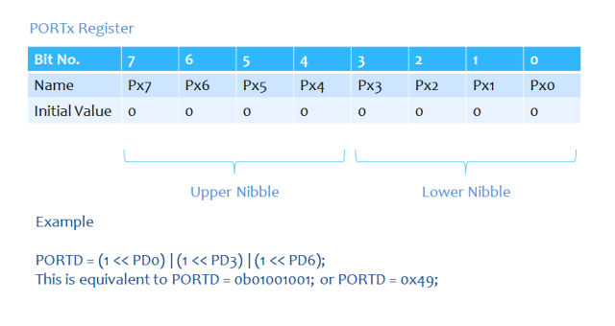
Registers in AVR

Slide 18
Registers in AVR
DDRC = 0x0F; PORTC = 0x0C; // lets assume a 4V supply comes to PORTC.6 and Vcc = 5V if (PINC == 0b01000000) PORTC = 0x0B; else PORTC = 0x00;
while(1)
{
// a condition of 4V supply to PORTC.6 and Vcc = 5V
if (PINC == 0b01000000)
PORTC = 0x0B;
else
PORTC = 0x00;
}

Slide 19
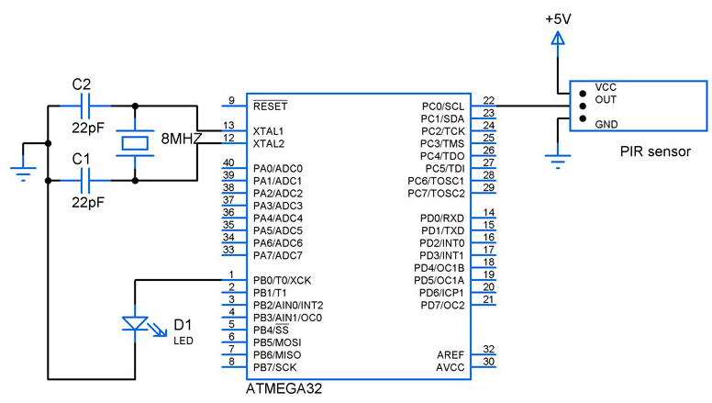
Example using bitwise operation
#define LED 0 //PB0
#define PIR_SENSOR 0 //PC0
#include <avr/io.h>
int main(){
DDRB|=(1<<LED);
DDRC&=~(1<<PIR_SENSOR);
while(1)
{
if (PINC &(1<<PIR_SENSOR))
PORTB |=(1<<LED);
else
PORTB &=(1<<LED);
}
}

Slide 20
Example Buzzer
#define LED 0 //PB0
#define PIR_SENSOR 0 //PC0
#include <avr/io.h>
int main(){
DDRB|=(1<<LED);
DDRC&=~(1<<PIR_SENSOR);
while(1)
{
if (PINC &(1<<PIR_SENSOR))
PORTB |=(1<<LED);
else
PORTB &=~(1<<LED);
}
}

Slide 21
Example Relay
#define RELAY 1 //PA2
#define BUTTON 2 //PD2
#define RELAY_PORT PORTA
#define BUTTON_PORT PORTD
#include “dio_hw.h”
#include “bitMath.h”
int main(){
SET_BIT(RELAY_PORT,RELAY);
CLEAR_BIT(BUTTON_PORT, BUTTON);
while(1)
{
if (GET_BIT(BUTTON_PORT,BUTTON)
SET_BIT(RELAY_PORT,RELAY);
else
CLEAR_BIT(RELAY_PORT,RELAY);
}
}
Use datasheet to get the addresses of I/O Ports Registers and place them into dio_hw.h
Use the previously created bitMath Library for bitwise operations

Slide 22
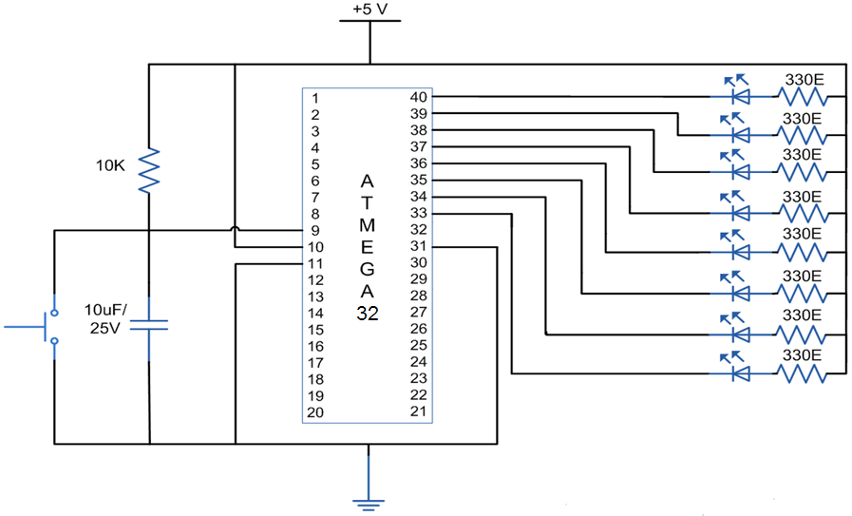
LAB2
Draw the schematic diagram
on proteus
Make the LEDS
Glow on rotation
For example :
LED one glows first and all are off
Then LED one gets off and LED two gets on and other LEDs are off

