Slide 1

Interrupt
Mohamed Saied

Slide 2
What is Interrupt?
Embedded systems often perform some tasks which are infrequent and possibly unpredictable
Hang up a VOIP phone when receiver is dropped
Apply brakes when brake pedal is pressed
Regular tasks must be temporarily stopped to deal with the event
Interrupts are the unusual events
Interrupt handlers, or interrupt service routines, are programs which perform necessary tasks

Slide 3
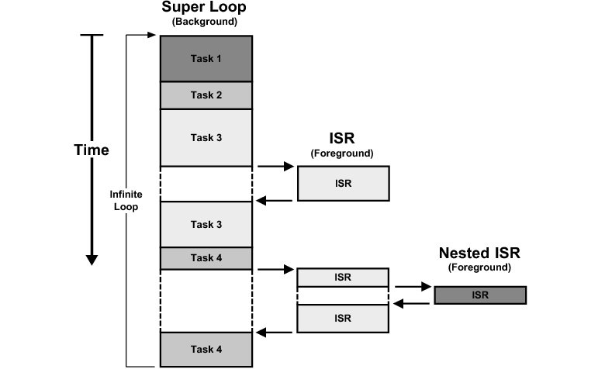
Foreground vs Background

Slide 4
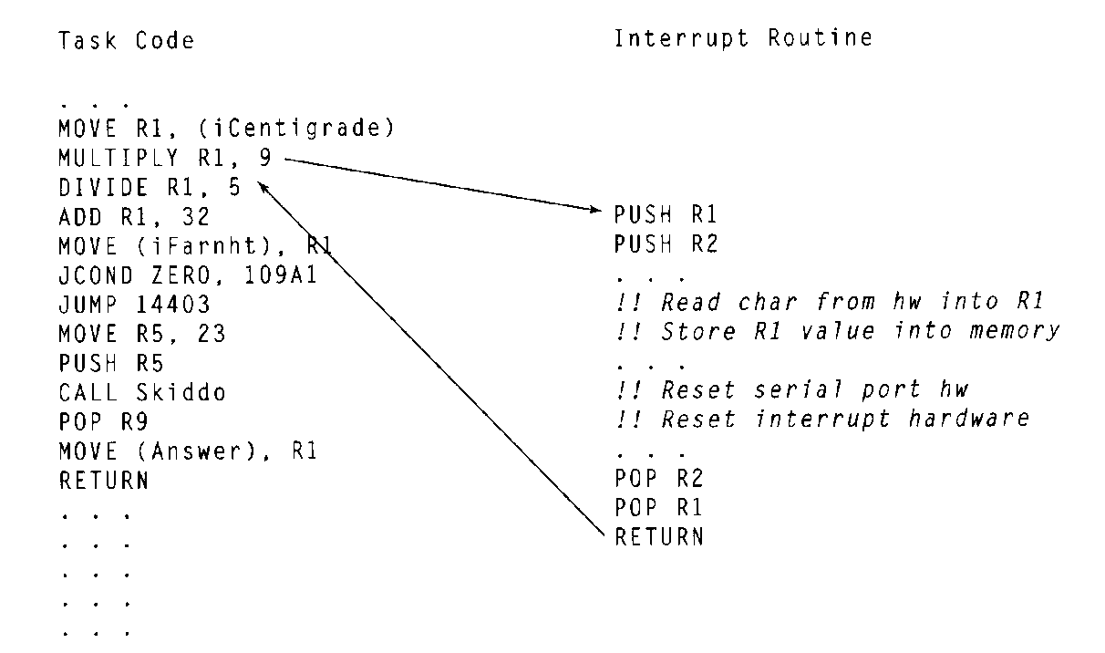
Interrupt Handling
Interrupt can be invoked at any time
Regular code must stop for a while

Slide 5
Interrupt Types
A software interrupt, also called an exception, is an interrupt that is caused by software, usually by a program in user mode.
hardware interrupt, is a signal to the system from an event that has originated in hardware, such as the pressing of a key on the keyboard, a movement of the mouse or a progression in the system clock.

Slide 6

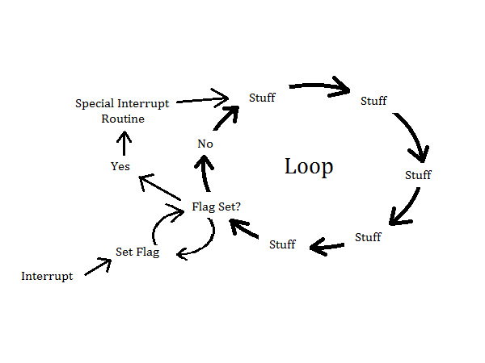
Two Methods to write a software
Polling: which used to continuously check for an event and takes 100% of CPU time.
interrupt, is when an event happens it interrupts the running SW and CPU executes a special routine which might take 0.01 % of CPU utilization

Slide 7
Saving and Restoring Context
Interrupt should not interfere with normal tasks
Need to save all used registers at the beginning and restore them at the end
Stack is typically used for temporary storage
Last in, first out (LIFO)
push, pop

Slide 8
Disabling Interrupts
Some events should be ignored completely
Some tasks are time-critical and should not be interrupted
X-ray emitter in radiation therapy
Interrupts can be disabled (usually by setting a register)
Nonmaskable interrupt cannot be disabled
For critical events (like loss of power)

Slide 9
Interrupt Vectors
Interrupt vector is a pointer to an interrupt in memory
Interrupt number is used to index the table
Interrupt vector table holds pointers to all interrupts
Table location may be fixed or placed in a known register

Slide 10
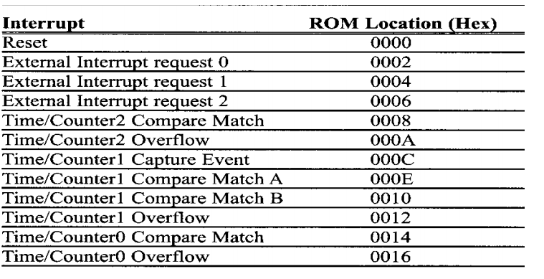
Interrupt Vector Table

Slide 11
Enabling/Disabling Interrupts
ATmega contains a status register called SREG
Bit 7 of SREG , the I bit, is the Global Interrupt Enable
Clearing I bit disables interrupts, setting I bit enables them
I bit is automatically cleared when an interrupt starts, set when interrupt is done
Interrupts are not interrupted
Use the SEI() and CLI() macros to set and clear in C

Slide 12
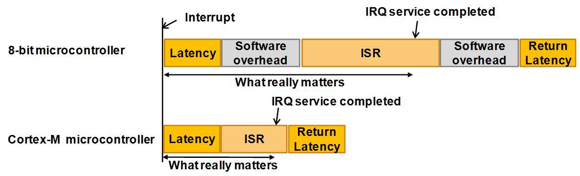
Interrupt Latency
How quickly does the system respond to an interrupt?
Contributing Factors:
Maximum time when interrupts are disabled
Time required to execute higher priority interrupts
Time between interrupt event and running interrupt code
Time required to complete ISR code execution

Slide 13
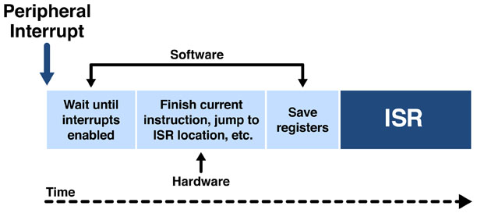
Interrupt in AVR

Slide 14
Steps on Executing Interrupt
◉ Finishes the current instruction. Stack← PC+1
◉ Jumps to Interrupt Vector Table. ISR ← IVR
◉ Executes ISR till RETI.
◉ PC ← Stack, continue main program

Slide 15
Interrupt in AVR
Example interrupt handler for the INT0:
#include <avr/interrupt.h>
ISR(INT0_vect)
{
// user code here
}
● The interrupt source, here the INT0, has to be configured and enabled using SFRs
● Global interrupt instructions: sei () … set interupt enable
(I – bit in SREG) cli () … clear interrupt enable
● AVR hardware clears the global interrupt flag before entering an
interrupt vector -> use sei() to enable global interrupts

Slide 16
Reducing Interrupt Latency
Make interrupt code short
Reduces ISR execution time and time for higher priority interrupts
Reduce time during which interrupts are disabled
Minimize size of critical regions

Slide 17
Defining Interrupts in C
ISR(vector_name)
- Defines an ISR for vector_name. Updates interrupt vector table automatically.
Ex. ISR(ADC_vect) {
//do something
}
EMPTY_INTERRUPT(vector_name)
- Defines an interrupt which does nothing.
ISR_ALIAS(vector_name, target_vector_name)
- Makes the ISR for vector_name the same as the ISR for target_vector_name.
- Copies a pointer in the interrupt vector table

Slide 18
External Interrupt in AVR
Steps to configure the Interrupt INT0:
Set INT0 bits in the General Interrupt Control Register (GICR)
Configure MCU Control Register (MCUCR) to select interrupt type.
Set Global Interrupt(I-bit) Enable bit in the AVR Status Register(SREG)
Handle the interrupt in the Interrupt Service Routine code.

Slide 19
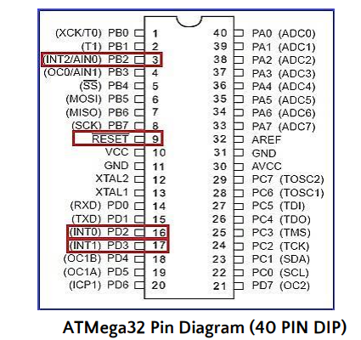
External Hardware Interrupt

Slide 20
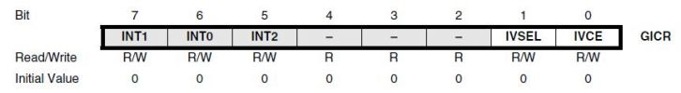
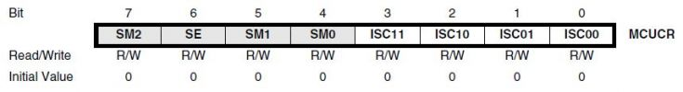
External Interrupt Registers
General Interrupt Control Register – GICR
MCU Control Register – MCUCR

Slide 21
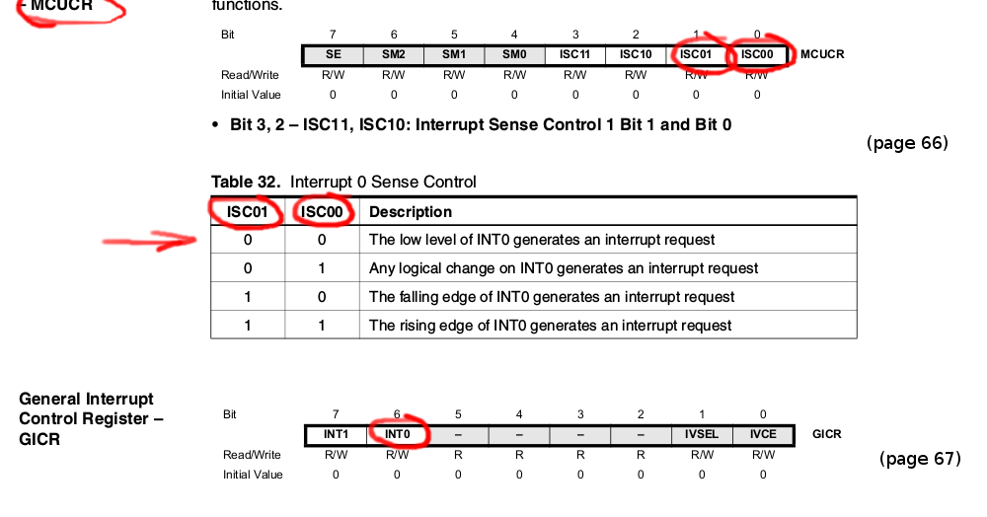
Interrupt Sense Control
Bit 1, 0 – ISC01, ISC00: Interrupt Sense Control 0 Bit 1 and Bit 0

Slide 22
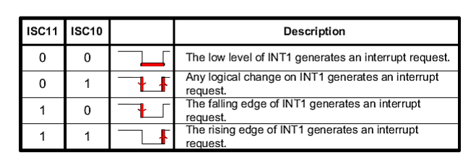
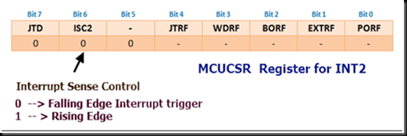
Interrupt Sense Control
For INT1
For INT2

Slide 23
LABS
Use INT0 which attached to Button 2 on AMIT kit to toggle LED 1 on kit
Use INT0 ISR to increment a counter with every button press, use this counter to be displayed on Seven Segment and if it gets to 9 restart it

Slide 24
Reference
Thanks
Professor Ian G. Harris Course Slides
Embedded Systems with AVR for Muhammad Ali Mazidi

