Slide 1

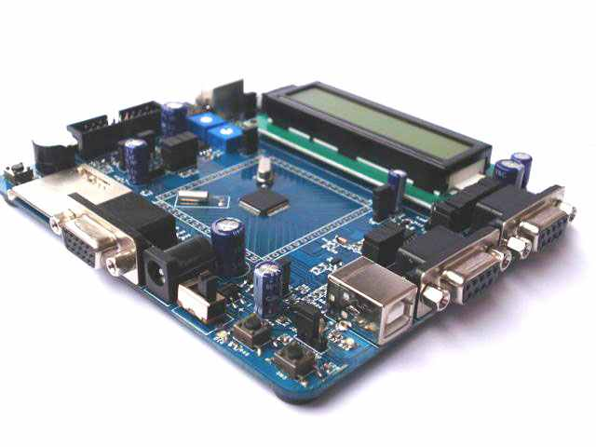
LCD Interfacing

Slide 2
Agenda
Human Machine Interface Concept
Input Types
Display Types
LCD 16x2
LAB

Slide 3
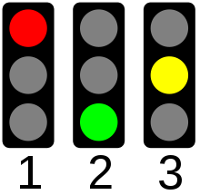
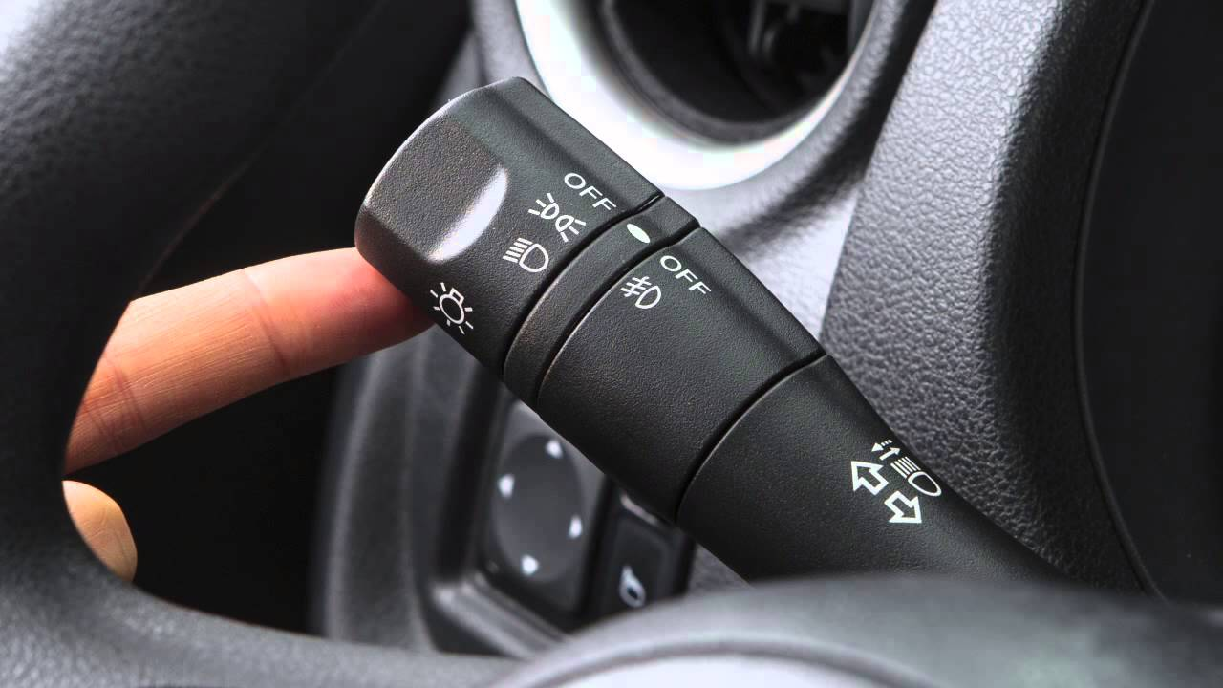
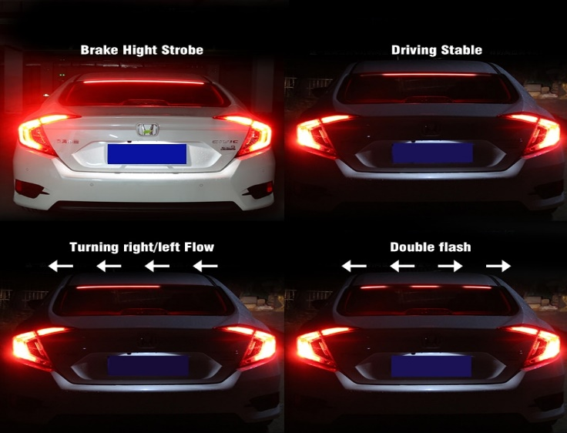
Human Machine Interface (HMI)
Human machine interface is the concept of interacting with the machine through inputs (buttons, switches ,Keypads and sliders) while the output of the machine is display through LED’s or LCD , sometimes input and display are combined in one device such as Touch screen.

Slide 4
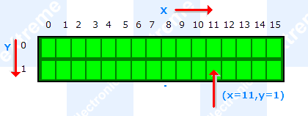
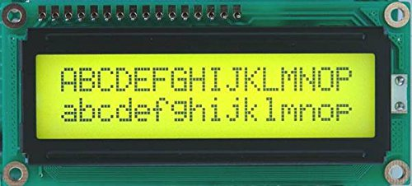
LCD
Character LCD
Two Lines 16 characters each
Each character is 5x8 pixels

Slide 5
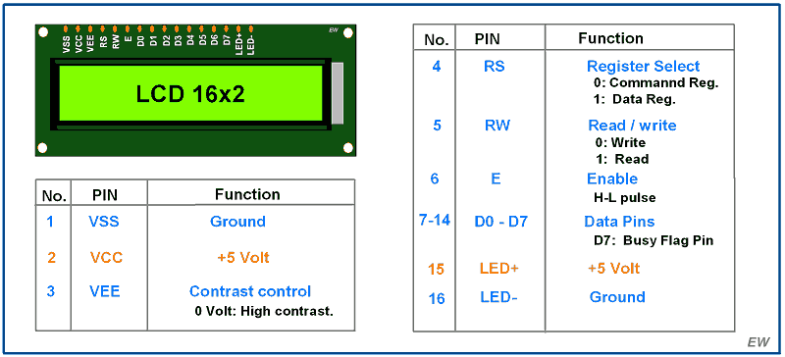
LCD pins

Slide 6
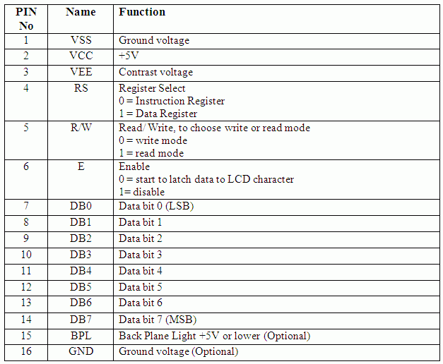
LCD pin out

Slide 7
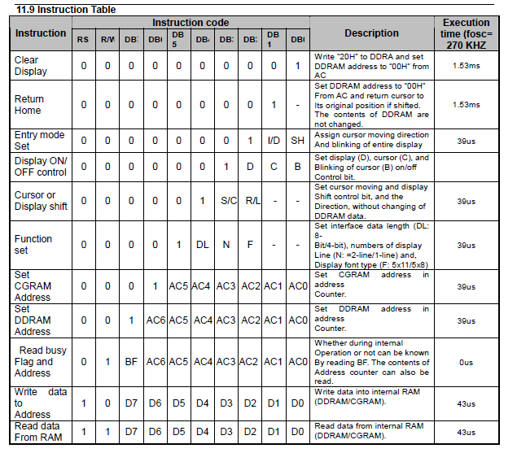
LCD Commands

Slide 8
LCD Data bit Modes
LCD has 2 Modes , 8 Bit modes which 8 bits are used and 4 bits mode only 4 pins are used for writing an ASCII character (8 bits) to LCD
Only four GPIO pins are connected to LCD data (D4-D7) pin which helps to save GPIO pins. By default, LCD16x2 is in 8-bit mode. To use LCD16x2 in 4-bit mode, we need to send some commands for LCD initialization and configuration. To send these commands following data formats should follow.
DL: Interface Data length
0 =4-bit
1 = 8-bit
N: Number of display lines
0 = 1 line
1 = 2 line
F: Character Font
0 = 5x8 dots
1 = 5x10 dots
D7 | D6 | D5 | D4 | D3 | D2 | D1 | D0
0 | 0 | 1 | DL | N | F | - | -
D1:D0: These bits are set to 0.
D7:D6: These bits are set to 0.
D5: This bit should set to 1.

Slide 9
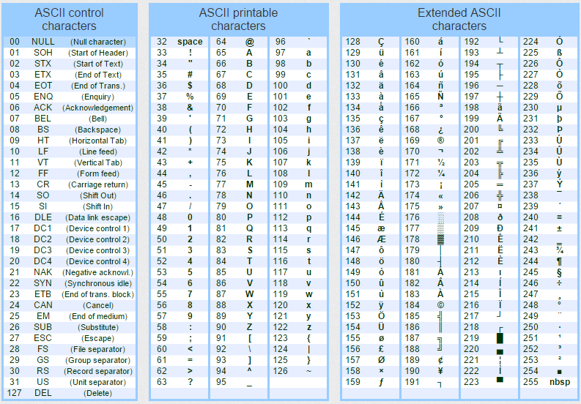
ASCII Table
You are allowed to only write ASCII
To LCD

Slide 10
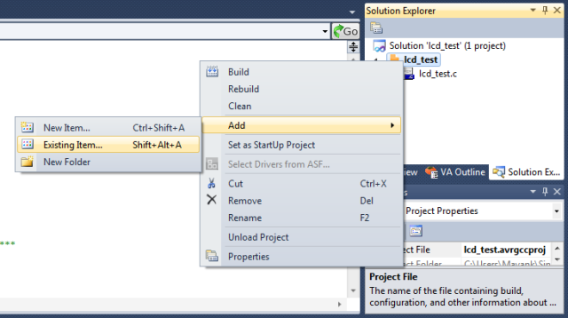
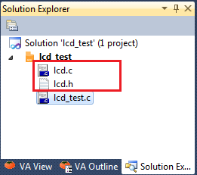
Build up LCD Module
Module for LCD will be divided into LCD.c and LCD.h
Which should contain the LCD driver, the basic driver should contain the following functions:
LCD_Init();
LCD_Command(cmd);
LCD_char(data);
LCD_String(*str);

Slide 11
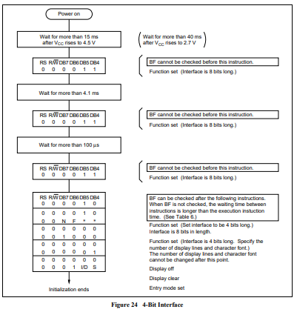
Initialize LCD
Procedure for initializing LCD
Datasheet HD44780

Slide 12
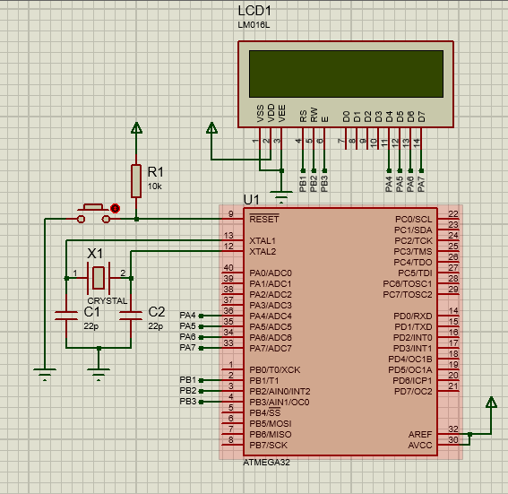
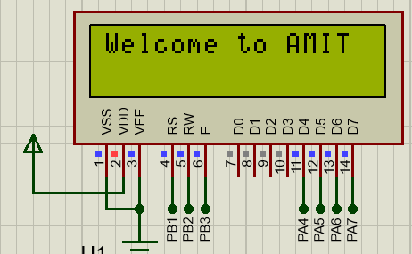
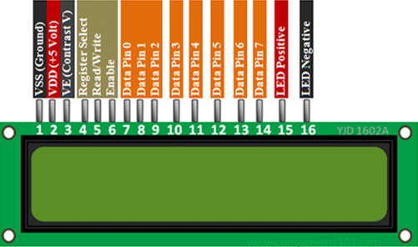
LCD in AMIT Kit

Slide 13
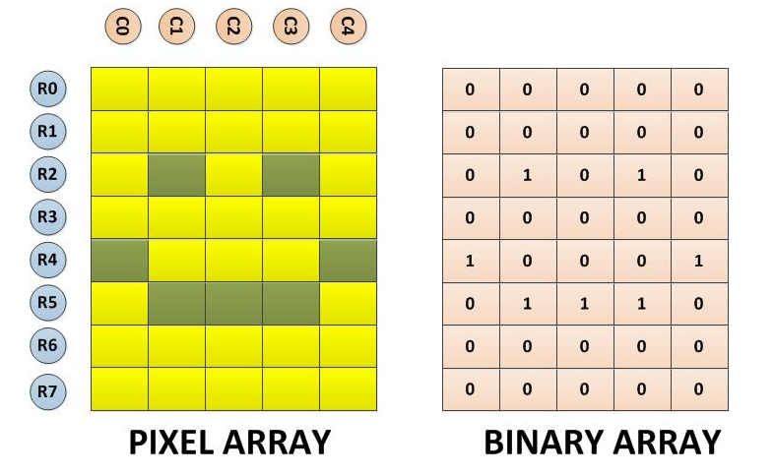
Special Character Display
The 8*5 pixel array and the corresponding binary array for the smile symbol
displayed in the project are shown in the following image

Slide 14
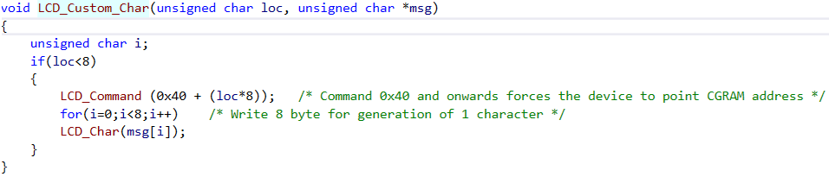

LCD Custom Character
You can use https://maxpromer.github.io/LCD-Character-Creator/ for custom character generation
Use LCD_Custom_Char function to create the character in CGRAM of LCD
Sequence to display custom character on LCD, Note in the last line position of the created character in CGRAM

