Slide 1
WiFi Module
Mohamed Saied

Slide 2
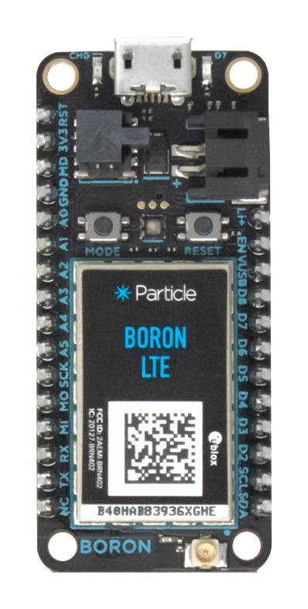
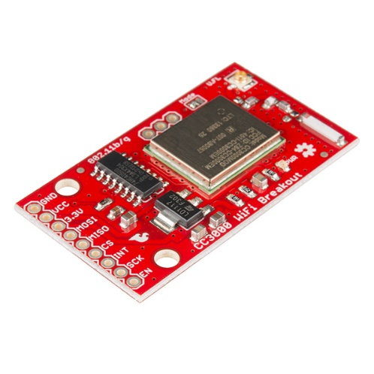
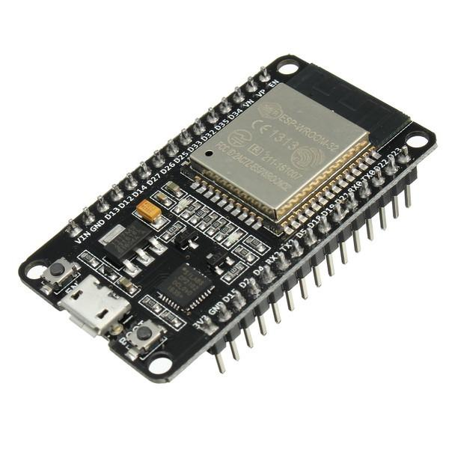
Available WiFi Modules
CC3000
ESP8266/ESP32
Particle BORON

Slide 3
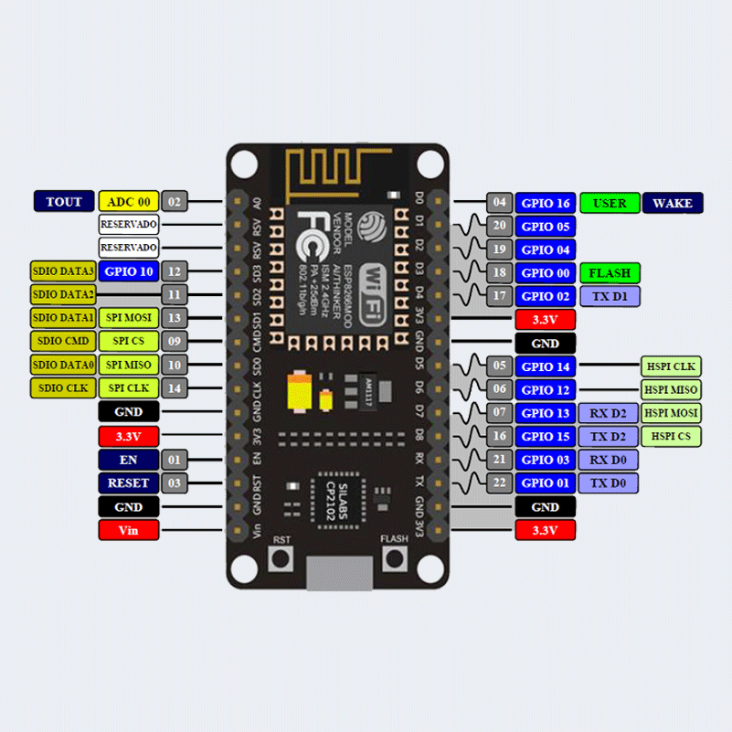
Node MCU

Slide 4
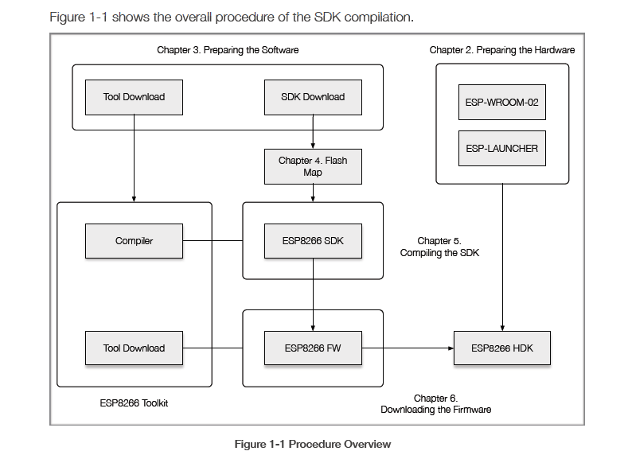
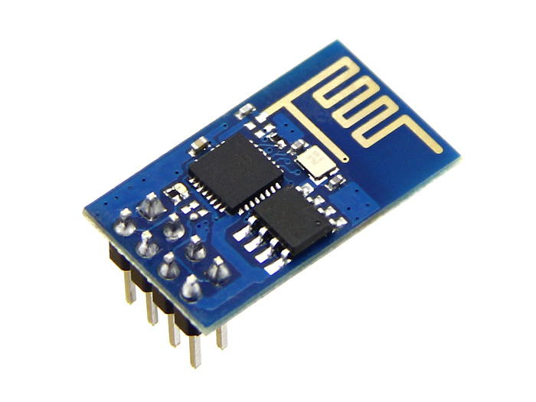
Studying ESP01

Slide 5
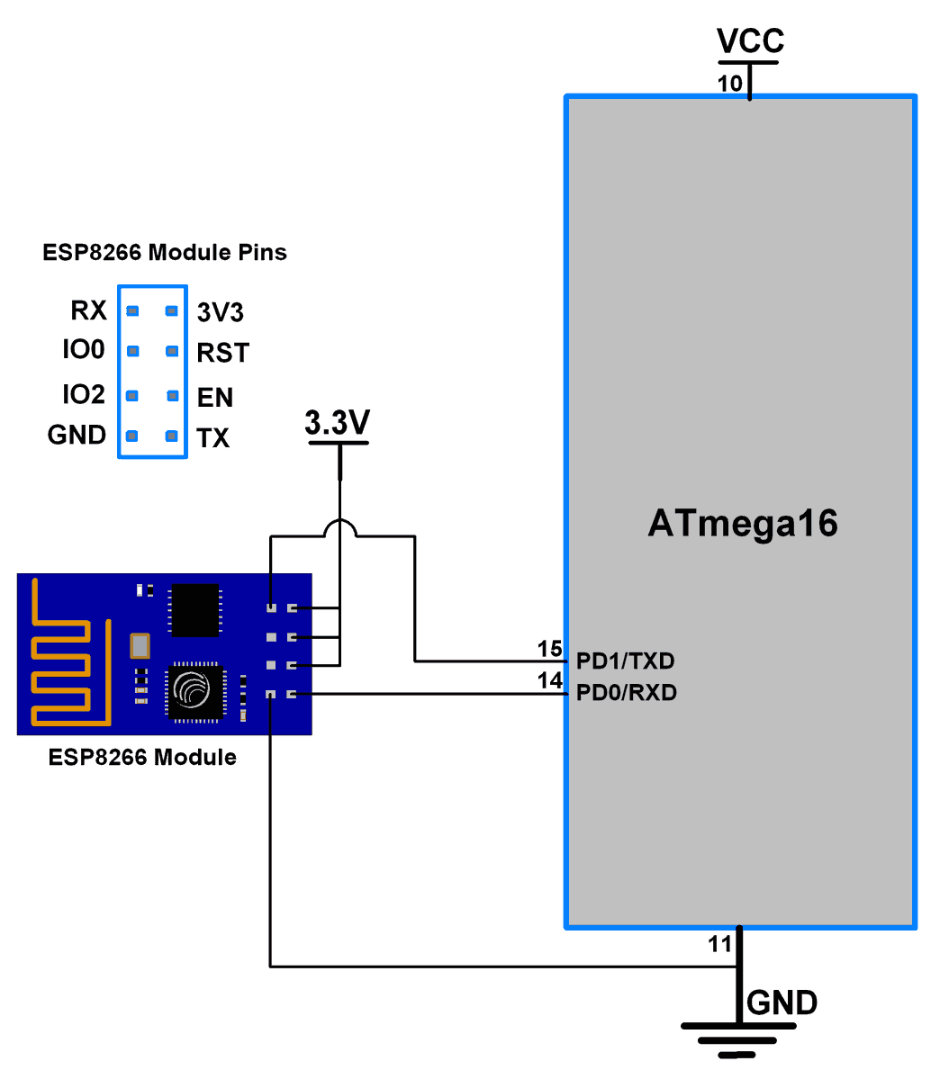
Schematic
Interface Through UART
Operation Voltage is 3.3V
Reset and EN are pulled HIGH

Slide 6
Driver SW Design
UART_SEND
ESP
CLOUD
CLOUD
ESP
ISR_UART

Slide 7
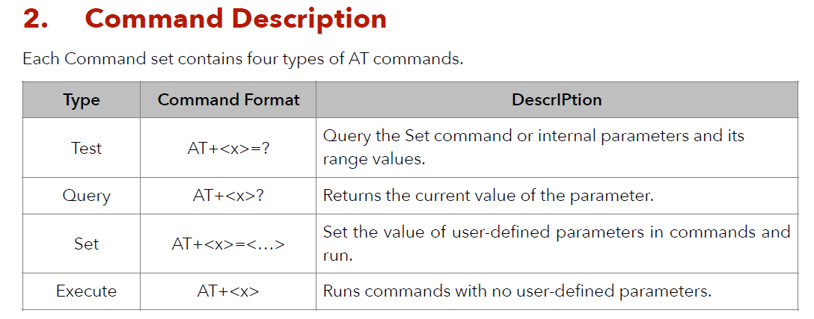
AT Commands

Slide 8
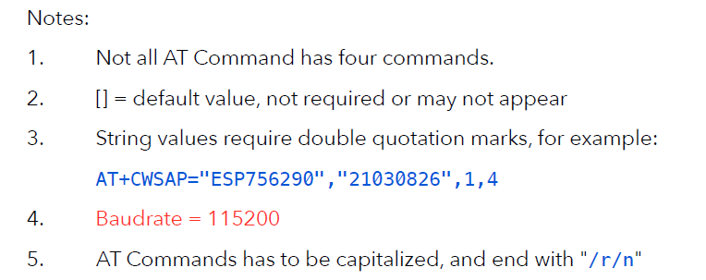
Notes about AT Commands

Slide 9
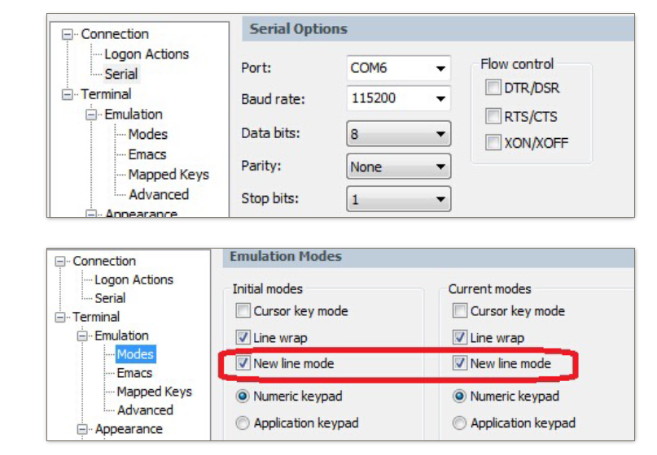

Slide 10
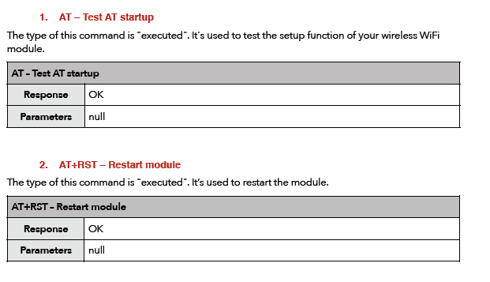

Slide 11
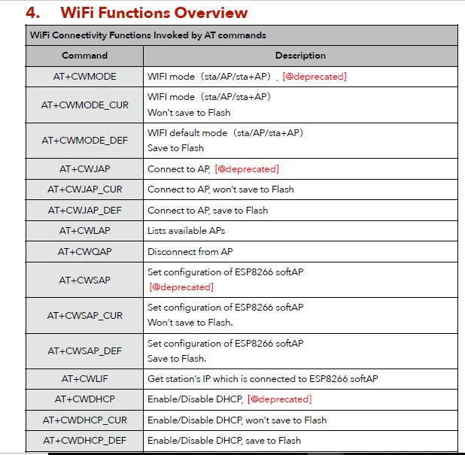

Slide 12
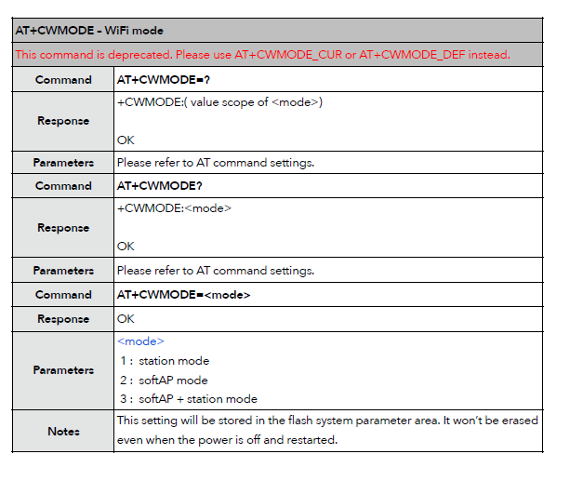

Slide 13
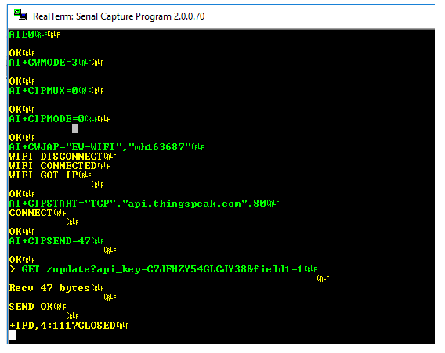
Client AT Commands
Every command should
end with \r\n
Carriage Return and Line feed

Slide 14
Server AT Commands
AT+RST
AT+CWJAP="SSID","password"
AT+CIFSR
AT+CWMODE=1
AT+CIPMUX=1
AT+CIPSERVER=1,80

Slide 15
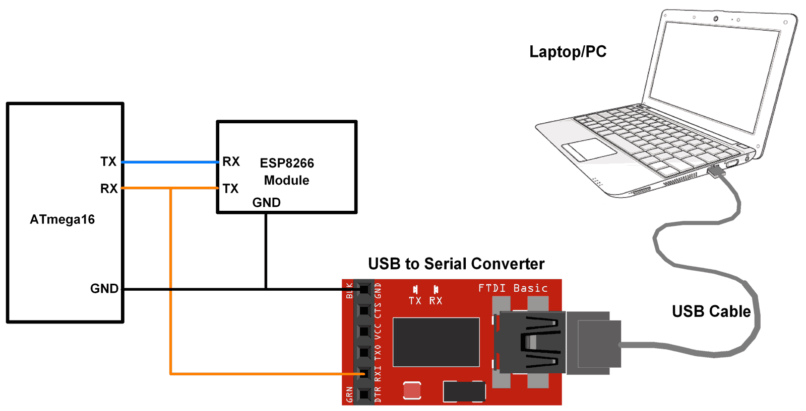
Testing Strategy

Slide 16
Thank You

