Slide 1
IoT Platforms
Mohamed Saied

Slide 2
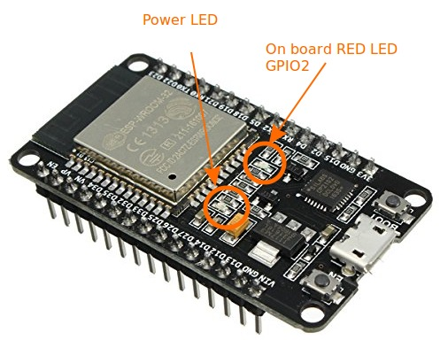
ESP32
ESP32-WROOM-32 is a powerful, generic Wi-Fi+BT+BLE MCU module that targets a wide variety of applications, ranging from low-power sensor networks to the most demanding tasks, such as voice encoding, music streaming and MP3 decoding.

Slide 3
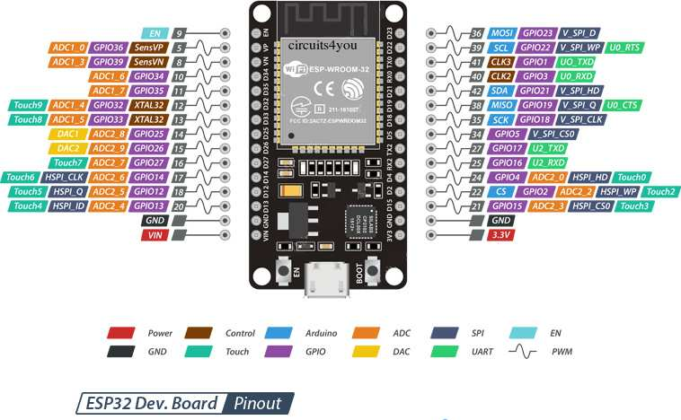
ESP32

Slide 4
ESP32 Peripherals Features
18 Analog-to-Digital Converter (ADC) channels
10 Capacitive sensing GPIOs
3 UART interfaces
3 SPI interfaces
2 I2C interfaces
16 PWM output channels
2 Digital-to-Analog Converters (DAC)
2 I2S interfaces

Slide 5
Input Only Pins
ESP32 Wroom32 DevKit has total 25 GPIOs out of that few pins are Input only Pins,
Input Only Pins
GPIO 34
GPIO 35
GPIO 36
GPIO 39

Slide 6
Pins with internal pull up INPUT_PULLUP
Not all pins have input pullup, you need external pullup on these pins when using as input pullup.
GPIO14
GPIO16
GPIO17
GPIO18
GPIO19
GPIO21
GPIO22
GPIO23

Slide 7
Pins without internal pull up
GPIO13
GPIO25
GPIO26
GPIO27
GPIO32
GPIO33

Slide 8
Analog
Note that only a subset of ADC pins and functions are exposed. First, the supplied drivers expose only ADC1. The board layout of the ESP32-DevKitC only exposes some of the pins. Specifically, the following are exposed:
ADC1_CH0 , ADC1_CH3 , ADC1_CH4 , ADC1_CH5 , ADC1_CH6 and ADC1_CH7 .

Slide 9
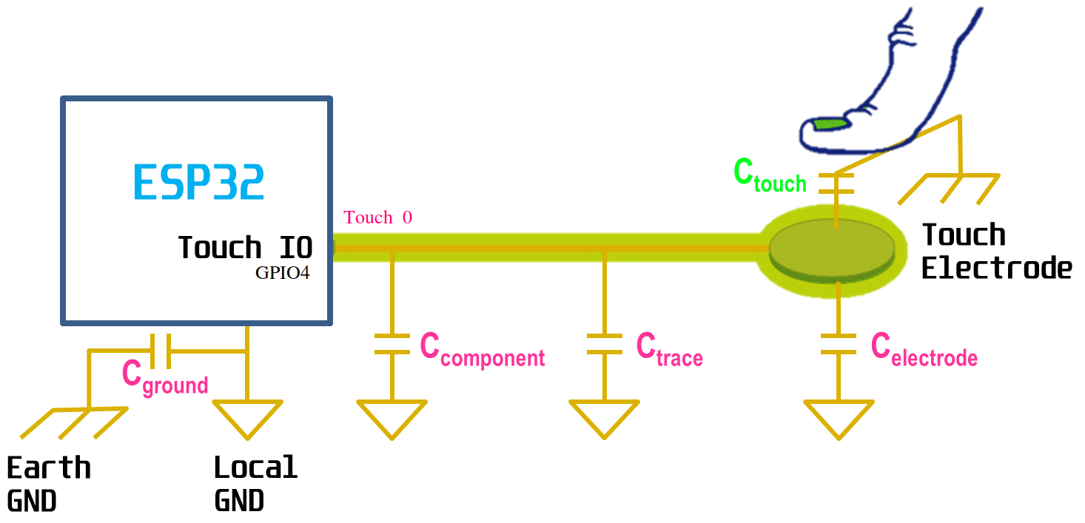
Capacitive touch GPIOs
T0 (GPIO 4)
T1 (GPIO 0)
T2 (GPIO 2)
T3 (GPIO 15)
T4 (GPIO 13)
T5 (GPIO 12)
T6 (GPIO 14)
T7 (GPIO 27)
T8 (GPIO 33)
T9 (GPIO 32)

Slide 10
DAC
There are 2 x 8 bits DAC channels on the ESP32 to convert digital signals into analog voltage signal outputs. These are the DAC channels:
DAC1 (GPIO25)
DAC2 (GPIO26)

Slide 11
RTC GPIOs
There is RTC GPIO support on the ESP32. The GPIOs routed to the RTC low-power subsystem can be used when the ESP32 is in deep sleep. These RTC GPIOs can be used to wake up the ESP32 from deep sleep when the Ultra Low Power (ULP) co-processor is running. The following GPIOs can be used as an external wake up source.
RTC_GPIO0 (GPIO36) RTC_GPIO9 (GPIO32)
RTC_GPIO10 (GPIO4) RTC_GPIO3 (GPIO39)
RTC_GPIO11 (GPIO0) RTC_GPIO4 (GPIO34)
RTC_GPIO12 (GPIO2) RTC_GPIO5 (GPIO35)
RTC_GPIO13 (GPIO15) RTC_GPIO6 (GPIO25)
RTC_GPIO14 (GPIO13) RTC_GPIO8 (GPIO33)
RTC_GPIO7 (GPIO26) RTC_GPIO17 (GPIO27)
RTC_GPIO15 (GPIO12) RTC_GPIO16 (GPIO14)

Slide 12
PWM
The ESP32 LED PWM controller has 16 independent channels that can be configured to generate PWM signals with different properties. All pins that can act as outputs can be used as PWM pins (Input only pin GPIOs 34 to 39 can’t generate PWM).
To set a PWM signal, you need to define these parameters in the code:
Signal’s frequency;
Duty cycle;
PWM channel;
GPIO where you want to output the signal.

Slide 13
Serial (UART)
ESP32 has three serial ports
First Serial RX0, TX0 is used for programming,
GPIO3 (U0RXD)
GPIO1(U0TXD)
Another Serial port is available on
GPIO16 (U2RXD).
GIIO17 (U2TXD).

Slide 14
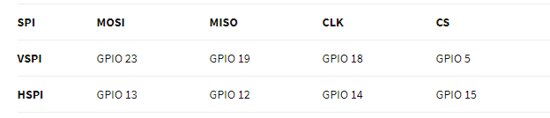
SPI
By default, the pin mapping for SPI is:

Slide 15
I2C
When using the ESP32 with the Arduino IDE, you should use the ESP32 I2C default pins (supported by the Wire library):
GPIO 21 (SDA)
GPIO 22 (SCL)

Slide 16
Interrupt
All GPIOs can be configured as interrupts.

Slide 17
Enable pin (EN)
Enable (EN) is the 3.3V regulator’s enable pin. It’s pulled up, so connect to ground to disable the 3.3V regulator. This means that you can use this pin connected to a pushbutton to restart your ESP32.

Slide 18
GPIO Current Drawn
The absolute maximum current drawn per GPIO is source 40mA and sink 28mAmp according to the “Recommended Operating Conditions” section in the ESP32 datasheet.

